Slide 1



01 / 02
SQA · JDN
2-DAY HANDS-ON WORKSHOP · KRISA 2.0-ALIGNED
Mastering Software Quality Assurance
Modules 1 & 2
The Shift-Left phase, building quality before a line of code is written.
One continuous project: ShopFast checkout.
MODULE 1 · FOUNDATION
MODULE 2 · PLAN
The Quality Mindset
QA Planning & Proactive Quality
Trainer · Al-Abrar bin Abdul Wahid
Notes:
Welcome. Modules 1 & 2 are the Shift-Left half of the workshop: set the mindset, then plan quality in before any code exists. Everything runs on one project, ShopFast checkout.

Slide 2
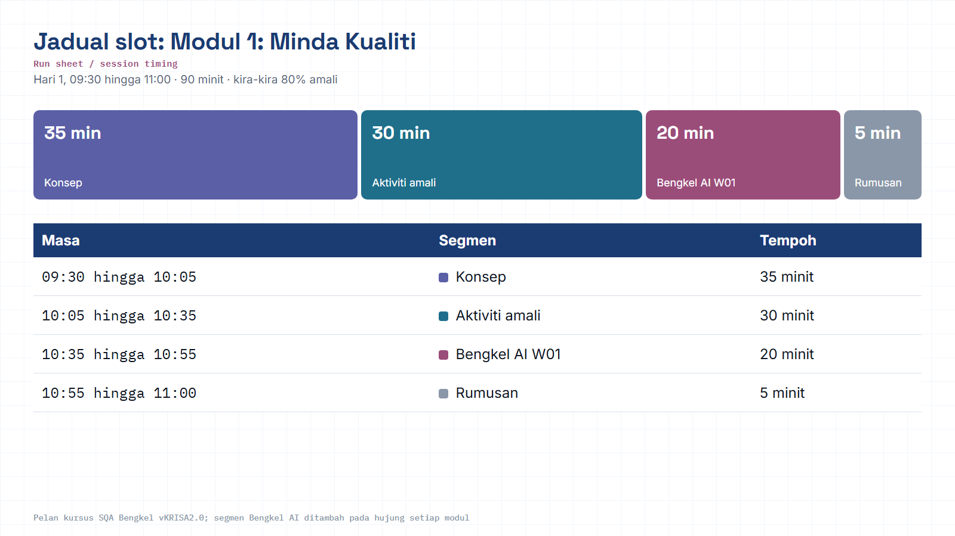
Module hub
Notes:
Run sheet for this module. Keep to the slot times; the SQA-AI workshop segment is reserved at the end.

Slide 3
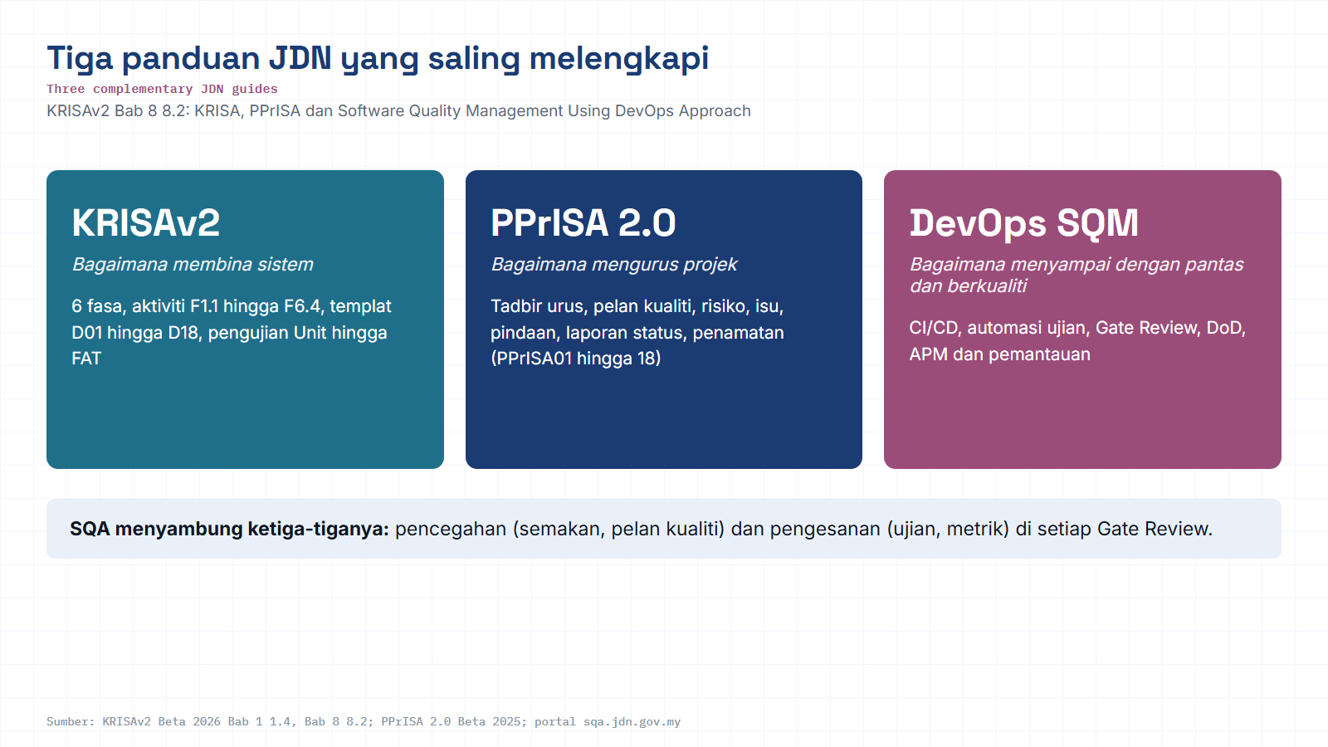
Module hub
Open: KRISAv2 Bab 8 p.1
Notes:
Diagram built from the KRISAv2 Beta 2026 / PPrISA 2.0 references. Use the Open chip to show the source page live.

Slide 4





SQA · MAP
HOW THE TWO MODULES CONNECT
Quality flows through five phases
Modules 1 & 2 establish the front of that flow, the Shift-Left foundation. You set the mindset (M1), then plan and prevent (M2) before the build begins.
Plan
Build-in
Verify
Assure
Sustain
Set standards & scope
Prevent in reqs & design
Design, run & automate
Audit & prove for release
Govern change & monitor
Modules 1 & 2 establish the Plan foundation, quality embedded before code (Shift-Left).
Notes:
Orient the group: the whole workshop is a left-to-right quality flow. Today we own the left end.

Slide 5
01
MODULE 01 · FOUNDATION
The Quality Mindset
Understand why quality is everyone’s responsibility, and where SQA fits in the SDLC & Agile.
TIME
DURATION
THEME
09:30 - 11:00
1h 30m
Quality = everyone
Notes:
Section marker for MODULE 01 · FOUNDATION

Slide 6
M1 · OBJECTIVE
OBJECTIVE & TOPICS
What you’ll master
After this module you can explain SQA’s role across the SDLC & Agile, and tell apart the core terms people most often confuse.
01 Software quality basics
02 QA vs QC
03 Verification vs Validation
04 Testing vs Inspection
05 SDLC vs STLC
06 Shift-Left / Shift-Right
07 Continuous Quality
08 DevOps Quality
◇ Every topic is practiced on the ShopFast project, not theory alone.
Notes:
Run through the topic list quickly; each becomes a hands-on artifact.

Slide 7
M1 · CORE IDEA
CORE IDEA
Quality is everyone’s job
BA
Quality isn’t a final phase, it’s embedded from requirements through operations.
Ops
Dev
Every role contributes: BA clarifies requirements, Dev builds with tests, QA steers the process.
QUALITY
shared
DevOps
QA
SQA governs the process; it does not replace the team’s ownership of quality.
PO
Notes:
The central message of Module 1: everyone owns quality; SQA governs the process.

Slide 8
M1 · DISTINGUISH
DISTINGUISH
QA vs QC
QA, Quality Assurance
QC, Quality Control
“Are we doing things the right way?”
“Does the product meet requirements?”
FOCUS
Process & prevention
FOCUS
Product & detection
VS
WHEN
Throughout the SDLC
WHEN
After it’s built
NATURE
Proactive · prevent defects
NATURE
Reactive · find defects
EXAMPLE
Standards, reviews, quality gates
EXAMPLE
Executing test cases
Notes:
QA is preventive & process-focused; QC is detective & product-focused. Both are needed.

Slide 9
M1 · DISTINGUISH
DISTINGUISH
Verification vs Validation
Verification
Validation
“Are we building the product right?”
“Are we building the right product?”
AGAINST
Spec & design
AGAINST
Real user needs
>
HOW
Reviews, walkthroughs (static)
HOW
Executing software (dynamic)
ASKS
Conforms to the documents?
ASKS
Solves the real problem?
◇ Verification catches misinterpretation early; Validation confirms it’s actually useful.
Notes:
Verification = build it right (vs spec). Validation = build the right thing (vs need).

Slide 10
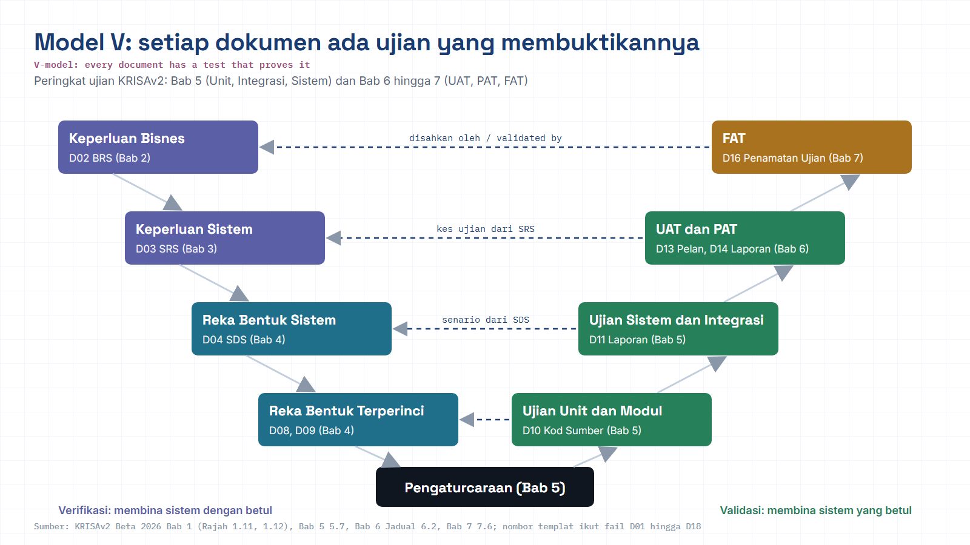
Module hub
Open: KRISAv2 Bab 6 p.5
Notes:
Diagram built from the KRISAv2 Beta 2026 / PPrISA 2.0 references. Use the Open chip to show the source page live.

Slide 11

M1 · TWO PAIRS
TWO TERM PAIRS
Dynamic vs static · process vs process
Testing vs Inspection
SDLC vs STLC
Testing, run the software and observe its behaviour (dynamic).
SDLC, the life cycle to build software: Requirements to Design to Build to Test to Deploy.
Inspection, review artifacts without executing them (static).
STLC, the testing life cycle running in parallel: analyse to plan to design to execute to close.
Notes:
Two easy-to-confuse pairs. Static vs dynamic; build cycle vs test cycle.

Slide 12
M1 · WHERE QUALITY SITS
WHERE QUALITY SITS
Shift-Left & Shift-Right
Shift-Left
test earlier · prevent
Requirements
Design
Build
Test
Release
Operate
monitor · in production
Shift-Right
Shift-Left moves quality activities earlier so defects are caught when cheapest to fix. Shift-Right continues quality into production via monitoring & observability.
Notes:
Modules 1 & 2 live on the left. Shift-Right (monitoring) returns on Day 2.

Slide 13

M1 · SIGNATURE IDEA
SIGNATURE IDEA
Cost to fix escalates the later you catch it
Prevent early
A defect caught in requirements can cost ~1× to fix; the same defect in production can cost many times more.
That is the economic case for Shift-Left.
◇ Relative, illustrative figures, the escalation pattern is a widely-cited idea (Boehm; IBM Systems Sciences Institute). Exact numbers vary by study.
Notes:
Keep the figures illustrative. The point is the shape of the curve, not the exact multiples.

Slide 14
M1 · GUIDED LAB
3-STEP GUIDED LAB
Practice: where quality begins
1
In groups, list 3 real software failures & their quality root causes.
2
Sketch the “Cost of Poor Quality”, the cost of fixing a bug at each SDLC phase.
3
Mark where Shift-Left could catch each defect earlier, using the ShopFast project.
Notes:
Facilitate the lab; each step produces part of the module deliverable.

Slide 15


M1 · OUTPUT
MODULE 1 DELIVERABLE
What you carry out
OUTPUT to
A short “where quality begins” map for ShopFast + a team glossary for QA-vs-QC / V&V.
FEEDS INTO
PRINCIPLE
Module 2
Prevent, don’t just find
This glossary & prevention mindset becomes the base for the QA Plan and Requirement Review.
Every defect avoided early saves multiplied cost later, the core of Shift-Left.
Notes:
Close Module 1: the deliverable is a shared vocabulary and mindset that feeds planning.

Slide 16
M01 · KRISAv2 BETA 2026 · PPrISA 2.0 · CLICK ANY LINE
References and templates for this module
Every line opens the official JDN document at the exact page. Templates download as Word or PDF.
WHERE IT IS IN THE GUIDES
TEMPLATES TO USE
Bab 1, 1.5 Metodologi KRISA (6 fasa)
page 11 · KRISAv2 Bab 1 Perancangan
D01
Pelan Pembangunan Sistem (PPS)
WORD
PDF
Bab 1, 1.6.4 Jaminan Kualiti Perisian (SQA), Jadual 1.3 Atribut Kualiti
page 19 · KRISAv2 Bab 1 Perancangan
PPrISA02
Pelan Pengurusan Projek
WORD
PDF
Bab 1, Rajah 1.11 dan 1.12 Verifikasi dan Validasi
page 20 · KRISAv2 Bab 1 Perancangan
Bab 1, Jadual 1.4 Jenis Pengujian IV&V
page 22 · KRISAv2 Bab 1 Perancangan
Bab 8, KRISA + PPrISA + DevOps saling melengkapi
page 1 · KRISAv2 Bab 8 Penyelarasan DevOps
PPrISA 2.0, 4.2.1 b) skop: SPA dan Independent Validation & Verification
page 60 · PPrISA 2.0 Versi Beta Feb 2025
PPrISA 2.0, peranan pasukan Jaminan Kualiti dan Pengujian Sistem
page 53 · PPrISA 2.0 Versi Beta Feb 2025
sqa.jdn.gov.my portal
All references (repo)
Module hub
Note: KRISAv2 Beta renumbers deliverables in its chapters; links follow the published D01 to D18 template files.
Notes:
Reference slide for M01. Click through live if time allows; otherwise tell trainees every link is also in the module hub page and in references/README.md of the repo.
- Bab 1, 1.5 Metodologi KRISA (6 fasa) (PDF page 11): https://fth-abr.github.io/sqa-krisa-bengkel/references/krisa-v2-beta-2026/BAB1-PERANCANGAN.pdf#page=11
- Bab 1, 1.6.4 Jaminan Kualiti Perisian (SQA), Jadual 1.3 Atribut Kualiti (PDF page 19): https://fth-abr.github.io/sqa-krisa-bengkel/references/krisa-v2-beta-2026/BAB1-PERANCANGAN.pdf#page=19
- Bab 1, Rajah 1.11 dan 1.12 Verifikasi dan Validasi (PDF page 20): https://fth-abr.github.io/sqa-krisa-bengkel/references/krisa-v2-beta-2026/BAB1-PERANCANGAN.pdf#page=20
- Bab 1, Jadual 1.4 Jenis Pengujian IV&V (PDF page 22): https://fth-abr.github.io/sqa-krisa-bengkel/references/krisa-v2-beta-2026/BAB1-PERANCANGAN.pdf#page=22
- Bab 8, KRISA + PPrISA + DevOps saling melengkapi (PDF page 1): https://fth-abr.github.io/sqa-krisa-bengkel/references/krisa-v2-beta-2026/BAB8-PENYELARASAN-PEMBANGUNAN-SISTEM-DEVOPS.pdf#page=1
- PPrISA 2.0, 4.2.1 b) skop: SPA dan Independent Validation & Verification (PDF page 60): https://fth-abr.github.io/sqa-krisa-bengkel/references/pprisa-2.0/PPrISA_2.0_Versi_Beta_Februari_2025.pdf#page=60
- PPrISA 2.0, peranan pasukan Jaminan Kualiti dan Pengujian Sistem (PDF page 53): https://fth-abr.github.io/sqa-krisa-bengkel/references/pprisa-2.0/PPrISA_2.0_Versi_Beta_Februari_2025.pdf#page=53

Slide 17
M01 · W01 · 20 MINUTES · Hari 1, 10:35 hingga 10:55
Hands-On SQA-AI Assistant Workshop
AI as your quality coach
Use the read-only Plan agent to analyse five ShopFast incidents, see where each defect was injected, then let the Build agent save a bilingual QA glossary.
TOOL
opencode 1.18 in the lab folder · model: Big Pickle via OpenCode Zen (free, no API key) · synthetic ShopFast data only
Step-by-step guide (web)
Workshop slides (W01)
Setup guide W00
opencode docs
Notes:
Reserved slot: 20 minutes (Hari 1, 10:35 hingga 10:55). Trainees open lab\ in the terminal and start opencode. Walk the first step live on the projector, then let pairs continue with the web guide. Stop 3 minutes early for the human-check discussion.

Slide 18
W01 · HANDS-ON SQA-AI ASSISTANT WORKSHOP · 20 MIN
AI as your quality coach
STEPS
TYPE THIS (opencode> in opencode, PS> in PowerShell)
1
Start opencode in Plan mode and analyse the incidents
opencode> Baca @shopfast/docs/incidents.md. Bagi setiap insiden berikan: punca akar, fasa SDLC kecacatan disuntik, fasa ia ditemui, dan aktiviti SQA yang boleh menangkapnya lebih awal. Rujuk KRISAv2 Bab 1 1.6.4 menggunakan jadual rujukan dalam AGENTS.md. Jadual maksimum 6 lajur.
opencode> Bina jadual Cost of Poor Quality (fasa, kos relatif, contoh ShopFast) dan terangkan Shift-Left dalam 3 ayat.
opencode> Tulis fail outputs/m01-glosari-qa.md: 12 istilah (QA, QC, Verifikasi, Validasi, Ujian Statik, Shift-Left, Shift-Right, Quality Gate, Kecacatan, Kegagalan, IV&V, DevOps) dalam satu jadual dengan takrif Bahasa Melayu dan Inggeris.
2
Ask for a Cost of Poor Quality table in the same session
3
Switch to Build and ask for the glossary file
4
Approve the file write and open the result
OUTPUT TO SAVE
HUMAN CHECK BEFORE YOU ACCEPT IT
outputs/m01-glosari-qa.md
- Every incident is mapped to a real KRISAv2 phase (Permulaan to Pelaksanaan)
- QA is described as prevention and QC as detection
- Links point to the KRISAv2 page table, not invented page numbers
Open step-by-step guide
Module hub
Notes:
Prompts are identical to the web guide and the W deck, so trainees can copy them. Commands starting with / are project commands in lab/.opencode/commands. Ask each pair to show the output file and read out one human-check result before moving on.

Slide 19
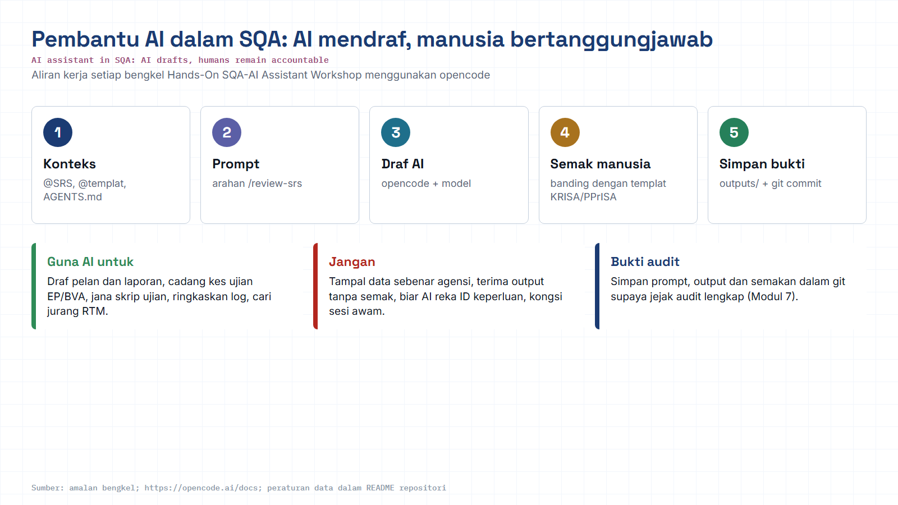
Module hub
Open: opencode docs
Notes:
Reminder of the rules for every AI workshop: context, prompt, AI draft, human review against the KRISA/PPrISA template, save evidence. Stress the data rule: synthetic data only.

Slide 20
02
MODULE 02 · PLAN
QA Planning & Proactive Quality
Build quality before coding begins, produce a QA Plan, review requirements, and start the RTM.
TIME
DURATION
DELIVERABLE
11:15 - 13:00
1h 45m
QA Plan · RTM v0
Notes:
Section marker for MODULE 02 · PLAN

Slide 21
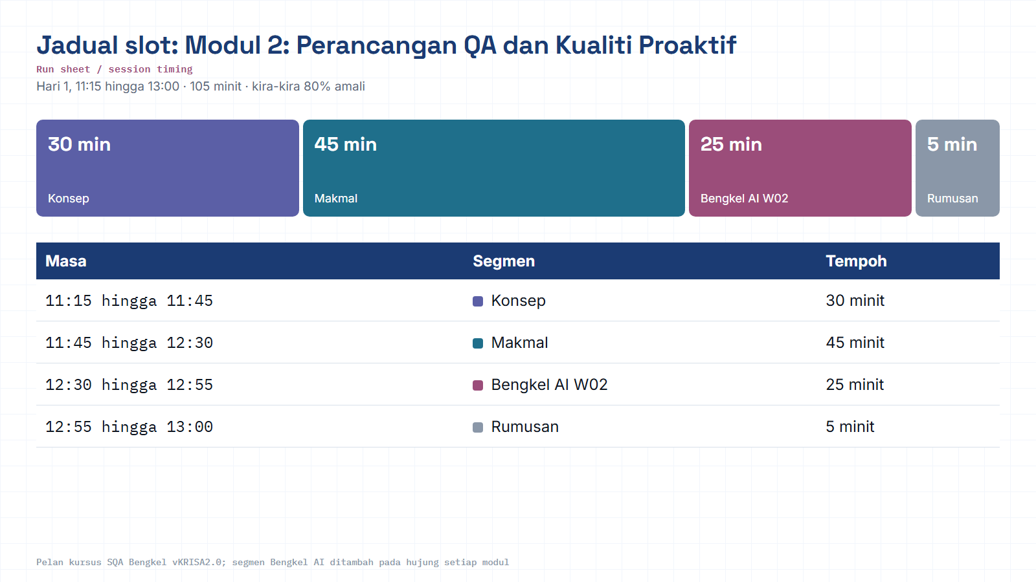
Module hub
Notes:
Run sheet for this module. Keep to the slot times; the SQA-AI workshop segment is reserved at the end.

Slide 22
M2 · OBJECTIVE
OBJECTIVE & TOPICS
Quality is built, not tested in
This module’s focus: set up the process, criteria and traceability so defects are prevented before code exists.
01 Test Strategy
02 Test Plan
03 Definition of Ready / Done
04 Quality Gates
05 Risk Register
06 Acceptance Criteria (INVEST)
07 Static Testing
08 Function Points (sizing)
09 BRS · SRS (KRISA)
10 RTM · Gap Analysis
◇ Every topic is practiced on the ShopFast project, not theory alone.
Notes:
Run through the topic list quickly; each becomes a hands-on artifact.

Slide 23


M2 · BRIDGE
FROM MODULE 1 to MODULE 2
From understanding to planning
Set the process
Review requirements
Trace everything
Test Strategy & Test Plan define scope, approach and success criteria.
Static testing catches vague & untestable requirements before they become code.
The RTM links every requirement to test case to defect.
◇ This is Shift-Left in practice: quality embedded before the build.
Notes:
Bridge slide: carry M1 mindset into three planning moves.

Slide 24
M2 · TWO DOCUMENTS
TWO DOCUMENTS
Test Strategy vs Test Plan
Test Strategy
Test Plan
Organisation / product level, the direction.
Project / feature level, the execution.
SCOPE
Overall principles & approach
SCOPE
Scope, entry/exit, schedule, resources
>
STABILITY
Rarely changes
STABILITY
Specific per release
ANSWERS
How do we test in general?
ANSWERS
What do we test for ShopFast?
Notes:
Strategy = long-lived direction. Plan = per-project execution detail.

Slide 25



M2 · CRITERIA & GATES
CRITERIA & QUALITY GATES
Definition of Ready to Done to Gate
Definition of Ready
Build
Definition of Done
Quality Gate
Ready to build?
Code + tests
Truly done?
Pass to release?
Definition of Ready, conditions to start (clear, testable, has acceptance criteria). Definition of Done, conditions to be truly finished. A Quality Gate enforces it.
Notes:
Gates make "done" objective and enforceable rather than a matter of opinion.

Slide 26
M2 · TESTABLE REQUIREMENTS
TESTABLE REQUIREMENTS
INVEST + Given / When / Then
INVEST
EXAMPLE · SHOPFAST CHECKOUT
I
Independent
Given a cart with items and a signed-in user
N
Negotiable
When the user taps “Pay”
V
Valuable
Then the order is confirmed & a receipt is shown
E
Estimable
S
Small
Criteria written like this convert straight into test cases.
T
Testable
Notes:
INVEST keeps stories healthy; GWT makes acceptance testable and unambiguous.

Slide 27

M2 · STATIC TESTING
STATIC TESTING · REQUIREMENT REVIEW
Catch flawed requirements early
Static testing reads the document without running code, hunting ambiguity, contradictions and untestable requirements in a deliberately flawed SRS.
“system must be fast”
“user-friendly interface”
⚑ no measurable threshold
⚑ subjective · untestable
“handle many users”
“etc.”
⚑ how many? no number
⚑ scope left open
Notes:
Give the group a flawed SRS; they flag ambiguity like these before it becomes code.

Slide 28
M2 · RISK
RISK DRIVES PRIORITY
Risk Register & risk matrix
LIKELIHOOD ↑
Each risk is scored: likelihood × impact.
High
Red cells = test first and most thoroughly; green = light coverage.
Med
For ShopFast, payment & security are usually the highest risks.
The Register makes coverage decisions transparent & defensible.
Low
Low
Med
High
IMPACT to
Notes:
Risk turns limited test time into prioritised coverage, highest risk first.

Slide 29
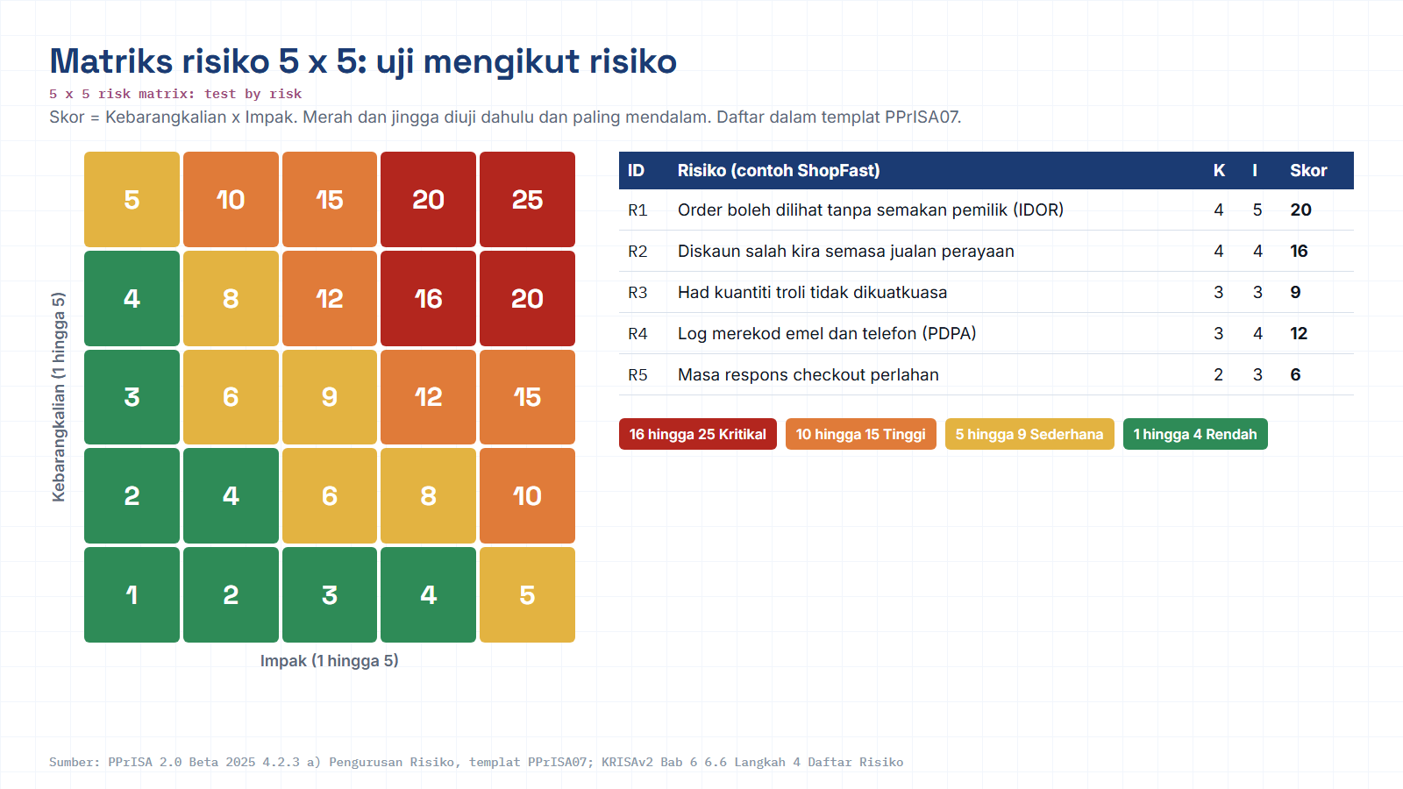
Module hub
Open: PPrISA07 template
Notes:
Diagram built from the KRISAv2 Beta 2026 / PPrISA 2.0 references. Use the Open chip to show the source page live.

Slide 30

M2 · TRACEABILITY
DOCUMENT CHAIN & TRACEABILITY
BRS to SRS to SDS, traced by the RTM
D2.1
BRS
SRS
SDS
Business Req.
System Req.
System Design
RTM · requirement to test case to defect traceability
BRS / SRS capture business & system requirements; Function Points give an early size for estimation. The RTM ensures no requirement goes untested.
Notes:
The RTM is the backbone that connects every later module back to requirements.

Slide 31
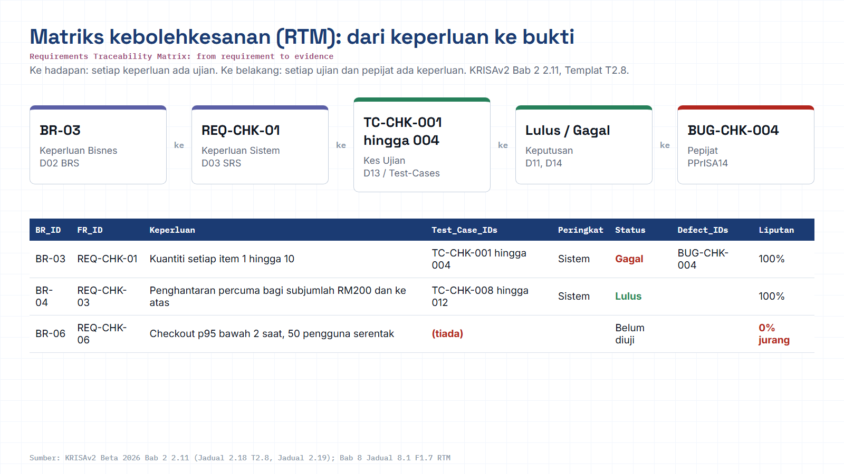
Module hub
Open: KRISAv2 Bab 2 p.56
Notes:
Diagram built from the KRISAv2 Beta 2026 / PPrISA 2.0 references. Use the Open chip to show the source page live.

Slide 32
M2 · GUIDED LAB
4-STEP GUIDED LAB
Practice: build quality before code
1
Fill a QA Plan template for ShopFast: scope, entry & exit criteria, Quality Gate.
2
Review a deliberately flawed SRS; flag ambiguity & untestable requirements.
3
Rewrite 5 requirements into testable form + Acceptance Criteria (Given/When/Then).
4
Start the RTM v0, link each requirement to an ID.
TOOLS
QA Plan template
Sample SRS
Review checklist
RTM (Sheet)
Jira / Confluence
Notes:
Facilitate the lab; each step produces part of the module deliverable.

Slide 33
M2 · OUTPUT
MODULE 2 DELIVERABLE
What you carry out
OUTPUT to
QA Plan + Requirement Review Report + RTM v0, carried into every later module.
KRISA 2.0-ALIGNED
FEEDS INTO
BRS (D2.1) · SRS
Module 3 onward
Deliverables map to KRISA 2.0 Ch.2 (Initiation) & Ch.3 (Analysis).
The RTM v0 becomes the backbone of later test design, automation & audit.
Note: KRISA 2.0 is Beta 2026 (JDN); deliverable numbering such as D2.1 is still being refined. Confirm the version with your agency.
Notes:
Close Module 2: three artifacts that anchor the rest of the workshop, aligned to KRISA.

Slide 34


REFERENCE · SAMPLE ARTIFACTS
SAMPLE MODULE ARTIFACTS
What the deliverables look like
QA Plan, outline
RTM, columns
Rewrite, sample
✓ Scope & objectives
A
Req ID
BEFORE
“Checkout must be fast and user-friendly.”
✓ Test approach
B
Requirement
✓ Entry criteria
C
Acceptance criteria
AFTER
✓ Exit criteria
“Given a cart with ≥1 item, when the user taps Pay, the confirmation shows within 3 seconds.”
D
Test case ID
✓ Quality Gate
✓ Roles & responsibilities
E
Status
✓ Risks & assumptions
F
Defect ID
◇ Illustrative samples for facilitation, adapt IDs, thresholds and columns to your agency’s templates.
Notes:
Show concrete shapes of the artifacts so participants know exactly what to produce.

Slide 35

REFERENCE · STANDARDS
REFERENCES & STANDARDS
Where these practices come from
KRISA 2.0 (Beta 2026), JDN
ISO/IEC 25010 · 29119 · ISO 9001
Ch.2 Initiation to BRS (D2.1); Ch.3 Analysis to SRS. Public-Sector SQA Portal, JDN.
Product quality model · software testing · quality management system.
CMMI
INVEST (Bill Wake)
Process maturity model referenced in the audit module.
Criteria for healthy, testable user stories.
Given / When / Then
Cost-of-quality escalation
Gherkin / BDD structure for acceptance criteria.
Widely-cited idea (Barry Boehm; IBM SSI), figures illustrative.
◇ KRISA 2.0 is a Beta; numbering (e.g. D2.1) is still being refined and KRISA 1.0 remains the baseline until finalised, confirm with your agency.
Notes:
Sources for the practices used. Keep the KRISA Beta caveat visible.

Slide 36
M02 · KRISAv2 BETA 2026 · PPrISA 2.0 · CLICK ANY LINE
References and templates for this module
Every line opens the official JDN document at the exact page. Templates download as Word or PDF.
WHERE IT IS IN THE GUIDES
TEMPLATES TO USE
Bab 2, 2.4 Kajian Keperluan Bisnes (BRS)
page 10 · KRISAv2 Bab 2 Fasa Permulaan
D02
Spesifikasi Keperluan Bisnes (BRS)
WORD
PDF
Bab 2, 2.11 Traceability Matrix (RTM) F1.8, Templat T2.8
page 56 · KRISAv2 Bab 2 Fasa Permulaan
D03
Spesifikasi Keperluan Sistem (SRS)
WORD
PDF
Bab 3, 3.8 Keperluan Bukan Fungsian F2.4
page 33 · KRISAv2 Bab 3 Fasa Analisis
D12
Pelan Induk Pengujian
WORD
PDF
PPrISA05
Pelan Pengurusan Kualiti
WORD
PDF
Bab 3, 3.10 Spesifikasi Keperluan Sistem (SRS)
page 42 · KRISAv2 Bab 3 Fasa Analisis
PPrISA07
Pelan Pengurusan Risiko
WORD
PDF
Bab 8, 8.3.1 Gate Review dan Definition of Done
page 5 · KRISAv2 Bab 8 Penyelarasan DevOps
PPrISA 2.0, 4.2.4 a) Pengurusan Kualiti
page 74 · PPrISA 2.0 Versi Beta Feb 2025
sqa.jdn.gov.my portal
All references (repo)
Module hub
Note: KRISAv2 Beta renumbers deliverables in its chapters; links follow the published D01 to D18 template files.
Notes:
Reference slide for M02. Click through live if time allows; otherwise tell trainees every link is also in the module hub page and in references/README.md of the repo.
- Bab 2, 2.4 Kajian Keperluan Bisnes (BRS) (PDF page 10): https://fth-abr.github.io/sqa-krisa-bengkel/references/krisa-v2-beta-2026/BAB2-FASA-PERMULAAN.pdf#page=10
- Bab 2, 2.11 Traceability Matrix (RTM) F1.8, Templat T2.8 (PDF page 56): https://fth-abr.github.io/sqa-krisa-bengkel/references/krisa-v2-beta-2026/BAB2-FASA-PERMULAAN.pdf#page=56
- Bab 3, 3.8 Keperluan Bukan Fungsian F2.4 (PDF page 33): https://fth-abr.github.io/sqa-krisa-bengkel/references/krisa-v2-beta-2026/BAB3-FASA-ANALISIS.pdf#page=33
- Bab 3, 3.10 Spesifikasi Keperluan Sistem (SRS) (PDF page 42): https://fth-abr.github.io/sqa-krisa-bengkel/references/krisa-v2-beta-2026/BAB3-FASA-ANALISIS.pdf#page=42
- Bab 8, 8.3.1 Gate Review dan Definition of Done (PDF page 5): https://fth-abr.github.io/sqa-krisa-bengkel/references/krisa-v2-beta-2026/BAB8-PENYELARASAN-PEMBANGUNAN-SISTEM-DEVOPS.pdf#page=5
- PPrISA 2.0, 4.2.4 a) Pengurusan Kualiti (PDF page 74): https://fth-abr.github.io/sqa-krisa-bengkel/references/pprisa-2.0/PPrISA_2.0_Versi_Beta_Februari_2025.pdf#page=74

Slide 37



WRAP-UP · MODULES 1 & 2
What you leave with
A shared quality vocabulary, QA/QC, V&V, Shift-Left.
AA
A QA Plan with entry/exit criteria and a Quality Gate.
A Requirement Review Report on a flawed SRS.
Al-Abrar bin Abdul Wahid
SQA Trainer · KRISA 2.0 (JDN)
An RTM v0 linking requirements to tests to defects.
abrar.abdulwahid@gmail.com
+60 13-283 5415
al-abrar-abdul-wahid
Every module runs on one shared project, ShopFast checkout, so you leave with a connected quality trail.
Notes:
Recap the four artifacts and hand off to Module 3.

Slide 38
M02 · W02 · 25 MINUTES · Hari 1, 12:30 hingga 12:55
Hands-On SQA-AI Assistant Workshop
AI-assisted requirement review and RTM
Let the AI statically review the flawed ShopFast SRS against the BRS, rewrite weak requirements as Given/When/Then and draft the RTM as CSV.
TOOL
opencode 1.18 in the lab folder · model: Big Pickle via OpenCode Zen (free, no API key) · synthetic ShopFast data only
Step-by-step guide (web)
Workshop slides (W02)
Setup guide W00
opencode docs
Notes:
Reserved slot: 25 minutes (Hari 1, 12:30 hingga 12:55). Trainees open lab\ in the terminal and start opencode. Walk the first step live on the projector, then let pairs continue with the web guide. Stop 3 minutes early for the human-check discussion.

Slide 39
W02 · HANDS-ON SQA-AI ASSISTANT WORKSHOP · 25 MIN
AI-assisted requirement review and RTM
STEPS
TYPE THIS (opencode> in opencode, PS> in PowerShell)
1
Run /review-srs on two checkout requirements
opencode> /review-srs REQ-CHK-03 dan REQ-CHK-04
opencode> /rewrite-gwt REQ-CHK-03 REQ-CHK-04
opencode> /rtm REQ-CHK-01 hingga REQ-CHK-06
2
Compare the AI findings with your team review
3
Run /rewrite-gwt and approve the file
4
Run /rtm and open the CSV
OUTPUT TO SAVE
HUMAN CHECK BEFORE YOU ACCEPT IT
outputs/m02-gwt-rewrite.md, outputs/m02-rtm.csv
- Every finding quotes text that really exists in the SRS
- Each Given/When/Then has one observable Then
- RTM rows match the requirement IDs in the SRS, none invented
Open step-by-step guide
Module hub
Notes:
Prompts are identical to the web guide and the W deck, so trainees can copy them. Commands starting with / are project commands in lab/.opencode/commands. Ask each pair to show the output file and read out one human-check result before moving on.

