Slide 1

MODULE 03 · BUILD-IN PHASE
Design Review &
Risk-Based Test Planning
Semakan Reka Bentuk & Perancangan Ujian Berasaskan Risiko
Evaluate the system design before development, and plan testing where risk is highest, practised end-to-end on one project: ShopFast checkout.
DURATION
FORMAT
PROJECT
KRISA 2.0
90 min
~80% hands-on
ShopFast
Ch.4 · SDS
SQA Hands-On Workshop · Aligned to KRISA 2.0 (JDN) · Trainer: Al-Abrar bin Abdul Wahid
Notes:
Key points on this slide:
- MODULE 03 · BUILD-IN PHASE
- Design Review &
- Risk-Based Test Planning
- Semakan Reka Bentuk & Perancangan Ujian Berasaskan Risiko
Link each point back to the ShopFast project and ask one trainee to give an example from their own agency.

Slide 2
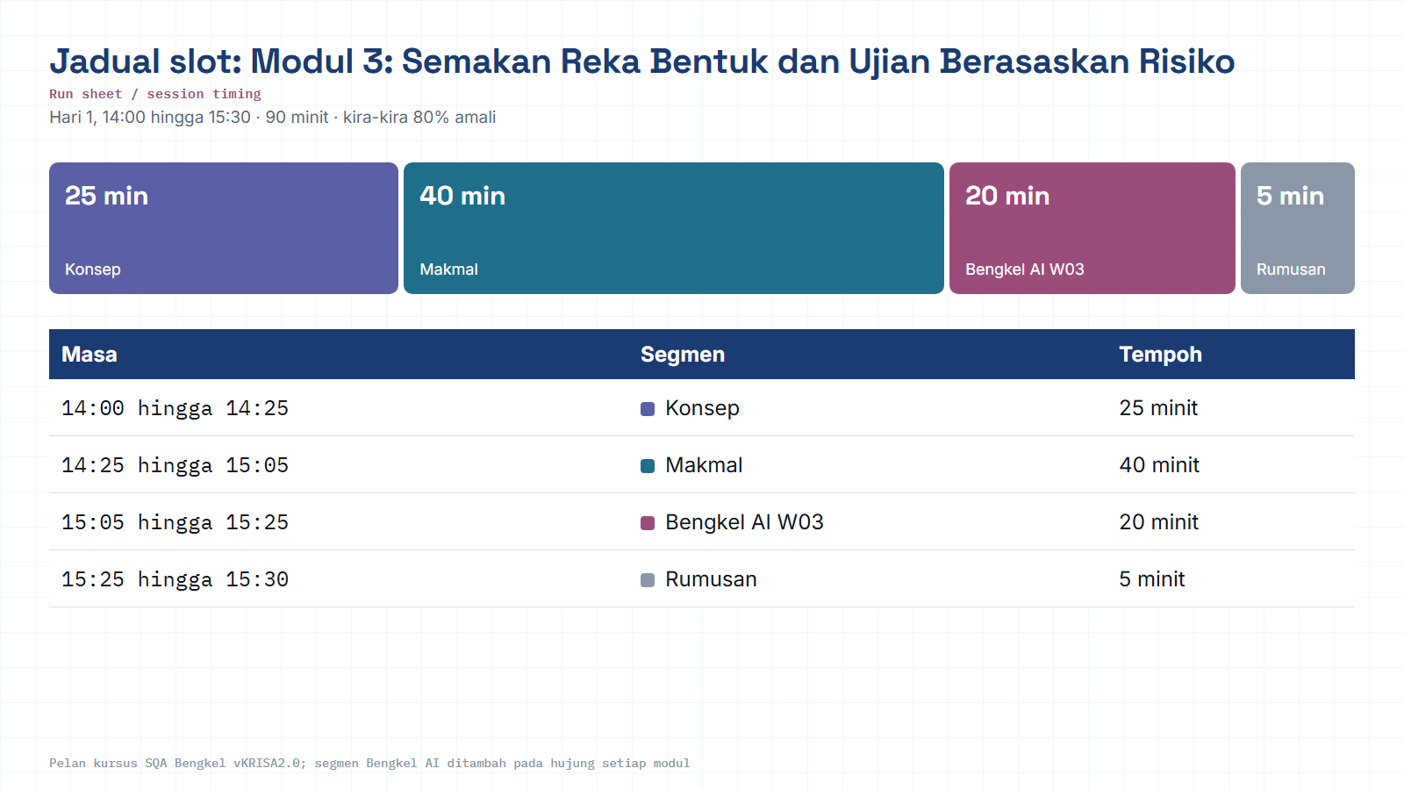
Module hub
Notes:
Run sheet for this module. Keep to the slot times; the SQA-AI workshop segment is reserved at the end.

Slide 3
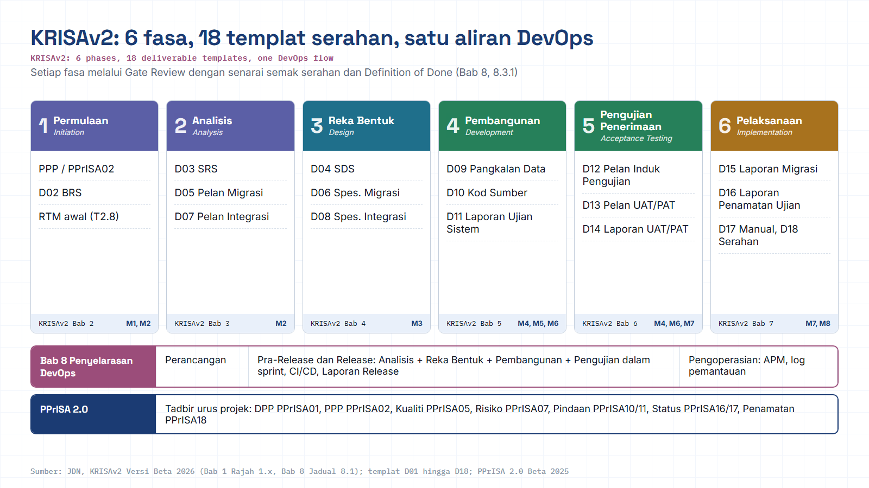
Module hub
Open: KRISAv2 portal
Notes:
Diagram built from the KRISAv2 Beta 2026 / PPrISA 2.0 references. Use the Open chip to show the source page live.

Slide 4


THE THROUGH-LINE
BUILD-IN · CEGAH
Where this module sits in the quality flow
Nine SQA activities map onto five phases. You move one feature, ShopFast, left to right. Module 3 lives in Build-in.
YOU ARE HERE
01 · PLAN
02 · BUILD-IN
03 · VERIFY
04 · ASSURE
05 · SUSTAIN
Define
›
Prevent
›
Test
›
Prove
›
Control
Set standards & scope
Catch design defects
Design & run tests
Audit the evidence
Change & monitor
The cheapest defect is one you never build. Design review catches problems while they are still on paper, before code, before test data, before production. That is the whole point of the Build-in phase.
SQA · BENGKEL AMALI
02 / 18
Notes:
Key points on this slide:
- THE THROUGH-LINE
- Where this module sits in the quality flow
- Nine SQA activities map onto five phases. You move one feature, ShopFast, left to right. Module 3 lives in Build-in.
- BUILD-IN · CEGAH
Link each point back to the ShopFast project and ask one trainee to give an example from their own agency.

Slide 5




LEARNING OBJECTIVES
BUILD-IN · CEGAH
What you will be able to do
By the end of this 90-minute module, on the ShopFast checkout feature.
Read a system design
01
Run a structured design review
02
Interpret an architecture diagram, API contract and data model, and judge how testable each part is.
Walk a review checklist to surface defects before a single line of code is written.
Assess design-time security
03
Prioritise testing by risk
04
Evaluate the design against OWASP Top 10 (2025) and lightweight threat modelling.
Score risks by likelihood × impact and turn them into a focused, risk-based test strategy.
SQA · BENGKEL AMALI
03 / 18
Notes:
Key points on this slide:
- LEARNING OBJECTIVES
- What you will be able to do
- By the end of this 90-minute module, on the ShopFast checkout feature.
- BUILD-IN · CEGAH
Link each point back to the ShopFast project and ask one trainee to give an example from their own agency.

Slide 6

WHY REVIEW AT ALL
BUILD-IN · CEGAH
The cost of a defect grows with every phase
Fix it in design and it is a conversation. Fix it in production and it is an incident. This is why we shift left.
40×
THE ECONOMICS
Design review is prevention, not inspection.
A defect caught in design costs a rewrite of a sentence.
15×
The same defect in production costs hotfixes, rollbacks and trust.
10×
5×
Requirement & design reviews are the highest-leverage QA activities you have.
1×
Requirements
Design
Build
Testing
Production
Relative cost to fix the same defect, by the phase it is caught · illustrative, exact multipliers vary by study
SQA · BENGKEL AMALI
04 / 18
Notes:
Key points on this slide:
- WHY REVIEW AT ALL
- The cost of a defect grows with every phase
- Fix it in design and it is a conversation. Fix it in production and it is an incident. This is why we shift left.
- BUILD-IN · CEGAH
Link each point back to the ShopFast project and ask one trainee to give an example from their own agency.

Slide 7

THE SHAPE OF THIS MODULE
BUILD-IN · CEGAH
Two disciplines, one continuous move
A design review surfaces what could go wrong; risk ranking decides where the testing goes.
A · Design Review
B · Risk-Based Test Planning
Static · preventive
Focused · prioritised
A structured inspection of the design itself. No code runs, you examine architecture, interfaces, data and security decisions while they are still cheap to change.
You cannot test everything equally. Rank what could go wrong by likelihood × impact, then aim the deepest testing at the areas where failure hurts most.
PRODUCES Findings log + a completed Design Review Checklist
PRODUCES A scored Risk Register + a Risk-Based Test Strategy
Review surfaces the risks to the risk ranking directs the testing
SQA · BENGKEL AMALI
05 / 18
Notes:
Key points on this slide:
- THE SHAPE OF THIS MODULE
- Two disciplines, one continuous move
- A design review surfaces what could go wrong; risk ranking decides where the testing goes.
- BUILD-IN · CEGAH
Link each point back to the ShopFast project and ask one trainee to give an example from their own agency.

Slide 8




PART A · DESIGN REVIEW
BUILD-IN · CEGAH
What a design review inspects
Four lenses. Each asks: is this correct, testable and safe, before we build it?
Architecture
API contract
Boundaries & coupling · single points of failure · scalability · failure & recovery modes.
Endpoints · status codes · request/response schemas · error model · idempotency · versioning.
Data model
Security
Entities & keys · referential integrity · PII handling · migration & retention.
Access control · secrets & input handling · OWASP-aligned design flaws.
SQA · BENGKEL AMALI
06 / 18
Notes:
Key points on this slide:
- PART A · DESIGN REVIEW
- What a design review inspects
- Four lenses. Each asks: is this correct, testable and safe, before we build it?
- BUILD-IN · CEGAH
Link each point back to the ShopFast project and ask one trainee to give an example from their own agency.

Slide 9
PART A · WALKTHROUGH
BUILD-IN · CEGAH
The design we review: ShopFast checkout
Trace one checkout request end-to-end. At every hop, ask what could break, and how you would test it.
TRUST BOUNDARY · internal services
Payment Gateway
external · 3rd-party
Browser
API Gateway
Checkout Svc
Inventory Service
ShopFast web
auth · routing
orchestration
stock levels
Orders Database
PII · order records
REVIEW FOCUS AT EACH HOP
● Auth & authz at the gateway
● Idempotent checkout (no double-charge)
● Timeout + retry to payment
● Stock race on concurrent buys
● PII protection in the Orders DB
SQA · BENGKEL AMALI
07 / 18
Notes:
Key points on this slide:
- PART A · WALKTHROUGH
- The design we review: ShopFast checkout
- Trace one checkout request end-to-end. At every hop, ask what could break, and how you would test it.
- BUILD-IN · CEGAH
Link each point back to the ShopFast project and ask one trainee to give an example from their own agency.

Slide 10

PART A · API CONTRACT
BUILD-IN · CEGAH
Review the contract, not just the happy path
An OpenAPI / Swagger spec is a testable promise. Read it like a tester: where are the failure paths?
READ THE SPEC FOR
checkout.openapi.yaml
Every response documented, 2xx, 4xx and 5xx, not only success
POST /api/checkout
Idempotency-Key: <uuid>
body: { cartId, payment,
A consistent error schema: code · message · field
address }
Idempotency on checkout / payment to prevent double-charge
responses:
200 order confirmed
Explicit authentication & authorization per endpoint
400 validation error
409 stock conflict
Typed input constraints you can assert against
422 payment declined
5xx upstream failure
A versioning strategy for breaking changes
SQA · BENGKEL AMALI
08 / 18
Notes:
Key points on this slide:
- PART A · API CONTRACT
- Review the contract, not just the happy path
- An OpenAPI / Swagger spec is a testable promise. Read it like a tester: where are the failure paths?
- BUILD-IN · CEGAH
Link each point back to the ShopFast project and ask one trainee to give an example from their own agency.

Slide 11

PART A · SECURITY REVIEW
BUILD-IN · CEGAH
Review the design against OWASP Top 10 : 2025
The current edition, released November 2025, the first update since 2021. Four categories are decided at design time.
A01
Broken Access Control
A06
Insecure Design
A02
Security Misconfiguration
A07
Authentication Failures
A03
Software Supply Chain Failures
A08
Software / Data Integrity Failures
A04
Cryptographic Failures
A09
Security Logging & Alerting Failures
A05
Injection
A10
Mishandling of Exceptional Conditions
Fix at design, not in a pen-test. A01 access control, A02 misconfiguration, A06 insecure design and A10 mishandling of exceptional conditions are architecture choices, a review catches them; a scanner mostly cannot.
Source: OWASP Top 10 : 2025, owasp.org/Top10 (highlighted = predominantly design-time).
SQA · BENGKEL AMALI
09 / 18
Notes:
Key points on this slide:
- PART A · SECURITY REVIEW
- Review the design against OWASP Top 10 : 2025
- The current edition, released November 2025, the first update since 2021. Four categories are decided at design time.
- BUILD-IN · CEGAH
Link each point back to the ShopFast project and ask one trainee to give an example from their own agency.

Slide 12
PART A · SECURITY REVIEW
BUILD-IN · CEGAH
Threat-model the design with STRIDE
A structured way to ask "what can go wrong?", one threat class at a time, mapped onto ShopFast.
THREAT
SHOPFAST EXAMPLE
DESIGN MITIGATION
S
Spoofing
Someone poses as another shopper at checkout
Strong auth · session integrity
T
Tampering
Cart total or price altered in transit
Server-side validation · signing
R
Repudiation
User denies placing a paid order
Immutable audit logs
I
Info disclosure
Card data or PII leaks from Orders DB
Encryption · data minimisation
D
Denial of service
Checkout flooded, real buyers blocked
Rate limiting · quotas
E
Elevation of priv.
A shopper reaches admin actions
Least privilege · authz checks
The four questions: What are we building? · What can go wrong? · What will we do about it? · Did we do a good job?
SQA · BENGKEL AMALI
10 / 18
Notes:
Key points on this slide:
- PART A · SECURITY REVIEW
- Threat-model the design with STRIDE
- A structured way to ask "what can go wrong?", one threat class at a time, mapped onto ShopFast.
- BUILD-IN · CEGAH
Link each point back to the ShopFast project and ask one trainee to give an example from their own agency.

Slide 13



PART A · DELIVERABLE
BUILD-IN · CEGAH
The Design Review Checklist
Three lenses you walk on every review. Each unchecked box is a finding, and a candidate test case.
Testability
Error handling
Security (basic)
Observable output for each function
Every failure path is defined
Access control enforced server-side
Test data & environments definable
Fails closed, returns a clear error
Sensitive data minimised & protected
Interfaces mockable / stubbable
Timeouts, retries & rollback set
Inputs validated against the contract
States you can set up and reset
No silent or undefined states
Secrets kept out of code & logs
SQA · BENGKEL AMALI
11 / 18
Notes:
Key points on this slide:
- PART A · DELIVERABLE
- The Design Review Checklist
- Three lenses you walk on every review. Each unchecked box is a finding, and a candidate test case.
- BUILD-IN · CEGAH
Link each point back to the ShopFast project and ask one trainee to give an example from their own agency.

Slide 14


PART B · RISK-BASED TESTING
BUILD-IN · CEGAH
You cannot test everything, so test by risk
Rank each risk, then match test depth to its rank. Testing is a budget; spend it where failure hurts most.
Likelihood
×
Impact
=
Risk score
>
Test priority
HIGH RISK
MEDIUM RISK
LOW RISK
Deepest testing
Standard coverage
Light touch
Automation, edge cases, negative & security tests, load where relevant.
Core functional cases plus the main boundary and error paths.
Smoke / sanity checks only, confirm it works, then move on.
SQA · BENGKEL AMALI
12 / 18
Notes:
Key points on this slide:
- PART B · RISK-BASED TESTING
- You cannot test everything, so test by risk
- Rank each risk, then match test depth to its rank. Testing is a budget; spend it where failure hurts most.
- BUILD-IN · CEGAH
Link each point back to the ShopFast project and ask one trainee to give an example from their own agency.

Slide 15
PART B · DELIVERABLE
BUILD-IN · CEGAH
Plot every risk on the 5 × 5 matrix
Likelihood × impact places each risk in a zone. The zone sets how hard you test it.
5
5
10
15
20
25
ZONE to TEST RESPONSE
Critical (15-25)
4
4
8
12
16
20
Test hardest: automation, security, load
S
High (10-14)
3
3
6
9
12
15
Thorough functional + negative + boundary
LIKELIHOOD to
D
P
Medium (5-9)
2
2
4
6
8
10
Standard functional coverage
U
Low (1-4)
1
1
2
3
4
5
Smoke / sanity only
1
2
3
4
5
IMPACT to
Markers: P payment double-charge · S stock oversold · D discount abuse · U UI copy
SQA · BENGKEL AMALI
13 / 18
Notes:
Key points on this slide:
- PART B · DELIVERABLE
- Plot every risk on the 5 × 5 matrix
- Likelihood × impact places each risk in a zone. The zone sets how hard you test it.
- BUILD-IN · CEGAH
Link each point back to the ShopFast project and ask one trainee to give an example from their own agency.

Slide 16
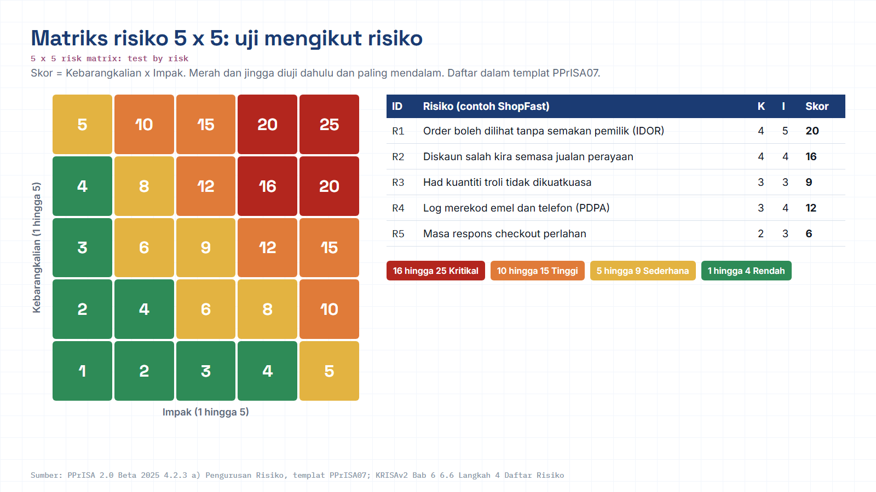
Module hub
Open: PPrISA07 template
Notes:
Diagram built from the KRISAv2 Beta 2026 / PPrISA 2.0 references. Use the Open chip to show the source page live.

Slide 17
PART B · WORKED EXAMPLE
BUILD-IN · CEGAH
From risk to test priority, ShopFast
The same four risks from the matrix, turned into a concrete, defensible testing plan.
RISK
L
I
SCORE
ZONE
TEST RESPONSE
Payment double-charge on retry
3
5
15
Idempotency tests + API automation + edge cases
Critical
Stock oversold on concurrent buys
4
4
16
Concurrency / load tests + regression suite
Critical
Discount-code abuse (new change)
3
3
9
Boundary + negative test cases
Medium
Address-field validation gap
3
2
6
Standard functional cases
Medium
Checkout button mislabeled
2
1
2
Smoke check only
Low
Scores are illustrative for the ShopFast exercise, your team sets its own likelihood and impact.
SQA · BENGKEL AMALI
14 / 18
Notes:
Key points on this slide:
- PART B · WORKED EXAMPLE
- From risk to test priority, ShopFast
- The same four risks from the matrix, turned into a concrete, defensible testing plan.
- BUILD-IN · CEGAH
Link each point back to the ShopFast project and ask one trainee to give an example from their own agency.

Slide 18

HANDS-ON LAB · 40 MIN
BUILD-IN · CEGAH
Your guided run on ShopFast
Three timeboxed steps. You leave with three artifacts that feed straight into Module 4.
1
12 min
2
13 min
3
15 min
Study the design
Run the review
Build the risk plan
›
›
Open the ShopFast architecture diagram and the OpenAPI spec. Trace one checkout request end-to-end and note every trust boundary.
Walk the checklist, testability, error handling, security. Log each finding; flag anything untestable or unsafe by design.
List what could go wrong, score likelihood × impact, plot the 5 × 5, and set a test priority per risk to your test strategy.
Architecture diagram · Swagger UI
Design Review Checklist · OWASP 2025
Risk matrix (Sheet) · Risk register
Carries forward: your risk ranking decides which test cases Module 4 writes first. Nothing here is throwaway.
SQA · BENGKEL AMALI
15 / 18
Notes:
Key points on this slide:
- HANDS-ON LAB · 40 MIN
- Your guided run on ShopFast
- Three timeboxed steps. You leave with three artifacts that feed straight into Module 4.
- BUILD-IN · CEGAH
Link each point back to the ShopFast project and ask one trainee to give an example from their own agency.

Slide 19


OUTPUTS
BUILD-IN · CEGAH
What you walk away with
Three artifacts, added to the ShopFast quality trail, and mapped to a KRISA 2.0 deliverable.
Design Review Checklist
Risk Register
Risk-Based Test Strategy
Completed, with every finding logged and rated.
Each risk scored by likelihood × impact and zoned.
Test priorities and coverage plan, driven by risk.
KRISA 2.0
Chapter 4 · Design to System Design Specification (SDS)
Your architecture, API and data-model review evidence supports the SDS, the design deliverable an agency signs off before build.
Beta 2026 · JDN
SQA · BENGKEL AMALI
16 / 18
Notes:
Key points on this slide:
- OUTPUTS
- What you walk away with
- Three artifacts, added to the ShopFast quality trail, and mapped to a KRISA 2.0 deliverable.
- BUILD-IN · CEGAH
Link each point back to the ShopFast project and ask one trainee to give an example from their own agency.

Slide 20


TAKE-HOME
BUILD-IN · CEGAH
Sample artifacts, templates & references
Grab-and-go examples in the format your deliverables should take, plus the standards behind them.
SAMPLE ROWS (copy the format)
STANDARDS & GUIDELINES
// risk register
OWASP Top 10 : 2025
R-07 | Payment double-charge | L3×I5 = 15
owasp.org/Top10, current edition
| Critical | Idempotency + API automation
ISO/IEC 25010
Product quality model (security, reliability…)
// review finding
DR-02 | /checkout has no 409 defined | Major
ISO/IEC/IEEE 42010
| Add stock-conflict response to spec
Architecture description
KRISA 2.0 · Ch.4 Design
System Design Spec (SDS) · JDN
LAB TOOLS
Swagger / OpenAPI
draw.io
Google Sheets
Jira
OWASP Threat Dragon
KRISA 2.0 is a Beta (2026); deliverable numbering may change, confirm the version with your agency.
SQA · BENGKEL AMALI
17 / 18
Notes:
Key points on this slide:
- TAKE-HOME
- Sample artifacts, templates & references
- Grab-and-go examples in the format your deliverables should take, plus the standards behind them.
- BUILD-IN · CEGAH
Link each point back to the ShopFast project and ask one trainee to give an example from their own agency.

Slide 21
M03 · KRISAv2 BETA 2026 · PPrISA 2.0 · CLICK ANY LINE
References and templates for this module
Every line opens the official JDN document at the exact page. Templates download as Word or PDF.
WHERE IT IS IN THE GUIDES
TEMPLATES TO USE
Bab 4, 4.5 Reka Bentuk Seni Bina
page 4 · KRISAv2 Bab 4 Fasa Reka Bentuk
D04
Spesifikasi Reka Bentuk Sistem (SDS)
WORD
PDF
Bab 4, Jadual 4.4 Jenis seni bina (DevOps, CI/CD)
page 10 · KRISAv2 Bab 4 Fasa Reka Bentuk
D08
Spesifikasi Integrasi Data
WORD
PDF
Bab 4, 4.12 Spesifikasi Integrasi
page 111 · KRISAv2 Bab 4 Fasa Reka Bentuk
PPrISA07
Pelan Pengurusan Risiko
WORD
PDF
PPrISA12
Borang Pelaporan Risiko
WORD
PDF
Bab 1, 1.6.7 Faktor Keselamatan ICT, Jadual 1.5
page 24 · KRISAv2 Bab 1 Perancangan
PPrISA13
Log Penyelesaian Risiko
WORD
PDF
Bab 5, 5.6.8 Amalan Pengaturcaraan Selamat
page 30 · KRISAv2 Bab 5 Fasa Pembangunan
PPrISA 2.0, 4.2.3 a) Pengurusan Risiko
page 71 · PPrISA 2.0 Versi Beta Feb 2025
sqa.jdn.gov.my portal
All references (repo)
Module hub
Note: KRISAv2 Beta renumbers deliverables in its chapters; links follow the published D01 to D18 template files.
Notes:
Reference slide for M03. Click through live if time allows; otherwise tell trainees every link is also in the module hub page and in references/README.md of the repo.
- Bab 4, 4.5 Reka Bentuk Seni Bina (PDF page 4): https://fth-abr.github.io/sqa-krisa-bengkel/references/krisa-v2-beta-2026/BAB4-FASA-REKA-BENTUK.pdf#page=4
- Bab 4, Jadual 4.4 Jenis seni bina (DevOps, CI/CD) (PDF page 10): https://fth-abr.github.io/sqa-krisa-bengkel/references/krisa-v2-beta-2026/BAB4-FASA-REKA-BENTUK.pdf#page=10
- Bab 4, 4.12 Spesifikasi Integrasi (PDF page 111): https://fth-abr.github.io/sqa-krisa-bengkel/references/krisa-v2-beta-2026/BAB4-FASA-REKA-BENTUK.pdf#page=111
- Bab 1, 1.6.7 Faktor Keselamatan ICT, Jadual 1.5 (PDF page 24): https://fth-abr.github.io/sqa-krisa-bengkel/references/krisa-v2-beta-2026/BAB1-PERANCANGAN.pdf#page=24
- Bab 5, 5.6.8 Amalan Pengaturcaraan Selamat (PDF page 30): https://fth-abr.github.io/sqa-krisa-bengkel/references/krisa-v2-beta-2026/BAB5-FASA-PEMBANGUNAN.pdf#page=30
- PPrISA 2.0, 4.2.3 a) Pengurusan Risiko (PDF page 71): https://fth-abr.github.io/sqa-krisa-bengkel/references/pprisa-2.0/PPrISA_2.0_Versi_Beta_Februari_2025.pdf#page=71

Slide 22



MODULE 03 · RECAP
Prevent early. Secure by design. Test by risk.
Prevention beats detection
Security is a design decision
Test by risk
The cheapest defect is one caught while the design is still on paper.
Review against OWASP Top 10 : 2025 and threat-model with STRIDE.
Likelihood × impact tells you exactly where to aim the deepest testing.
NEXT to Module 4 · Test Design & Test Management, your risk ranking decides which cases to write first.
Al-Abrar bin Abdul Wahid
abrar.abdulwahid@gmail.com
+60 13-283 5415
LinkedIn
SQA Trainer · Aligned to KRISA 2.0 (JDN)
Notes:
Key points on this slide:
- MODULE 03 · RECAP
- Prevent early. Secure by design. Test by risk.
- Prevention beats detection
- The cheapest defect is one caught while the design is still on paper.
Link each point back to the ShopFast project and ask one trainee to give an example from their own agency.

Slide 23
M03 · W03 · 20 MINUTES · Hari 1, 15:05 hingga 15:25
Hands-On SQA-AI Assistant Workshop
AI design review and 5 x 5 risk register
Review the ShopFast architecture and OpenAPI contract with the AI, challenge one finding for evidence, then build a scored risk register in PPrISA07 format.
TOOL
opencode 1.18 in the lab folder · model: Big Pickle via OpenCode Zen (free, no API key) · synthetic ShopFast data only
Step-by-step guide (web)
Workshop slides (W03)
Setup guide W00
opencode docs
Notes:
Reserved slot: 20 minutes (Hari 1, 15:05 hingga 15:25). Trainees open lab\ in the terminal and start opencode. Walk the first step live on the projector, then let pairs continue with the web guide. Stop 3 minutes early for the human-check discussion.

Slide 24
W03 · HANDS-ON SQA-AI ASSISTANT WORKSHOP · 20 MIN
AI design review and 5 x 5 risk register
STEPS
TYPE THIS (opencode> in opencode, PS> in PowerShell)
1
Run /design-review on the order endpoint
opencode> /design-review GET /api/orders/{orderId}
opencode> Petik baris tepat dalam shopfast/docs/openapi.yaml yang membuktikan penemuan anda tentang GET /api/orders/{orderId}.
opencode> /risk-register checkout ShopFast berdasarkan penemuan semakan reka bentuk di atas
2
Challenge one finding: ask for the exact line as evidence
3
Run /risk-register and approve the CSV
4
Sort by score and agree the top three test priorities
OUTPUT TO SAVE
HUMAN CHECK BEFORE YOU ACCEPT IT
outputs/m03-risk-register.csv
- Findings quote the exact path or line in openapi.yaml or architecture.md
- Scores use 1 to 5 scales and Skor = K x I
- Each top risk has a test priority, not only a mitigation
Open step-by-step guide
Module hub
Notes:
Prompts are identical to the web guide and the W deck, so trainees can copy them. Commands starting with / are project commands in lab/.opencode/commands. Ask each pair to show the output file and read out one human-check result before moving on.

Slide 25
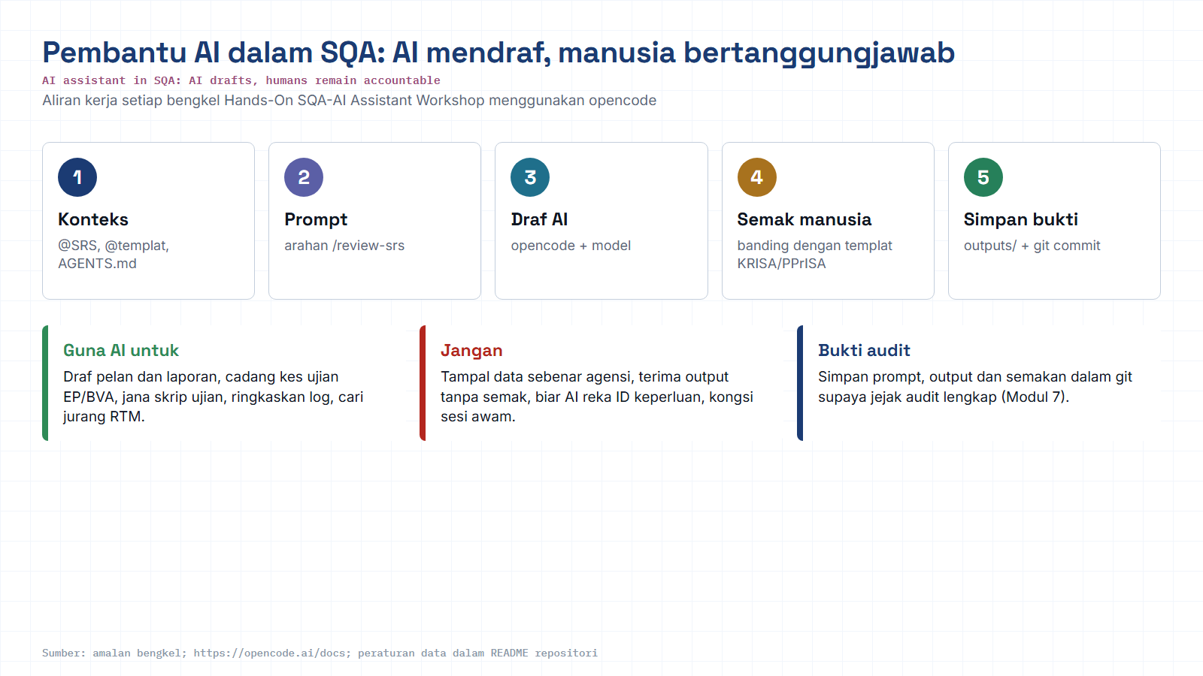
Module hub
Open: opencode docs
Notes:
Reminder of the rules for every AI workshop: context, prompt, AI draft, human review against the KRISA/PPrISA template, save evidence. Stress the data rule: synthetic data only.

