Slide 1
RUNNING PROJECT
ShopFast
Checkout module, the same project from Module 1 through the capstone.
MODULE 04 · VERIFY PHASE · SQA HANDS-ON WORKSHOP
Test Design &
Test Management Fundamentals
SCHEDULE SLOT
15:45 - 17:00
Day 1 · final session before the retrospective.
Good test cases are not guessed, they are engineered. This module turns the ShopFast requirements into a small, traceable, fully covered set of tests.
MODULE DELIVERABLE
Test Plan + 15-20 test cases
Equivalence Partitioning
Boundary Value Analysis
Decision Table
State Transition
mapped to RTM v1.
DURATION
TECHNIQUES
TEST CASES
HANDS-ON
75 min
4
15-20
60 min
KRISA ALIGNMENT
D12
Master Test Plan, Acceptance Testing phase deliverable, Ch.6.
MODUL 04 · SQA
Cover
KRISA · Bab 6 · D12
01 / 25
Notes:
Module 4, Day 1, 15:45-17:00. Verify phase. Deliverable: Test Plan + 15-20 test cases mapped to the RTM.

Slide 2
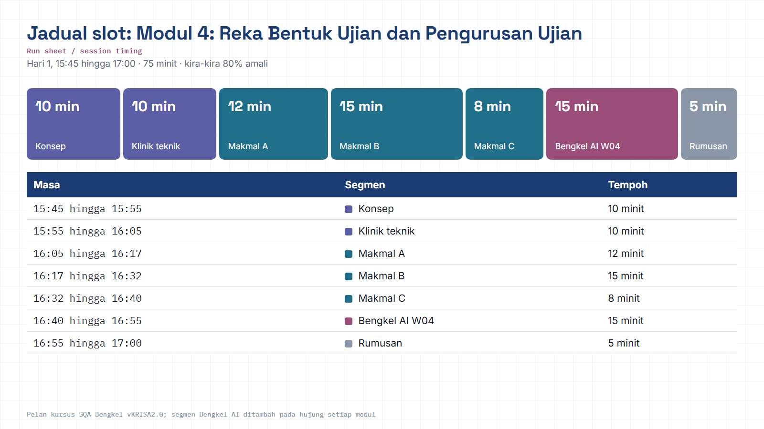
Module hub
Notes:
Run sheet for this module. Keep to the slot times; the SQA-AI workshop segment is reserved at the end.

Slide 3
THE THROUGH-LINE
Module 4 is where quality turns from opinion into evidence
Modules 2 and 3 produced testable requirements and prioritised risks. Module 4 converts them into concrete test cases, and everything after this refers back to them.
01 · PLAN
02 · BUILD-IN
03 · VERIFY
03 · VERIFY
04-05 · ASSURE / SUSTAIN
Modules 1-2
Module 3
MODUL 4
Modules 5-6
Modules 7-8
QA Plan · RTM v0
Risk register · SDS
15-20 cases + RTM
Automation · defects
Audit · change
in: testable requirements + risk
out: traceable test cases
WE BRING IN
WE PRODUCE HERE
WE HAND FORWARD
RTM v0 from Module 2, the Risk Register from Module 3, and the ShopFast SRS rewritten to be testable.
A Test Plan (Master Test Plan structure) + 15-20 test cases + RTM v1 with computed coverage.
Module 5 automates these cases; Module 6 logs defects against them; Module 8 uses them for impact analysis.
MODUL 04 · SQA
Where this sits
Phase 03 · Verify
02 / 25
Notes:
Input: RTM v0 (Module 2) and the Risk Register (Module 3). Output: traceable test cases for Modules 5-8.

Slide 4
BY 17:00 YOU CAN
Four abilities, not four topics
Each outcome is checked against a real artifact you produce in the lab.
01
Pick the right test level
02
Design cases by technique, not instinct
Place each requirement at the cheapest level that can test it, unit, integration, system, UAT or PAT, and know who owns it.
Use EP, BVA, decision tables and state transition for maximum coverage from minimum cases.
EVIDENCE
The Level column in your test case sheet.
EVIDENCE
Every case names the technique that produced it.
03
Write cases someone else can run
04
Prove coverage with the RTM
Preconditions, test data, steps, and one observable expected result.
Link requirement to case to result to defect, compute coverage, and spot gaps early.
EVIDENCE
Peer check: another team runs 2 of your cases.
EVIDENCE
RTM v1 with a coverage cell and a gap list.
MODUL 04 · SQA
Learning outcomes
Module objectives
03 / 25
Notes:
Each outcome is checked against a real artifact, not a quiz.

Slide 5
HOW THE 75 MINUTES ARE SPENT
20% concept · 80% hands on the keyboard
15:45
15:55
16:05
16:17
16:32
16:40
Concept: levels + criteria
Technique clinic
LAB A · EP + BVA
LAB B · write 15-20 cases
LAB C · RTM
SQA-AI workshop + review
10 min
10 min
12 min
15 min
8 min
20 min
GUIDED INPUT
TEAM WORK, 35 CONTINUOUS MINUTES
PEER REVIEW
TEAM ROLES (4 PEOPLE)
TOOLING (PICK ONE)
WORKING RULE
Test designer, owns techniques and the case list.
Data writer, owns test data and preconditions.
RTM keeper, owns traceability and coverage.
Reviewer, tries to run another team’s cases.
TestRail · Zephyr · Xray · Jira · Google Sheets (default).
A sheet is enough today. What is assessed is structure and traceability, not the tool.
No test case gets written without a requirement ID beside it. If you cannot name the requirement being tested, the case is not ready.
MODUL 04 · SQA
75-minute run sheet
15:45 - 17:00
04 / 25
Notes:
12 min concept, 13 min technique clinic, 45 min lab, 5 min peer review.

Slide 6
CONCEPT 1 OF 3
Every deliverable has a test that proves it
The left arm produces documents; the right arm proves them. In KRISA, acceptance testing splits into UAT (functional) and PAT (functional and non-functional).
dashed line = this document is the basis for the test cases on the right
BRS · Business requirements
PAT · provisional acceptance
Module 2 · KRISA Ch.2
functional + non-functional
SRS · System requirements
UAT · user acceptance
Module 2 · KRISA Ch.3
functional · process owner
SDS · System design
System & integration testing
Module 3 · KRISA Ch.4
development team · Ch.5
Module / component design
Unit testing
KRISA Ch.5
developer · inside CI
DEVELOPMENT / CODE
TODAY’S LAB
The cases you write in Lab B sit at the system test level, detailed enough for Module 5 automation, and the source for UAT scenarios later.
MODUL 04 · SQA
Test levels (V-model)
KRISA Ch.5-6
05 / 25
Notes:
UAT covers functional aspects; PAT covers functional and non-functional.

Slide 7
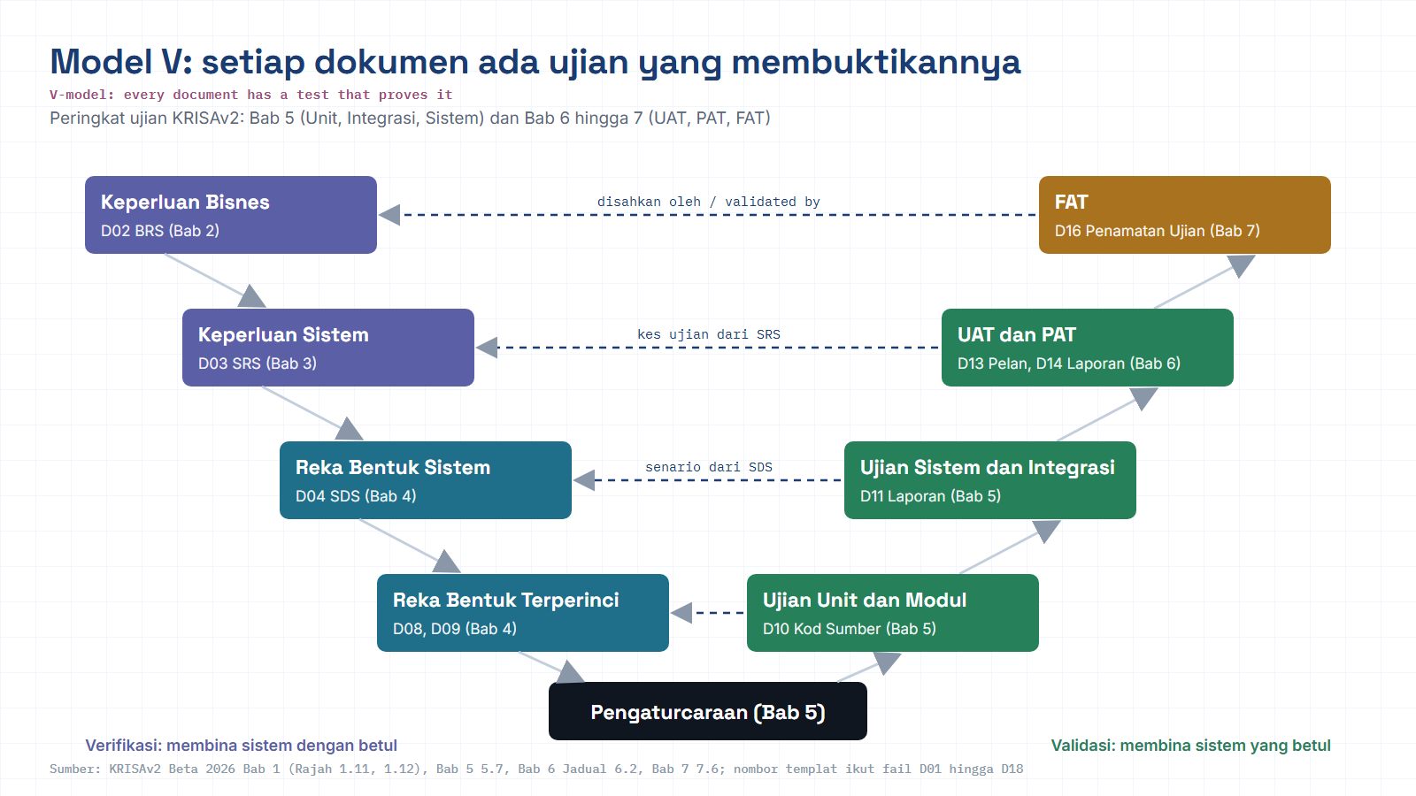
Module hub
Open: KRISAv2 Bab 6 p.5
Notes:
Diagram built from the KRISAv2 Beta 2026 / PPrISA 2.0 references. Use the Open chip to show the source page live.

Slide 8
CONCEPT 1 · CONTINUED
How many tests sit at each level decides your feedback speed
TARGET
The automation pyramid
ANTI-PATTERN
The ice-cream cone
slow · brittle · costly
Manual testing · repeated regression
UI / end-to-end
API / integration tests
UI tests
API
Unit tests, many, milliseconds
fast · stable · cheap
unit
Module 5 automates only 1-2 UI paths. The rest drops to the API level.
Symptoms: regression takes days, release dates slip, testers become the bottleneck.
KRISA LINK
KRISA 2.0 Ch.8 (DevOps alignment) calls for automation and continuous monitoring, the pyramid shape is what lets a release pipeline run without days of manual testing.
MODUL 04 · SQA
Shape of the suite
Concept 1 · levels
06 / 25
Notes:
Pyramid = fast feedback. Ice-cream cone = days of manual regression.

Slide 9
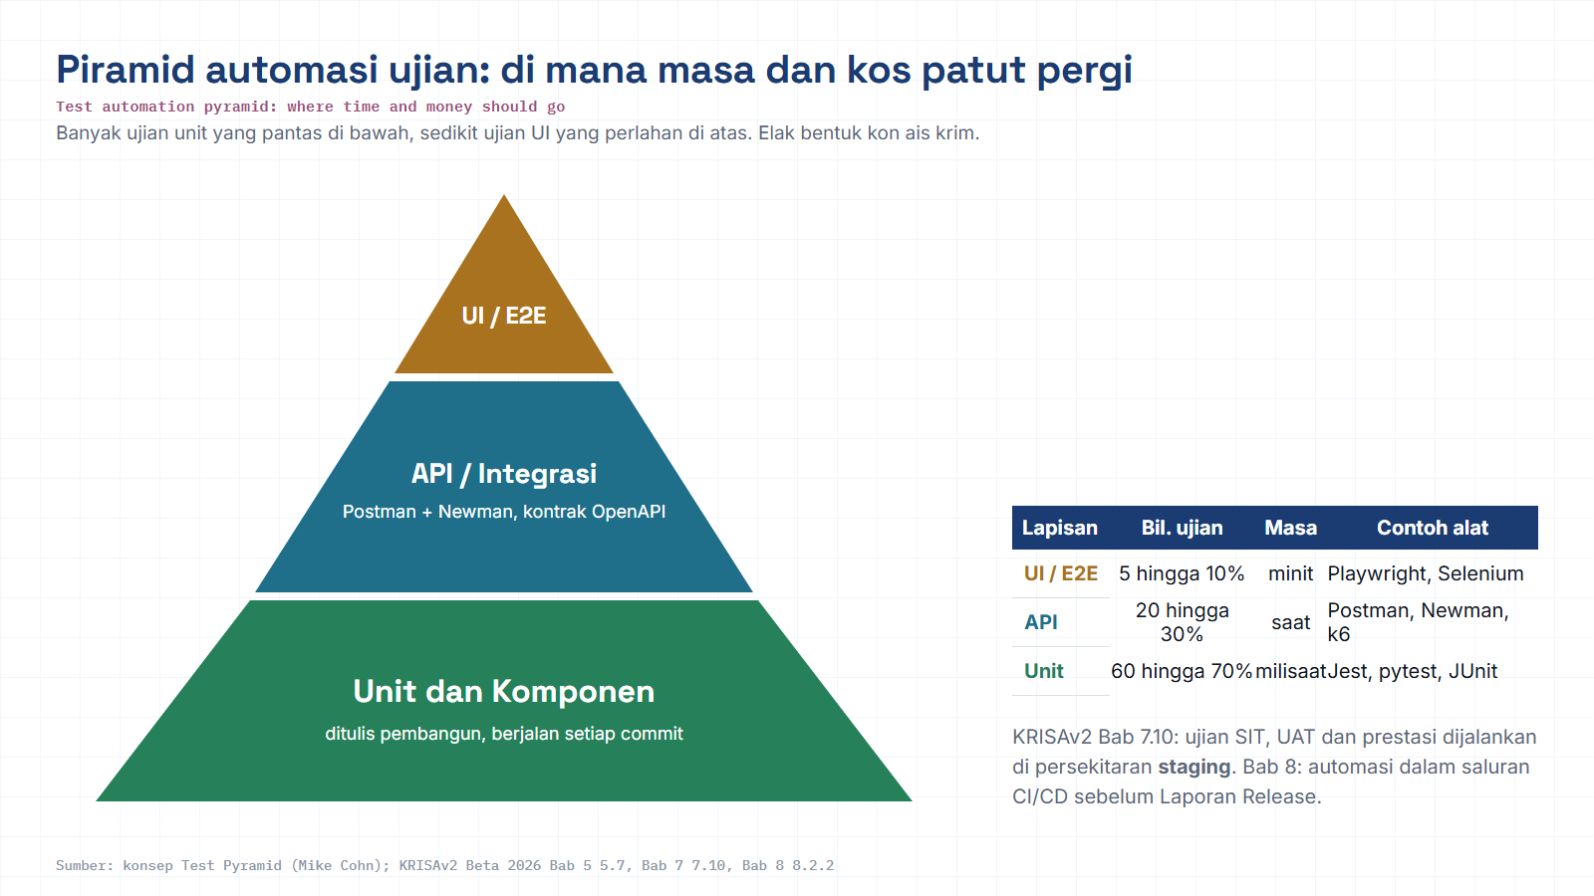
Module hub
Open: KRISAv2 Bab 5 p.33
Notes:
Diagram built from the KRISAv2 Beta 2026 / PPrISA 2.0 references. Use the Open chip to show the source page live.

Slide 10
CONCEPT 2 OF 3
Quality gates: when testing starts, and when it is finished
Without both, testing starts too early and ends when time runs out, not when risk is closed.
Build ready · SUT deployed
ENTRY GATE
Test cycle
EXIT GATE
staging environment
Every entry checklist item = YES
execute · log · retest
Release decision: go / no-go
if not, testing does not start
backed by the Test Closure Report
ENTRY
Examples (KRISA, UAT)
EXIT
Examples (KRISA, UAT)
The UAT plan has been approved by the project team.
The staging environment is ready and the SUT is deployed in it.
Test scenarios and scripts are prepared and approved.
Test data has been loaded into the SUT database.
System test results accepted; testers have been briefed.
All severity 1 and 2 defects are fixed, retested and closed.
The UAT closure report is approved by the project owner.
Remaining open defects accepted in writing with a workaround.
High-risk requirement coverage reaches 100% in the RTM.
PAT adds non-functional aspects, performance, security, usability, to the same criteria.
MODUL 04 · SQA
Entry & exit criteria
KRISA F5.4 · F5.5
07 / 25
Notes:
Entry and exit criteria are agreed up front between the project owner and the test lead.

Slide 11
CONCEPT 2 · THE DELIVERABLE
D12 Master Test Plan, one document, five decisions
You are not writing the full document today. You fill the five sections that carry all the real decisions.
Section | Decision it records | Source in your ShopFast work
1 · Project introduction | Purpose, scope, stakeholders, glossary | QA Plan, Module 2
2 · Test context | Test items, test levels, entry & exit criteria | Previous slide + the SRS
3 · Test strategy | Test types, design techniques, environment, data | Technique clinic + Lab A
4 · Test risk register | Product and project risks + mitigation | Risk Register, Module 3
5 · Test deliverables | What is handed over: cases, reports, data, logs | Lab B + Lab C
VERIFIED KRISA REFERENCES
D12 Master Test Plan is listed as an Acceptance Testing phase deliverable (Ch.6).
Processes: F5.1 Master Test Plan · F5.3 UAT/PAT plans · F5.4 UAT · F5.5 PAT · F5.6 Acceptance Test Report.
References D03 SRS · D04 SDS · D08 Integration Spec · D11 System Test Report.
VERSION CAUTION
KRISA 2.0 is still Beta 2026. Deliverable and template numbering (D-, F-, T-) is still being refined. Confirm current numbering with your agency before submitting a real document.
TASK
Each team fills Sections 2, 3 and 5 before 16:17, one paragraph each is enough. Sections 1 and 4 are copied from Modules 2 and 3.
MODUL 04 · SQA
Master Test Plan
KRISA D12 · F5.1
08 / 25
Notes:
Fill Sections 2, 3 and 5 only in the workshop. KRISA 2.0 is still Beta, confirm numbering with the agency.

Slide 12
CONCEPT 3 OF 3
You cannot test everything, so pick the tests that remove the most uncertainty
A single 1-10 quantity field already has billions of inputs. Test design techniques bring that down to a handful of cases, without losing a single class of bug.
BLACK BOX
WHITE BOX
EXPERIENCE-BASED
Specification-based. You do not see the code, you test the behaviour promised to the user.
Structure-based. Measured by coverage tools in the pipeline, usually owned by developers.
Complements structured techniques, it finds what the specification never mentioned.
Equivalence Partitioning, classes of input that should behave the same
Boundary Value Analysis, the edges of each class
Decision Table, combinations of business conditions
State Transition, valid / invalid sequences and transitions
Statement coverage, every line executed at least once.
Branch coverage, every if tested both true and false.
100% statement coverage is reachable without ever testing an else branch, so branch coverage is stronger.
Exploratory testing, timeboxed sessions with a clear charter.
Error guessing, a list of usual failures: empty fields, double clicks, expired sessions.
These four = today’s lab.
Common CI threshold: fail the build if branch coverage drops.
Keep the last 10 minutes of Lab B for one exploratory session.
RULE
Structured techniques give you coverage you can defend in an audit. Experience-based testing gives you the bugs nobody predicted. You need both.
MODUL 04 · SQA
Technique map
ISO/IEC/IEEE 29119-4
09 / 25
Notes:
The four black-box techniques are the focus of today’s lab.

Slide 13
TECHNIQUE 1 OF 4 · SHOPFAST QUANTITY FIELD
Group the inputs that should behave identically, then test one from each group
REQ-CHK-01 · Item quantity must be an integer between 1 and 10.
P1 · INVALID
P2 · VALID
P3 · INVALID
P4 · INVALID
integer ≤ 0
integer 1 … 10
integer ≥ 11
not an integer
… −2, −1, 0
1, 2, 3 … 9, 10
11, 12, 999 …
empty · 2.5 · abc
0
5
11
abc
one representative per partition, 4 values stand in for billions of inputs
THE RULE
COMMON TRAP
HOW TO ID IT
If two values take the same code path and produce the same message, testing both adds no information.
Only partitioning the valid side. Most production bugs live in the invalid partitions, especially empty input and wrong formats.
Name the partition (P1…P4) in the test case. When the requirement changes in Module 8, you know which cases to revisit.
MODUL 04 · SQA
Equivalence Partitioning
Technique 1 / 4
10 / 25
Notes:
Ask the room: how many values must you test for a 1-10 field? Answer: 4 partitions, 4 representatives.

Slide 14
TECHNIQUE 2 OF 4 · THE SAME FIELD
Bugs cluster at the edges, not in the middle
EP tells you which groups exist. BVA tests the exact line where a developer typed < when they meant ≤.
VALID RANGE 1 … 10
0
1
2
9
10
11
just below
lower boundary
just above
just below
upper boundary
just above
3 values per boundary = 6 cases · 2 values per boundary (0,1 and 10,11) = 4 cases, enough when time is short
THE BUG BVA CATCHES, AND NOTHING ELSE DOES
BOUNDARIES ARE NOT ONLY NUMBERS
// ShopFast · CartService.java
if (qty > 0 && qty < 10) { addToCart(qty); }
Text length, promo codes of 5, 6, 10, 11 characters.
Dates, a card expiring this month vs last month.
Money, subtotals of RM199.99, RM200.00, RM200.01.
Lists, empty cart, 1 item, maximum items.
A value of 5 passes. A value of 11 correctly fails. Only the value 10 exposes this bug.
MODUL 04 · SQA
Boundary Value Analysis
Technique 2 / 4
11 / 25
Notes:
Show the < vs <= bug. Only the value 10 exposes it.

Slide 15
EP + BVA COMBINED · THIS IS LAB A’S OUTPUT
Four checkout fields to ten test cases
Field / requirement | Valid partition | Invalid partitions | Boundary values tested | Cases
REQ-CHK-01 Item quantity | integer 1-10 | ≤ 0 · ≥ 11 · non-integer | 0 · 1 · 10 · 11 | 4
REQ-CHK-02 Promo code | 6-10 chars, uppercase | empty · 5 chars · 11 chars | SAVE5 · SAVE10 · SAVE123456 | 3
REQ-CHK-03 Free-shipping threshold | subtotal ≥ RM200 | subtotal < RM200 | 199.99 · 200.00 | 2
REQ-CHK-04 Card expiry | current month or later | last month · wrong format | current month · last month | 1
HOW THE COUNT WORKS
WHAT IS STILL MISSING
INTO THE RTM
Boundary values absorb the partition representatives, 0 already tests P1, so you do not also need −5. That is why 4 fields yield 10 cases, not 24.
These ten cases test fields in isolation. Business rules that combine fields need a decision table, next slide.
Four requirement rows, ten test case IDs. Coverage at this point: 4 of 6 checkout requirements = 67%.
MODUL 04 · SQA
Worked example
ShopFast checkout
12 / 25
Notes:
Boundary values absorb the partition representatives, that is why 4 fields yield 10 cases, not 24.

Slide 16
TECHNIQUE 3 OF 4 · REQ-CHK-03 DISCOUNT RULES
When business rules overlap, tabulate every combination
Members 10%. Orders of RM200+: free shipping. Promo code 15%. Total discount never exceeds 25%. Three conditions = eight combinations.
Condition / action | R1 | R2 | R3 | R4 | R5 | R6 | R7 | R8
C1 · Customer is a member | Y | Y | Y | Y | N | N | N | N
C2 · Subtotal ≥ RM200 | Y | Y | N | N | Y | Y | N | N
C3 · Valid promo code entered | Y | N | Y | N | Y | N | Y | N
A1 · Apply 10% member discount | ● | ● | ● | ●
A2 · Free shipping | ● | ● |  |  | ● | ●
A3 · Apply 15% promo discount | ● |  | ● |  | ● |  | ●
A4 · Cap total discount at 25% | ●
A5 · Show rejected-code error |  | ○ |  | ○ |  | ○ |  | ○
PRIORITISE WHEN TIME IS SHORT
WHAT THE TABLE EXPOSES
● vs ○
Test R1 first, it alone triggers the 25% cap and the triple-discount combination. Then R5, R2, R8.
The spec never says what happens when member + promo discount exceeds 25% and free shipping applies. That is a question for the product owner, not a guess.
● = the action happens. ○ = only when a code was entered and rejected. If no code is entered at all, no error is shown, a separate test case.
MODUL 04 · SQA
Decision table
Technique 3 / 4
13 / 25
Notes:
Only R1 exercises the 25% cap. Ask: what does the spec fail to state?

Slide 17
TECHNIQUE 4 OF 4 · REQ-CHK-05 ORDER LIFECYCLE
Test the sequence, not just the screen
New
pay
Paid
pack
Packed
ship
Shipped
receive
Completed
S1
S2
S3
S4
S5
not allowed, must be rejected
Payment failed
Cancelled
S6
S7
0-switch coverage = every valid transition taken once (7 cases). Add 2 cases for transitions that must be rejected.
VALID CASES TO WRITE
INVALID CASES, WHERE THE REAL BUGS ARE
S1 to S2 · S2 to S3 · S3 to S4 · S4 to S5 · S1 to S6 · S1 to S7 · S2 to S7
Cancel an order that is already Shipped (must fail) · skip New to Shipped through the API · pay a Completed order again.
Seven valid transitions = seven baseline cases.
MODUL 04 · SQA
State transition
Technique 4 / 4
14 / 25
Notes:
0-switch = every valid transition once. Invalid cases are where the real bugs are.

Slide 18
QUICK REFERENCE CARD, KEEP THIS ONE
Read the requirement, recognise its shape, pick the technique
If the requirement sounds like… | Use | Because | ShopFast example
between X and Y · at least · maximum | EP + BVA | A range has edges, and edges are what break. | REQ-CHK-01, 03
must be in the format · valid / invalid · from a list | EP | Values cluster into accepted or rejected classes. | REQ-CHK-02, 04
if … and … then · unless · except when | Decision table | Combinations of conditions produce different outcomes. | REQ-CHK-03
status moves from … to · only before | State transition | Validity depends on what happened before. | REQ-CHK-05
within N seconds · N concurrent users · complies | Non-functional test | Measured with a tool, not manual steps, Module 5. | REQ-CHK-06
no written requirement at all | Exploratory | You are testing to discover the missing requirement. | 10-minute session
CASE BUDGET
Lab B target: 8 cases from EP/BVA · 5 from the decision table (R1, R2, R5, R7, R8) · 4 from state transition · 1-3 exploratory = 18-20 cases.
MODUL 04 · SQA
Choosing a technique
Quick reference
15 / 25
Notes:
Quick reference card, tell participants to keep this slide.

Slide 19
QUALITY TEST: CAN SOMEONE ELSE RUN IT WITHOUT ASKING YOU?
A test case is an experiment, one question, one observable answer
RUNNABLE
NOT RUNNABLE, AND WHY
Field | Content
ID | TC-CHK-004
Requirement | REQ-CHK-01 · P2 / BVA
Title | Quantity 10 (upper boundary) is accepted into the cart
Precondition | Logged in as a standard customer; cart empty; SKU-88 stock 50
Test data | SKU-88, qty = 10
Steps | 1. Open the SKU-88 product page. 2. Set quantity to 10. 3. Click Add to cart.
Expected result | Cart shows SKU-88 with quantity 10; subtotal = 10 × list price; no error message.
Level · Priority | System test · High (revenue risk)
Check the quantity field to check for what? no question asked.
Try different quantities to no two people run the same test.
System works correctly to cannot objectively pass or fail.
ID CONVENTION (USE THIS TODAY)
REQ-CHK-01 to requirement
TC-CHK-004 to test case
BUG-CHK-004 to defect (Module 6)
One shared prefix across all three keeps the RTM sortable and makes Module 8 impact analysis trivial.
MODUL 04 · SQA
Anatomy of a test case
Writing standard
16 / 25
Notes:
Compare the runnable case with the vague one. Stress the ID convention.

Slide 20
MODULE DELIVERABLE · CARRIED INTO MODULES 5, 6 AND 8
The RTM answers the two questions every auditor asks
Forward: does every requirement have a test? Backward: why does this test exist?
FORWARD, coverage
BRS / SRS
REQ-CHK-01
TC-CHK-001…004
Execution result
BUG-CHK-004
business requirement
system requirement
test cases · today
pass / fail · Module 5
defect · Module 6
BACKWARD, justification, impact analysis, regression scope
Req ID | Risk | Test cases | Technique | Status
REQ-CHK-01 | High | TC-001…004 | EP + BVA | Covered
REQ-CHK-02 | Medium | TC-005…007 | EP | Covered
REQ-CHK-03 | High | TC-008…012 | Decision table | Covered
REQ-CHK-04 | High | TC-013 | EP | Thin, no negative case
REQ-CHK-05 | Medium | TC-014…017 | State transition | Covered
REQ-CHK-06 | High |  | non-functional | GAP
REQUIREMENT COVERAGE
= requirements with ≥ 1 case ÷ total requirements
= 5 ÷ 6 = 83%
83% is not a failure, it is a recorded decision. REQ-CHK-06 needs a performance tool, so it moves to Module 5.
TWO GAPS TO HUNT
A requirement with no case = untested risk.
A case with no requirement = an orphan test; either the requirement is missing from the SRS, or the test is not needed.
MODUL 04 · SQA
Traceability matrix
RTM v1 · coverage
17 / 25
Notes:
Two directions: forward (coverage) and backward (justification, impact analysis).

Slide 21
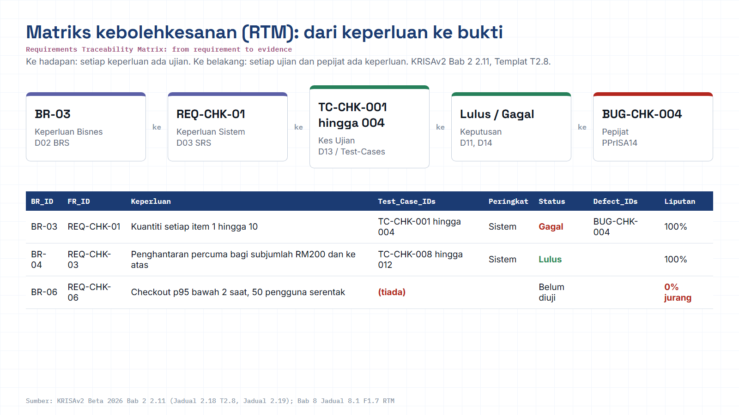
Module hub
Open: KRISAv2 Bab 2 p.56
Notes:
Diagram built from the KRISAv2 Beta 2026 / PPrISA 2.0 references. Use the Open chip to show the source page live.

Slide 22
LAB A · 12 MINUTES · IN PAIRS
Map the partitions and boundaries for ShopFast checkout
GUIDED STEPS
SHEET TEMPLATE (TAB 1)
Open ShopFast-SRS.md and copy the four field requirements into the EP-BVA Analysis tab.
For each field list the valid partitions first, then every invalid partition. Do not forget empty and wrong-format.
Mark every boundary. Write the value just below, on, and just above each boundary.
Remove overlaps: if a boundary value already tests a partition, do not add a second representative.
Count what remains. Target 8-10 across four fields. Over 14 means you are testing the same value twice.
Req ID | Field | Partition | Valid? | Value
REQ-CHK-01 | Quantity | P1 ≤ 0 | N | 0
REQ-CHK-01 | Quantity | P2 1-10 | Y | 1 / 10
… | … | … | … | …
TRAINER SPOT-CHECK AT 16:17
Every field has at least one invalid partition.
Every range has both a lower and an upper boundary.
No value appears twice in the sheet.
MODUL 04 · SQA
Lab A
16:05 - 16:17 · 12 min
18 / 25
Notes:
15 minutes, in pairs. Check: every field has an invalid partition.

Slide 23
LAB B · 15 MINUTES · FULL TEAM
Write 15-20 test cases someone else can run
GUIDED STEPS
TEST CASE SHEET COLUMNS (TAB 2)
Split the work: each member takes one technique from the case budget.
Write all case titles first, one line each. Check for duplicates before filling in steps.
Fill in preconditions, data and steps. One observable expected result per case.
Set level and priority using the Module 3 Risk Register, not instinct.
Swap with the next team. They run two of your cases without asking any questions.
TC ID | Req ID | Title | Technique | Priority
TC-CHK-001 | REQ-CHK-01 | Quantity 0 rejected with a field error | BVA | High
TC-CHK-004 | REQ-CHK-01 | Quantity 10 accepted into the cart | BVA | High
TC-CHK-008 | REQ-CHK-03 | Member + RM200 + promo capped at 25% | DT · R1 | High
TC-CHK-016 | REQ-CHK-05 | Cancelling a Shipped order is rejected | ST | Medium
WHAT THE TRAINER CHECKS
Every case has a requirement ID · every case names its technique · at least 5 negative cases · no case depends on the previous one.
PASS
If the reviewer can run it without a single question, the case is done.
MODUL 04 · SQA
Lab B
16:17 - 16:32 · 15 min
19 / 25
Notes:
20 minutes. Swap with the next team at minute 15.

Slide 24
LAB C · 8 MINUTES · RTM KEEPER LEADS
Map every case to a requirement, then hunt the gaps
GUIDED STEPS
ANSWERS YOU MUST HAVE AT 16:40
Open RTM v0 from Module 2. Add columns: Test Case IDs, Technique, Coverage status.
Paste the test case IDs into their requirement row. Every case must land somewhere.
Mark empty rows red, those are your coverage gaps. Mark orphan cases amber.
Compute coverage and write one sentence: what stays untested, and why that is acceptable.
What percentage of checkout requirements is covered?
Which high-risk requirement is still uncovered?
Which test case has no requirement, and should the SRS be updated?
If only 5 cases could run tonight, which ones and why?
WHY THIS MATTERS LATER
In Module 8 a change request arrives: add discount codes to checkout. This RTM is what tells you in seconds which cases must be re-run, not the whole suite.
SHEET FORMULA
=COUNTIF(D2:D20,"<>")/COUNTA(A2:A20)
Format as a percentage, one decimal place.
MODUL 04 · SQA
Lab C
16:32 - 16:40 · 8 min
20 / 25
Notes:
10 minutes. Every team must be able to answer the four coverage questions.

Slide 25
MODULE REFERENCE SAMPLES, IN THE PARTICIPANT FOLDER
Three sample artifacts: copy the structure, not the content
01
Test Plan (short form)
02
Test case sheet
03
RTM v1
M4-ShopFast-TestPlan.md
├─ 1 Project introduction
├─ 2 Context: items, levels, entry/exit
├─ 3 Strategy: techniques, data, environment
├─ 4 Test risk register
└─ 5 Test deliverables
M4-ShopFast-TestCases.xlsx
├─ tab 1 · EP-BVA analysis
├─ tab 2 · Test cases (11 columns)
├─ tab 3 · Decision table
└─ tab 4 · State transitions
M4-ShopFast-RTM.xlsx
├─ Req ID · summary · risk
├─ Test case IDs · technique
├─ run status · defect IDs
└─ coverage cell · gap list
2 pages. Structure follows the Master Test Plan.
18 worked cases are pre-filled as a detail reference.
The same file is reopened in Modules 6, 7 and 8.
KRISA CROSS-REFERENCE FOR THESE ARTIFACTS
RULE OF USE
Test Plan to D12 Master Test Plan (Ch.6). Test cases and the RTM support the D11 System Test Report (Ch.5) and feed the Acceptance Test Report (F5.6).
These samples are written for ShopFast. Take the column structure and ID conventions back to your agency; the content must come from your own system SRS.
MODUL 04 · SQA
Reference pack
Sample deliverables
21 / 25
Notes:
Samples are in the participant folder, copy the structure, not the content.

Slide 26
WHAT TRAINERS SEE IN EVERY RUN OF THIS WORKSHOP
Six pitfalls that make a test suite look complete but hollow
01 · Happy path only
02 · Vague expectations
03 · Chained cases
Eighteen cases, all valid input. Real users type odd characters and hit the back button.
The system should work. Nobody can prove that failed, so the case never finds anything.
TC-007 only runs if TC-006 passed first. One early failure wipes out half your run.
Fix: at least 30% negative cases.
Fix: name the exact message, value or screen.
Fix: every case sets up its own precondition.
04 · Missed boundaries
05 · Testing the implementation
06 · RTM written on the last day
Testing 5 and 50 but never 1, 10 or 11, exactly where a developer typed < instead of ≤.
Check the orders table has status = 2. When the database is refactored the test breaks even though behaviour is correct.
Filled in backwards to pass the audit. It never reveals a gap because it was built from the cases that already exist.
Fix: every range contributes 4-6 cases.
Fix: assert what the user can see.
Fix: update the RTM on the same day.
MODUL 04 · SQA
Six pitfalls
Peer review
22 / 25
Notes:
The most common pitfalls: happy path only and vague expectations.

Slide 27
HOW THIS MODULE IS ASSESSED
The artifact is the assessment, there is no exam
Criterion | Adequate | Strong
Case count | 15 cases written | 18-20, no duplicates
Technique spread | EP + BVA only | All four techniques used and named
Negative cases | 3 cases | ≥ 5, including a rejected transition
Runnability | Reviewer asks 1-2 questions | Reviewer runs the case with no questions
Traceability | Most cases have a Req ID | 100% mapped + coverage computed + gaps stated
EXIT TICKET, WRITE IT ON A STICKY NOTE
One requirement you could not test, and why.
One bug you expect your cases to find tomorrow.
WHAT HAPPENS TOMORROW MORNING
Module 5 takes two of your cases and automates them in Playwright and Postman. Poorly written cases show up immediately.
TAKE HOME TONIGHT
The test case sheet, RTM v1 and the 2-page Test Plan, keep them in the team folder. Modules 6, 7 and 8 start by opening the same files.
MODUL 04 · SQA
Assessment & handoff
16:55 - 17:00
23 / 25
Notes:
Exit ticket on a sticky note. Module 5 automates their cases tomorrow morning.

Slide 28
MODULE 4 ON ONE PAGE
From six sentences of requirements to evidence of coverage
IN
TECHNIQUE
DESIGNED
TRACED
PROVEN
6
4
18
1
83%
checkout requirements
EP · BVA · DT · ST
runnable cases
RTM v1
requirement coverage
SRS + Module 3 risk
chosen by requirement shape
5+ negative · all with IDs
forward + backward
+ 1 recorded gap
EVERY ARTIFACT IS REUSED, MODULE 4 DOES NOT END HERE
Module 5 automates the cases
Module 6 logs defects against them
Module 7 audits the evidence
Module 8 scopes regression
KRISA: Test Plan to D12 Master Test Plan (Ch.6) · cases + RTM support D11 System Test Report (Ch.5) and the Acceptance Test Report (F5.6)
Techniques: ISO/IEC/IEEE 29119-4 (test techniques) · ISTQB Foundation Level
MODUL 04 · SQA
Visual recap
Module 4 · one page
24 / 25
Notes:
Use this slide to close the module in 60 seconds.

Slide 29
SOURCES TO READ AFTER THE WORKSHOP
References and standards
JDN
Malaysian public sector
INTERNATIONAL
Testing standards
KRISA, Public-Sector Application Engineering, Ch.6 Acceptance Testing (D12 Master Test Plan; processes F5.1, F5.3-F5.6).
Public-Sector Software Quality Assurance Portal, sqa.jdn.gov.my
PPrISA, Public-Sector ICT Project Management guideline.
ISO/IEC/IEEE 29119, software testing standards series; Part 3 test documentation, Part 4 test techniques.
ISTQB Certified Tester Foundation Level, the official syllabus for EP, BVA, decision tables and state transition.
ISO/IEC 25010, product quality model; the source for non-functional requirements tested in PAT.
KRISA 2.0 is Beta 2026; deliverable numbering is still being refined. Confirm which version your agency uses.
MODULE FILES
TRAINER
M4-ShopFast-TestPlan.md
M4-ShopFast-TestCases.xlsx
M4-ShopFast-RTM.xlsx
ShopFast-SRS.md (from Module 2)
Al-Abrar bin Abdul Wahid
SQA Trainer · 2-Day Hands-On Workshop · aligned to KRISA (JDN)
abrar.abdulwahid@gmail.com · +60 13-283 5415
MODUL 04 · SQA
References
Sources & standards
25 / 25
Notes:
Confirm the KRISA version with the participant agency.

Slide 30
M04 · KRISAv2 BETA 2026 · PPrISA 2.0 · CLICK ANY LINE
References and templates for this module
Every line opens the official JDN document at the exact page. Templates download as Word or PDF.
WHERE IT IS IN THE GUIDES
TEMPLATES TO USE
Bab 5, 5.7 Pengujian Sistem, peringkat ujian
page 33 · KRISAv2 Bab 5 Fasa Pembangunan
D12
Pelan Induk Pengujian
WORD
PDF
Bab 6, 6.6 Pelan Induk Pengujian F5.1
page 4 · KRISAv2 Bab 6 Fasa Pengujian Penerimaan
D13
Pelan Ujian Penerimaan (UAT/PAT)
WORD
PDF
Bab 6, Jadual 6.2 Peringkat UAT, PAT, FAT
page 5 · KRISAv2 Bab 6 Fasa Pengujian Penerimaan
PPrISA05
Pelan Pengurusan Kualiti
WORD
PDF
Bab 6, 6.7 Dokumentasi Persediaan Ujian F5.2
page 9 · KRISAv2 Bab 6 Fasa Pengujian Penerimaan
Bab 6, Kes ujian aras tinggi dan rendah
page 11 · KRISAv2 Bab 6 Fasa Pengujian Penerimaan
Bab 6, 6.8 UAT, kriteria masuk dan keluar
page 20 · KRISAv2 Bab 6 Fasa Pengujian Penerimaan
sqa.jdn.gov.my portal
All references (repo)
Module hub
Note: KRISAv2 Beta renumbers deliverables in its chapters; links follow the published D01 to D18 template files.
Notes:
Reference slide for M04. Click through live if time allows; otherwise tell trainees every link is also in the module hub page and in references/README.md of the repo.
- Bab 5, 5.7 Pengujian Sistem, peringkat ujian (PDF page 33): https://fth-abr.github.io/sqa-krisa-bengkel/references/krisa-v2-beta-2026/BAB5-FASA-PEMBANGUNAN.pdf#page=33
- Bab 6, 6.6 Pelan Induk Pengujian F5.1 (PDF page 4): https://fth-abr.github.io/sqa-krisa-bengkel/references/krisa-v2-beta-2026/BAB6-FASA-PENGUJIAN-PENERIMAAN.pdf#page=4
- Bab 6, Jadual 6.2 Peringkat UAT, PAT, FAT (PDF page 5): https://fth-abr.github.io/sqa-krisa-bengkel/references/krisa-v2-beta-2026/BAB6-FASA-PENGUJIAN-PENERIMAAN.pdf#page=5
- Bab 6, 6.7 Dokumentasi Persediaan Ujian F5.2 (PDF page 9): https://fth-abr.github.io/sqa-krisa-bengkel/references/krisa-v2-beta-2026/BAB6-FASA-PENGUJIAN-PENERIMAAN.pdf#page=9
- Bab 6, Kes ujian aras tinggi dan rendah (PDF page 11): https://fth-abr.github.io/sqa-krisa-bengkel/references/krisa-v2-beta-2026/BAB6-FASA-PENGUJIAN-PENERIMAAN.pdf#page=11
- Bab 6, 6.8 UAT, kriteria masuk dan keluar (PDF page 20): https://fth-abr.github.io/sqa-krisa-bengkel/references/krisa-v2-beta-2026/BAB6-FASA-PENGUJIAN-PENERIMAAN.pdf#page=20

Slide 31
M04 · W04 · 15 MINUTES · Hari 1, 16:40 hingga 16:55
Hands-On SQA-AI Assistant Workshop
AI test design: EP, BVA and coverage gaps
Generate D13-format test cases with named techniques for two checkout requirements, then ask the AI to find RTM coverage gaps.
TOOL
opencode 1.18 in the lab folder · model: Big Pickle via OpenCode Zen (free, no API key) · synthetic ShopFast data only
Step-by-step guide (web)
Workshop slides (W04)
Setup guide W00
opencode docs
Notes:
Reserved slot: 15 minutes (Hari 1, 16:40 hingga 16:55). Trainees open lab\ in the terminal and start opencode. Walk the first step live on the projector, then let pairs continue with the web guide. Stop 3 minutes early for the human-check discussion.

Slide 32
W04 · HANDS-ON SQA-AI ASSISTANT WORKSHOP · 15 MIN
AI test design: EP, BVA and coverage gaps
STEPS
TYPE THIS (opencode> in opencode, PS> in PowerShell)
1
Run /testcases for REQ-CHK-01 and REQ-CHK-03
opencode> /testcases REQ-CHK-01 dan REQ-CHK-03, maksimum 10 kes ujian
opencode> Bandingkan outputs/m04-testcases.csv dengan outputs/m02-rtm.csv. Senaraikan keperluan tanpa kes ujian dan kes ujian tanpa keperluan. Jangan tulis fail.
2
Approve the CSV and check boundaries 0, 1, 10, 11 and RM200.00
3
Ask the Plan agent for RTM coverage gaps
4
Merge the good cases into your Lab B sheet
OUTPUT TO SAVE
HUMAN CHECK BEFORE YOU ACCEPT IT
outputs/m04-testcases.csv
- Boundary values 10 and RM200.00 are present
- Every case names its technique and REQ-CHK ID
- Expected results come from the SRS, not from what the app does
Open step-by-step guide
Module hub
Notes:
Prompts are identical to the web guide and the W deck, so trainees can copy them. Commands starting with / are project commands in lab/.opencode/commands. Ask each pair to show the output file and read out one human-check result before moving on.

Slide 33
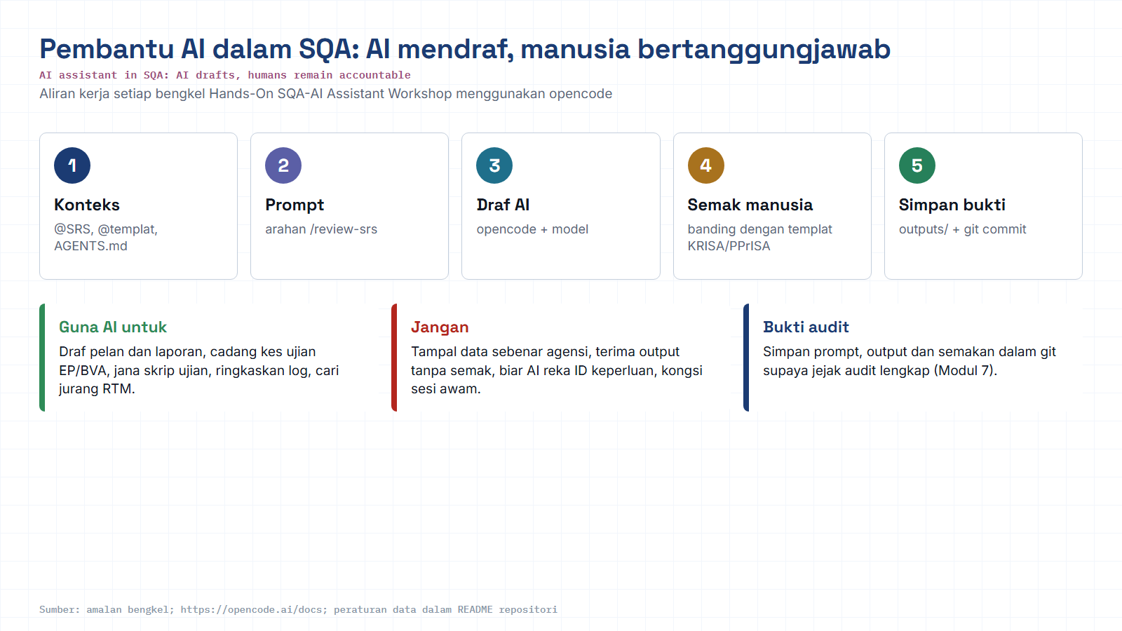
Module hub
Open: opencode docs
Notes:
Reminder of the rules for every AI workshop: context, prompt, AI draft, human review against the KRISA/PPrISA template, save evidence. Stress the data rule: synthetic data only.

