Slide 1
HARI 2 · 09:00-10:30 · FASA SAH (VERIFY)
Modul 5, Pengujian Perisian & Automasi Ujian
Module 5, Software Testing & Test Automation
Laksanakan pengujian yang berkesan, fungsian & bukan fungsian, dan fahami ke mana automasi harus diletakkan dalam saluran penyampaian anda.
Execute effective testing, functional & non-functional, and understand where automation belongs in your delivery pipeline.
1j 30m / 1h30m
2 Makmal / Live Labs
Projek: ShopFast
KRISA 2.0 · Bab 5 & 8
SQA · BENGKEL AMALI 2 HARI / 2-DAY HANDS-ON WORKSHOP
01 / 12
Notes:
Key points on this slide:
- HARI 2 · 09:00-10:30 · FASA SAH (VERIFY)
- Modul 5, Pengujian Perisian & Automasi Ujian Module 5, Software Testing & Test Automation
- Laksanakan pengujian yang berkesan, fungsian & bukan fungsian, dan fahami ke mana automasi harus diletakkan dalam saluran penyampaian anda. Execute effective te
- 1j 30m / 1h30m
Link each point back to the ShopFast project and ask one trainee to give an example from their own agency.

Slide 2
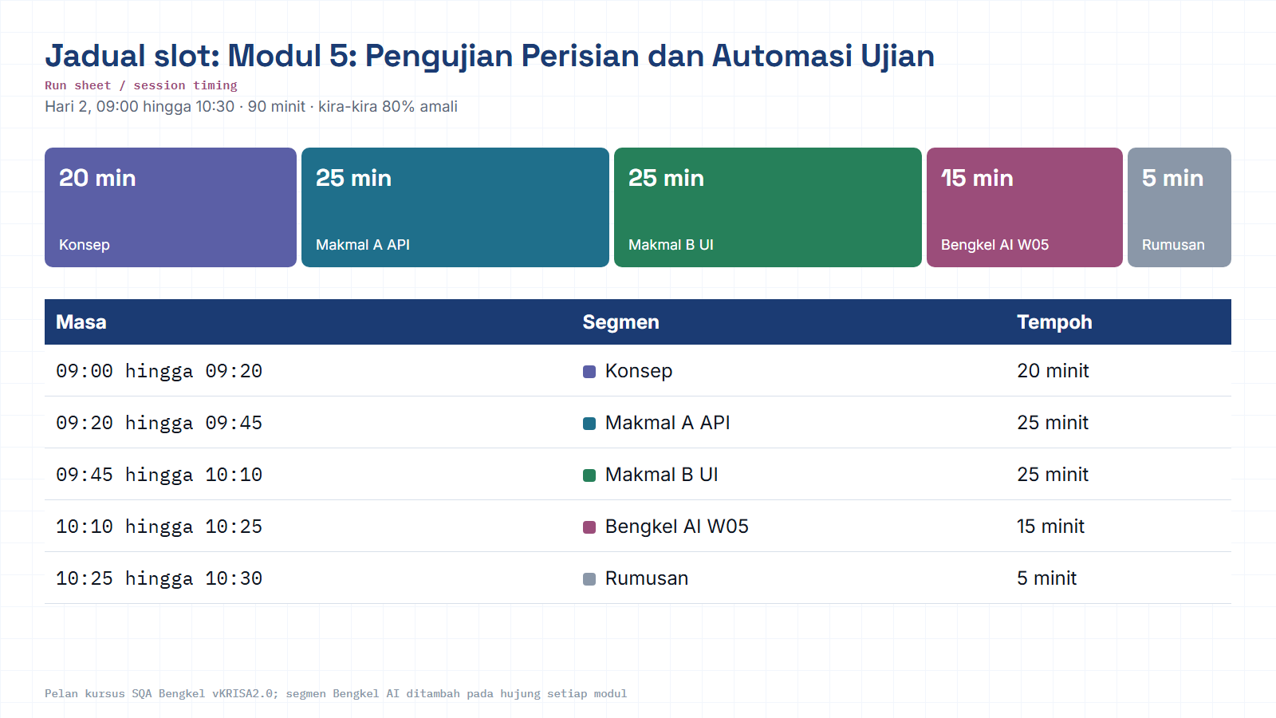
Module hub
Notes:
Run sheet for this module. Keep to the slot times; the SQA-AI workshop segment is reserved at the end.

Slide 3
: DI MANA KITA BERADA / WHERE WE ARE
Modul 5 membuka Hari 2, di dalam fasa SAH (VERIFY)
Hari 1 menetapkan piawaian (Rancang) & mencegah kecacatan awal (Bina-Dalam). Kini kita mengesahkan ShopFast benar-benar berfungsi seperti dirancang, dengan bukti, bukan andaian.
Day 1 set the standards (Plan) & prevented early defects (Build-in). Now we verify ShopFast truly works as planned, with evidence, not assumptions.
01
02
03
04
05
Rancang
Bina-Dalam
Sah
Jamin
Kekal
Plan
>
Build-in
>
Verify
>
Assure
>
Sustain
ANDA DI SINI / YOU ARE HERE
RTM
Setiap kes ujian pagi ini terus dipetakan ke RTM v0 dari Modul 2, keterjejakan tidak putus. / Every test case maps back to the RTM v0 from Module 2, traceability stays unbroken.
02 / 12
Notes:
Key points on this slide:
- : DI MANA KITA BERADA / WHERE WE ARE
- Modul 5 membuka Hari 2, di dalam fasa SAH (VERIFY)
- Hari 1 menetapkan piawaian (Rancang) & mencegah kecacatan awal (Bina-Dalam). Kini kita mengesahkan ShopFast benar-benar berfungsi seperti dirancang, dengan bukt
- Rancang
Link each point back to the ShopFast project and ask one trainee to give an example from their own agency.

Slide 4
: OBJEKTIF MODUL / MODULE OBJECTIVE
Daripada “ia nampak berfungsi” kepada bukti automatik
Executing effective testing (functional & non-functional) and understanding automation strategy, so every ShopFast change can be verified in seconds, not days.
1h30
2
5
2
DURASI / DURATION
MAKMAL / LABS (API + UI)
ALATAN / INDUSTRY TOOLS
HASIL KERJA / DELIVERABLES
●
●
●
Jenis Ujian / Test Types
Bukan Fungsian / Non-Functional
Automasi / Automation
Smoke, Sanity, Regression, Exploratory
Performance, Security, Accessibility
Piramid Automasi + integrasi CI/CD / Automation Pyramid + CI/CD
03 / 12
Notes:
Key points on this slide:
- : OBJEKTIF MODUL / MODULE OBJECTIVE
- Daripada “ia nampak berfungsi” kepada bukti automatik
- Executing effective testing (functional & non-functional) and understanding automation strategy, so every ShopFast change can be verified in seconds, not days.
- 1h30
Link each point back to the ShopFast project and ask one trainee to give an example from their own agency.

Slide 5
: 01 · TOPIK / TOPIC
Empat lensa pengujian fungsian / Four lenses of functional testing
Pilih lensa yang betul mengikut situasi, build baharu, pembetulan pepijat, sebelum release, atau meneroka. / Pick the right lens for the moment.
Smoke
Sanity
“Bolehkah app dimuatkan?” Semakan pantas & cetek selepas build baharu.
"Does the build even start?" A fast, shallow check right after a new build.
Fokus sempit selepas satu pembetulan, sahkan satu ciri waras tanpa regresi penuh.
A narrow check after one fix, confirm one feature is sane without full regression.
Regression
Exploratory
“Adakah ciri lama masih berfungsi?” Larian semula suite sedia ada selepas perubahan.
"Do old features still work?" Re-run the existing suite after any change.
Tiada skrip. Penguji meneroka aplikasi secara kreatif untuk menemui yang tak terfikir.
No script, the tester roams creatively to surface what scripts miss.
04 / 12
Notes:
Key points on this slide:
- : 01 · TOPIK / TOPIC
- Empat lensa pengujian fungsian / Four lenses of functional testing
- Pilih lensa yang betul mengikut situasi, build baharu, pembetulan pepijat, sebelum release, atau meneroka. / Pick the right lens for the moment.
- Smoke
Link each point back to the ShopFast project and ask one trainee to give an example from their own agency.

Slide 6
: 02 · TOPIK / TOPIC
“Ia berfungsi” ≠ “Ia sedia produksi” / “Works” ≠ “Production-ready”
Pengujian bukan fungsian menyoal: pantas ke, selamat ke, boleh capai semua ke? / Non-functional testing asks: is it fast, safe, and accessible to everyone?
Prestasi / Performance
Keselamatan / Security
Kebolehcapaian / Accessibility
Load / Stress, berapa ramai pengguna serentak sebelum sistem merosot?
How many concurrent users before response time degrades?
Imbas kelemahan OWASP pada API checkout sebelum penyerang menemuinya.
Scan the checkout API for OWASP vulnerabilities first.
Pembaca skrin, kontras warna & navigasi papan kekunci untuk semua pengguna.
Screen reader, color contrast & keyboard nav for every user.
JMeter
k6
OWASP ZAP
Burp Suite
WCAG 2.2
axe DevTools
NOTA / NOTE: Ketiga-tiganya didemo langsung, bukan untuk dikuasai penuh hari ini, tetapi supaya anda kenal bila memanggilnya. / All three are live-demoed, so you recognize when to reach for them.
05 / 12
Notes:
Key points on this slide:
- : 02 · TOPIK / TOPIC
- “Ia berfungsi” ≠ “Ia sedia produksi” / “Works” ≠ “Production-ready”
- Pengujian bukan fungsian menyoal: pantas ke, selamat ke, boleh capai semua ke? / Non-functional testing asks: is it fast, safe, and accessible to everyone?
- Prestasi / Performance
Link each point back to the ShopFast project and ask one trainee to give an example from their own agency.

Slide 7
: 03 · TOPIK / TOPIC
Piramid Automasi, di mana masa & wang patut pergi / The Automation Pyramid
Lebih tinggi lapisan, lebih perlahan & mahal ujian itu. Strategi sihat: banyak di bawah, sikit di atas. / Higher layer = slower & pricier. Healthy strategy: lots at the base, few at the top.
MAHAL / EXPENSIVE ↑
Unit, Asas piramid / the base
UI / E2E
Ratusan ujian, saat untuk berjalan, tanpa DB/rangkaian. Isolasi satu fungsi sahaja.
Hundreds of tests, seconds to run, no DB/network.
SEDIKIT · PERLAHAN
API / Integrasi
Integrasi / API, Lapisan tengah (Makmal A)
SEDERHANA · MINIT / MODERATE
Puluhan ujian, minit untuk berjalan, cth. koleksi Postman untuk API checkout.
Dozens of tests, minutes to run (Lab A).
Unit
BANYAK · SAAT / MANY · SECONDS
UI / E2E, Puncak (Makmal B)
MURAH / CHEAP ↓
Sedikit ujian, paling perlahan & rapuh, simulasi pengguna sebenar log masuk to checkout.
Few tests, slowest & most brittle (Lab B).
06 / 12
Notes:
Key points on this slide:
- : 03 · TOPIK / TOPIC
- Piramid Automasi, di mana masa & wang patut pergi / The Automation Pyramid
- Lebih tinggi lapisan, lebih perlahan & mahal ujian itu. Strategi sihat: banyak di bawah, sikit di atas. / Higher layer = slower & pricier. Healthy strategy: lot
- UI / E2E
Link each point back to the ShopFast project and ask one trainee to give an example from their own agency.

Slide 8
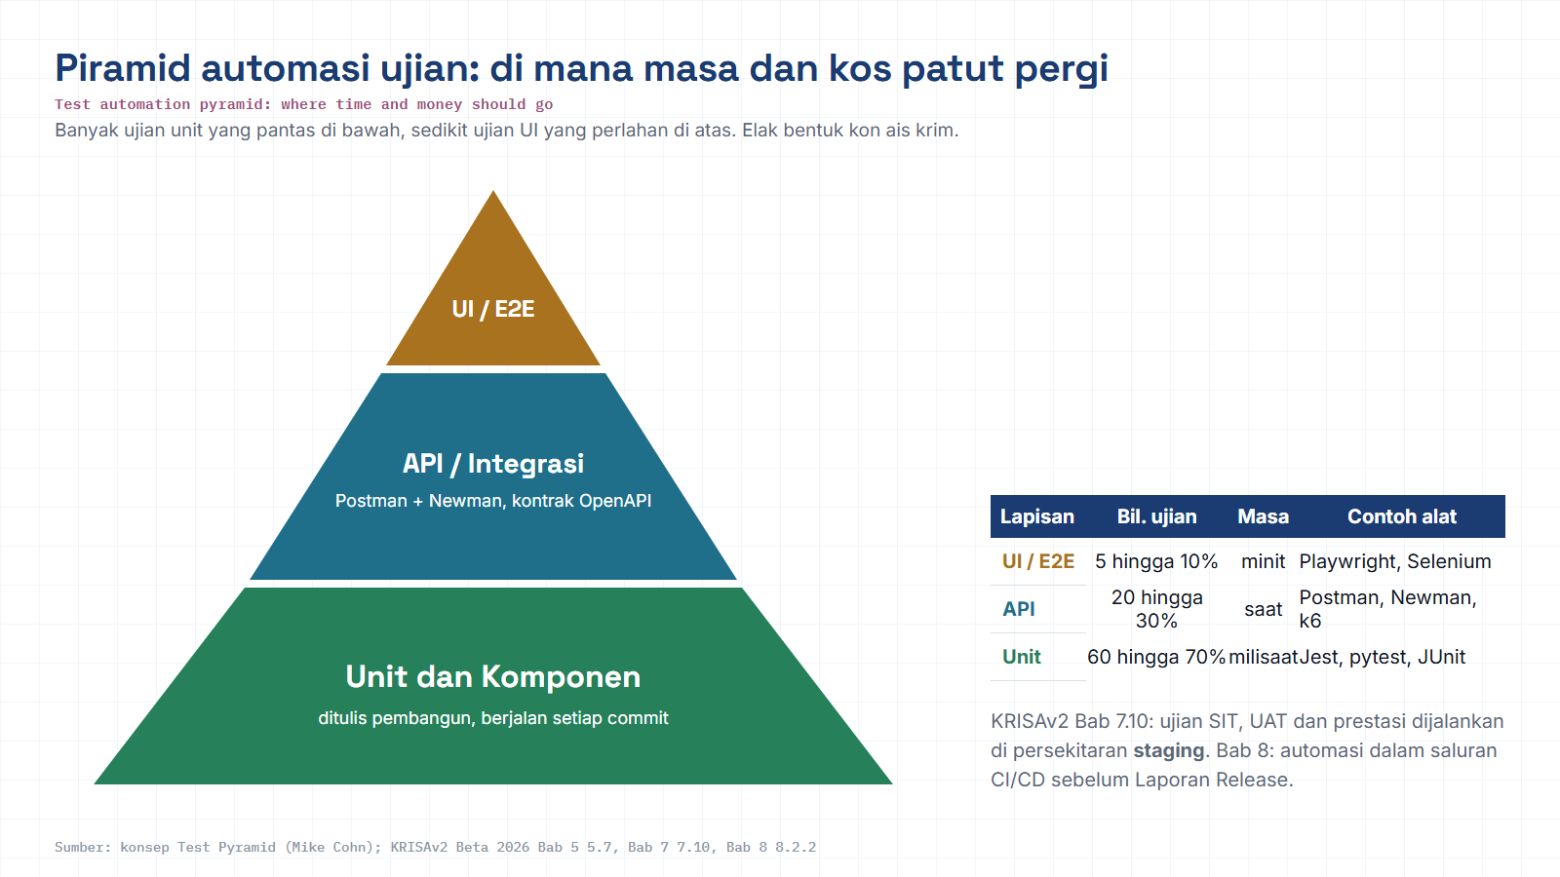
Module hub
Open: KRISAv2 Bab 5 p.33
Notes:
Diagram built from the KRISAv2 Beta 2026 / PPrISA 2.0 references. Use the Open chip to show the source page live.

Slide 9
: 03 · TOPIK / TOPIC
Automasi bernilai bila ia berjalan sendiri / Automation pays off when it runs itself
Ujian yang anda tulis pagi ini menjadi Quality Gate dalam CI/CD, dilaksanakan setiap kali kod ditolak. / The tests you write become a Quality Gate, run on every push.
Commit Kod
>
Bina (Build)
>
Ujian Automatik
>
Quality Gate
>
Deploy
>
Pantau
Code Commit
Build
Automated Tests
Quality Gate
Deploy
Monitor
MODUL 5
MODUL 8
PRATONTON / PREVIEW: Modul 8 memasukkan tepat ujian yang anda tulis sekarang ke GitHub Actions sebagai Quality Gate produksi.
07 / 12
Notes:
Key points on this slide:
- : 03 · TOPIK / TOPIC
- Automasi bernilai bila ia berjalan sendiri / Automation pays off when it runs itself
- Ujian yang anda tulis pagi ini menjadi Quality Gate dalam CI/CD, dilaksanakan setiap kali kod ditolak. / The tests you write become a Quality Gate, run on every
- Commit Kod
Link each point back to the ShopFast project and ask one trainee to give an example from their own agency.

Slide 10
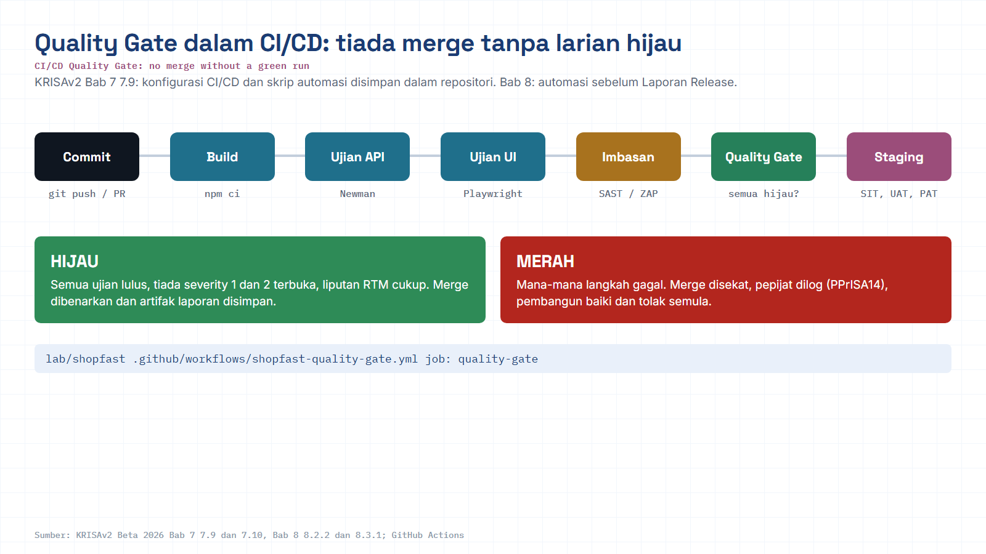
Module hub
Open: Workflow in repo
Notes:
Diagram built from the KRISAv2 Beta 2026 / PPrISA 2.0 references. Use the Open chip to show the source page live.

Slide 11
: MAKMAL A · 25 MINIT / LAB A · 25 MIN
Makmal A, Pengujian API dengan Postman / API Testing with Postman
Sahkan API checkout ShopFast bercakap seperti dikontrakkan, tanpa menyentuh satu skrin UI pun. / Verify the checkout API behaves as contracted, without touching the UI.
1
Bina koleksi Postman untuk API checkout terus daripada spesifikasi OpenAPI.
Build a Postman collection for the checkout API from the OpenAPI spec.
OpenAPI Spec
Kontrak API checkout / API contract
Tambah assertions: kod status, skema respons & masa respons.
Add assertions: status code, response schema & response time.
↓
2
Postman Collection
Bina permintaan + assertions / Build requests + assertions
3
Jalankan koleksi tanpa UI guna Newman & baca laporannya.
Run the collection headless with Newman & read the report.
↓
Newman (headless run)
Jalankan tanpa UI dalam CLI / Run headless in CLI
↓
Postman
Newman (CLI)
OpenAPI Spec
Laporan / Report
Lulus / gagal, terperinci / Pass/fail, detailed
OUTPUT: Koleksi Postman lengkap dengan assertions, boleh dijalankan semula bila-bila masa. / A complete Postman collection with assertions, rerunnable any time.
08 / 12
Notes:
Key points on this slide:
- : MAKMAL A · 25 MINIT / LAB A · 25 MIN
- Makmal A, Pengujian API dengan Postman / API Testing with Postman
- Sahkan API checkout ShopFast bercakap seperti dikontrakkan, tanpa menyentuh satu skrin UI pun. / Verify the checkout API behaves as contracted, without touching
- Bina koleksi Postman untuk API checkout terus daripada spesifikasi OpenAPI. Build a Postman collection for the checkout API from the OpenAPI spec.
Link each point back to the ShopFast project and ask one trainee to give an example from their own agency.

Slide 12
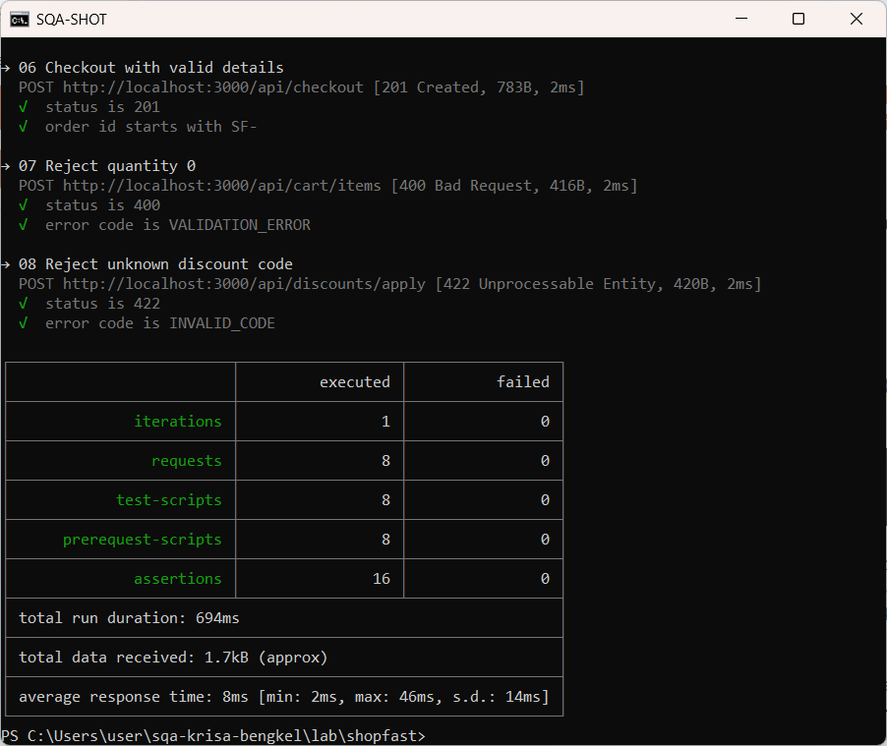
Real run: Newman on the ShopFast API
Captured on the lab PC: npm run test:api in lab/shopfast
Module hub
Notes:
Real run: Newman on the ShopFast API. This is a real screenshot from the lab environment, not a mock-up. Point at what the trainees should read: pass/fail counts, the failing assertion and the time taken.

Slide 13
: MAKMAL B · 25 MINIT / LAB B · 25 MIN
Makmal B, Automasi UI dengan Playwright / UI Automation with Playwright
Tulis skrip pertama yang berkelakuan seperti pengguna sebenar, dan buktikan ia menangkap kerosakan. / Write a script that behaves like a real user, and prove it catches breakage.
1
Tulis ujian Playwright (atau Selenium + pytest) pertama untuk log masuk to checkout.
Write your first Playwright (or Selenium+pytest) test for login to checkout.
Login to Checkout Script
Playwright / Selenium + pytest
↓
2
Tambah assertion pada skrin pengesahan pesanan; pastikan ia stabil.
Add an assertion on the order-confirmation screen; make it stable.
Assertion pada pengesahan
Order-confirmation screen
↓
3
Jalankan & lihat ia lulus, kemudian rosakkan app dan lihat ia gagal dengan jelas.
Run it and watch it pass, then break the app and watch it fail clearly.
✓ RUN, LULUS / PASS
✕ APP ROSAK / BROKEN
App stabil / App stable
Ujian gagal jelas / Fails clearly
Playwright
Selenium
Cypress
Bukti: ujian menangkap kerosakan sebenar / Proof the test catches real breakage
OUTPUT: Satu skrip automasi UI yang lulus, bukti ujian anda menguji sesuatu yang penting. / One passing UI automation script.
09 / 12
Notes:
Key points on this slide:
- : MAKMAL B · 25 MINIT / LAB B · 25 MIN
- Makmal B, Automasi UI dengan Playwright / UI Automation with Playwright
- Tulis skrip pertama yang berkelakuan seperti pengguna sebenar, dan buktikan ia menangkap kerosakan. / Write a script that behaves like a real user, and prove it
- Tulis ujian Playwright (atau Selenium + pytest) pertama untuk log masuk to checkout. Write your first Playwright (or Selenium+pytest) test for login to checkout
Link each point back to the ShopFast project and ask one trainee to give an example from their own agency.

Slide 14
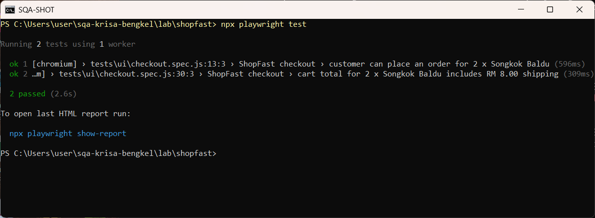
Real run: Playwright UI tests
Captured on the lab PC: npx playwright test in lab/shopfast
Module hub
Notes:
Real run: Playwright UI tests. This is a real screenshot from the lab environment, not a mock-up. Point at what the trainees should read: pass/fail counts, the failing assertion and the time taken.

Slide 15
: ALATAN MODUL INI / THIS MODULE'S TOOLKIT
Sampel alatan rujukan, semua bertaraf industri / Sample tool references
Boleh ditukar mengikut stack pasukan anda, konsepnya yang penting, bukan jenama. / Swappable to match your stack, the concept matters, not the brand.
Postman + Newman
Playwright
Selenium / Cypress
Bina & jalankan koleksi ujian API tanpa UI.
Build & run headless API test collections.
Automasi pelayar rentas-platform, stabil & pantas.
Cross-browser automation, stable & fast.
Alternatif automasi UI popular, konsep sama.
Popular UI automation alternatives.
JMeter / k6 (demo)
OWASP ZAP (demo)
GitHub Actions (pratonton)
Simulasi beban & tekanan pada API checkout.
Simulate load & stress on the checkout API.
Imbasan kelemahan keselamatan automatik.
Automated security vulnerability scanning.
Rumah untuk Quality Gate automasi di Modul 8.
Home for the automation Quality Gate (Module 8).
10 / 12
Notes:
Key points on this slide:
- : ALATAN MODUL INI / THIS MODULE'S TOOLKIT
- Sampel alatan rujukan, semua bertaraf industri / Sample tool references
- Boleh ditukar mengikut stack pasukan anda, konsepnya yang penting, bukan jenama. / Swappable to match your stack, the concept matters, not the brand.
- Postman + Newman
Link each point back to the ShopFast project and ask one trainee to give an example from their own agency.

Slide 16
: HASIL KERJA / DELIVERABLES
Apa yang anda bawa keluar dari modul ini / What you carry out of this module
Dua artifak konkrit, bukan nota, tetapi kod & koleksi yang boleh dijalankan semula. / Two concrete, rerunnable artifacts.
Koleksi Postman + skrip UI
Postman collection + UI script
Menyokong Laporan Ujian Sistem
Feeds the System Test Report
Koleksi Postman dengan ujian penuh, dan satu skrip automasi UI yang lulus, kedua-duanya boleh dijalankan semula pada bila-bila masa.
A Postman collection with full tests, and one passing UI script, both rerunnable at will.
Bukti ujian pagi ini menjadi input kepada Laporan Ujian Sistem & keterjejakan RTM yang disemak di Modul 7 (Audit).
This evidence feeds the System Test Report & RTM traceability reviewed in Module 7 (Audit).
Selaras KRISA 2.0 (JDN) / KRISA 2.0 Alignment (JDN)
Bab 5 · Pembangunan, pengujian sistem menghasilkan Laporan Ujian Sistem. Bab 8 · Penyelarasan DevOps, automasi ujian ialah asas kepada pipeline kualiti berterusan.
Ch.5 Development, system testing produces the System Test Report. Ch.8 DevOps Alignment, test automation is the foundation of the continuous quality pipeline.
11 / 12
Notes:
Key points on this slide:
- : HASIL KERJA / DELIVERABLES
- Apa yang anda bawa keluar dari modul ini / What you carry out of this module
- Dua artifak konkrit, bukan nota, tetapi kod & koleksi yang boleh dijalankan semula. / Two concrete, rerunnable artifacts.
- Koleksi Postman + skrip UI Postman collection + UI script
Link each point back to the ShopFast project and ask one trainee to give an example from their own agency.

Slide 17
M05 · KRISAv2 BETA 2026 · PPrISA 2.0 · CLICK ANY LINE
References and templates for this module
Every line opens the official JDN document at the exact page. Templates download as Word or PDF.
WHERE IT IS IN THE GUIDES
TEMPLATES TO USE
Bab 5, 5.7 Pengujian Sistem F4.3
page 33 · KRISAv2 Bab 5 Fasa Pembangunan
D10
Dokumentasi Kod Sumber
WORD
PDF
Bab 5, Langkah 5 Laporan Ujian Sistem (Jadual 5.6)
page 39 · KRISAv2 Bab 5 Fasa Pembangunan
D11
Laporan Ujian Sistem
WORD
PDF
Bab 5, 5.6.7 Amalan terbaik (Git, piawaian kod)
page 28 · KRISAv2 Bab 5 Fasa Pembangunan
Bab 6, 6.9 PAT (prestasi, bebanan, keselamatan)
page 23 · KRISAv2 Bab 6 Fasa Pengujian Penerimaan
Bab 7, 7.10 Persekitaran Pembangunan (Dev, Staging, Prod)
page 19 · KRISAv2 Bab 7 Fasa Pelaksanaan
Bab 8, 8.2.2 Pendekatan DevOps dan CI/CD
page 3 · KRISAv2 Bab 8 Penyelarasan DevOps
sqa.jdn.gov.my portal
All references (repo)
Module hub
Note: KRISAv2 Beta renumbers deliverables in its chapters; links follow the published D01 to D18 template files.
Notes:
Reference slide for M05. Click through live if time allows; otherwise tell trainees every link is also in the module hub page and in references/README.md of the repo.
- Bab 5, 5.7 Pengujian Sistem F4.3 (PDF page 33): https://fth-abr.github.io/sqa-krisa-bengkel/references/krisa-v2-beta-2026/BAB5-FASA-PEMBANGUNAN.pdf#page=33
- Bab 5, Langkah 5 Laporan Ujian Sistem (Jadual 5.6) (PDF page 39): https://fth-abr.github.io/sqa-krisa-bengkel/references/krisa-v2-beta-2026/BAB5-FASA-PEMBANGUNAN.pdf#page=39
- Bab 5, 5.6.7 Amalan terbaik (Git, piawaian kod) (PDF page 28): https://fth-abr.github.io/sqa-krisa-bengkel/references/krisa-v2-beta-2026/BAB5-FASA-PEMBANGUNAN.pdf#page=28
- Bab 6, 6.9 PAT (prestasi, bebanan, keselamatan) (PDF page 23): https://fth-abr.github.io/sqa-krisa-bengkel/references/krisa-v2-beta-2026/BAB6-FASA-PENGUJIAN-PENERIMAAN.pdf#page=23
- Bab 7, 7.10 Persekitaran Pembangunan (Dev, Staging, Prod) (PDF page 19): https://fth-abr.github.io/sqa-krisa-bengkel/references/krisa-v2-beta-2026/BAB7-FASA-PELAKSANAAN.pdf#page=19
- Bab 8, 8.2.2 Pendekatan DevOps dan CI/CD (PDF page 3): https://fth-abr.github.io/sqa-krisa-bengkel/references/krisa-v2-beta-2026/BAB8-PENYELARASAN-PEMBANGUNAN-SISTEM-DEVOPS.pdf#page=3

Slide 18
: RINGKASAN / RECAP
Anda kini tahu apa yang rosak.Seterusnya: uruskannya. / Next: govern it.
Empat lensa ujian fungsian: Smoke, Sanity, Regression, Exploratory.
Four functional test lenses.
Bukan fungsian membuktikan sistem pantas, selamat & boleh dicapai semua.
Non-functional testing proves speed, safety & accessibility.
Piramid Automasi: banyak Unit, sederhana API, sedikit UI.
Automation Pyramid: lots of Unit, moderate API, few UI.
Dua hasil kerja sebenar: koleksi Postman + 1 skrip UI yang lulus.
Two real deliverables: Postman collection + 1 passing UI script.
SETERUSNYA / NEXT UP
Modul 6, Pengurusan Pepijat & Metrik Kualiti. Bawa apa yang anda temui pagi ini; kita akan log, triage & ukur ia.
Module 6, Bug Management & Quality Metrics. Bring what you found; we'll log, triage & measure it.
SQA · BENGKEL AMALI 2 HARI · MODUL 5
12 / 12
Notes:
Key points on this slide:
- : RINGKASAN / RECAP
- Anda kini tahu apa yang rosak.Seterusnya: uruskannya. / Next: govern it.
- Empat lensa ujian fungsian: Smoke, Sanity, Regression, Exploratory. Four functional test lenses.
- Bukan fungsian membuktikan sistem pantas, selamat & boleh dicapai semua. Non-functional testing proves speed, safety & accessibility.
Link each point back to the ShopFast project and ask one trainee to give an example from their own agency.

Slide 19
M05 · W05 · 15 MINUTES · Hari 2, 10:10 hingga 10:25
Hands-On SQA-AI Assistant Workshop
AI-generated UI and API tests that find a real bug
Ask the AI for a Playwright test for the quantity boundary, save and run it against ShopFast, read the failure, then generate API tests from the OpenAPI contract.
Minta AI menjana ujian Playwright untuk sempadan kuantiti, simpan dan jalankan pada ShopFast, baca kegagalan, kemudian jana ujian API daripada kontrak OpenAPI.
TOOL
opencode 1.18 in the lab folder · model: Big Pickle via OpenCode Zen (free, no API key) · synthetic ShopFast data only
Step-by-step guide (web)
Workshop slides (W05)
Setup guide W00
opencode docs
Notes:
Reserved slot: 15 minutes (Hari 2, 10:10 hingga 10:25). Trainees open lab\ in the terminal and start opencode. Walk the first step live on the projector, then let pairs continue with the web guide. Stop 3 minutes early for the human-check discussion.

Slide 20
W05 · HANDS-ON SQA-AI ASSISTANT WORKSHOP · 15 MIN
AI-generated UI and API tests that find a real bug
STEPS
TYPE THIS (opencode> in opencode, PS> in PowerShell)
1
Run /gen-ui-test for TC-CHK-004 (quantity 10)
opencode> /gen-ui-test TC-CHK-004 tambah P002 kuantiti 10 ke troli dan semak troli menerima kuantiti 10 (REQ-CHK-01)
PS> cd shopfast ; npx playwright test tests/ui/m05-senario.spec.js
opencode> /gen-api-tests REQ-CHK-01 REQ-CHK-03
2
Save the code block as tests\ui\m05-senario.spec.js
3
Run it with npx playwright test and read the result
4
Run /gen-api-tests for the same requirements
OUTPUT TO SAVE
HUMAN CHECK BEFORE YOU ACCEPT IT
outputs/m05-ui-test.md, shopfast/tests/ui/m05-senario.spec.js, outputs/m05-api-tests.md
- The test selects elements by data-testid that really exist
- A failing test is a finding: reproduce it by hand before logging a bug
- Generated tests are reviewed like code before they are committed
Open step-by-step guide
Module hub
Notes:
Prompts are identical to the web guide and the W deck, so trainees can copy them. Commands starting with / are project commands in lab/.opencode/commands. Ask each pair to show the output file and read out one human-check result before moving on.

Slide 21
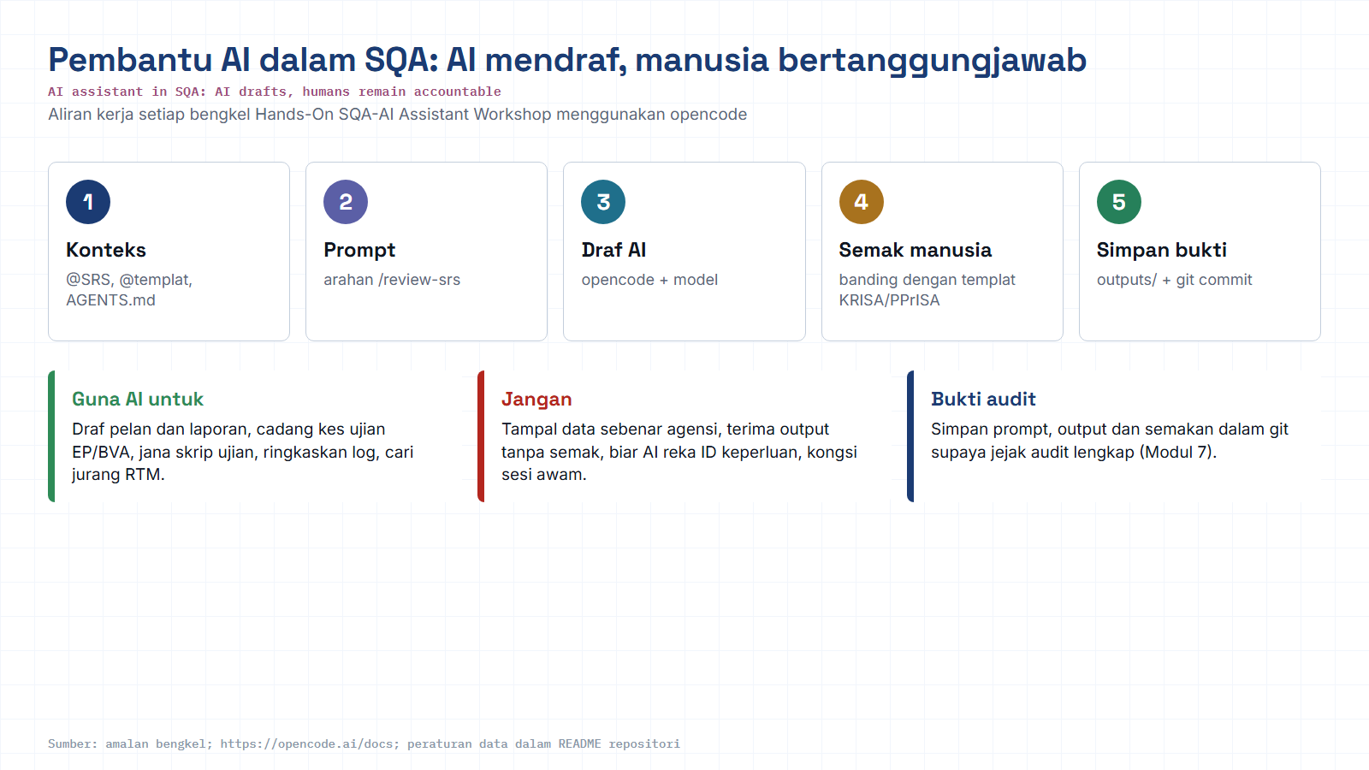
Module hub
Open: opencode docs
Notes:
Reminder of the rules for every AI workshop: context, prompt, AI draft, human review against the KRISA/PPrISA template, save evidence. Stress the data rule: synthetic data only.

