Slide 1
2-DAY HANDS-ON SQA WORKSHOP · DAY 2
Bug Management
Pengurusan Pepijat & Metrik Kualiti
Module 6 of 9, tracking, classifying and resolving defects with discipline, then proving quality with numbers instead of opinions.
TIME
DURATION
PHASE
PROJECT
10:45-12:30
1h 45m
Verify
ShopFast
KRISA 2.0 · Ch.5 Development, System Test Report
Notes:
Module 6 opens Day 2's mid-morning block. Anchor the session by restating the ShopFast thread: everything found in Module 5's tests becomes the raw material for today.

Slide 2
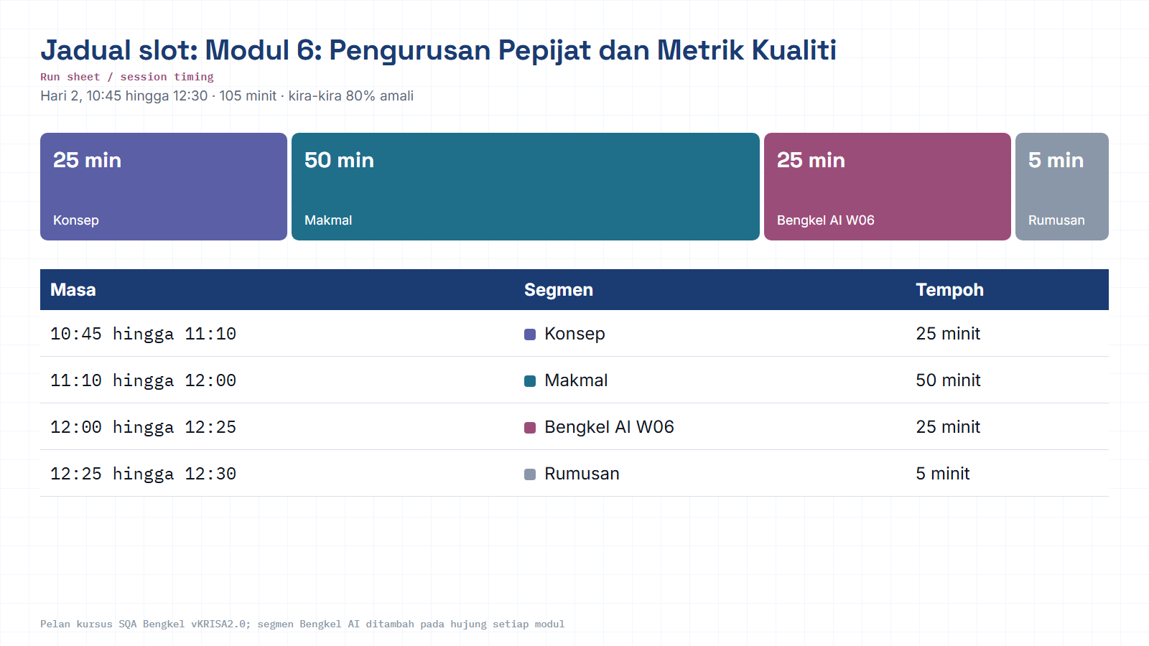
Module hub
Notes:
Run sheet for this module. Keep to the slot times; the SQA-AI workshop segment is reserved at the end.

Slide 3
█ ORIENTATION
Where Module 6 sits in the quality flow
Nine SQA activities map onto five delivery phases. Bug Management is the engine room of Verify, where every test result becomes a tracked, prioritized, measurable action.
▾ YOU ARE HERE
03 · VERIFY
01 · PLAN
02 · BUILD-IN
Test & Manage Bugs
04 · ASSURE
05 · SUSTAIN
Define
Prevent
Prove
Control
Test design, automation, defect triage, metrics
QA Plan, Requirement Review
Design Review, Risk Planning
Audit, compliance, release evidence
Change & production monitoring
Follows: Module 5, Software Testing & Test Automation
Feeds into: Module 7, Audit, Compliance & Documentation
Notes:
Key points on this slide:
- █ ORIENTATION
- Where Module 6 sits in the quality flow
- Nine SQA activities map onto five delivery phases. Bug Management is the engine room of Verify, where every test result becomes a tracked, prioritized, measurab
- 01 · PLAN
Link each point back to the ShopFast project and ask one trainee to give an example from their own agency.

Slide 4
█ LEARNING OBJECTIVE
Track, classify and manage defects effectively, and turn testing activity into meaningful quality metrics.
Reproduce with evidence
Write bug reports that don't bounce back
Triage by severity & priority
Measure instead of guess
Notes:
Key points on this slide:
- █ LEARNING OBJECTIVE
- Track, classify and manage defects effectively, and turn testing activity into meaningful quality metrics.
- Reproduce with evidence
- Write bug reports that don't bounce back
Link each point back to the ShopFast project and ask one trainee to give an example from their own agency.

Slide 5
█ KEY TOPICS
Six concepts, one shared vocabulary
Every topic gets a hands-on touchpoint in the lab, the language your team needs to triage a bug in under two minutes.
1
2
3
Defect Lifecycle
Severity vs Priority
Root Cause Analysis
The states a bug moves through, from first sighting to closed, and who owns each handoff.
How bad it is, versus how soon it must be fixed, two independent axes, often confused.
Asking “why” until you reach the actual source, not just the symptom reported.
4
5
6
Defect Density & Leakage
MTTR & MTBF
Defect Removal Efficiency
How many bugs per unit of work, and how many escape into later stages.
Mean time to repair, and mean time between failures, speed and stability.
The percentage of defects caught before release vs. found after, the scorecard.
Notes:
Key points on this slide:
- █ KEY TOPICS
- Six concepts, one shared vocabulary
- Every topic gets a hands-on touchpoint in the lab, the language your team needs to triage a bug in under two minutes.
- Defect Lifecycle
Link each point back to the ShopFast project and ask one trainee to give an example from their own agency.

Slide 6
█ INFOGRAPHIC · ORIGINAL DIAGRAM
The defect lifecycle
A bug moves through a governed state machine. Miss a state and you lose traceability.
REJECTED / DUPLICATE
DEFERRED
CLOSED
NEW
ASSIGNED
IN PROGRESS
FIXED
RETEST
VERIFIED
REOPENED, if retest fails
Lab focus: reproduce a seeded bug, push it through New to Assigned to In Progress to Fixed to Retest to Verified to Closed, and practice the reopen path when a fix doesn't hold.
Notes:
Key points on this slide:
- █ INFOGRAPHIC · ORIGINAL DIAGRAM
- The defect lifecycle
- A bug moves through a governed state machine. Miss a state and you lose traceability.
- ASSIGNED
Link each point back to the ShopFast project and ask one trainee to give an example from their own agency.

Slide 7
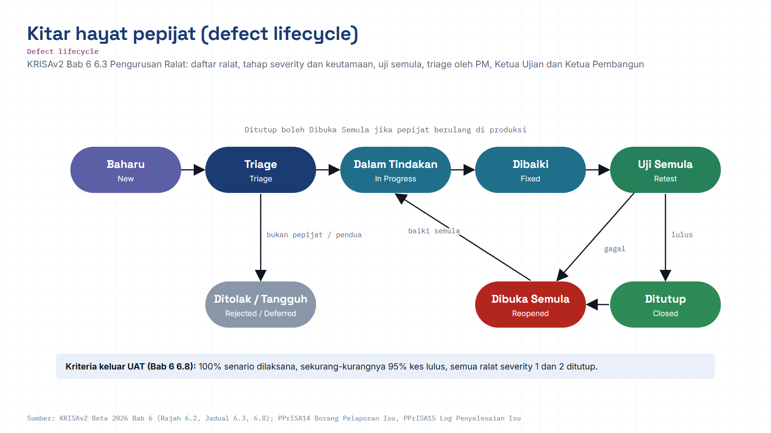
Module hub
Open: KRISAv2 Bab 6 p.2
Notes:
Diagram built from the KRISAv2 Beta 2026 / PPrISA 2.0 references. Use the Open chip to show the source page live.

Slide 8
█ INFOGRAPHIC · ORIGINAL DIAGRAM
Severity vs. priority
Severity is a fact about impact. Priority is a decision about sequence.
PRIORITY to
HIGH SEVERITY · LOW PRIORITY
HIGH SEVERITY · HIGH PRIORITY
Severity
“Fix it, but not this sprint”
“Drop everything”
Technical impact on the system, crash, data loss, blocked workflow. Set by QA based on observed behavior.
e.g. rare crash on an unused legacy report page
e.g. checkout payment fails for all users
Priority
SEVERITY ↑
Business urgency, how soon it must be fixed relative to everything else. Set by Product/PM.
LOW SEVERITY · LOW PRIORITY
LOW SEVERITY · HIGH PRIORITY
“Backlog it”
“Fix before demo”
Lab rule of thumb
Log both independently for every ShopFast bug, never infer one from the other.
e.g. minor spacing issue in the footer
e.g. wrong label on the homepage banner
LOW
HIGH
Notes:
Key points on this slide:
- █ INFOGRAPHIC · ORIGINAL DIAGRAM
- Severity vs. priority
- Severity is a fact about impact. Priority is a decision about sequence.
- PRIORITY to
Link each point back to the ShopFast project and ask one trainee to give an example from their own agency.

Slide 9
█ INFOGRAPHIC · ORIGINAL DIAGRAM
Root Cause Analysis, fishbone view
Trace every bug back to a category of cause before closing it, this keeps the same defect from resurfacing.
PEOPLE
PROCESS
• Misread requirement
• Missed edge case in review
• No Definition of Done check
• Skipped code review step
DEFECT
(observed failure)
ENVIRONMENT
CODE / DESIGN
• Config drift, staging ≠ prod
• Test data out of date
• Unhandled null / edge input
• Tight coupling, side effects
Lab focus: for one logged ShopFast bug, ask “why” three times and record which of these four categories it truly belongs to.
Notes:
Key points on this slide:
- █ INFOGRAPHIC · ORIGINAL DIAGRAM
- Root Cause Analysis, fishbone view
- Trace every bug back to a category of cause before closing it, this keeps the same defect from resurfacing.
- DEFECT
Link each point back to the ShopFast project and ask one trainee to give an example from their own agency.

Slide 10
█ QUALITY METRICS DASHBOARD
Turning bug data into a quality story
Five metrics, five formulas, computed by hand once in the lab so the dashboard never feels like a black box.
Defect Density
Defect Leakage
MTTR
MTBF
DRE
Defects ÷ KLOC
Escaped ÷ Total × 100
Σ repair time ÷ # incidents
Total uptime ÷ # failures
Pre ÷ (pre + post) × 100
0.42
12%
3.1h
96h
88%
Bugs per unit of code size, lower is tighter code.
Share of bugs that slipped past a test stage.
Mean time to repair, how fast the team recovers.
Mean time between failures, system stability.
Defect Removal Efficiency, the release scorecard.
Notes:
Key points on this slide:
- █ QUALITY METRICS DASHBOARD
- Turning bug data into a quality story
- Five metrics, five formulas, computed by hand once in the lab so the dashboard never feels like a black box.
- Defect Density
Link each point back to the ShopFast project and ask one trainee to give an example from their own agency.

Slide 11
█ GUIDED LAB · 4 STEPS
Hands-on: from reproduction to metrics
PROJECT ShopFast checkout, the same project carried through every module of this workshop.
01
02
03
04
Reproduce
Log 5 reports
Triage the board
Compute metrics
Reproduce seeded bugs in the demo app and confirm exact repro steps before logging anything.
Write 5 high-quality bug reports: steps, expected vs. actual, severity/priority, and evidence.
Move tickets across the lifecycle: Open to In Progress to Fixed to Verified to Closed.
Calculate simple metrics from your own data: Defect Density & pass rate.
Notes:
Key points on this slide:
- █ GUIDED LAB · 4 STEPS
- Hands-on: from reproduction to metrics
- PROJECT ShopFast checkout, the same project carried through every module of this workshop.
- Reproduce
Link each point back to the ShopFast project and ask one trainee to give an example from their own agency.

Slide 12
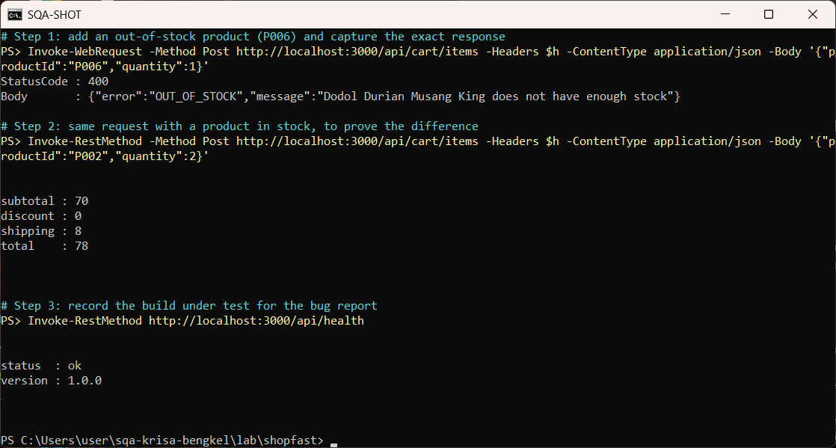
Real run: capture exact evidence before you log a bug
Request, status code, response body and build version from the ShopFast lab app (PowerShell)
Module hub
Notes:
Real run: capture exact evidence before you log a bug. This is a real screenshot from the lab environment, not a mock-up. Point at what the trainees should read: pass/fail counts, the failing assertion and the time taken.

Slide 13
█ TOOLS FOR THIS MODULE
What you'll use in the lab
Industry-standard and swappable, use whichever your organization already runs.
1
Jira
2
GitHub Issues
3
Azure DevOps / GitLab
Bug tracking & workflow
Lightweight defect logging
Enterprise triage boards
4
Bug report template
5
Metrics sheet
6
RTM (carried forward)
Consistent, reviewable reports
Density, leakage, MTTR/MTBF, DRE
Linking bugs back to requirements
Notes:
Key points on this slide:
- █ TOOLS FOR THIS MODULE
- What you'll use in the lab
- Industry-standard and swappable, use whichever your organization already runs.
- Jira
Link each point back to the ShopFast project and ask one trainee to give an example from their own agency.

Slide 14
█ WHAT YOU LEAVE WITH
Module 6 deliverables
5 defect reports
A moving triage board
Basic quality metrics
Payment fails on retry
HIGH
OPEN
IN PROGRESS
VERIFIED
Defect Density
0.42 / KLOC
Discount code not applied
MED
Cart badge
Discount code
Payment retry
Pass Rate
82%
Cart badge miscounts
MED
Footer link 404s
LOW
Defect Leakage
12%
Confirmation email delay
LOW
Practiced end-to-end lifecycle movement, not just static logging.
Computed from your own ShopFast bug data, not a slide of theory.
Each with steps, expected vs. actual, severity/priority & evidence.
Notes:
Key points on this slide:
- █ WHAT YOU LEAVE WITH
- Module 6 deliverables
- 5 defect reports
- Payment fails on retry
Link each point back to the ShopFast project and ask one trainee to give an example from their own agency.

Slide 15
M06 · KRISAv2 BETA 2026 · PPrISA 2.0 · CLICK ANY LINE
References and templates for this module
Every line opens the official JDN document at the exact page. Templates download as Word or PDF.
WHERE IT IS IN THE GUIDES
TEMPLATES TO USE
Bab 6, 6.3 Pengurusan Ralat (Rajah 6.2)
page 2 · KRISAv2 Bab 6 Fasa Pengujian Penerimaan
D11
Laporan Ujian Sistem
WORD
PDF
Bab 6, Jadual 6.3 Tahap Severity
page 7 · KRISAv2 Bab 6 Fasa Pengujian Penerimaan
D14
Laporan Ujian Penerimaan (UAT/PAT)
WORD
PDF
Bab 6, 6.8 Defect Triage dan kriteria keluar UAT
page 21 · KRISAv2 Bab 6 Fasa Pengujian Penerimaan
PPrISA14
Borang Pelaporan Isu
WORD
PDF
PPrISA15
Log Penyelesaian Isu
WORD
PDF
Bab 5, Jadual 5.5 Ujian Sistem (tiada severity Blocking/Critical)
page 38 · KRISAv2 Bab 5 Fasa Pembangunan
PPrISA 2.0, 5.4.2 i b) Isu: Borang Pelaporan dan Log Penyelesaian Isu
page 92 · PPrISA 2.0 Versi Beta Feb 2025
sqa.jdn.gov.my portal
All references (repo)
Module hub
Note: KRISAv2 Beta renumbers deliverables in its chapters; links follow the published D01 to D18 template files.
Notes:
Reference slide for M06. Click through live if time allows; otherwise tell trainees every link is also in the module hub page and in references/README.md of the repo.
- Bab 6, 6.3 Pengurusan Ralat (Rajah 6.2) (PDF page 2): https://fth-abr.github.io/sqa-krisa-bengkel/references/krisa-v2-beta-2026/BAB6-FASA-PENGUJIAN-PENERIMAAN.pdf#page=2
- Bab 6, Jadual 6.3 Tahap Severity (PDF page 7): https://fth-abr.github.io/sqa-krisa-bengkel/references/krisa-v2-beta-2026/BAB6-FASA-PENGUJIAN-PENERIMAAN.pdf#page=7
- Bab 6, 6.8 Defect Triage dan kriteria keluar UAT (PDF page 21): https://fth-abr.github.io/sqa-krisa-bengkel/references/krisa-v2-beta-2026/BAB6-FASA-PENGUJIAN-PENERIMAAN.pdf#page=21
- Bab 5, Jadual 5.5 Ujian Sistem (tiada severity Blocking/Critical) (PDF page 38): https://fth-abr.github.io/sqa-krisa-bengkel/references/krisa-v2-beta-2026/BAB5-FASA-PEMBANGUNAN.pdf#page=38
- PPrISA 2.0, 5.4.2 i b) Isu: Borang Pelaporan dan Log Penyelesaian Isu (PDF page 92): https://fth-abr.github.io/sqa-krisa-bengkel/references/pprisa-2.0/PPrISA_2.0_Versi_Beta_Februari_2025.pdf#page=92

Slide 16
MODULE 6 · RECAP
From chaos to a controlled quality signal
Daripada kekeliruan kepada isyarat kualiti terkawal
✔
Reproduced & logged 5 high-quality defect reports
✔
Classified severity independently from priority
✔
Practiced the full defect lifecycle, including reopen
✔
Traced one bug to its true root cause
✔
Moved tickets across a live triage board
✔
Computed Defect Density & pass rate from real data
>
NEXT UP, MODULE 7
Audit, Compliance & Quality Documentation
SQA · 2-DAY HANDS-ON WORKSHOP · Module 6 of 9 · Aligned to KRISA 2.0 (Beta 2026, JDN)
Notes:
Key points on this slide:
- MODULE 6 · RECAP
- From chaos to a controlled quality signal
- Daripada kekeliruan kepada isyarat kualiti terkawal
- Reproduced & logged 5 high-quality defect reports
Link each point back to the ShopFast project and ask one trainee to give an example from their own agency.

Slide 17
M06 · W06 · 25 MINUTES · Hari 2, 12:00 hingga 12:25
Hands-On SQA-AI Assistant Workshop
AI bug reports and quality metrics
Turn the failure you reproduced into a complete bug report with KRISAv2 severity, compute metrics from your test run, and prepare a triage summary.
TOOL
opencode 1.18 in the lab folder · model: Big Pickle via OpenCode Zen (free, no API key) · synthetic ShopFast data only
Step-by-step guide (web)
Workshop slides (W06)
Setup guide W00
opencode docs
Notes:
Reserved slot: 25 minutes (Hari 2, 12:00 hingga 12:25). Trainees open lab\ in the terminal and start opencode. Walk the first step live on the projector, then let pairs continue with the web guide. Stop 3 minutes early for the human-check discussion.

Slide 18
W06 · HANDS-ON SQA-AI ASSISTANT WORKSHOP · 25 MIN
AI bug reports and quality metrics
STEPS
TYPE THIS (opencode> in opencode, PS> in PowerShell)
1
Run /bug-report with steps, expected and actual result
opencode> /bug-report Langkah: tambah P002 kuantiti 10 melalui POST /api/cart/items. Dijangka: 201 dan kuantiti 10 diterima (REQ-CHK-01). Sebenar: 400 VALIDATION_ERROR. Bukti: ujian tests/ui/m05-senario.spec.js gagal, binaan 1.0.0.
opencode> /metrics kes dirancang 20, dilaksana 18, lulus 13, gagal 5, pepijat ditemui 5, pepijat bocor ke produksi 1, saiz kod 1.2 KLOC
opencode> Ringkaskan pepijat terbuka mengikut severity dan keutamaan untuk mesyuarat triage dalam 3 baris. Jangan tulis fail.
2
Check severity against KRISAv2 Bab 6 Jadual 6.3
3
Run /metrics with your run numbers
4
Ask for a three-line triage summary
OUTPUT TO SAVE
HUMAN CHECK BEFORE YOU ACCEPT IT
outputs/m06-bug-report-BUG-CHK-001.md, outputs/m06-metrics.csv
- Steps can be reproduced by someone else
- Severity follows KRISAv2 Jadual 6.3; priority is a business decision
- Metric formulas are shown so the numbers can be rechecked
Open step-by-step guide
Module hub
Notes:
Prompts are identical to the web guide and the W deck, so trainees can copy them. Commands starting with / are project commands in lab/.opencode/commands. Ask each pair to show the output file and read out one human-check result before moving on.

Slide 19
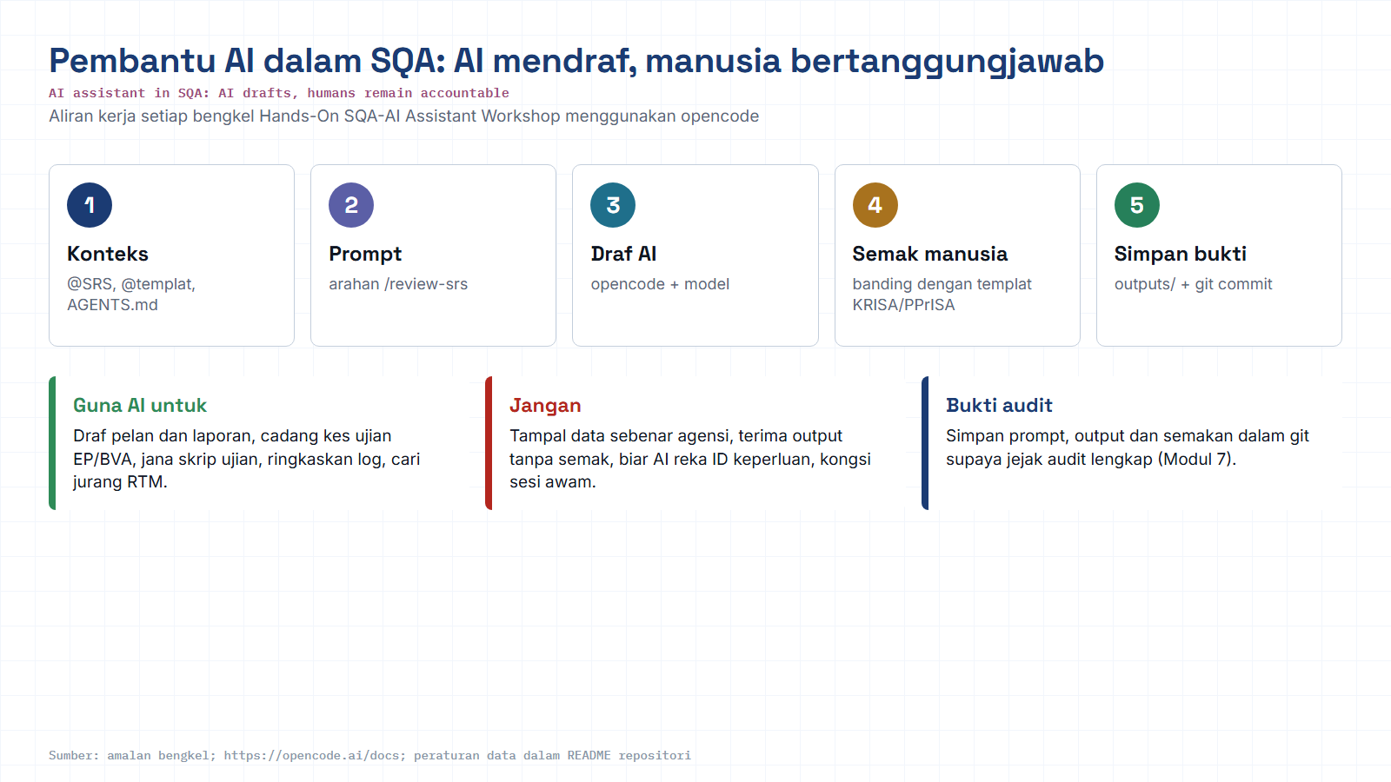
Module hub
Open: opencode docs
Notes:
Reminder of the rules for every AI workshop: context, prompt, AI draft, human review against the KRISA/PPrISA template, save evidence. Stress the data rule: synthetic data only.

