Slide 1


SQA · BENGKEL AMALI 2 HARI
KRISA 2.0 (JDN) ALIGNED · PHASE 04 OF 05, ASSURE
MODULE 07
Audit, Compliance &
Quality Documentation
Prove the process. Document the evidence. Decide the release.
13:30 - 15:00
1h 30m
ASSURE
SESSION TIME
DURATION
PIPELINE PHASE
Sample module reference · ShopFast checkout continuity project
Notes:
Key points on this slide:
- SQA · BENGKEL AMALI 2 HARI
- KRISA 2.0 (JDN) ALIGNED · PHASE 04 OF 05, ASSURE
- MODULE 07
- Audit, Compliance & Quality Documentation
Link each point back to the ShopFast project and ask one trainee to give an example from their own agency.

Slide 2
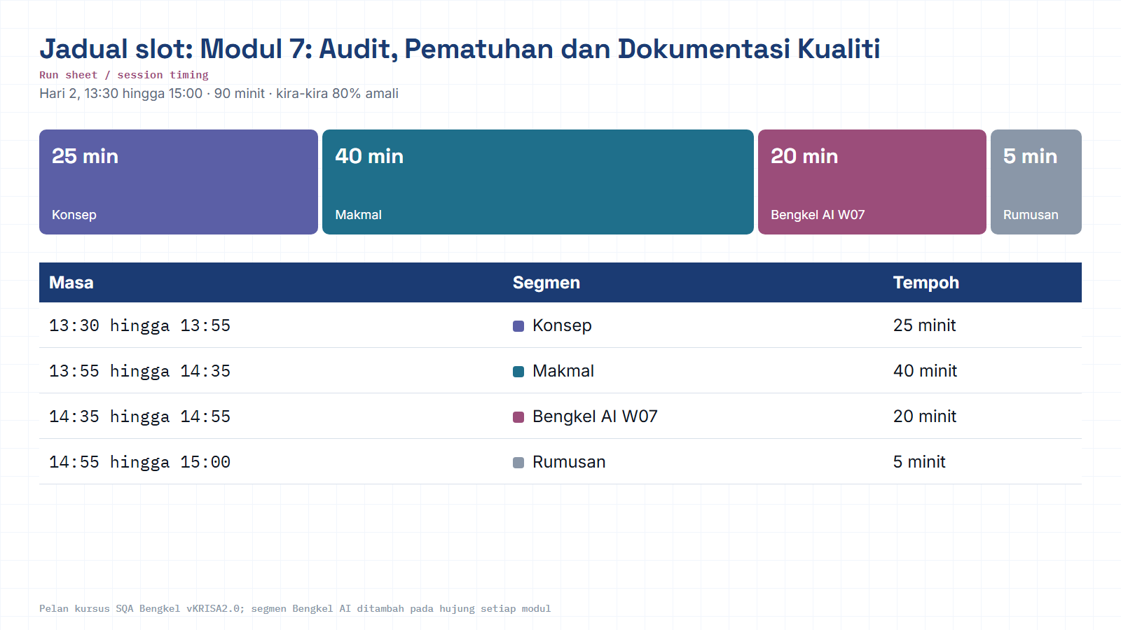
Module hub
Notes:
Run sheet for this module. Keep to the slot times; the SQA-AI workshop segment is reserved at the end.

Slide 3
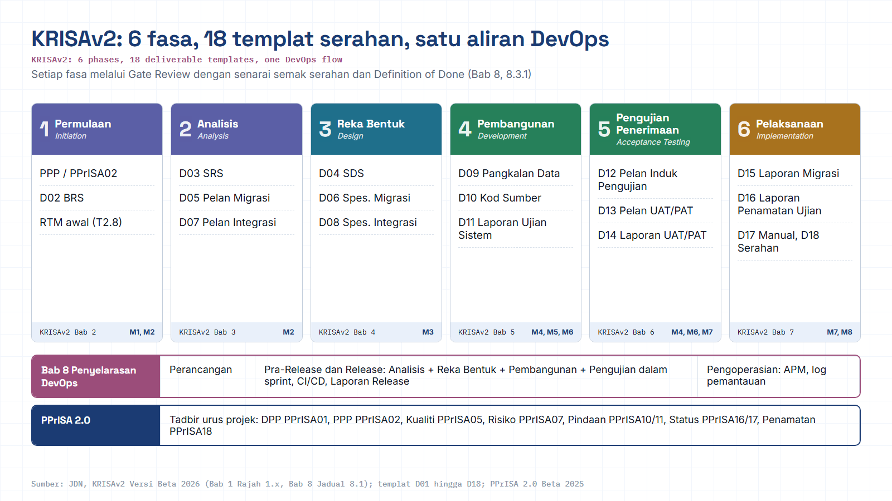
Module hub
Open: KRISAv2 portal
Notes:
Diagram built from the KRISAv2 Beta 2026 / PPrISA 2.0 references. Use the Open chip to show the source page live.

Slide 4

01 · CONTEXT
Where Module 7 fits in the quality pipeline
Nine SQA activities move through five phases on one continuous project. Module 7 is where the team proves, with evidence, that everything built so far actually meets a standard.
ASSURE
PLAN
>
BUILD-IN
>
VERIFY
>
>
SUSTAIN
Modules 1-2
Module 3
Modules 4-6
YOU ARE HERE
Module 8
Module 7
Coming in from Module 6: a moving defect-triage board and basic quality metrics (Defect Density, pass rate).
Module 7 asks: does everything we built stand up against a recognized standard, and can we prove it to a release board?
Handing off to Module 8: the signed-off documentation becomes the baseline for change control and production monitoring.
MODULE 07 · AUDIT, COMPLIANCE & QUALITY DOCUMENTATION
02 / 10
Notes:
Key points on this slide:
- 01 · CONTEXT
- Where Module 7 fits in the quality pipeline
- Nine SQA activities move through five phases on one continuous project. Module 7 is where the team proves, with evidence, that everything built so far actually
- PLAN
Link each point back to the ShopFast project and ask one trainee to give an example from their own agency.

Slide 5



What you leave the room with
Three connected artifacts, each one feeding the next, built from yesterday's real QA Plan, RTM and test evidence.
LEARNING OBJECTIVE
Ensure the quality process complies with a recognized standard, and produce documentation strong enough to justify a release decision.
Mini Audit Report
Findings recorded as conformity / non-conformity against an ISO / CMMI-lite checklist.
CAPA Log
Corrective and preventive actions assigned to every non-conformity found.
Test Summary Report
Scope, results and a go / no-go / conditional release recommendation.
13:30-15:00 · Audit & Compliance + Documentation
MODULE 07 · AUDIT, COMPLIANCE & QUALITY DOCUMENTATION
03 / 10
Notes:
Key points on this slide:
- LEARNING OBJECTIVE
- Ensure the quality process complies with a recognized standard, and produce documentation strong enough to justify a release decision.
- 13:30-15:00 · Audit & Compliance + Documentation
- What you leave the room with
Link each point back to the ShopFast project and ask one trainee to give an example from their own agency.

Slide 6







02 · SCOPE
Key topics covered
ISO 9001
ISO/IEC 25010
ISO/IEC 29119
CMMI
Quality management system, process discipline
Product quality characteristics model
International software testing standard
Process maturity benchmarking
OWASP ASVS
Release Readiness Review
Test Summary Report
Release Notes & Lessons Learned
Application security verification levels
Structured go/no-go evaluation gate
Evidence package for the release decision
What shipped, and what improves next cycle
MODULE 07 · AUDIT, COMPLIANCE & QUALITY DOCUMENTATION
04 / 10
Notes:
Key points on this slide:
- 02 · SCOPE
- Key topics covered
- ISO 9001
- Quality management system, process discipline
Link each point back to the ShopFast project and ask one trainee to give an example from their own agency.

Slide 7
03 · REFERENCE
Which standard does what?
Five reference points, five different jobs, the audit checklist in Step 1 borrows from all of them.
ISO 9001
Is the process itself under control, documented, followed, improved?
QUALITY MANAGEMENT SYSTEM
ISO/IEC 25010
Does the product meet 8 quality characteristics: reliability, usability, security…?
PRODUCT QUALITY MODEL
ISO/IEC 29119
Was testing itself planned, designed and documented to a recognized method?
SOFTWARE TESTING STANDARD
CMMI
How repeatable and measured is the team's engineering process, level 1-5?
PROCESS MATURITY MODEL
OWASP ASVS
Were the right security controls verified at the right rigor level?
APPLICATION SECURITY VERIFICATION
MODULE 07 · AUDIT, COMPLIANCE & QUALITY DOCUMENTATION
05 / 10
Notes:
Key points on this slide:
- 03 · REFERENCE
- Which standard does what?
- Five reference points, five different jobs, the audit checklist in Step 1 borrows from all of them.
- ISO 9001
Link each point back to the ShopFast project and ask one trainee to give an example from their own agency.

Slide 8

04 · HANDS-ON LAB
Guided lab flow, three steps
Run on the ShopFast checkout artifacts you built in Modules 1-6.
1
STEP 1
2
STEP 2
3
STEP 3
Audit yesterday's artifacts
Record findings + CAPA
Compile the Test Summary
>
>
Check the QA Plan, RTM and test evidence against an ISO / CMMI-lite checklist.
Mark each item conformity or non-conformity, then assign a corrective action.
Write the report and recommend go, no-go, or conditional release.
TOOLS FOR THIS LAB
Audit checklist
ISO / CMMI reference
Test Summary template
Confluence / Markdown
MODULE 07 · AUDIT, COMPLIANCE & QUALITY DOCUMENTATION
06 / 10
Notes:
Key points on this slide:
- 04 · HANDS-ON LAB
- Guided lab flow, three steps
- Run on the ShopFast checkout artifacts you built in Modules 1-6.
- STEP 1
Link each point back to the ShopFast project and ask one trainee to give an example from their own agency.

Slide 9

05 · INFOGRAPHIC
From finding to fix, the audit loop
Every checklist item ends in one of two lanes. Non-conformities don't just get logged, they get closed.
re-verify
Conformity
Evidence matches the standard, item passes as-is.
Non-conformity
Gap identified against the checklist, logged with evidence.
CAPA
AUDIT
ITEM
Corrective & preventive action assigned
MODULE 07 · AUDIT, COMPLIANCE & QUALITY DOCUMENTATION
07 / 10
Notes:
Key points on this slide:
- 05 · INFOGRAPHIC
- From finding to fix, the audit loop
- Every checklist item ends in one of two lanes. Non-conformities don't just get logged, they get closed.
- AUDIT ITEM
Link each point back to the ShopFast project and ask one trainee to give an example from their own agency.

Slide 10
06 · OUTCOME
The release recommendation
The Test Summary Report ends in one of three calls, never a silent shrug.
GO
CONDITIONAL
NO-GO
All exit criteria met. No open critical or high-severity defects. Audit shows full conformity.
Minor non-conformities remain, each with an owner and a CAPA due date before launch.
Critical defects or non-conformities open. Release blocked until re-verified.
INSIDE THE TEST SUMMARY REPORT
Scope tested
Results by module
Defect summary
Residual risks
Audit findings
Release recommendation
Reference: exit criteria are set once, in the Module 2 QA Plan, Module 7 simply checks the evidence against them.
MODULE 07 · AUDIT, COMPLIANCE & QUALITY DOCUMENTATION
08 / 10
Notes:
Key points on this slide:
- 06 · OUTCOME
- The release recommendation
- The Test Summary Report ends in one of three calls, never a silent shrug.
- All exit criteria met. No open critical or high-severity defects. Audit shows full conformity.
Link each point back to the ShopFast project and ask one trainee to give an example from their own agency.

Slide 11
07 · TRACEABILITY
Deliverables & KRISA 2.0 alignment
WHAT YOU PRODUCE
KRISA 2.0 (JDN) MAPPING
Mini Audit Report
Ch.6 · Acceptance Testing
Master Test Plan to UAT & PAT execution
Deliverable: Acceptance Test Report (UAT/PAT)
Ch.7 · Implementation
FAT, migration, handover documentation
Deliverable: Test Closure Report; Manual; Handover
Conformity / non-conformity findings
CAPA Log
Corrective actions with owners
Test Summary Report
This module's audit checklist also feeds KRISA's cross-cutting success factor: Software Quality Assurance (SQA).
Go / no-go / conditional recommendation
Reference note: KRISA 2.0 is currently at Beta 2026 status. Deliverable and template numbering (e.g. D2.1, Tx.y) is still being refined by JDN, confirm the current version with your agency before formal submission.
MODULE 07 · AUDIT, COMPLIANCE & QUALITY DOCUMENTATION
09 / 10
Notes:
Key points on this slide:
- 07 · TRACEABILITY
- Deliverables & KRISA 2.0 alignment
- WHAT YOU PRODUCE
- Mini Audit Report
Link each point back to the ShopFast project and ask one trainee to give an example from their own agency.

Slide 12
M07 · KRISAv2 BETA 2026 · PPrISA 2.0 · CLICK ANY LINE
References and templates for this module
Every line opens the official JDN document at the exact page. Templates download as Word or PDF.
WHERE IT IS IN THE GUIDES
TEMPLATES TO USE
Bab 6, 6.10 Laporan Ujian Penerimaan (UAT dan PAT)
page 26 · KRISAv2 Bab 6 Fasa Pengujian Penerimaan
D14
Laporan Ujian Penerimaan (UAT/PAT)
WORD
PDF
Bab 7, 7.6 Ujian Penerimaan Akhir (FAT)
page 7 · KRISAv2 Bab 7 Fasa Pelaksanaan
D16
Laporan Penamatan Ujian
WORD
PDF
Bab 7, Laporan Penamatan Ujian (Jadual 7.5, ISO/IEC/IEEE 29119)
page 9 · KRISAv2 Bab 7 Fasa Pelaksanaan
D18
Laporan Serahan Sistem
WORD
PDF
PPrISA05
Pelan Pengurusan Kualiti
WORD
PDF
Bab 7, 7.8 Serahan Sistem
page 14 · KRISAv2 Bab 7 Fasa Pelaksanaan
PPrISA17
Laporan Status Projek (Keseluruhan)
WORD
PDF
PPrISA 2.0, 5.4.2 ii b) Penilaian Kualiti Serahan
page 94 · PPrISA 2.0 Versi Beta Feb 2025
PPrISA 2.0, 6.1.2 Penilaian Akhir
page 98 · PPrISA 2.0 Versi Beta Feb 2025
sqa.jdn.gov.my portal
All references (repo)
Module hub
Note: KRISAv2 Beta renumbers deliverables in its chapters; links follow the published D01 to D18 template files.
Notes:
Reference slide for M07. Click through live if time allows; otherwise tell trainees every link is also in the module hub page and in references/README.md of the repo.
- Bab 6, 6.10 Laporan Ujian Penerimaan (UAT dan PAT) (PDF page 26): https://fth-abr.github.io/sqa-krisa-bengkel/references/krisa-v2-beta-2026/BAB6-FASA-PENGUJIAN-PENERIMAAN.pdf#page=26
- Bab 7, 7.6 Ujian Penerimaan Akhir (FAT) (PDF page 7): https://fth-abr.github.io/sqa-krisa-bengkel/references/krisa-v2-beta-2026/BAB7-FASA-PELAKSANAAN.pdf#page=7
- Bab 7, Laporan Penamatan Ujian (Jadual 7.5, ISO/IEC/IEEE 29119) (PDF page 9): https://fth-abr.github.io/sqa-krisa-bengkel/references/krisa-v2-beta-2026/BAB7-FASA-PELAKSANAAN.pdf#page=9
- Bab 7, 7.8 Serahan Sistem (PDF page 14): https://fth-abr.github.io/sqa-krisa-bengkel/references/krisa-v2-beta-2026/BAB7-FASA-PELAKSANAAN.pdf#page=14
- PPrISA 2.0, 5.4.2 ii b) Penilaian Kualiti Serahan (PDF page 94): https://fth-abr.github.io/sqa-krisa-bengkel/references/pprisa-2.0/PPrISA_2.0_Versi_Beta_Februari_2025.pdf#page=94
- PPrISA 2.0, 6.1.2 Penilaian Akhir (PDF page 98): https://fth-abr.github.io/sqa-krisa-bengkel/references/pprisa-2.0/PPrISA_2.0_Versi_Beta_Februari_2025.pdf#page=98

Slide 13
MODULE 07 RECAP
Quality is only real once it's proven
Audit against a standard, not a feeling, ISO, CMMI and ASVS give the checklist teeth.
Every non-conformity gets a CAPA and an owner, nothing is logged and forgotten.
The Test Summary Report turns two days of work into one defensible release call.
This is the evidence trail an auditor, or KRISA reviewer, will actually ask for.
NEXT to
Module 08 · Change Management, Monitoring & Continuous Quality
15:15-16:30 · The signed-off Test Summary becomes the baseline for controlled change and live monitoring.
MODULE 07 · AUDIT, COMPLIANCE & QUALITY DOCUMENTATION
10 / 10
Notes:
Key points on this slide:
- MODULE 07 RECAP
- Quality is only real once it's proven
- Audit against a standard, not a feeling, ISO, CMMI and ASVS give the checklist teeth.
- Every non-conformity gets a CAPA and an owner, nothing is logged and forgotten.
Link each point back to the ShopFast project and ask one trainee to give an example from their own agency.

Slide 14
M07 · W07 · 20 MINUTES · Hari 2, 14:35 hingga 14:55
Hands-On SQA-AI Assistant Workshop
AI audit, CAPA and Test Summary Report
Audit your outputs folder against the ISO/CMMI-lite checklist, raise CAPA for non-conformities and draft the D14/D16 Test Summary with a release recommendation.
TOOL
opencode 1.18 in the lab folder · model: Big Pickle via OpenCode Zen (free, no API key) · synthetic ShopFast data only
Step-by-step guide (web)
Workshop slides (W07)
Setup guide W00
opencode docs
Notes:
Reserved slot: 20 minutes (Hari 2, 14:35 hingga 14:55). Trainees open lab\ in the terminal and start opencode. Walk the first step live on the projector, then let pairs continue with the web guide. Stop 3 minutes early for the human-check discussion.

Slide 15
W07 · HANDS-ON SQA-AI ASSISTANT WORKSHOP · 20 MIN
AI audit, CAPA and Test Summary Report
STEPS
TYPE THIS (opencode> in opencode, PS> in PowerShell)
1
Run /audit on the RTM and test cases (Plan agent)
opencode> /audit outputs/m02-rtm.csv dan outputs/m04-testcases.csv
opencode> Simpan hasil audit di atas ke outputs/m07-audit.md dengan pautan ../../references/.
opencode> /capa semua NC dalam outputs/m07-audit.md
opencode> /test-summary Ujian sistem 14 hingga 15 September 2026, binaan 1.0.0, penguji 4 orang
2
Switch to Build and save the audit to outputs/
3
Run /capa on the saved audit, then /test-summary
4
Decide GO, NO-GO or CONDITIONAL as a team
OUTPUT TO SAVE
HUMAN CHECK BEFORE YOU ACCEPT IT
outputs/m07-audit.md, outputs/m07-capa.md, outputs/m07-test-summary.md
- Each non-conformity cites evidence (file and line)
- Exit criteria use KRISAv2 Bab 6 6.8 numbers (95% pass, severity 1 and 2 closed)
- The release decision is made and signed by a person
Open step-by-step guide
Module hub
Notes:
Prompts are identical to the web guide and the W deck, so trainees can copy them. Commands starting with / are project commands in lab/.opencode/commands. Ask each pair to show the output file and read out one human-check result before moving on.

Slide 16
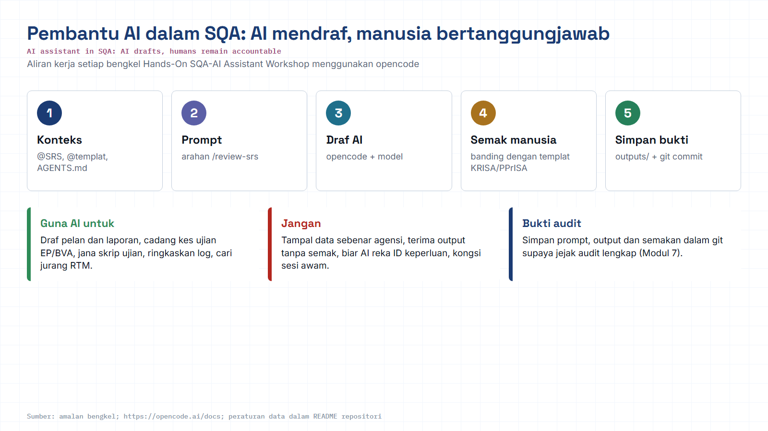
Module hub
Open: opencode docs
Notes:
Reminder of the rules for every AI workshop: context, prompt, AI draft, human review against the KRISA/PPrISA template, save evidence. Stress the data rule: synthetic data only.

