Slide 1


SQA · BENGKEL AMALI 2 HARI
KRISA 2.0 (JDN) ALIGNED · PHASE 05 OF 05, SUSTAIN · FINAL MODULE BEFORE CAPSTONE
MODULE 08
Change Management, Monitoring
& Continuous Quality
Control what changes. Watch what runs. Never stop improving.
15:15 - 16:30
1h 15m
SUSTAIN
SESSION TIME
DURATION
PIPELINE PHASE
Sample module reference · ShopFast checkout continuity project
Notes:
Key points on this slide:
- SQA · BENGKEL AMALI 2 HARI
- KRISA 2.0 (JDN) ALIGNED · PHASE 05 OF 05, SUSTAIN · FINAL MODULE BEFORE CAPSTONE
- MODULE 08
- Change Management, Monitoring & Continuous Quality
Link each point back to the ShopFast project and ask one trainee to give an example from their own agency.

Slide 2
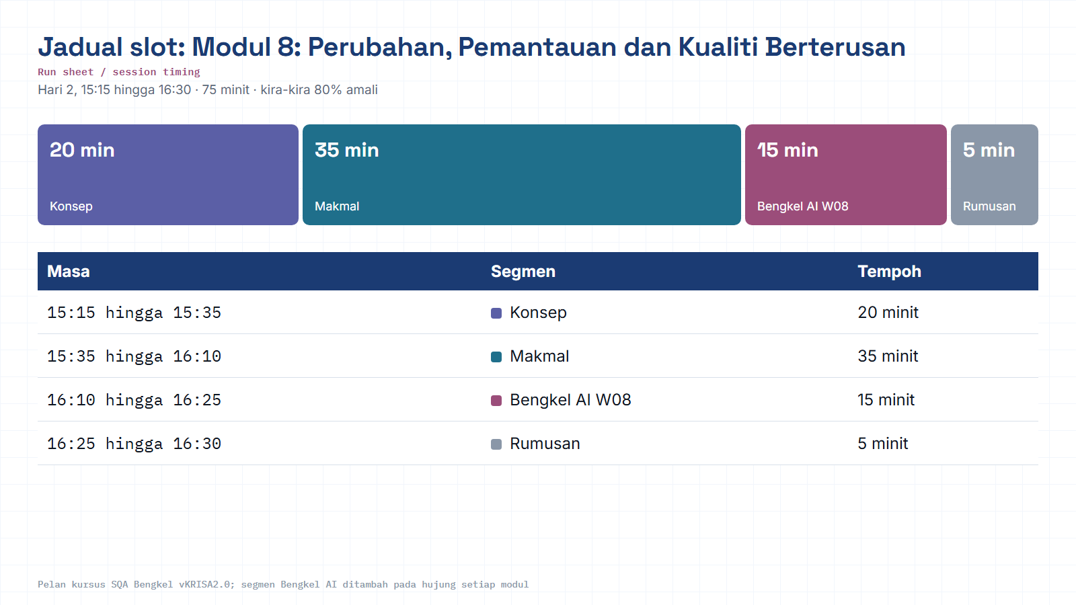
Module hub
Notes:
Run sheet for this module. Keep to the slot times; the SQA-AI workshop segment is reserved at the end.

Slide 3

01 · CONTEXT
Where Module 8 fits, the last phase before capstone
The audited, documented release from Module 7 now goes live. Module 8 keeps it healthy, and feeds what's learned back into the next cycle.
SUSTAIN
PLAN
>
BUILD-IN
>
VERIFY
>
ASSURE
>
Modules 1-2
Module 3
Modules 4-6
Module 7
YOU ARE HERE
Module 8
Coming in from Module 7: a signed-off Audit Report, CAPA log and Test Summary Report with a GO / conditional release call.
Module 8 asks: now that it's live, how do we change it safely, know the moment it breaks, and keep getting better?
Closing the loop: PDCA/Kaizen feeds monitoring insights back into Module 1's quality mindset, then the Capstone brings all nine activities together.
MODULE 08 · CHANGE MANAGEMENT, MONITORING & CONTINUOUS QUALITY
02 / 14
Notes:
Key points on this slide:
- 01 · CONTEXT
- Where Module 8 fits, the last phase before capstone
- The audited, documented release from Module 7 now goes live. Module 8 keeps it healthy, and feeds what's learned back into the next cycle.
- PLAN
Link each point back to the ShopFast project and ask one trainee to give an example from their own agency.

Slide 4




What you leave the room with
Five artifacts that together prove a change was safe, and the system is being watched.
LEARNING OBJECTIVE
Sustain quality after deployment through controlled change and production monitoring, so the system stays healthy and keeps improving.
Change Request + Impact Analysis
Logged change, mapped to affected test cases via the RTM.
Rollback Plan
A minimal regression suite and a documented way back.
CI Quality Gate
Automation tests wired into GitHub Actions before merge.
Metrics Dashboard
15:15-16:30 · Change Management + Monitoring
Defect Density, pass rate, MTTR and uptime, with alert thresholds set.
MODULE 08 · CHANGE MANAGEMENT, MONITORING & CONTINUOUS QUALITY
03 / 14
Notes:
Key points on this slide:
- LEARNING OBJECTIVE
- Sustain quality after deployment through controlled change and production monitoring, so the system stays healthy and keeps improving.
- 15:15-16:30 · Change Management + Monitoring
- What you leave the room with
Link each point back to the ShopFast project and ask one trainee to give an example from their own agency.

Slide 5




02 · SCOPE
Key topics covered
Change Request · Impact Analysis
Change Advisory Board (CAB)
Rollback · Regression Planning
Logging / Monitoring / Alerting
What's changing, and what does it touch?
Who decides go / no-go on a change
The safety net if something breaks
Seeing problems before users report them
Observability
SLA · SLI · SLO
PDCA · Kaizen
Logs, metrics and traces working together
Promises, measurements, and targets
Closing the loop, plan, do, check, act
MODULE 08 · CHANGE MANAGEMENT, MONITORING & CONTINUOUS QUALITY
04 / 14
Notes:
Key points on this slide:
- 02 · SCOPE
- Key topics covered
- Change Request · Impact Analysis
- What's changing, and what does it touch?
Link each point back to the ShopFast project and ask one trainee to give an example from their own agency.

Slide 6


03 · INFOGRAPHIC · CHANGE CONTROL
From request to decision, the change control path
Every change, even 'just add discount codes to checkout', walks this path before it touches production.
>
>
Change
Request
Impact
Analysis
CAB
Review
Logged on a Change Control form
RTM shows which test cases are affected
Change Advisory Board weighs risk vs. value
CAB DECISION FORKS INTO THREE OUTCOMES
Approved
Deferred
Rejected
Minimal regression suite selected; scheduled for release.
More impact data needed before a decision.
Risk outweighs value; rollback plan stays on file.
MODULE 08 · CHANGE MANAGEMENT, MONITORING & CONTINUOUS QUALITY
05 / 14
Notes:
Key points on this slide:
- 03 · INFOGRAPHIC · CHANGE CONTROL
- From request to decision, the change control path
- Every change, even 'just add discount codes to checkout', walks this path before it touches production.
- Change Request
Link each point back to the ShopFast project and ask one trainee to give an example from their own agency.

Slide 7
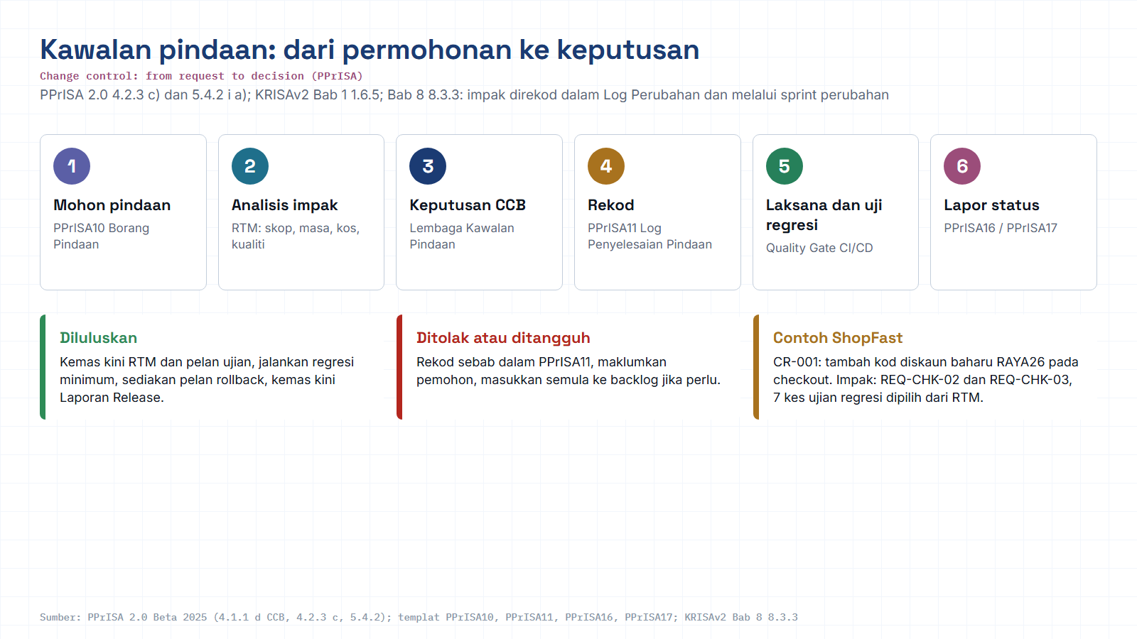
Module hub
Open: PPrISA10 Borang Pindaan
Notes:
Diagram built from the KRISAv2 Beta 2026 / PPrISA 2.0 references. Use the Open chip to show the source page live.

Slide 8
04 · INFOGRAPHIC · OBSERVABILITY
Seeing inside a running system
Logging, monitoring and alerting are three different jobs. Observability is what you get when all three talk to each other.
Logs
Metrics
Traces
What happened, in detail, the ShopFast checkout request that threw a 500.
How the system is trending, pass rate, latency, error rate over time.
Where the time went, one request's path across every service it touched.
Alerting sits on top of all three: a threshold breach on any metric, log pattern, or trace latency fires a notification, before a customer has to file a ticket.
MODULE 08 · CHANGE MANAGEMENT, MONITORING & CONTINUOUS QUALITY
06 / 14
Notes:
Key points on this slide:
- 04 · INFOGRAPHIC · OBSERVABILITY
- Seeing inside a running system
- Logging, monitoring and alerting are three different jobs. Observability is what you get when all three talk to each other.
- Logs
Link each point back to the ShopFast project and ask one trainee to give an example from their own agency.

Slide 9
05 · INFOGRAPHIC · SERVICE TARGETS
SLA, SLI, SLO, three letters, three different jobs
They nest inside each other: a measurement feeds a target, and a target backs a promise.
SLA, Service Level Agreement
The promise made to the customer (e.g. 99.9% uptime/month, with penalties if missed).
SLO, Service Level Objective
The internal target the team aims for, stricter than the SLA (e.g. 99.95% uptime).
SLI, Service Level Indicator
The actual measurement, read straight off the dashboard (e.g. 99.97% this week).
Reading it live: SLI (99.97%) meets SLO (99.95%) with room to spare, so the SLA promise (99.9%) to the customer stays safely kept.
MODULE 08 · CHANGE MANAGEMENT, MONITORING & CONTINUOUS QUALITY
07 / 14
Notes:
Key points on this slide:
- 05 · INFOGRAPHIC · SERVICE TARGETS
- SLA, SLI, SLO, three letters, three different jobs
- They nest inside each other: a measurement feeds a target, and a target backs a promise.
- SLA, Service Level Agreement
Link each point back to the ShopFast project and ask one trainee to give an example from their own agency.

Slide 10
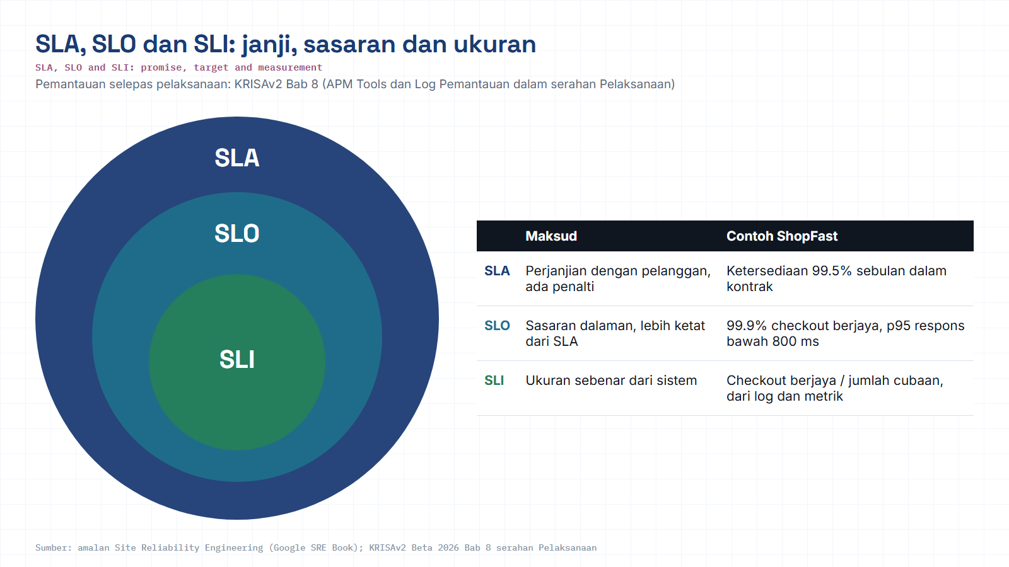
Module hub
Open: KRISAv2 Bab 8 p.8
Notes:
Diagram built from the KRISAv2 Beta 2026 / PPrISA 2.0 references. Use the Open chip to show the source page live.

Slide 11
06 · HANDS-ON LAB
Guided lab flow, four steps
Run on the ShopFast checkout artifacts carried from every earlier module.
1
2
3
4
STEP 1
STEP 2
STEP 3
STEP 4
Log the change
Impact Analysis
Wire the Quality Gate
Read the dashboard
>
>
>
A change request arrives, 'add discount codes to checkout', logged on a Change Control form.
Use the RTM to see which cases are affected; pick a minimal regression + plan a rollback.
Add the automation tests to GitHub Actions so they run as a gate before every merge.
Check Grafana: Defect Density, pass rate, MTTR, uptime, then set alert thresholds.
TOOLS FOR THIS LAB
Change request form
GitHub Actions
Grafana / Prometheus / ELK
RTM
MODULE 08 · CHANGE MANAGEMENT, MONITORING & CONTINUOUS QUALITY
08 / 14
Notes:
Key points on this slide:
- 06 · HANDS-ON LAB
- Guided lab flow, four steps
- Run on the ShopFast checkout artifacts carried from every earlier module.
- STEP 1
Link each point back to the ShopFast project and ask one trainee to give an example from their own agency.

Slide 12



07 · INFOGRAPHIC · CI/CD
The Quality Gate, no merge without a green run
The Module 5 automation suite now runs automatically on every push, inside GitHub Actions.
>
>
>
Commit
Build
Automated Tests
Quality Gate
Developer pushes to ShopFast checkout branch
App compiled, dependencies installed
Postman + Playwright suite runs headless
Pass to merge allowed. Fail to merge blocked
PASS to Merge & Deploy
FAIL to Merge Blocked
Change ships to production; dashboard begins tracking its impact immediately.
Developer gets the failure report and fixes it before trying again, no exceptions.
MODULE 08 · CHANGE MANAGEMENT, MONITORING & CONTINUOUS QUALITY
09 / 14
Notes:
Key points on this slide:
- 07 · INFOGRAPHIC · CI/CD
- The Quality Gate, no merge without a green run
- The Module 5 automation suite now runs automatically on every push, inside GitHub Actions.
- Commit
Link each point back to the ShopFast project and ask one trainee to give an example from their own agency.

Slide 13
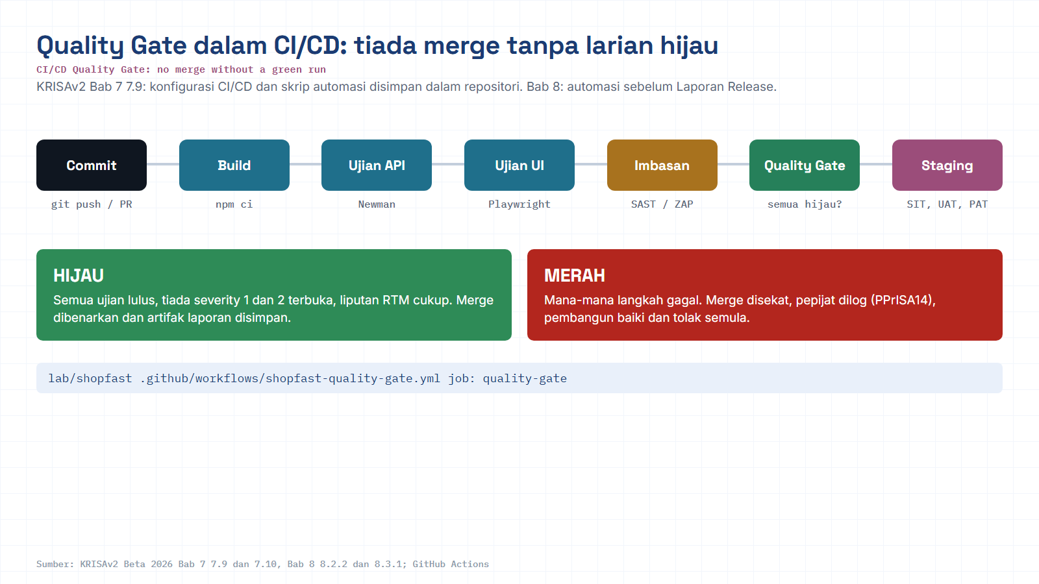
Module hub
Open: Workflow in repo
Notes:
Diagram built from the KRISAv2 Beta 2026 / PPrISA 2.0 references. Use the Open chip to show the source page live.

Slide 14
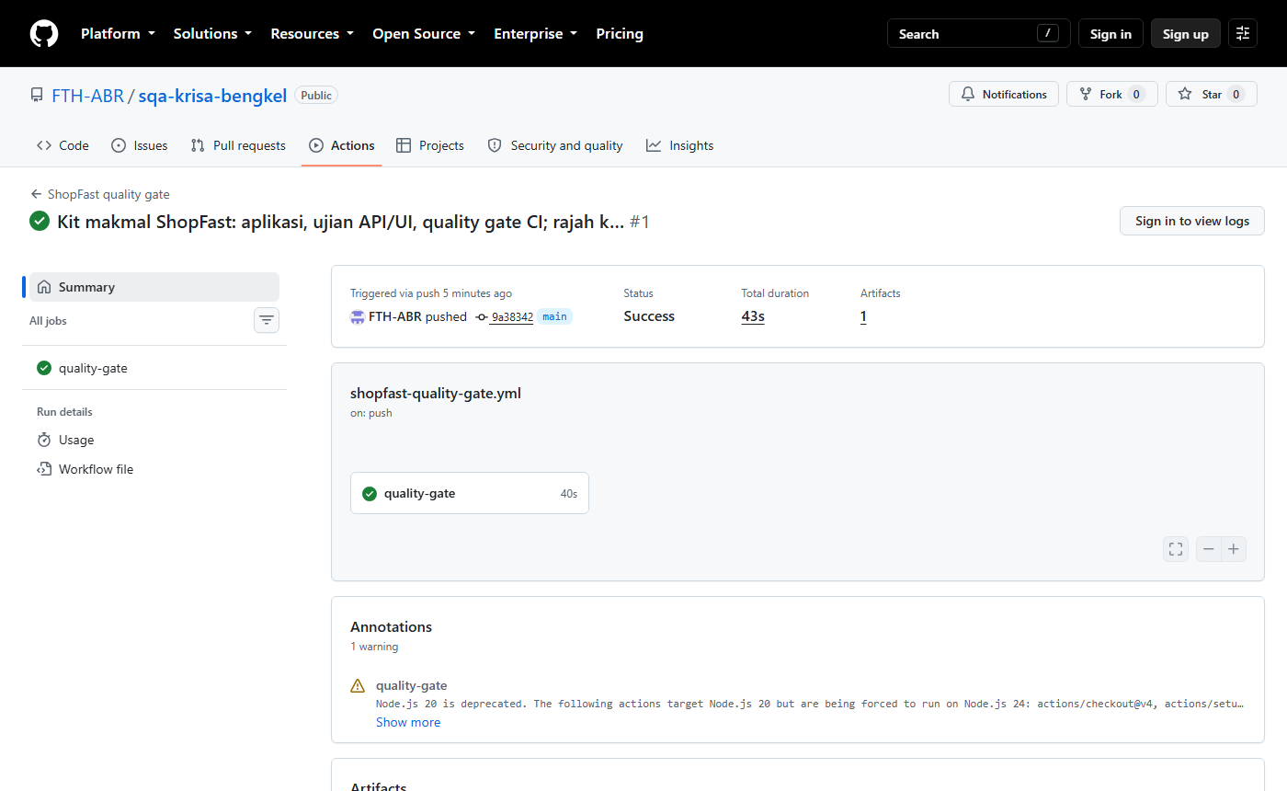
Real run: GitHub Actions quality gate
github.com/FTH-ABR/sqa-krisa-bengkel/actions, job quality-gate
Module hub
Notes:
Real run: GitHub Actions quality gate. This is a real screenshot from the lab environment, not a mock-up. Point at what the trainees should read: pass/fail counts, the failing assertion and the time taken.

Slide 15


08 · INFOGRAPHIC · DASHBOARD
Reading the Grafana dashboard
Four numbers tell you whether ShopFast checkout is healthy right now.
DEFECT DENSITY
PASS RATE
MTTR
UPTIME
0.8 / KLOC
98.4 %
42 min
99.97 %
Target < 1.2, trending down
Above the 95% SLO
Watch, creeping up this week
Meets SLO of 99.95%
Setting alert thresholds: MTTR above 60 min pages the on-call engineer. Uptime under 99.9% (the SLA floor) triggers an incident review. Defect Density above 1.2/KLOC blocks the next release train automatically.
MODULE 08 · CHANGE MANAGEMENT, MONITORING & CONTINUOUS QUALITY
10 / 14
Notes:
Key points on this slide:
- 08 · INFOGRAPHIC · DASHBOARD
- Reading the Grafana dashboard
- Four numbers tell you whether ShopFast checkout is healthy right now.
- DEFECT DENSITY
Link each point back to the ShopFast project and ask one trainee to give an example from their own agency.

Slide 16

09 · INFOGRAPHIC · SAFETY NET
If it breaks, rollback and regression planning
Planned before the change ships, not improvised after it fails.
Change deployed, monitor closely
Stable
Regressed
Metrics stay within SLO. Nothing further to do, the change is folded into the next audit cycle.
A metric breaches its alert threshold, Defect Density spikes or uptime drops below SLA.
Execute rollback + minimal regression suite
Revert to the last known-good build; re-run the regression set the RTM flagged in Impact Analysis.
MODULE 08 · CHANGE MANAGEMENT, MONITORING & CONTINUOUS QUALITY
11 / 14
Notes:
Key points on this slide:
- 09 · INFOGRAPHIC · SAFETY NET
- If it breaks, rollback and regression planning
- Planned before the change ships, not improvised after it fails.
- Change deployed, monitor closely
Link each point back to the ShopFast project and ask one trainee to give an example from their own agency.

Slide 17

10 · INFOGRAPHIC · CONTINUOUS IMPROVEMENT
PDCA & Kaizen, closing the loop back to Module 1
Monitoring doesn't end at the dashboard. What it finds becomes next cycle's quality plan.
PLAN
DO
Feed dashboard findings into the next QA Plan & Risk Register (Module 2)
Build, test and ship the next change through the same nine SQA activities
ACT
CHECK
Standardize what worked; raise the bar for Definition of Done (Kaizen)
Audit and monitor again, did the fix actually hold under real traffic?
Kaizen mindset: every capstone and every real project restarts this circle, the goal is never a perfect release, only a slightly better next one.
MODULE 08 · CHANGE MANAGEMENT, MONITORING & CONTINUOUS QUALITY
12 / 14
Notes:
Key points on this slide:
- 10 · INFOGRAPHIC · CONTINUOUS IMPROVEMENT
- PDCA & Kaizen, closing the loop back to Module 1
- Monitoring doesn't end at the dashboard. What it finds becomes next cycle's quality plan.
- PLAN
Link each point back to the ShopFast project and ask one trainee to give an example from their own agency.

Slide 18
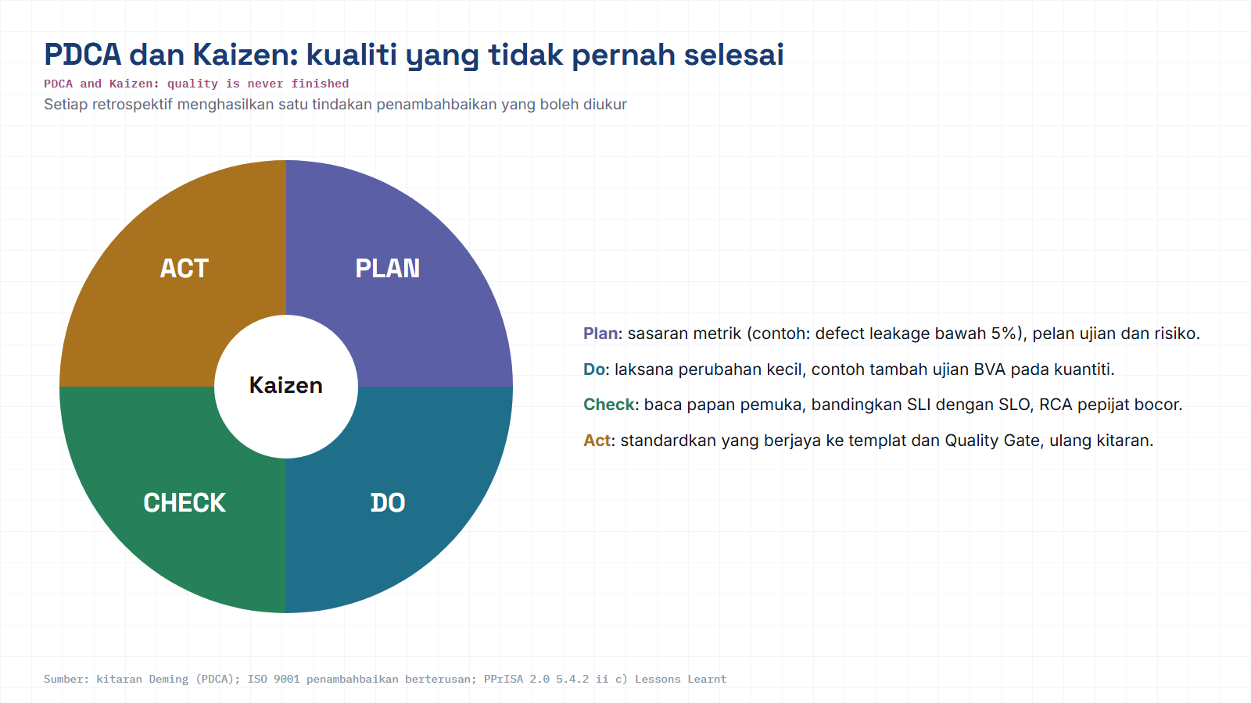
Module hub
Open: PPrISA 2.0 p.94
Notes:
Diagram built from the KRISAv2 Beta 2026 / PPrISA 2.0 references. Use the Open chip to show the source page live.

Slide 19

11 · TRACEABILITY
Tools & KRISA 2.0 alignment
TOOLS FOR THIS MODULE
KRISA 2.0 (JDN) MAPPING
Change request form
Ch.8 · DevOps Alignment
Automation, CI/CD, monitoring; KRISA and PPrISA and DevOps mapping; Change Log
Deliverable: Continuous quality pipeline & metrics
Cross-cutting: Change & Risk Control Management
One of KRISA's key success factors, this module is where it's operationalized.
Deliverable: Change Log; Impact Analysis record
Structured intake for every proposed change
GitHub Actions
CI pipeline running the Quality Gate
Grafana / Prometheus / ELK
Dashboards, metrics storage & log search
Together with Module 7's Ch.6-7 evidence, this closes KRISA's full Planning-to-Sustain lifecycle for the ShopFast release.
RTM
Traceability for impact analysis & regression
Reference note: KRISA 2.0 is currently at Beta 2026 status. Deliverable and template numbering is still being refined by JDN, confirm the current version with your agency before formal submission.
MODULE 08 · CHANGE MANAGEMENT, MONITORING & CONTINUOUS QUALITY
13 / 14
Notes:
Key points on this slide:
- 11 · TRACEABILITY
- Tools & KRISA 2.0 alignment
- TOOLS FOR THIS MODULE
- Change request form
Link each point back to the ShopFast project and ask one trainee to give an example from their own agency.

Slide 20
M08 · KRISAv2 BETA 2026 · PPrISA 2.0 · CLICK ANY LINE
References and templates for this module
Every line opens the official JDN document at the exact page. Templates download as Word or PDF.
WHERE IT IS IN THE GUIDES
TEMPLATES TO USE
Bab 8, Jadual 8.1 Pemetaan Aktiviti KRISA ke DevOps
page 6 · KRISAv2 Bab 8 Penyelarasan DevOps
D18
Laporan Serahan Sistem
WORD
PDF
Bab 8, 8.3.3 Penyelarasan Pengurusan Perubahan dan Risiko
page 9 · KRISAv2 Bab 8 Penyelarasan DevOps
PPrISA10
Borang Pindaan
WORD
PDF
Bab 7, 7.9 Repositori dan Serahan Kod Sumber (CI/CD)
page 17 · KRISAv2 Bab 7 Fasa Pelaksanaan
PPrISA11
Log Penyelesaian Pindaan
WORD
PDF
PPrISA16
Laporan Status Projek (Kumpulan)
WORD
PDF
Bab 1, 1.6.5 Pengurusan Kawalan Pindaan
page 22 · KRISAv2 Bab 1 Perancangan
PPrISA17
Laporan Status Projek (Keseluruhan)
WORD
PDF
PPrISA 2.0, 4.2.3 c) Pengurusan Pindaan (CR)
page 73 · PPrISA 2.0 Versi Beta Feb 2025
PPrISA 2.0, 5.4.2 Pemantauan dan laporan status
page 91 · PPrISA 2.0 Versi Beta Feb 2025
sqa.jdn.gov.my portal
All references (repo)
Module hub
Note: KRISAv2 Beta renumbers deliverables in its chapters; links follow the published D01 to D18 template files.
Notes:
Reference slide for M08. Click through live if time allows; otherwise tell trainees every link is also in the module hub page and in references/README.md of the repo.
- Bab 8, Jadual 8.1 Pemetaan Aktiviti KRISA ke DevOps (PDF page 6): https://fth-abr.github.io/sqa-krisa-bengkel/references/krisa-v2-beta-2026/BAB8-PENYELARASAN-PEMBANGUNAN-SISTEM-DEVOPS.pdf#page=6
- Bab 8, 8.3.3 Penyelarasan Pengurusan Perubahan dan Risiko (PDF page 9): https://fth-abr.github.io/sqa-krisa-bengkel/references/krisa-v2-beta-2026/BAB8-PENYELARASAN-PEMBANGUNAN-SISTEM-DEVOPS.pdf#page=9
- Bab 7, 7.9 Repositori dan Serahan Kod Sumber (CI/CD) (PDF page 17): https://fth-abr.github.io/sqa-krisa-bengkel/references/krisa-v2-beta-2026/BAB7-FASA-PELAKSANAAN.pdf#page=17
- Bab 1, 1.6.5 Pengurusan Kawalan Pindaan (PDF page 22): https://fth-abr.github.io/sqa-krisa-bengkel/references/krisa-v2-beta-2026/BAB1-PERANCANGAN.pdf#page=22
- PPrISA 2.0, 4.2.3 c) Pengurusan Pindaan (CR) (PDF page 73): https://fth-abr.github.io/sqa-krisa-bengkel/references/pprisa-2.0/PPrISA_2.0_Versi_Beta_Februari_2025.pdf#page=73
- PPrISA 2.0, 5.4.2 Pemantauan dan laporan status (PDF page 91): https://fth-abr.github.io/sqa-krisa-bengkel/references/pprisa-2.0/PPrISA_2.0_Versi_Beta_Februari_2025.pdf#page=91

Slide 21
MODULE 08 RECAP
Sustaining quality means never really finishing
Every change, however small, earns an Impact Analysis before it earns a merge.
Logs, metrics and traces, together, are what 'observability' actually means.
A rollback plan written before deployment is worth ten written after an incident.
PDCA turns this module's dashboard findings into next cycle's Module 1 quality mindset.
NEXT to
Capstone Exercise & Course Wrap-Up
16:30-17:30 · One team, one enterprise case study, all nine SQA activities, requirements to monitoring, then presented live.
MODULE 08 · CHANGE MANAGEMENT, MONITORING & CONTINUOUS QUALITY
14 / 14
Notes:
Key points on this slide:
- MODULE 08 RECAP
- Sustaining quality means never really finishing
- Every change, however small, earns an Impact Analysis before it earns a merge.
- Logs, metrics and traces, together, are what 'observability' actually means.
Link each point back to the ShopFast project and ask one trainee to give an example from their own agency.

Slide 22
M08 · W08 · 15 MINUTES · Hari 2, 16:10 hingga 16:25
Hands-On SQA-AI Assistant Workshop
AI change request, impact analysis and CI review
Raise a PPrISA10 change request for a new promo code, let the AI trace the impact through the RTM and test cases, and review the CI quality gate workflow.
TOOL
opencode 1.18 in the lab folder · model: Big Pickle via OpenCode Zen (free, no API key) · synthetic ShopFast data only
Step-by-step guide (web)
Workshop slides (W08)
Setup guide W00
opencode docs
Notes:
Reserved slot: 15 minutes (Hari 2, 16:10 hingga 16:25). Trainees open lab\ in the terminal and start opencode. Walk the first step live on the projector, then let pairs continue with the web guide. Stop 3 minutes early for the human-check discussion.

Slide 23
W08 · HANDS-ON SQA-AI ASSISTANT WORKSHOP · 15 MIN
AI change request, impact analysis and CI review
STEPS
TYPE THIS (opencode> in opencode, PS> in PowerShell)
1
Run /change-request for promo code RAYA26
opencode> /change-request Tambah kod promo RAYA26 (diskaun 26 peratus, sah 1 hingga 31 Mac 2027) pada checkout ShopFast
opencode> /impact-analysis RAYA26
opencode> Semak ../.github/workflows/shopfast-quality-gate.yml sebagai quality gate. Nyatakan apa yang disemak, apa yang tiada (contoh imbasan keselamatan atau ambang liputan) dan 3 cadangan. Jangan tulis fail.
2
Run /impact-analysis (Plan agent)
3
Ask the Plan agent to review the GitHub Actions workflow
4
Agree the minimal regression set and rollback trigger
OUTPUT TO SAVE
HUMAN CHECK BEFORE YOU ACCEPT IT
outputs/m08-change-request.md, outputs/m08-impact-analysis.md
- RAYA26 at 26 percent breaks the 25 percent cap in REQ-CHK-03: did the AI notice?
- The regression set is minimal and traced to REQ-CHK IDs
- Rollback has a clear trigger and an owner
Open step-by-step guide
Module hub
Notes:
Prompts are identical to the web guide and the W deck, so trainees can copy them. Commands starting with / are project commands in lab/.opencode/commands. Ask each pair to show the output file and read out one human-check result before moving on.

Slide 24
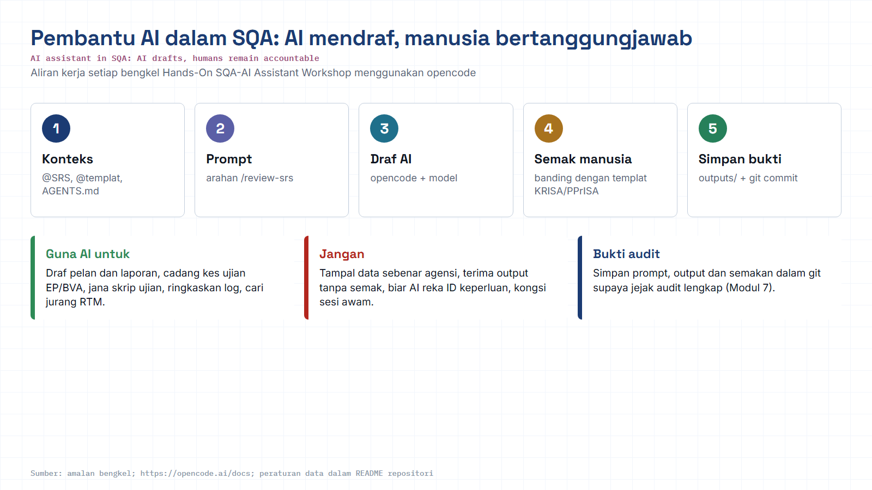
Module hub
Open: opencode docs
Notes:
Reminder of the rules for every AI workshop: context, prompt, AI draft, human review against the KRISA/PPrISA template, save evidence. Stress the data rule: synthetic data only.

