Slide 1
SQA · BENGKEL AMALI 2 HARI · KRISA 2.0
DAY 2 · MODULE 9 · CAPSTONE
Capstone Exercise & Course Wrap-Up
TIME
16:30 - 17:30
DURATION
1h 00m
Latihan Kemuncak & Penutup Kursus
FORMAT
Team enterprise case study
Every skill from Modules 1-8, run once more as one team, from business requirements to production monitoring, on the ShopFast quality trail built across both days.
PHASE COVERAGE
All 5 phases
LAB TYPE
Team steps (10)
2-Day Hands-On SQA Workshop
Aligned to KRISA 2.0 (JDN)
09
Notes:
Cover slide for Module 9, the workshop capstone. Frame it as the culmination of everything practiced across Modules 1-8 on the ShopFast project.

Slide 2
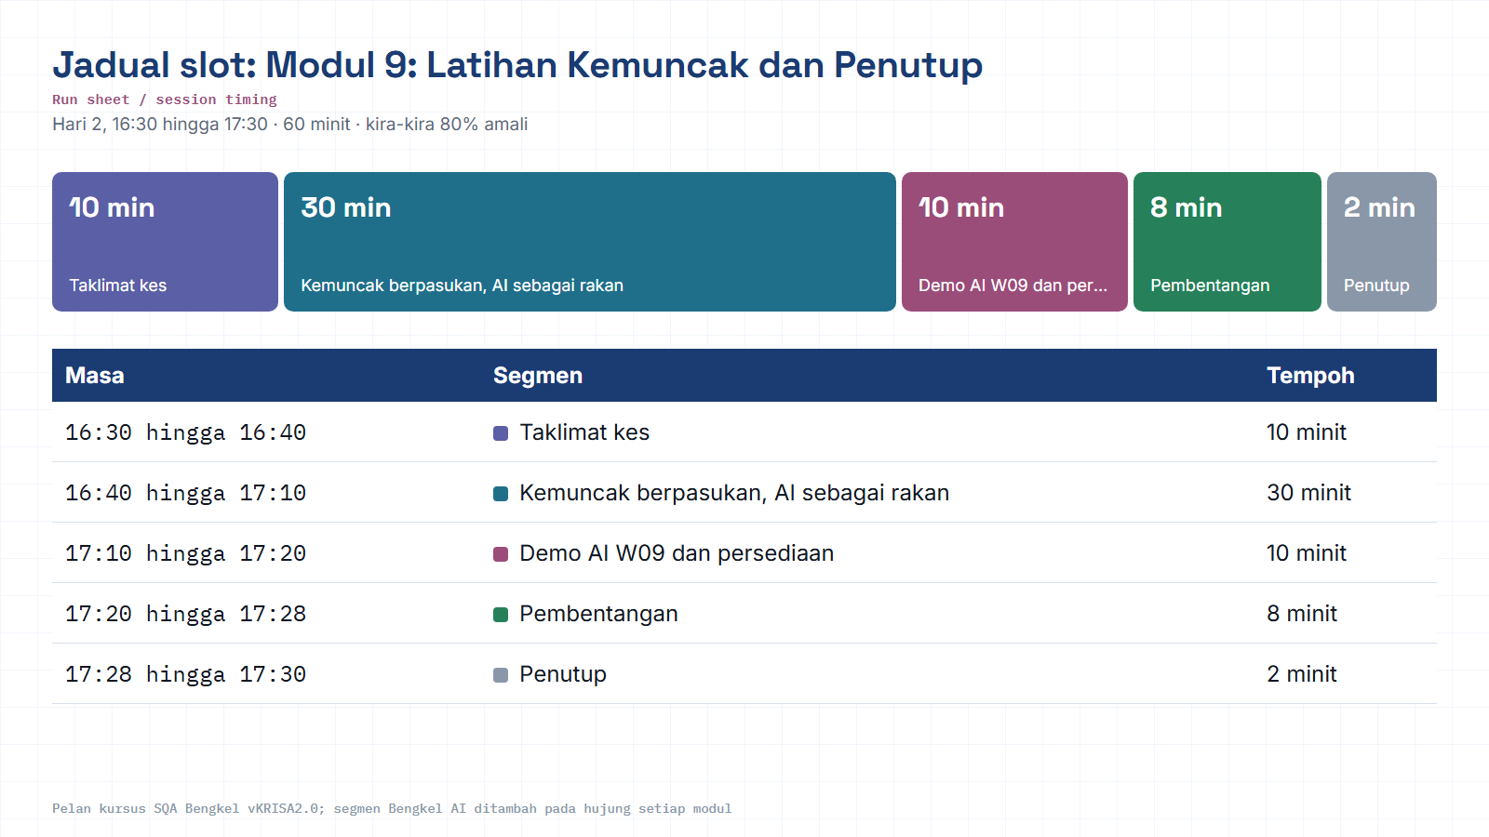
Module hub
Notes:
Run sheet for this module. Keep to the slot times; the SQA-AI workshop segment is reserved at the end.

Slide 3
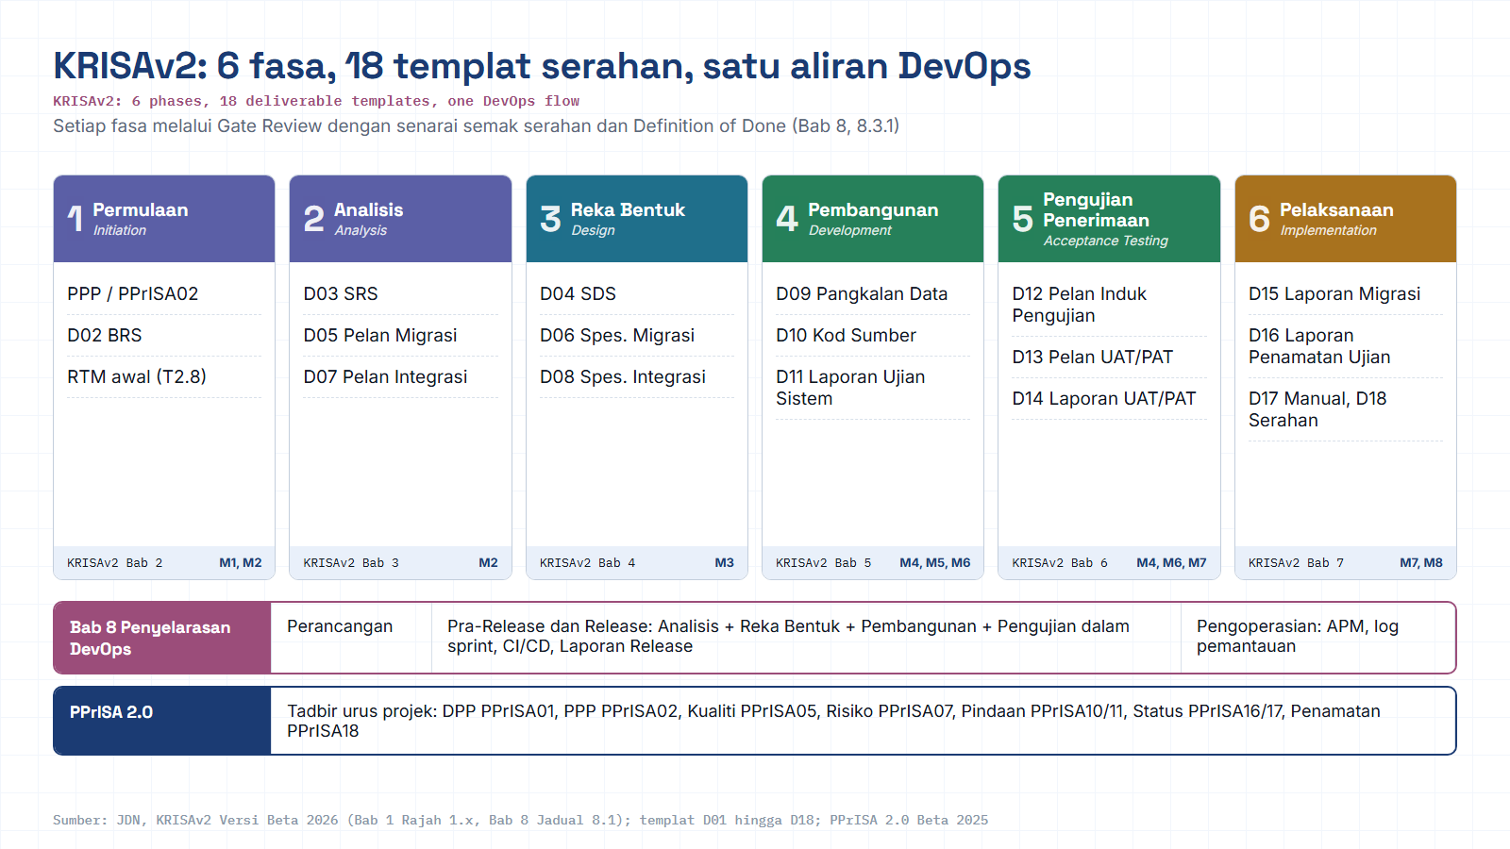
Module hub
Open: KRISAv2 portal
Notes:
Diagram built from the KRISAv2 Beta 2026 / PPrISA 2.0 references. Use the Open chip to show the source page live.

Slide 4
02 / 14 · PROGRAM MAP
WHERE THIS FITS
The workshop journey, nine stops, one project
Modules 1-8 practiced each SQA activity on the ShopFast checkout. Module 9 is the convergence point.
DAY 1
DAY 2
1
2
3
4
5
6
7
8
9
The Quality Mindset
QA Planning
Design Review
Test Design
Testing & Automation
Bug Management
Audit & Compliance
Change & Monitoring
Capstone & Wrap-Up
Modules 1-8 each ran one SQA activity, plan, review, design, test, defect-manage, audit, and monitor, on a single shared project. Module 9 is where every team replays that full lifecycle end-to-end, independently, as proof of mastery.
Notes:
Show how the nine modules connect as one continuous journey before diving into the capstone details.

Slide 5
03 / 14 · SNAPSHOT
SESSION SNAPSHOT
What this module is, at a glance
The final block of Day 2, a single guided team exercise that closes the workshop.
SCHEDULE
DURATION
PHASE PILL
DELIVERABLE
16:30-17:30
1h 00m
All Phases
Team presentation
Day 2, closing block
60 minutes, team-run
Plan to Build-in to Verify to Assure to Sustain
+ feedback + certificate
"Bring every skill together: each team drives one enterprise case study from requirements to monitoring, then presents it."
Notes:
Quick facts for the session: timing, duration, phase coverage, and the single deliverable expected.

Slide 6
04 / 14 · CASE BRIEF
THE CHALLENGE
One project, carried end to end
Every module runs on one shared project, the ShopFast checkout, so teams leave with one connected quality trail. The capstone is where that trail is walked in full, against an enterprise case study set by the trainer.
What your team already has
What the capstone asks
QA Plan, Requirement Review report & RTM v0, Module 2
Design Review checklist & Risk Register, Module 3
Test Plan + 15-20 mapped test cases, Module 4
API & UI automation scripts, Module 5
Defect reports, triage board & metrics, Module 6
Audit report, CAPA & Test Summary Report, Module 7
Change Request, CI Quality Gate & dashboard, Module 8
Re-run the full nine-activity SQA lifecycle as one coherent narrative, requirements to planning to review to testing to defects to audit to change to monitoring, then present the trail as evidence of a release-ready quality process.
Notes:
Set the scene: remind teams what artifacts they already have, and what the capstone specifically asks them to produce.

Slide 7
05 / 14 · OBJECTIVE
LEARNING OBJECTIVE
Bring every skill together.
Each team drives one enterprise case study from requirements to monitoring, then presents it to the full cohort.
Requirements to Planning
Review to Testing
Defects to Audit
Change to Monitoring
Notes:
State the objective clearly and let it breathe, this is the single sentence that frames the whole session.

Slide 8
06 / 14 · GUIDED STEPS
TEAM STEPS (10)
Requirements through test design
Steps 1-5 rebuild the foundation: understand the case, plan for quality, and design what you’ll verify.
1
Review the case study business requirements.
Ref: Module 1-2
2
Develop a QA Plan & Risk Register.
Ref: Module 2 · 3
3
Conduct Requirement Review & Design Review.
Ref: Module 2 · 3
4
Build the RTM & Risk-Based Test Strategy.
Ref: Module 2 · 3
5
Design & execute functional + non-functional test cases.
Ref: Module 4 · 5
Notes:
Walk through the first five team steps, these rebuild the planning and design foundation.

Slide 9
07 / 14 · GUIDED STEPS
TEAM STEPS (10)
Execution through continuous quality
Steps 6-10 close the loop: run it, prove it, govern the next change, and keep watching it in production.
6
Log & prioritize defects (severity / priority).
Ref: Module 6
7
Produce a Test Execution Report & QA documentation.
Ref: Module 6 · 7
8
Perform a quality audit against ISO/IEC & organizational standards.
Ref: Module 7
9
Evaluate a production change request & rollback plan.
Ref: Module 8
10
Recommend monitoring metrics & continuous improvement actions.
Ref: Module 8
Notes:
Walk through the final five team steps, these close the loop from execution to sustained quality.

Slide 10
08 / 14 · REFERENCE MAP
SAMPLE MODULE REFERENCES
Every capstone step traces back to a lab you already ran
Use this map as a quick refresher, if a team gets stuck on a step, point them back to the matching module’s artifact.
Step | Team Action | Module | Origin Skill
1 | Review case business requirements | 1-2 | The Quality Mindset / QA Planning
2 | Develop QA Plan & Risk Register | 2 · 3 | QA Planning / Design Review
3 | Requirement & Design Review | 2 · 3 | QA Planning / Design Review
4 | Build RTM & Risk-Based Test Strategy | 2 · 3 | QA Planning / Design Review
5 | Design & execute test cases | 4 · 5 | Test Design / Software Testing
6 | Log & prioritize defects | 6 | Bug Management & Quality Metrics
7 | Test Execution Report & QA docs | 6 · 7 | Bug Management / Audit & Compliance
8 | Quality audit vs ISO/IEC & org standards | 7 | Audit, Compliance & Documentation
9 | Evaluate change request & rollback plan | 8 | Change Management & Monitoring
10 | Recommend monitoring metrics & CI actions | 8 | Change Management & Monitoring
Notes:
Use this reference map if any team gets stuck, point them back to the original module and its artifact.

Slide 11
09 / 14 · FACILITATION
SUGGESTED FACILITATION FLOW
Pacing the 60-minute capstone
A trainer’s suggested rhythm for the hour, adapt the split to team size and case complexity.
16:30
Case brief & team roles · 10 min
16:40
Teams work the 10 steps (plan to test to audit to change) · 30 min
17:10
SQA-AI demo + prep the walkthrough · 10 min
17:20
Team presentations · 8 min
17:28
Wrap-up & certificates · 2 min
Suggested pacing for facilitation only, adapt to your cohort; not a fixed rule of the workshop.
Notes:
This is a suggested pacing only. Adjust based on team size, case complexity, and room energy.

Slide 12





10 / 14 · OUTPUT
SESSION OUTPUT
What closes out the workshop
Team presentation + instructor feedback + participant reflection + course evaluation + certificate.
Team
presentation
Instructor
feedback
Participant
reflection
Course
evaluation
Certificate
Notes:
Recap what closes the workshop for participants, the five things they walk away with.

Slide 13
11 / 14 · ASSESSMENT
HOW THE CAPSTONE IS ASSESSED
Assessment is the work itself
No written exam, participants are evaluated on the real artifacts produced across the two days, including the capstone walkthrough.
60%, Lab artifacts
12+ deliverables: QA Plan, RTM, test suite, automation, defect reports, audit & summary reports.
25%, Capstone walkthrough
Present the full ShopFast quality trail: from plan to a green CI gate & monitoring dashboard.
15%, Participation
Contribution to reviews, triage & the risk workshop across both days.
Notes:
Explain the weighting: capstone walkthrough is 25% of the total assessment, on top of the 60% lab artifacts already produced.

Slide 14
12 / 14 · OUTCOMES
COURSE-WIDE OUTCOMES
What the capstone proves participants can now do
Aligned with the nine core SQA activities practiced across the workshop.
Establish & govern an enterprise SQA framework
Embed quality across the SDLC through Shift-Left practices
1
2
Design & run risk-based testing strategies
Apply test automation with confidence
3
4
Manage defects using meaningful quality metrics
Ensure compliance with recognized standards
5
6
Integrate quality into Agile & DevOps pipelines
Sustain reliability through change management, monitoring & continuous improvement
7
8
Notes:
Recap the eight course-wide outcomes participants can now demonstrate.

Slide 15
13 / 14 · KRISA 2.0
KRISA 2.0 (BETA 2026, JDN) ALIGNMENT
Where the capstone sits in KRISA 2.0
Because it spans the full lifecycle, the capstone draws on the handbook’s final chapters, acceptance, implementation and DevOps alignment.
Ch.6 · Acceptance Testing
Master Test Plan; UAT & PAT, the execution backbone the capstone walks through.
Modules 4, 7
Ch.7 · Implementation
FAT, data migration, user manual, system handover, mirrored in the capstone’s audit & documentation steps.
Modules 7-8
Ch.8 · DevOps Alignment
Automation, CI/CD, monitoring; KRISA and PPrISA and DevOps mapping, the capstone’s change & monitoring steps.
Modules 5, 8
Based on KRISA 2.0 Beta 2026 (chapters dated 15 Jan 2026). KRISA 1.0 remains the official baseline until 2.0 is finalized, confirm the version with your agency.
Notes:
Tie the capstone back to KRISA 2.0 chapters 6-8, since it spans acceptance, implementation, and DevOps alignment.

Slide 16
M09 · KRISAv2 BETA 2026 · PPrISA 2.0 · CLICK ANY LINE
References and templates for this module
Every line opens the official JDN document at the exact page. Templates download as Word or PDF.
WHERE IT IS IN THE GUIDES
TEMPLATES TO USE
Bab 8, Serahan mengikut fasa (penyelarasan DevOps)
page 8 · KRISAv2 Bab 8 Penyelarasan DevOps
D03
Spesifikasi Keperluan Sistem (SRS)
WORD
PDF
Bab 1, 1.6 Faktor Kejayaan
page 14 · KRISAv2 Bab 1 Perancangan
D12
Pelan Induk Pengujian
WORD
PDF
PPrISA 2.0, Rajah 2.4 Pelan Tindakan (templat mengikut fasa)
page 21 · PPrISA 2.0 Versi Beta Feb 2025
D13
Pelan Ujian Penerimaan (UAT/PAT)
WORD
PDF
D14
Laporan Ujian Penerimaan (UAT/PAT)
WORD
PDF
PPrISA 2.0, 6.1.2 Penilaian Akhir
page 98 · PPrISA 2.0 Versi Beta Feb 2025
D16
Laporan Penamatan Ujian
WORD
PDF
PPrISA05
Pelan Pengurusan Kualiti
WORD
PDF
PPrISA07
Pelan Pengurusan Risiko
WORD
PDF
PPrISA10
Borang Pindaan
WORD
PDF
sqa.jdn.gov.my portal
All references (repo)
Module hub
Note: KRISAv2 Beta renumbers deliverables in its chapters; links follow the published D01 to D18 template files.
Notes:
Reference slide for M09. Click through live if time allows; otherwise tell trainees every link is also in the module hub page and in references/README.md of the repo.
- Bab 8, Serahan mengikut fasa (penyelarasan DevOps) (PDF page 8): https://fth-abr.github.io/sqa-krisa-bengkel/references/krisa-v2-beta-2026/BAB8-PENYELARASAN-PEMBANGUNAN-SISTEM-DEVOPS.pdf#page=8
- Bab 1, 1.6 Faktor Kejayaan (PDF page 14): https://fth-abr.github.io/sqa-krisa-bengkel/references/krisa-v2-beta-2026/BAB1-PERANCANGAN.pdf#page=14
- PPrISA 2.0, Rajah 2.4 Pelan Tindakan (templat mengikut fasa) (PDF page 21): https://fth-abr.github.io/sqa-krisa-bengkel/references/pprisa-2.0/PPrISA_2.0_Versi_Beta_Februari_2025.pdf#page=21
- PPrISA 2.0, 6.1.2 Penilaian Akhir (PDF page 98): https://fth-abr.github.io/sqa-krisa-bengkel/references/pprisa-2.0/PPrISA_2.0_Versi_Beta_Februari_2025.pdf#page=98

Slide 17
14 / 14 · CLOSE
COURSE COMPLETE
Thank you for building quality in.
AA
Al-Abrar bin Abdul Wahid
SQA Trainer · Aligned to KRISA 2.0 (JDN)
Two days, one project, nine activities, a complete quality trail you built yourselves. Certificates follow the capstone presentation.
abrar.abdulwahid@gmail.com
+60 13-283 5415 · WhatsApp
linkedin.com/in/al-abrar-abdul-wahid
SQA · 2-DAY HANDS-ON WORKSHOP · v5 (KRISA 2.0)
Notes:
Close with thanks and trainer contact details for follow-up questions.

Slide 18
M09 · W09 · 10 MINUTES · Hari 2, 17:10 hingga 17:20
Hands-On SQA-AI Assistant Workshop
Capstone with an AI pair: prove the quality gate
Let the AI evaluate a quality gate from the evidence you produced over two days, including a live test run, then present the trail and the AI mistakes you caught.
TOOL
opencode 1.18 in the lab folder · model: Big Pickle via OpenCode Zen (free, no API key) · synthetic ShopFast data only
Step-by-step guide (web)
Workshop slides (W09)
Setup guide W00
opencode docs
Notes:
Reserved slot: 10 minutes (Hari 2, 17:10 hingga 17:20). Trainees open lab\ in the terminal and start opencode. Walk the first step live on the projector, then let pairs continue with the web guide. Stop 3 minutes early for the human-check discussion.

Slide 19
W09 · HANDS-ON SQA-AI ASSISTANT WORKSHOP · 10 MIN
Capstone with an AI pair: prove the quality gate
STEPS
TYPE THIS (opencode> in opencode, PS> in PowerShell)
1
Run /quality-gate G3 with a live test run
opencode> /quality-gate G3 jalankan-ujian
opencode> Senaraikan 3 kesimpulan paling lemah dalam keputusan quality gate tadi dan bukti tambahan yang diperlukan untuk setiap satu. Jangan tulis fail.
PS> git add -f outputs shopfast/tests/ui/m05-senario.spec.js ; git commit -m "bukti kemuncak pasukan"
2
Check every criterion has an evidence file
3
Ask the AI to list its own weakest conclusions
4
Commit your outputs as audit evidence
OUTPUT TO SAVE
HUMAN CHECK BEFORE YOU ACCEPT IT
outputs/m09-quality-gate.md
- Every criterion links to an evidence file and a real value
- No GO while any criterion is unmet or without evidence
- At least one AI mistake was found and corrected by the team
Open step-by-step guide
Module hub
Notes:
Prompts are identical to the web guide and the W deck, so trainees can copy them. Commands starting with / are project commands in lab/.opencode/commands. Ask each pair to show the output file and read out one human-check result before moving on.

Slide 20
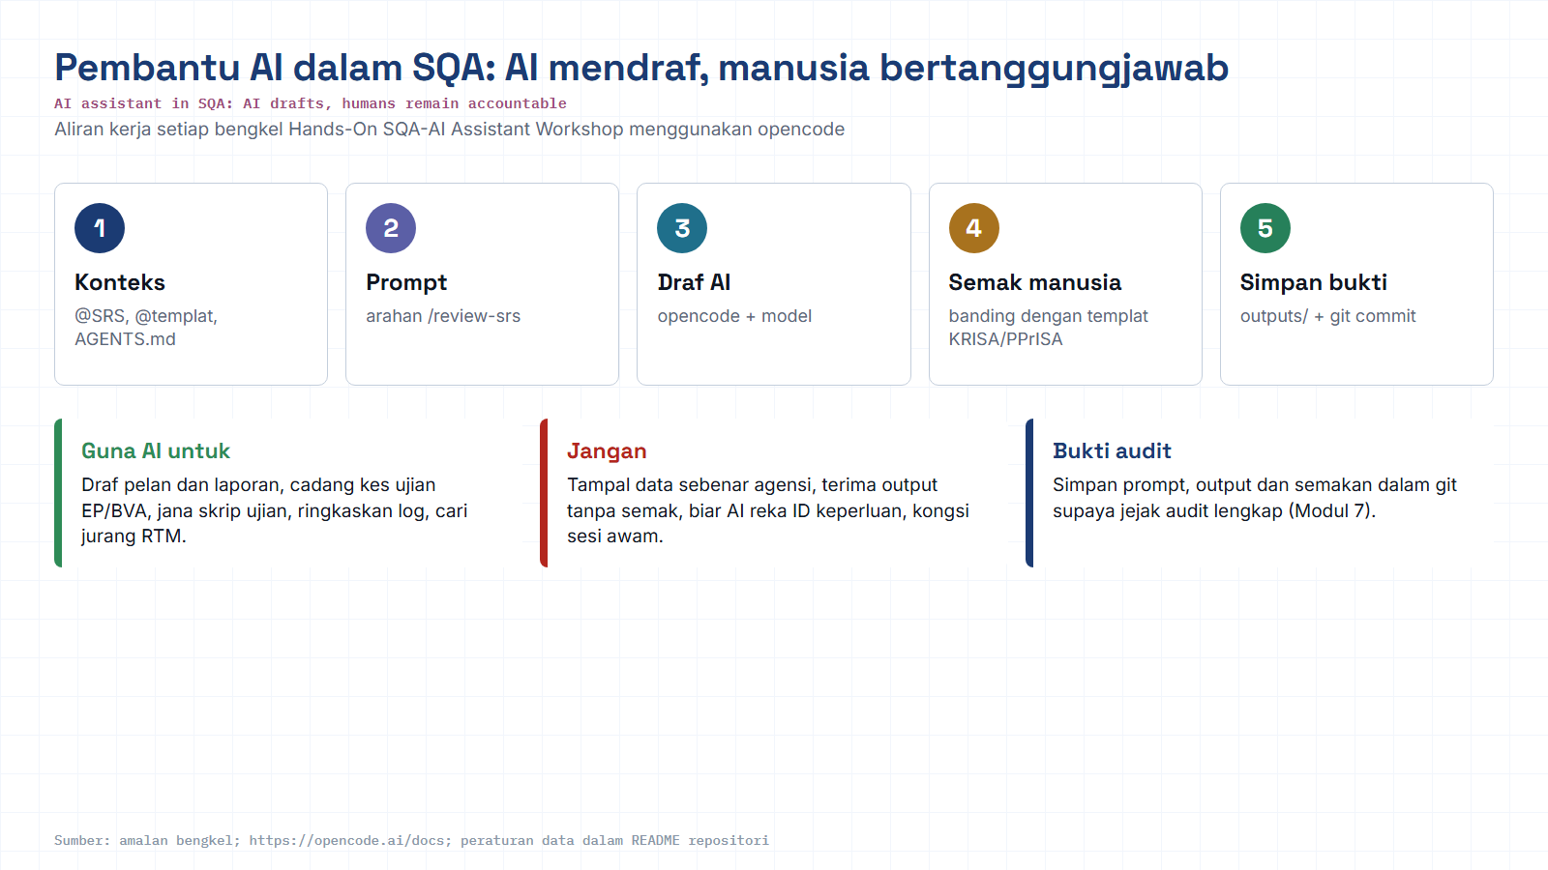
Module hub
Open: opencode docs
Notes:
Reminder of the rules for every AI workshop: context, prompt, AI draft, human review against the KRISA/PPrISA template, save evidence. Stress the data rule: synthetic data only.

