Slide 1
W00 · Setup · 30 MINIT / MINUTES · Hari 1, 09:00 hingga 09:30
Hands-On SQA-AI Assistant Workshop
Set up your SQA-AI assistant
Sediakan pembantu AI SQA anda
Clone the course repository, check the PC, install opencode, start it in the lab folder with the free model and learn the five controls you will use all day.
opencode 1.18 · model Big Pickle (OpenCode Zen, free, no API key) · synthetic ShopFast data only
Bengkel SQA KRISAv2 dan PPrISA 2.0 · 14 hingga 15 September 2026 · Makmal Komputer Aras 11, Menara MyIPO
Web guide (copy prompts)
Module hub
Example outputs (GitHub)
Notes:
W00: 30 minutes. Real screenshots captured on 13 Sep 2026 from a fresh clone of the course repository on Windows 11 with opencode 1.18.30 and the free Big Pickle model. AI answers vary between runs; the steps and checks do not.

Slide 2
Before you start / Sebelum mula
YOU WILL / ANDA AKAN
CHECK FIRST / SEMAK DAHULU
1. Clone the repository and run setup\check-lab.ps1
2. Install opencode with npm and check the version
3. Start opencode in lab\ with the Big Pickle model
4. Learn Tab (Plan or Build), @file, /command, /models and !command
- PowerShell is in C:\Users\<you>\sqa-krisa-bengkel\lab
- opencode starts and shows Big Pickle, OpenCode Zen (W00)
Data rules / Peraturan data
- Synthetic ShopFast data only. Never paste real agency documents or personal data.
- Free models run outside Malaysia and may learn from prompts.
- AI output is a draft. A person checks and signs off.
1. Klon repositori dan jalankan setup\check-lab.ps1
2. Pasang opencode dengan npm dan semak versi
3. Mulakan opencode dalam lab\ dengan model Big Pickle
4. Kenali Tab (Plan atau Build), @fail, /arahan, /models dan !arahan
OUTPUT
PC sedia: check-lab.ps1 menunjukkan SEMUA OK

Slide 3
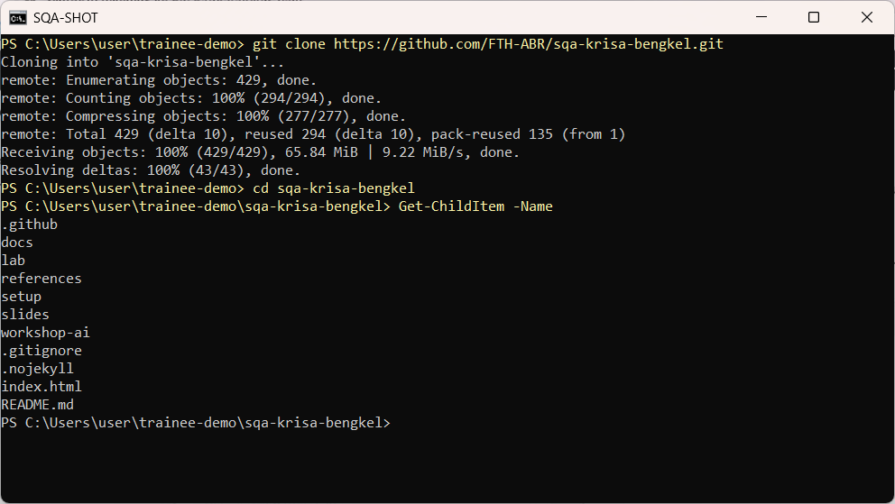
W00 · STEP 1 OF 10 · LANGKAH 1
Open PowerShell, go to your home folder and clone the course repository.
Buka PowerShell, pergi ke folder rumah dan klon repositori kursus.
TYPE IN POWERSHELL
cd $HOME
git clone https://github.com/FTH-ABR/sqa-krisa-bengkel.git
cd sqa-krisa-bengkel
Real screenshot, 13 Sep 2026
Notes:
Step 1: Open PowerShell, go to your home folder and clone the course repository.
Command or prompt:
cd $HOME
git clone https://github.com/FTH-ABR/sqa-krisa-bengkel.git
cd sqa-krisa-bengkel
Screenshot: workshop-ai/W00-setup/screenshots/01-git-clone.png

Slide 4
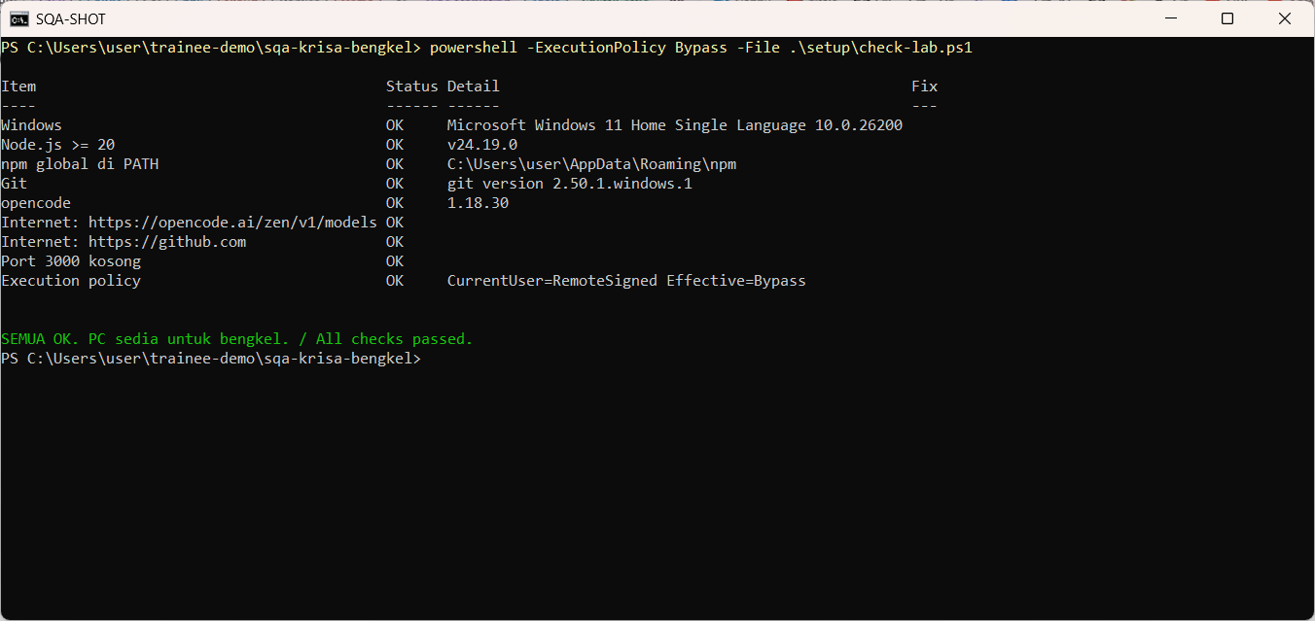
W00 · STEP 2 OF 10 · LANGKAH 2
Run the lab readiness check. Every line must say OK. Fix anything else using the Fix column.
Jalankan semakan kesediaan makmal. Setiap baris mesti OK. Betulkan yang lain menggunakan lajur Fix.
TYPE IN POWERSHELL
powershell -ExecutionPolicy Bypass -File .\setup\check-lab.ps1
Real screenshot, 13 Sep 2026
Notes:
Step 2: Run the lab readiness check. Every line must say OK. Fix anything else using the Fix column.
Command or prompt:
powershell -ExecutionPolicy Bypass -File .\setup\check-lab.ps1
Screenshot: workshop-ai/W00-setup/screenshots/02-check-lab.png

Slide 5
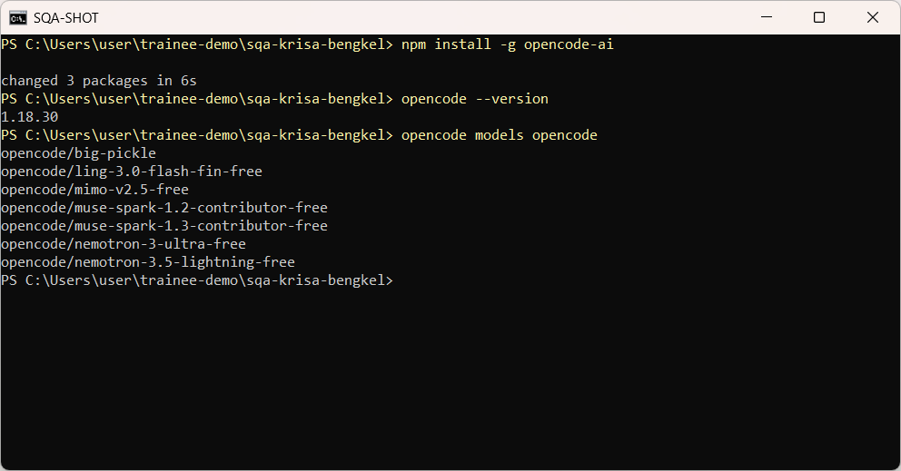
W00 · STEP 3 OF 10 · LANGKAH 3
Install opencode with npm, confirm the version and list the free OpenCode Zen models.
Pasang opencode dengan npm, sahkan versi dan senaraikan model percuma OpenCode Zen.
TYPE IN POWERSHELL
npm install -g opencode-ai
opencode --version
opencode models opencode
Real screenshot, 13 Sep 2026
Notes:
Step 3: Install opencode with npm, confirm the version and list the free OpenCode Zen models.
Command or prompt:
npm install -g opencode-ai
opencode --version
opencode models opencode
Screenshot: workshop-ai/W00-setup/screenshots/03-install-opencode.png

Slide 6
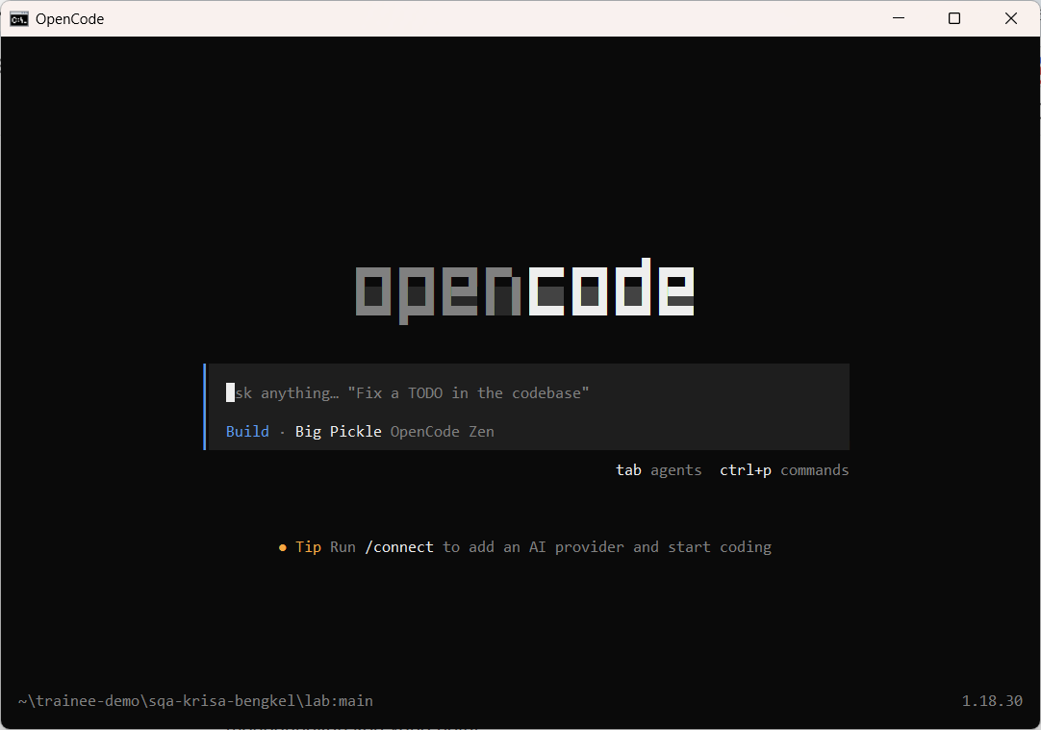
W00 · STEP 4 OF 10 · LANGKAH 4
Go into the lab folder and start opencode with the free Big Pickle model. No account or API key is needed.
Masuk ke folder lab dan mulakan opencode dengan model percuma Big Pickle. Tiada akaun atau kunci API diperlukan.
TYPE IN POWERSHELL
cd lab
opencode -m opencode/big-pickle
Real screenshot, 13 Sep 2026
Notes:
Step 4: Go into the lab folder and start opencode with the free Big Pickle model. No account or API key is needed.
Command or prompt:
cd lab
opencode -m opencode/big-pickle
Screenshot: workshop-ai/W00-setup/screenshots/04-opencode-home.png

Slide 7
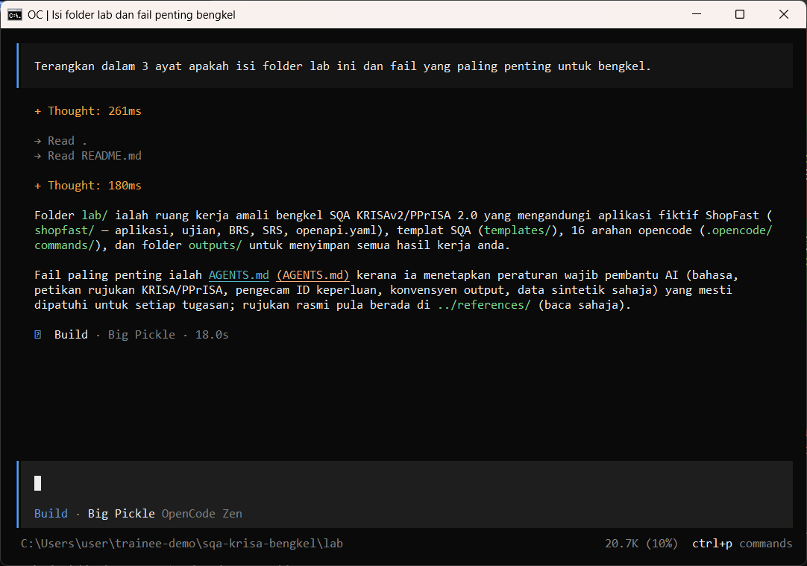
W00 · STEP 5 OF 10 · LANGKAH 5
Type your first question and press Enter. The assistant reads the folder and AGENTS.md before answering.
Taip soalan pertama dan tekan Enter. Pembantu membaca folder dan AGENTS.md sebelum menjawab.
TYPE IN OPENCODE
Terangkan dalam 3 ayat apakah isi folder lab ini dan fail yang paling penting untuk bengkel.
Real screenshot, 13 Sep 2026
Notes:
Step 5: Type your first question and press Enter. The assistant reads the folder and AGENTS.md before answering.
Command or prompt:
Terangkan dalam 3 ayat apakah isi folder lab ini dan fail yang paling penting untuk bengkel.
Screenshot: workshop-ai/W00-setup/screenshots/05-first-prompt.png

Slide 8
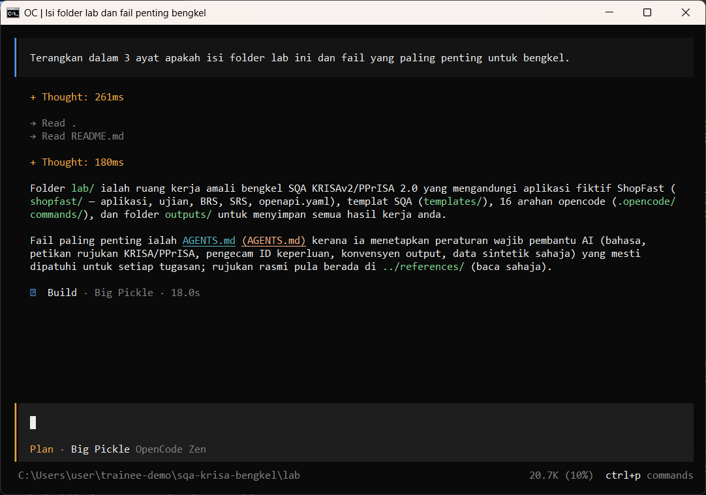
W00 · STEP 6 OF 10 · LANGKAH 6
Press Tab to switch between Build (can edit files) and Plan (read only). Use Plan for reviews.
Tekan Tab untuk bertukar antara Build (boleh ubah fail) dan Plan (baca sahaja). Guna Plan untuk semakan.
TYPE IN OPENCODE
Tab
Real screenshot, 13 Sep 2026
Notes:
Step 6: Press Tab to switch between Build (can edit files) and Plan (read only). Use Plan for reviews.
Command or prompt:
Tab
Screenshot: workshop-ai/W00-setup/screenshots/06-plan-agent.png

Slide 9
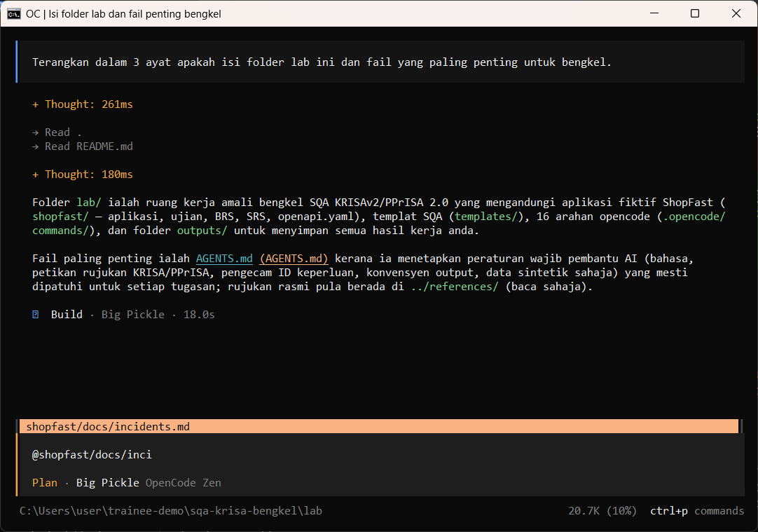
W00 · STEP 7 OF 10 · LANGKAH 7
Type @ and part of a file name to attach a file to your prompt. Pick it from the list.
Taip @ dan sebahagian nama fail untuk melampirkan fail pada prompt. Pilih daripada senarai.
TYPE IN OPENCODE
@shopfast/docs/inci
Real screenshot, 13 Sep 2026
Notes:
Step 7: Type @ and part of a file name to attach a file to your prompt. Pick it from the list.
Command or prompt:
@shopfast/docs/inci
Screenshot: workshop-ai/W00-setup/screenshots/07-at-file.png

Slide 10
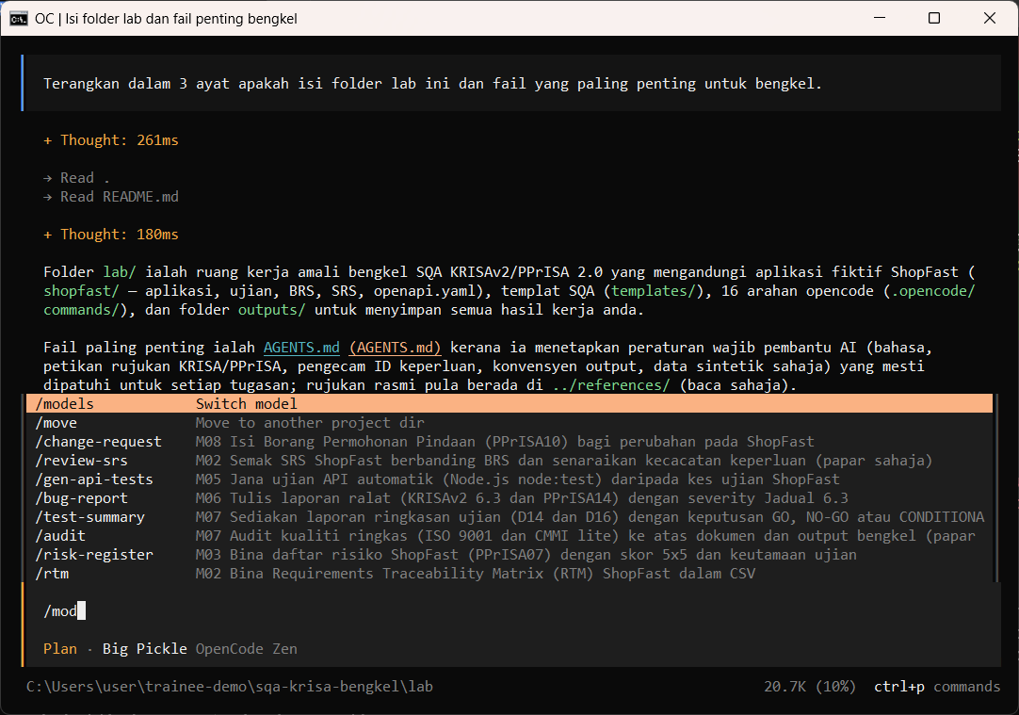
W00 · STEP 8 OF 10 · LANGKAH 8
Type / to see commands. The course adds 16 SQA commands such as /review-srs and /testcases.
Taip / untuk melihat arahan. Kursus menambah 16 arahan SQA seperti /review-srs dan /testcases.
TYPE IN OPENCODE
/mod
Real screenshot, 13 Sep 2026
Notes:
Step 8: Type / to see commands. The course adds 16 SQA commands such as /review-srs and /testcases.
Command or prompt:
/mod
Screenshot: workshop-ai/W00-setup/screenshots/08-slash-commands.png

Slide 11
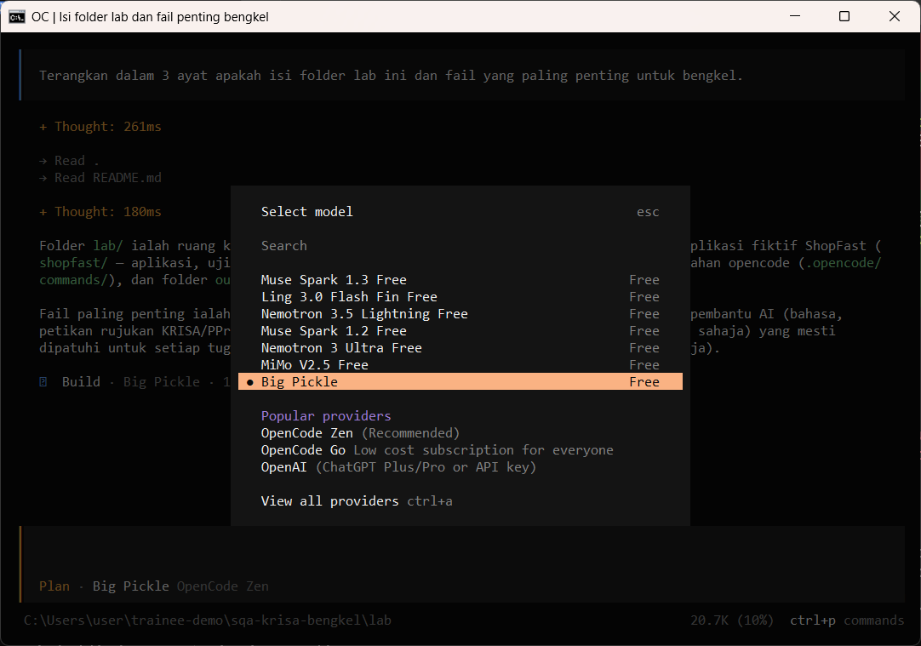
W00 · STEP 9 OF 10 · LANGKAH 9
/models shows the free models. Keep Big Pickle unless the trainer says otherwise.
/models memaparkan model percuma. Kekalkan Big Pickle melainkan jurulatih mengarahkan lain.
TYPE IN OPENCODE
/models
Real screenshot, 13 Sep 2026
Notes:
Step 9: /models shows the free models. Keep Big Pickle unless the trainer says otherwise.
Command or prompt:
/models
Screenshot: workshop-ai/W00-setup/screenshots/09-models-dialog.png

Slide 12
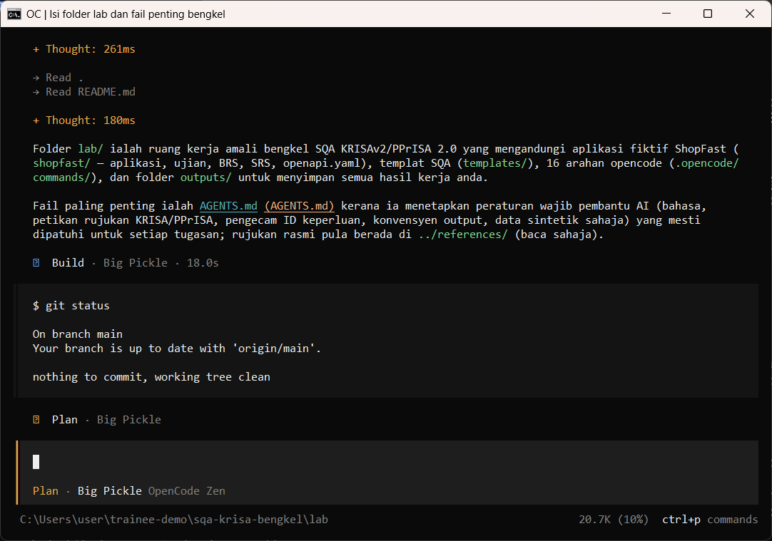
W00 · STEP 10 OF 10 · LANGKAH 10
Start a line with ! to run a terminal command without leaving opencode.
Mulakan baris dengan ! untuk menjalankan arahan terminal tanpa keluar dari opencode.
TYPE IN OPENCODE
!git status
Real screenshot, 13 Sep 2026
Notes:
Step 10: Start a line with ! to run a terminal command without leaving opencode.
Command or prompt:
!git status
Screenshot: workshop-ai/W00-setup/screenshots/10-bang-command.png

Slide 13
Human check before you accept the output / Semakan manusia
check-lab.ps1 shows all OK
check-lab.ps1 menunjukkan SEMUA OK
opencode --version prints 1.18.x
opencode --version memaparkan 1.18.x
The status line shows Big Pickle, OpenCode Zen
Baris status memaparkan Big Pickle, OpenCode Zen
The AI draft becomes evidence only after this check. Record who checked it and when (Module 7 audit trail).

Slide 14
If something goes wrong / Jika ada masalah
opencode is not recognised
Close and reopen PowerShell so PATH refreshes. Still failing: powershell -ExecutionPolicy Bypass -File .\setup\install-opencode.ps1 -Portable
Scripts are disabled on this system
Set-ExecutionPolicy -Scope CurrentUser RemoteSigned, or run opencode.cmd instead of opencode
The model is slow or stops
Wait up to 2 minutes. Press Esc to interrupt, then send the prompt again. Try another free model with /models
Permission required dialog
Read the preview. Choose Allow once for files in outputs/. Reject anything outside the lab folder
File or command not found
Check the status bar path ends with \lab. Commands and @files are relative to the lab folder
Answer uses Indonesian words or dashes
Reply: Ikut AGENTS.md peraturan 1 dan 14, tulis semula dalam Bahasa Melayu Malaysia
Network or proxy error
$env:HTTPS_PROXY = "http://proxy:port" and $env:NO_PROXY = "localhost,127.0.0.1" before starting opencode
Port 3000 already in use
$env:PORT = 3001 before npm start, and use http://localhost:3001

Slide 15
Links / Pautan
Web guide with copyable prompts
Module hub (slides, references, templates)
Example outputs from the real run
Lab README and command list
AGENTS.md rules used by the assistant
opencode documentation
opencode TUI commands and keys
OpenCode Zen free models and data policy

