Slide 1
W02 · M02 · 25 MINIT / MINUTES · Hari 1, 12:30 hingga 12:55
Hands-On SQA-AI Assistant Workshop
AI-assisted requirement review and RTM
Semakan keperluan dan RTM dibantu AI
Let the AI statically review the flawed ShopFast SRS against the BRS, rewrite weak requirements as Given/When/Then and draft the RTM as CSV.
opencode 1.18 · model Big Pickle (OpenCode Zen, free, no API key) · synthetic ShopFast data only
Bengkel SQA KRISAv2 dan PPrISA 2.0 · 14 hingga 15 September 2026 · Makmal Komputer Aras 11, Menara MyIPO
Web guide (copy prompts)
Module hub
Example outputs (GitHub)
Notes:
W02: 25 minutes. Real screenshots captured on 13 Sep 2026 from a fresh clone of the course repository on Windows 11 with opencode 1.18.30 and the free Big Pickle model. AI answers vary between runs; the steps and checks do not.

Slide 2
Before you start / Sebelum mula
YOU WILL / ANDA AKAN
CHECK FIRST / SEMAK DAHULU
1. Run /review-srs on two checkout requirements
2. Compare the AI findings with your team review
3. Run /rewrite-gwt and approve the file
4. Run /rtm and open the CSV
- PowerShell is in C:\Users\<you>\sqa-krisa-bengkel\lab
- opencode starts and shows Big Pickle, OpenCode Zen (W00)
Data rules / Peraturan data
- Synthetic ShopFast data only. Never paste real agency documents or personal data.
- Free models run outside Malaysia and may learn from prompts.
- AI output is a draft. A person checks and signs off.
1. Jalankan /review-srs untuk dua keperluan checkout
2. Bandingkan penemuan AI dengan semakan pasukan anda
3. Jalankan /rewrite-gwt dan luluskan fail
4. Jalankan /rtm dan buka CSV
OUTPUT
outputs/m02-gwt-rewrite.md, outputs/m02-rtm.csv

Slide 3
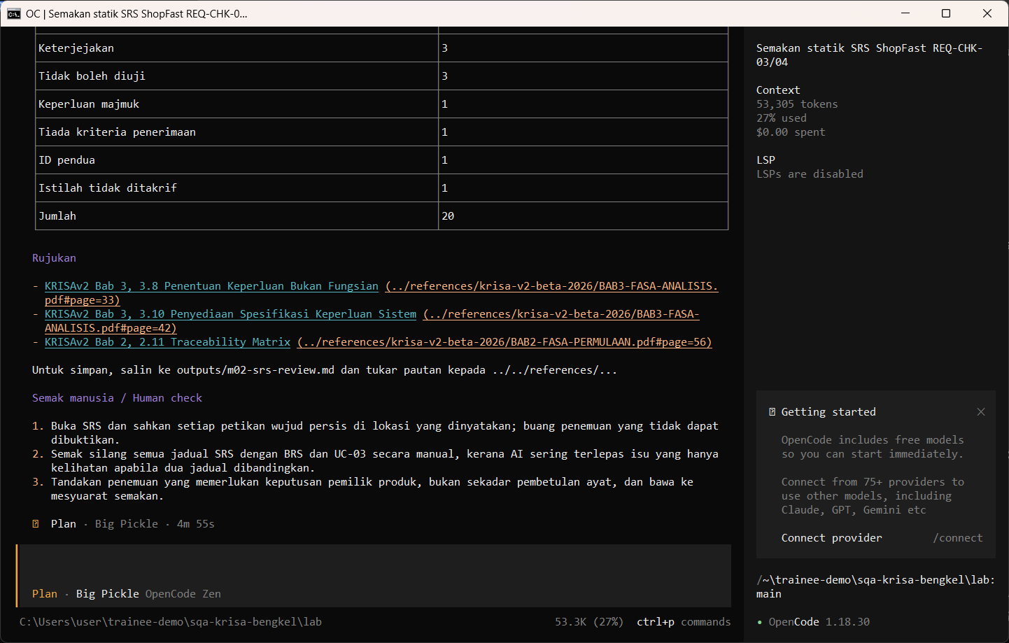
W02 · STEP 1 OF 6 · LANGKAH 1
Run the SRS review command in Plan mode. It reads the SRS, BRS and RTM guide and prints findings.
Jalankan arahan semakan SRS dalam mod Plan. Ia membaca SRS, BRS dan panduan RTM dan memaparkan penemuan.
TYPE IN OPENCODE (PLAN)
/review-srs REQ-CHK-03 dan REQ-CHK-04
Real screenshot, 13 Sep 2026
Notes:
Step 1: Run the SRS review command in Plan mode. It reads the SRS, BRS and RTM guide and prints findings.
Command or prompt:
/review-srs REQ-CHK-03 dan REQ-CHK-04
Screenshot: workshop-ai/W02-perancangan-qa/screenshots/01-review-srs.png

Slide 4
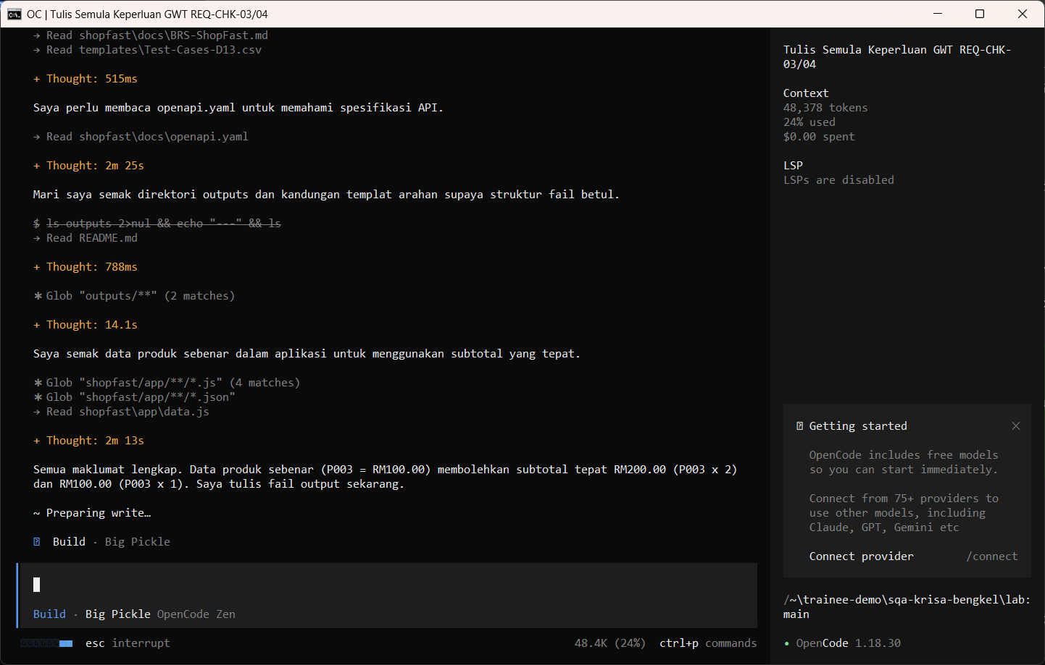
W02 · STEP 2 OF 6 · LANGKAH 2
Run /rewrite-gwt in Build mode and review the write permission. The AI reads the documents first and may pause at Preparing write. When the Permission required dialog appears, read the preview and choose Allow once.
Jalankan /rewrite-gwt dalam mod Build dan semak kebenaran menulis. AI membaca dokumen dahulu dan mungkin berhenti seketika pada Preparing write. Apabila dialog Permission required muncul, baca pratonton dan pilih Allow once.
TYPE IN OPENCODE (BUILD)
/rewrite-gwt REQ-CHK-03 REQ-CHK-04
Real screenshot, 13 Sep 2026
Notes:
Step 2: Run /rewrite-gwt in Build mode and review the write permission. The AI reads the documents first and may pause at Preparing write. When the Permission required dialog appears, read the preview and choose Allow once.
Command or prompt:
/rewrite-gwt REQ-CHK-03 REQ-CHK-04
Screenshot: workshop-ai/W02-perancangan-qa/screenshots/02-rewrite-gwt-permission.png

Slide 5
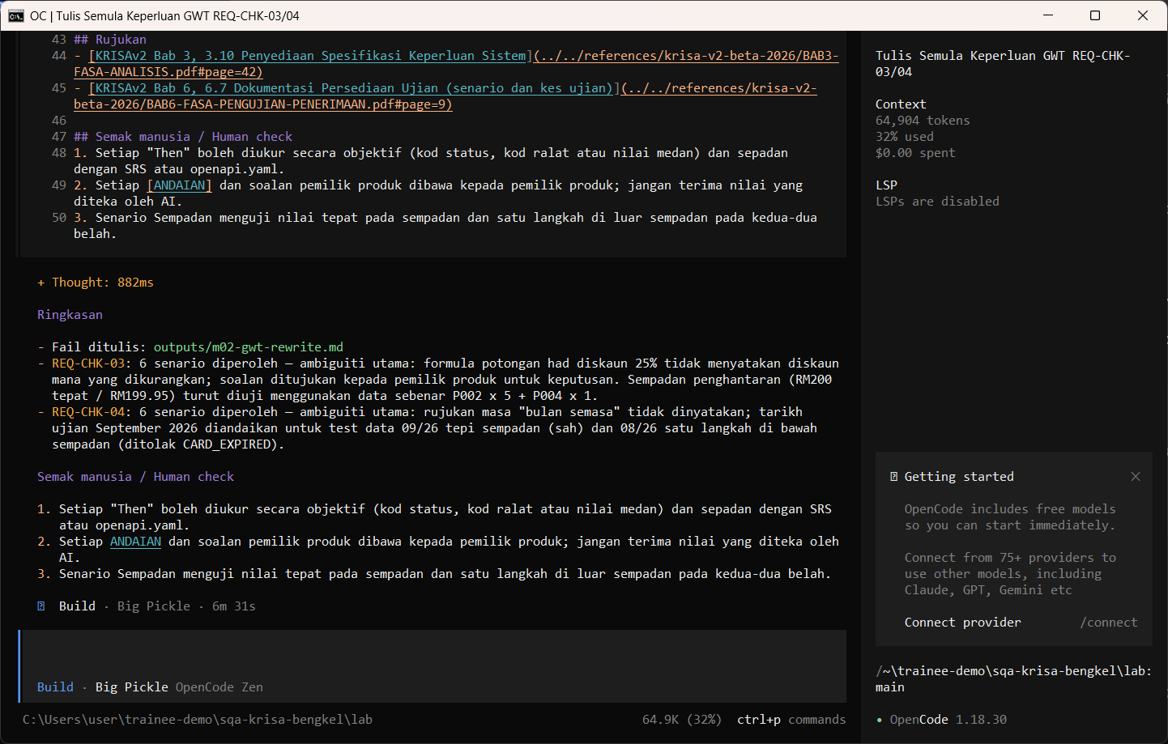
W02 · STEP 3 OF 6 · LANGKAH 3
Allow once. The Given/When/Then rewrite is saved.
Allow once. Tulis semula Given/When/Then disimpan.
TYPE IN OPENCODE
Allow once (Enter)
Real screenshot, 13 Sep 2026
Notes:
Step 3: Allow once. The Given/When/Then rewrite is saved.
Command or prompt:
Allow once (Enter)
Screenshot: workshop-ai/W02-perancangan-qa/screenshots/03-rewrite-gwt-saved.png

Slide 6
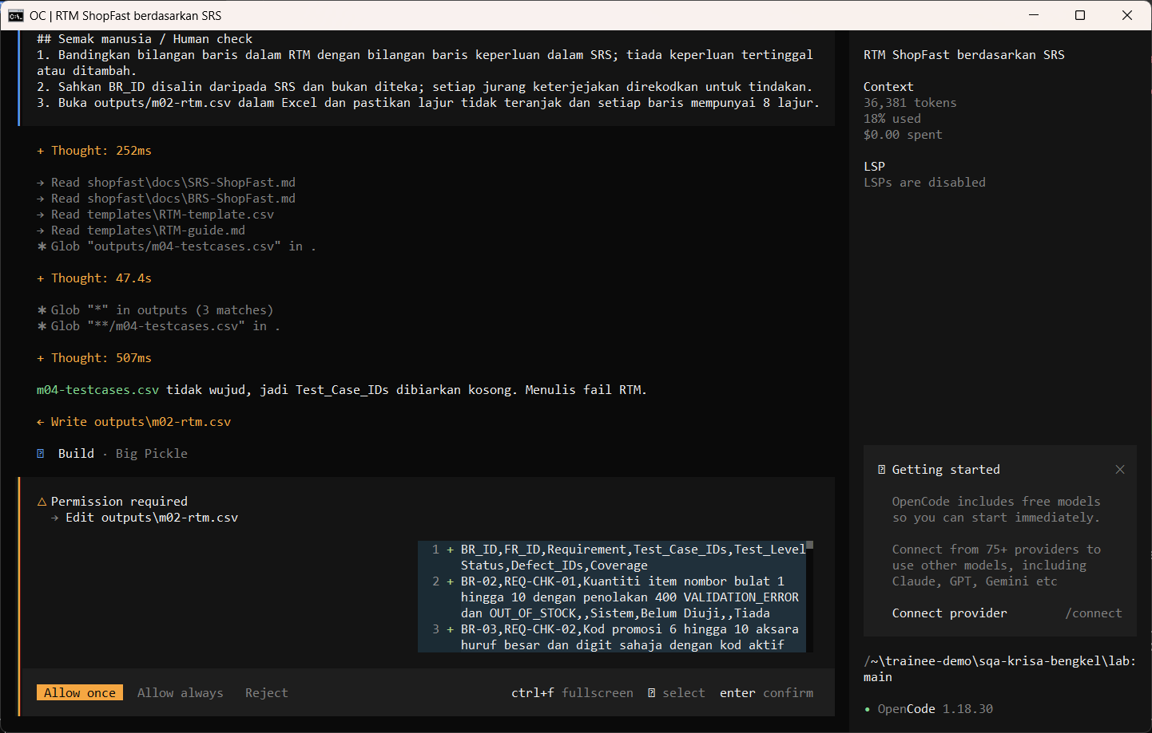
W02 · STEP 4 OF 6 · LANGKAH 4
Run /rtm to draft the traceability matrix. The AI reads the documents first and may pause at Preparing write. When the Permission required dialog appears, read the preview and choose Allow once.
Jalankan /rtm untuk mendraf matriks kebolehkesanan. AI membaca dokumen dahulu dan mungkin berhenti seketika pada Preparing write. Apabila dialog Permission required muncul, baca pratonton dan pilih Allow once.
TYPE IN OPENCODE (BUILD)
/rtm REQ-CHK-01 hingga REQ-CHK-06
Real screenshot, 13 Sep 2026
Notes:
Step 4: Run /rtm to draft the traceability matrix. The AI reads the documents first and may pause at Preparing write. When the Permission required dialog appears, read the preview and choose Allow once.
Command or prompt:
/rtm REQ-CHK-01 hingga REQ-CHK-06
Screenshot: workshop-ai/W02-perancangan-qa/screenshots/04-rtm-permission.png

Slide 7
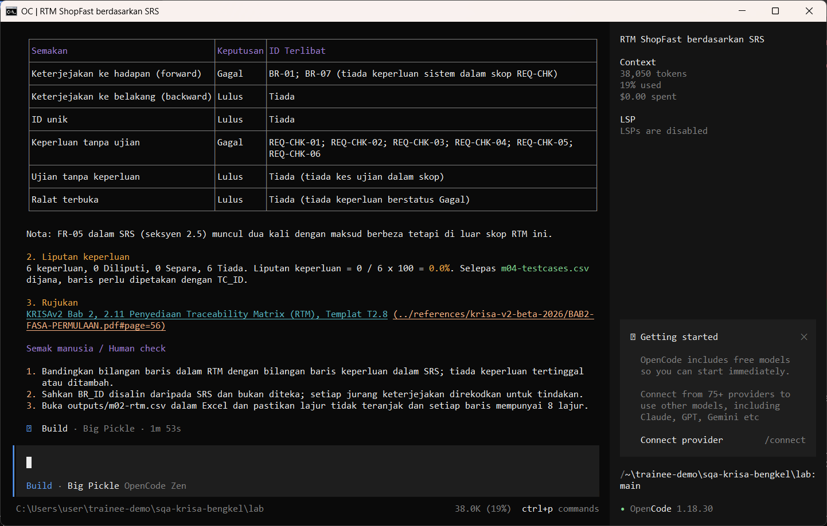
W02 · STEP 5 OF 6 · LANGKAH 5
Allow once. The RTM CSV is saved.
Allow once. CSV RTM disimpan.
TYPE IN OPENCODE
Allow once (Enter)
Real screenshot, 13 Sep 2026
Notes:
Step 5: Allow once. The RTM CSV is saved.
Command or prompt:
Allow once (Enter)
Screenshot: workshop-ai/W02-perancangan-qa/screenshots/05-rtm-saved.png

Slide 8
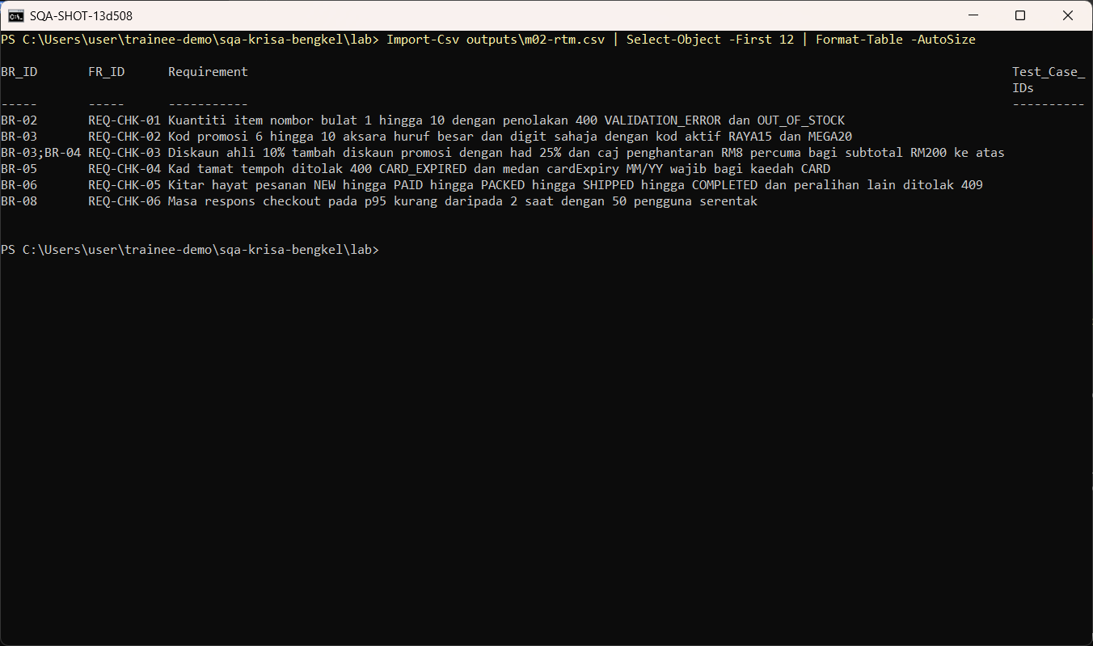
W02 · STEP 6 OF 6 · LANGKAH 6
Open the CSV and compare the rows with the SRS requirement IDs.
Buka CSV dan bandingkan baris dengan ID keperluan SRS.
TYPE IN POWERSHELL
Import-Csv outputs\m02-rtm.csv | Select-Object -First 12 | Format-Table -AutoSize
Real screenshot, 13 Sep 2026
Notes:
Step 6: Open the CSV and compare the rows with the SRS requirement IDs.
Command or prompt:
Import-Csv outputs\m02-rtm.csv | Select-Object -First 12 | Format-Table -AutoSize
Screenshot: workshop-ai/W02-perancangan-qa/screenshots/06-open-rtm.png

Slide 9
Human check before you accept the output / Semakan manusia
Every finding quotes text that really exists in the SRS
Setiap penemuan memetik teks yang benar-benar wujud dalam SRS
Each Given/When/Then has one observable Then
Setiap Given/When/Then mempunyai satu Then yang boleh diperhatikan
RTM rows match the requirement IDs in the SRS, none invented
Baris RTM sepadan dengan ID keperluan dalam SRS, tiada yang direka
The AI draft becomes evidence only after this check. Record who checked it and when (Module 7 audit trail).

Slide 10
If something goes wrong / Jika ada masalah
opencode is not recognised
Close and reopen PowerShell so PATH refreshes. Still failing: powershell -ExecutionPolicy Bypass -File .\setup\install-opencode.ps1 -Portable
Scripts are disabled on this system
Set-ExecutionPolicy -Scope CurrentUser RemoteSigned, or run opencode.cmd instead of opencode
The model is slow or stops
Wait up to 2 minutes. Press Esc to interrupt, then send the prompt again. Try another free model with /models
Permission required dialog
Read the preview. Choose Allow once for files in outputs/. Reject anything outside the lab folder
File or command not found
Check the status bar path ends with \lab. Commands and @files are relative to the lab folder
Answer uses Indonesian words or dashes
Reply: Ikut AGENTS.md peraturan 1 dan 14, tulis semula dalam Bahasa Melayu Malaysia
Network or proxy error
$env:HTTPS_PROXY = "http://proxy:port" and $env:NO_PROXY = "localhost,127.0.0.1" before starting opencode
Port 3000 already in use
$env:PORT = 3001 before npm start, and use http://localhost:3001

Slide 11
Links / Pautan
Web guide with copyable prompts
Module hub (slides, references, templates)
Example outputs from the real run
Lab README and command list
AGENTS.md rules used by the assistant
opencode documentation
opencode TUI commands and keys
OpenCode Zen free models and data policy
Bab 2, 2.4 Kajian Keperluan Bisnes (BRS) (p.10)
Bab 2, 2.11 Traceability Matrix (RTM) F1.8, Templat T2.8 (p.56)
Bab 3, 3.8 Keperluan Bukan Fungsian F2.4 (p.33)

