Slide 1
W03 · M03 · 20 MINIT / MINUTES · Hari 1, 15:05 hingga 15:25
Hands-On SQA-AI Assistant Workshop
AI design review and 5 x 5 risk register
Semakan reka bentuk AI dan daftar risiko 5 x 5
Review the ShopFast architecture and OpenAPI contract with the AI, challenge one finding for evidence, then build a scored risk register in PPrISA07 format.
opencode 1.18 · model Big Pickle (OpenCode Zen, free, no API key) · synthetic ShopFast data only
Bengkel SQA KRISAv2 dan PPrISA 2.0 · 14 hingga 15 September 2026 · Makmal Komputer Aras 11, Menara MyIPO
Web guide (copy prompts)
Module hub
Example outputs (GitHub)
Notes:
W03: 20 minutes. Real screenshots captured on 13 Sep 2026 from a fresh clone of the course repository on Windows 11 with opencode 1.18.30 and the free Big Pickle model. AI answers vary between runs; the steps and checks do not.

Slide 2
Before you start / Sebelum mula
YOU WILL / ANDA AKAN
CHECK FIRST / SEMAK DAHULU
1. Run /design-review on the order endpoint
2. Challenge one finding: ask for the exact line as evidence
3. Run /risk-register and approve the CSV
4. Sort by score and agree the top three test priorities
- PowerShell is in C:\Users\<you>\sqa-krisa-bengkel\lab
- opencode starts and shows Big Pickle, OpenCode Zen (W00)
Data rules / Peraturan data
- Synthetic ShopFast data only. Never paste real agency documents or personal data.
- Free models run outside Malaysia and may learn from prompts.
- AI output is a draft. A person checks and signs off.
1. Jalankan /design-review untuk endpoint pesanan
2. Cabar satu penemuan: minta baris tepat sebagai bukti
3. Jalankan /risk-register dan luluskan CSV
4. Susun mengikut skor dan setuju tiga keutamaan ujian teratas
OUTPUT
outputs/m03-risk-register.csv

Slide 3
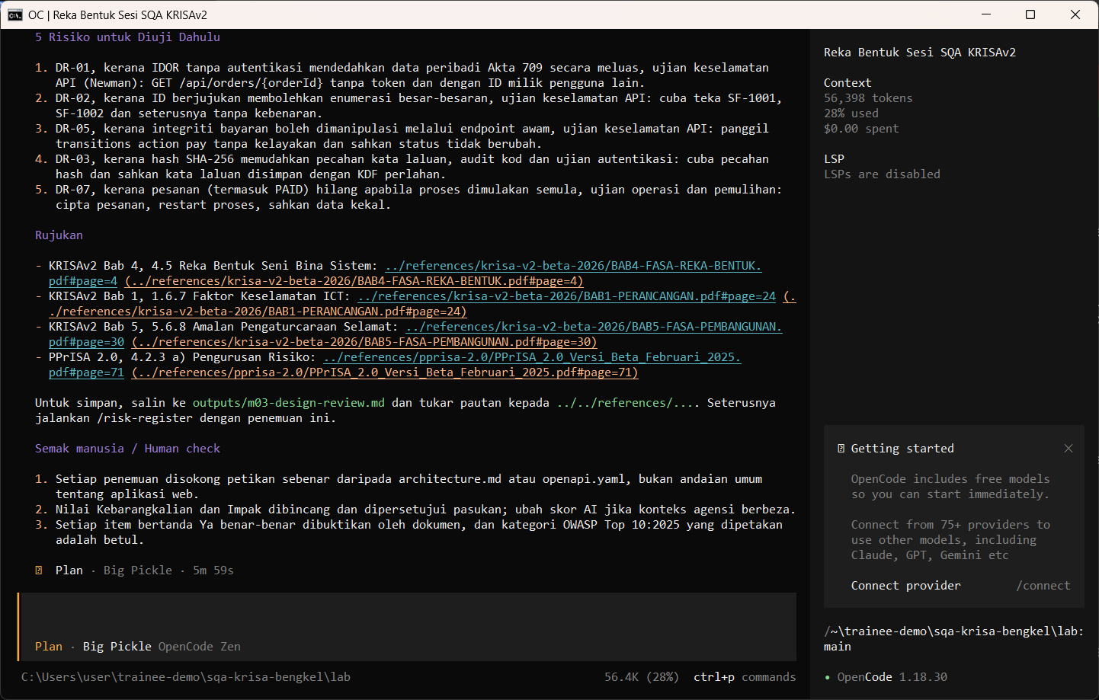
W03 · STEP 1 OF 5 · LANGKAH 1
Run the design review in Plan mode for the order endpoint.
Jalankan semakan reka bentuk dalam mod Plan untuk endpoint pesanan.
TYPE IN OPENCODE (PLAN)
/design-review GET /api/orders/{orderId}
Real screenshot, 13 Sep 2026
Notes:
Step 1: Run the design review in Plan mode for the order endpoint.
Command or prompt:
/design-review GET /api/orders/{orderId}
Screenshot: workshop-ai/W03-semakan-reka-bentuk-risiko/screenshots/01-design-review.png

Slide 4
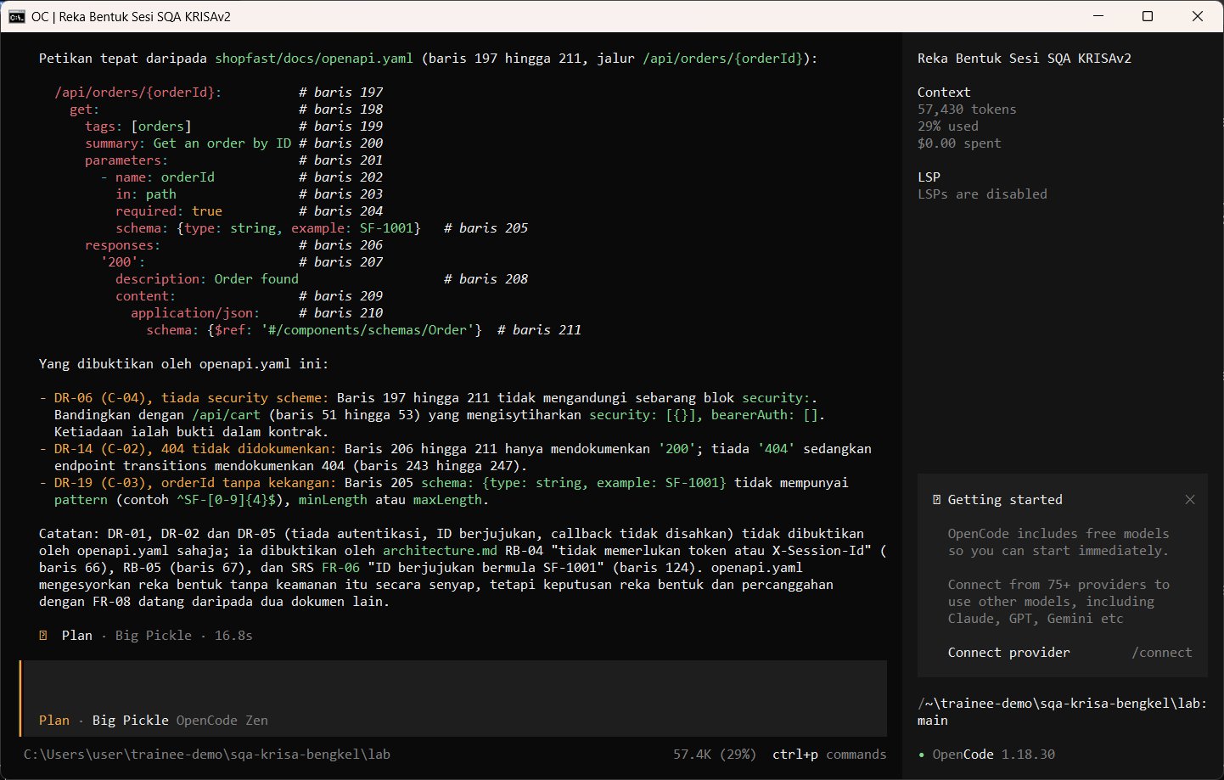
W03 · STEP 2 OF 5 · LANGKAH 2
Challenge the AI: ask for the exact line that proves the finding.
Cabar AI: minta baris tepat yang membuktikan penemuan.
TYPE IN OPENCODE (PLAN)
Petik baris tepat dalam shopfast/docs/openapi.yaml yang membuktikan penemuan anda tentang GET /api/orders/{orderId}.
Real screenshot, 13 Sep 2026
Notes:
Step 2: Challenge the AI: ask for the exact line that proves the finding.
Command or prompt:
Petik baris tepat dalam shopfast/docs/openapi.yaml yang membuktikan penemuan anda tentang GET /api/orders/{orderId}.
Screenshot: workshop-ai/W03-semakan-reka-bentuk-risiko/screenshots/02-challenge-evidence.png

Slide 5
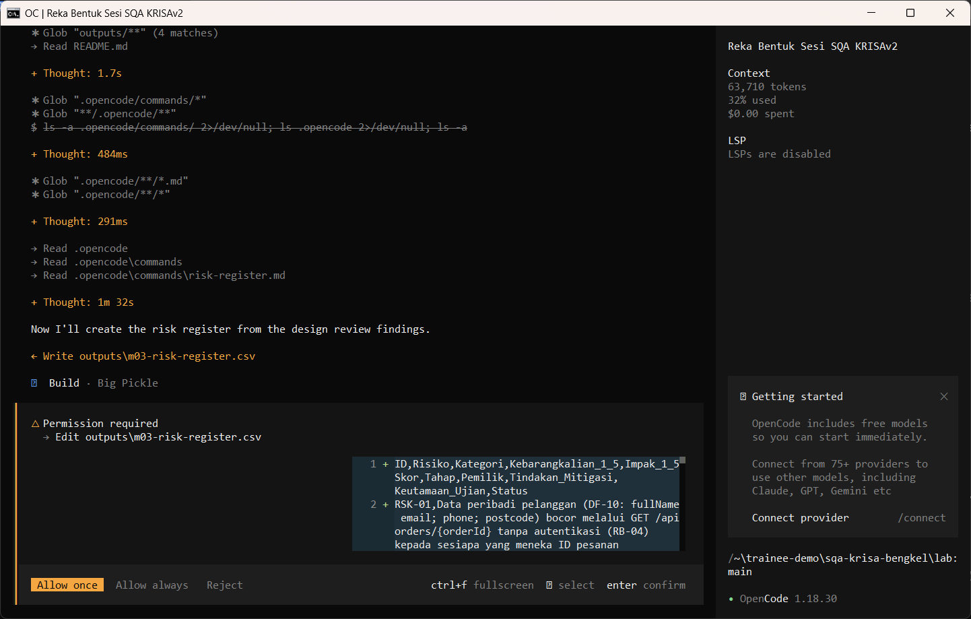
W03 · STEP 3 OF 5 · LANGKAH 3
Switch to Build and run /risk-register. Review the permission. The AI reads the documents first and may pause at Preparing write. When the Permission required dialog appears, read the preview and choose Allow once.
Tukar ke Build dan jalankan /risk-register. Semak kebenaran. AI membaca dokumen dahulu dan mungkin berhenti seketika pada Preparing write. Apabila dialog Permission required muncul, baca pratonton dan pilih Allow once.
TYPE IN OPENCODE (BUILD)
/risk-register checkout ShopFast berdasarkan penemuan semakan reka bentuk di atas
Real screenshot, 13 Sep 2026
Notes:
Step 3: Switch to Build and run /risk-register. Review the permission. The AI reads the documents first and may pause at Preparing write. When the Permission required dialog appears, read the preview and choose Allow once.
Command or prompt:
/risk-register checkout ShopFast berdasarkan penemuan semakan reka bentuk di atas
Screenshot: workshop-ai/W03-semakan-reka-bentuk-risiko/screenshots/03-risk-register-permission.png

Slide 6
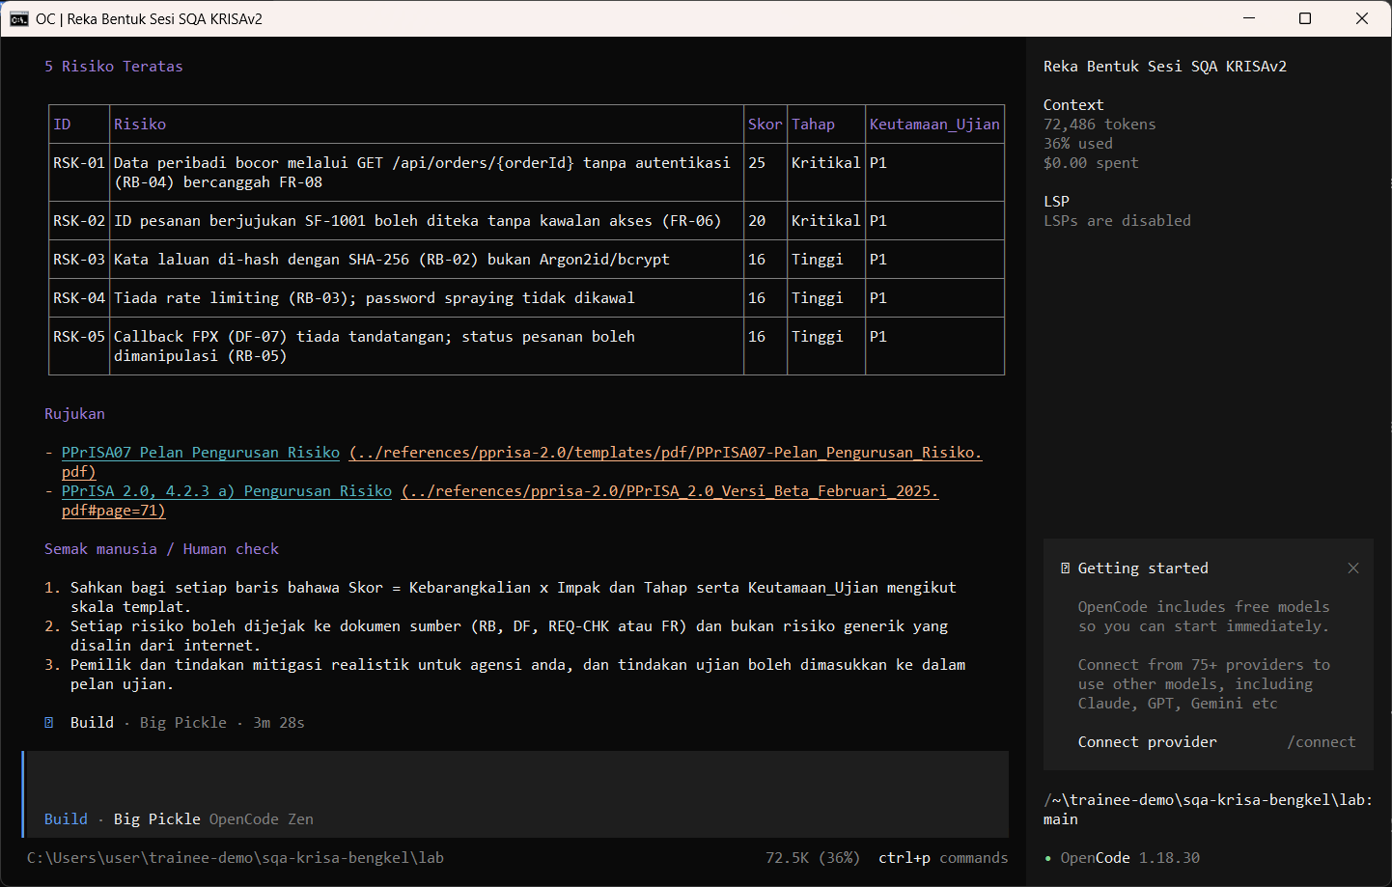
W03 · STEP 4 OF 5 · LANGKAH 4
Allow once. The risk register CSV is saved.
Allow once. CSV daftar risiko disimpan.
TYPE IN OPENCODE
Allow once (Enter)
Real screenshot, 13 Sep 2026
Notes:
Step 4: Allow once. The risk register CSV is saved.
Command or prompt:
Allow once (Enter)
Screenshot: workshop-ai/W03-semakan-reka-bentuk-risiko/screenshots/04-risk-register-saved.png

Slide 7
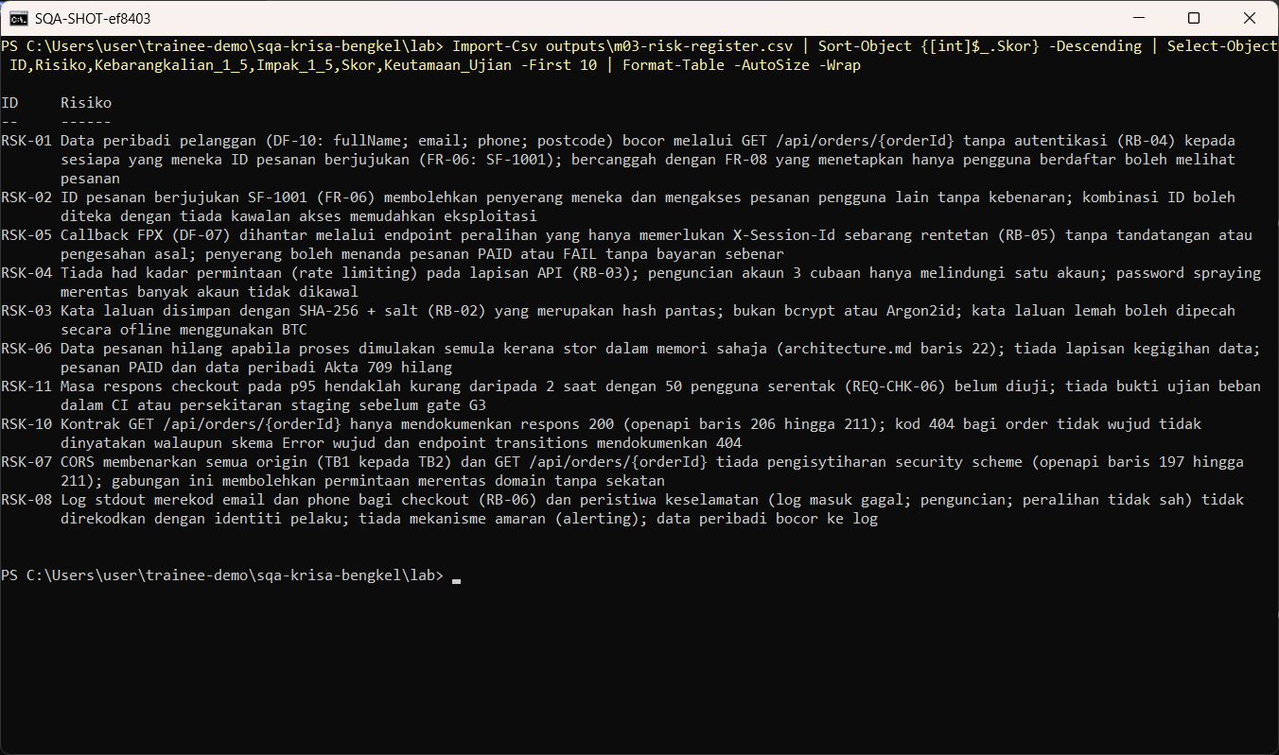
W03 · STEP 5 OF 5 · LANGKAH 5
Sort by score and agree the top three test priorities.
Susun mengikut skor dan setuju tiga keutamaan ujian teratas.
TYPE IN POWERSHELL
Import-Csv outputs\m03-risk-register.csv | Sort-Object {[int]$_.Skor} -Descending | Format-Table -AutoSize -Wrap
Real screenshot, 13 Sep 2026
Notes:
Step 5: Sort by score and agree the top three test priorities.
Command or prompt:
Import-Csv outputs\m03-risk-register.csv | Sort-Object {[int]$_.Skor} -Descending | Format-Table -AutoSize -Wrap
Screenshot: workshop-ai/W03-semakan-reka-bentuk-risiko/screenshots/05-open-risk-register.png

Slide 8
Human check before you accept the output / Semakan manusia
Findings quote the exact path or line in openapi.yaml or architecture.md
Penemuan memetik laluan atau baris tepat dalam openapi.yaml atau architecture.md
Scores use 1 to 5 scales and Skor = K x I
Skor menggunakan skala 1 hingga 5 dan Skor = K x I
Each top risk has a test priority, not only a mitigation
Setiap risiko utama mempunyai keutamaan ujian, bukan sekadar mitigasi
The AI draft becomes evidence only after this check. Record who checked it and when (Module 7 audit trail).

Slide 9
If something goes wrong / Jika ada masalah
opencode is not recognised
Close and reopen PowerShell so PATH refreshes. Still failing: powershell -ExecutionPolicy Bypass -File .\setup\install-opencode.ps1 -Portable
Scripts are disabled on this system
Set-ExecutionPolicy -Scope CurrentUser RemoteSigned, or run opencode.cmd instead of opencode
The model is slow or stops
Wait up to 2 minutes. Press Esc to interrupt, then send the prompt again. Try another free model with /models
Permission required dialog
Read the preview. Choose Allow once for files in outputs/. Reject anything outside the lab folder
File or command not found
Check the status bar path ends with \lab. Commands and @files are relative to the lab folder
Answer uses Indonesian words or dashes
Reply: Ikut AGENTS.md peraturan 1 dan 14, tulis semula dalam Bahasa Melayu Malaysia
Network or proxy error
$env:HTTPS_PROXY = "http://proxy:port" and $env:NO_PROXY = "localhost,127.0.0.1" before starting opencode
Port 3000 already in use
$env:PORT = 3001 before npm start, and use http://localhost:3001

Slide 10
Links / Pautan
Web guide with copyable prompts
Module hub (slides, references, templates)
Example outputs from the real run
Lab README and command list
AGENTS.md rules used by the assistant
opencode documentation
opencode TUI commands and keys
OpenCode Zen free models and data policy
Bab 4, 4.5 Reka Bentuk Seni Bina (p.4)
Bab 4, Jadual 4.4 Jenis seni bina (DevOps, CI/CD) (p.10)
Bab 4, 4.12 Spesifikasi Integrasi (p.111)

