Slide 1
W04 · M04 · 15 MINIT / MINUTES · Hari 1, 16:40 hingga 16:55
Hands-On SQA-AI Assistant Workshop
AI test design: EP, BVA and coverage gaps
Reka bentuk ujian AI: EP, BVA dan jurang liputan
Generate D13-format test cases with named techniques for two checkout requirements, then ask the AI to find RTM coverage gaps.
opencode 1.18 · model Big Pickle (OpenCode Zen, free, no API key) · synthetic ShopFast data only
Bengkel SQA KRISAv2 dan PPrISA 2.0 · 14 hingga 15 September 2026 · Makmal Komputer Aras 11, Menara MyIPO
Web guide (copy prompts)
Module hub
Example outputs (GitHub)
Notes:
W04: 15 minutes. Real screenshots captured on 13 Sep 2026 from a fresh clone of the course repository on Windows 11 with opencode 1.18.30 and the free Big Pickle model. AI answers vary between runs; the steps and checks do not.

Slide 2
Before you start / Sebelum mula
YOU WILL / ANDA AKAN
CHECK FIRST / SEMAK DAHULU
1. Run /testcases for REQ-CHK-01 and REQ-CHK-03
2. Approve the CSV and check boundaries 0, 1, 10, 11 and RM200.00
3. Ask the Plan agent for RTM coverage gaps
4. Merge the good cases into your Lab B sheet
- PowerShell is in C:\Users\<you>\sqa-krisa-bengkel\lab
- opencode starts and shows Big Pickle, OpenCode Zen (W00)
- Outputs from earlier workshops exist in outputs\ (or copy them from example-output)
Data rules / Peraturan data
- Synthetic ShopFast data only. Never paste real agency documents or personal data.
- Free models run outside Malaysia and may learn from prompts.
- AI output is a draft. A person checks and signs off.
1. Jalankan /testcases untuk REQ-CHK-01 dan REQ-CHK-03
2. Luluskan CSV dan semak sempadan 0, 1, 10, 11 dan RM200.00
3. Minta ejen Plan mencari jurang liputan RTM
4. Gabungkan kes yang baik ke dalam helaian Makmal B
OUTPUT
outputs/m04-testcases.csv

Slide 3
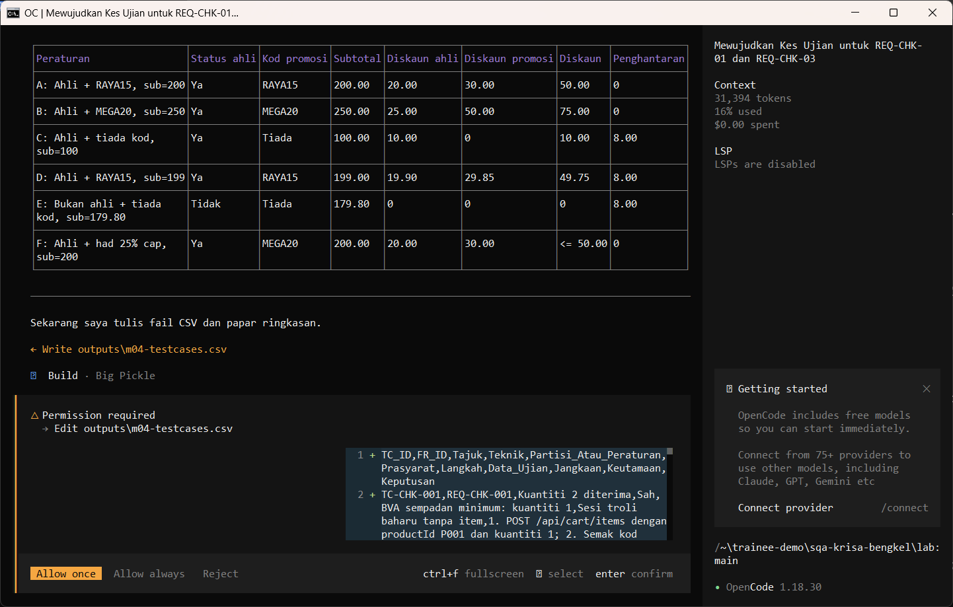
W04 · STEP 1 OF 4 · LANGKAH 1
Run /testcases for two checkout requirements. The AI reads the documents first and may pause at Preparing write. When the Permission required dialog appears, read the preview and choose Allow once.
Jalankan /testcases untuk dua keperluan checkout. AI membaca dokumen dahulu dan mungkin berhenti seketika pada Preparing write. Apabila dialog Permission required muncul, baca pratonton dan pilih Allow once.
TYPE IN OPENCODE (BUILD)
/testcases REQ-CHK-01 dan REQ-CHK-03, maksimum 10 kes ujian
Real screenshot, 13 Sep 2026
Notes:
Step 1: Run /testcases for two checkout requirements. The AI reads the documents first and may pause at Preparing write. When the Permission required dialog appears, read the preview and choose Allow once.
Command or prompt:
/testcases REQ-CHK-01 dan REQ-CHK-03, maksimum 10 kes ujian
Screenshot: workshop-ai/W04-reka-bentuk-ujian/screenshots/01-testcases-permission.png

Slide 4
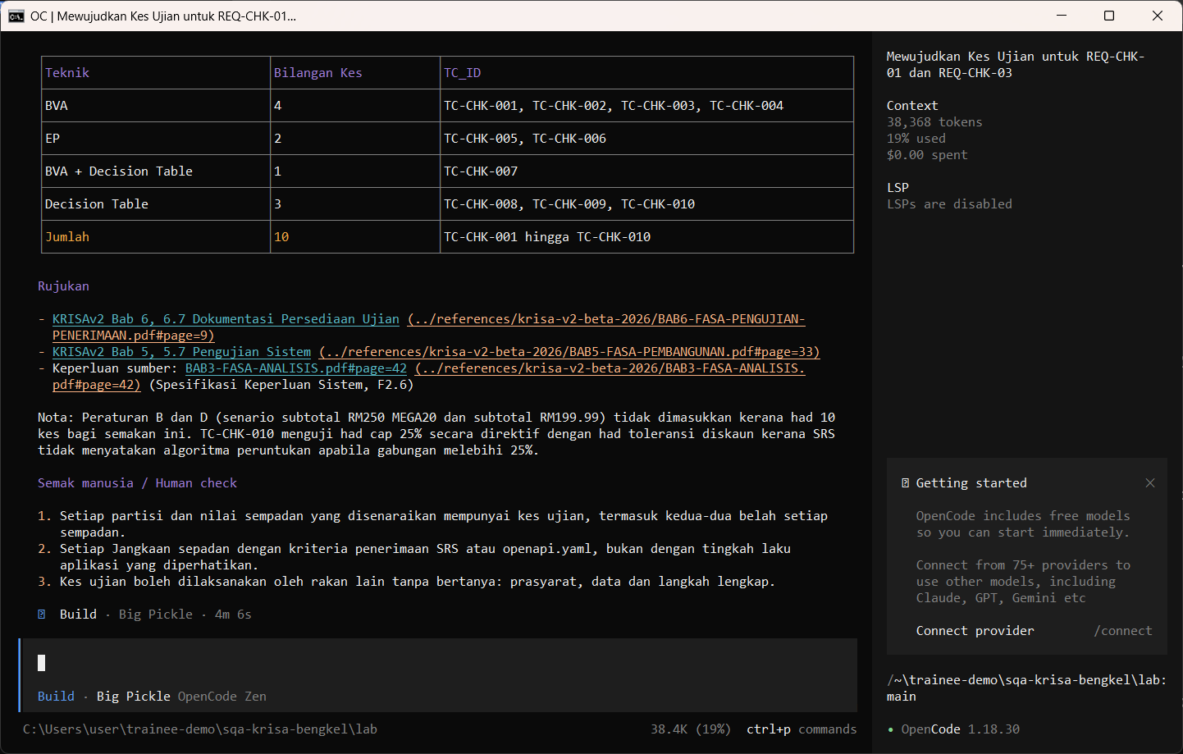
W04 · STEP 2 OF 4 · LANGKAH 2
Allow once. The D13-format test cases are saved.
Allow once. Kes ujian format D13 disimpan.
TYPE IN OPENCODE
Allow once (Enter)
Real screenshot, 13 Sep 2026
Notes:
Step 2: Allow once. The D13-format test cases are saved.
Command or prompt:
Allow once (Enter)
Screenshot: workshop-ai/W04-reka-bentuk-ujian/screenshots/02-testcases-saved.png

Slide 5
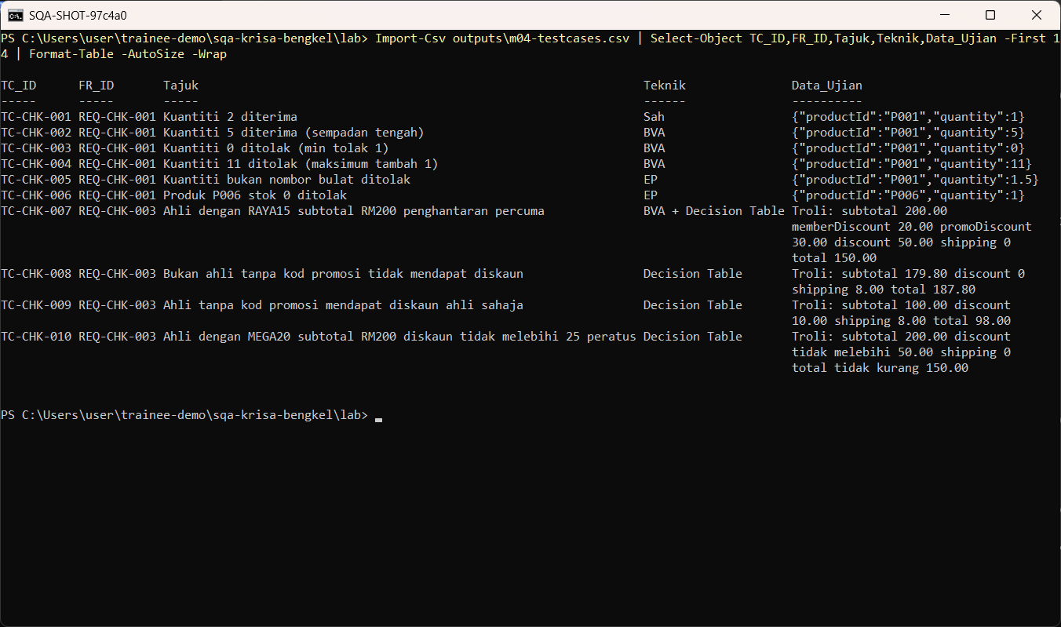
W04 · STEP 3 OF 4 · LANGKAH 3
Open the CSV and check it. In this real run the AI wrote REQ-CHK-001 instead of REQ-CHK-01, labelled one case Sah instead of a technique, and missed boundary 10, the value most likely to hide a bug. Fix these before using the file.
Buka CSV dan semak. Dalam larian sebenar ini AI menulis REQ-CHK-001 dan bukan REQ-CHK-01, melabel satu kes Sah dan bukan teknik, dan terlepas sempadan 10, nilai yang paling mungkin menyembunyikan pepijat. Betulkan sebelum fail digunakan.
TYPE IN POWERSHELL
Import-Csv outputs\m04-testcases.csv | Format-Table -AutoSize -Wrap
Real screenshot, 13 Sep 2026
Notes:
Step 3: Open the CSV and check it. In this real run the AI wrote REQ-CHK-001 instead of REQ-CHK-01, labelled one case Sah instead of a technique, and missed boundary 10, the value most likely to hide a bug. Fix these before using the file.
Command or prompt:
Import-Csv outputs\m04-testcases.csv | Format-Table -AutoSize -Wrap
Screenshot: workshop-ai/W04-reka-bentuk-ujian/screenshots/03-open-testcases.png

Slide 6
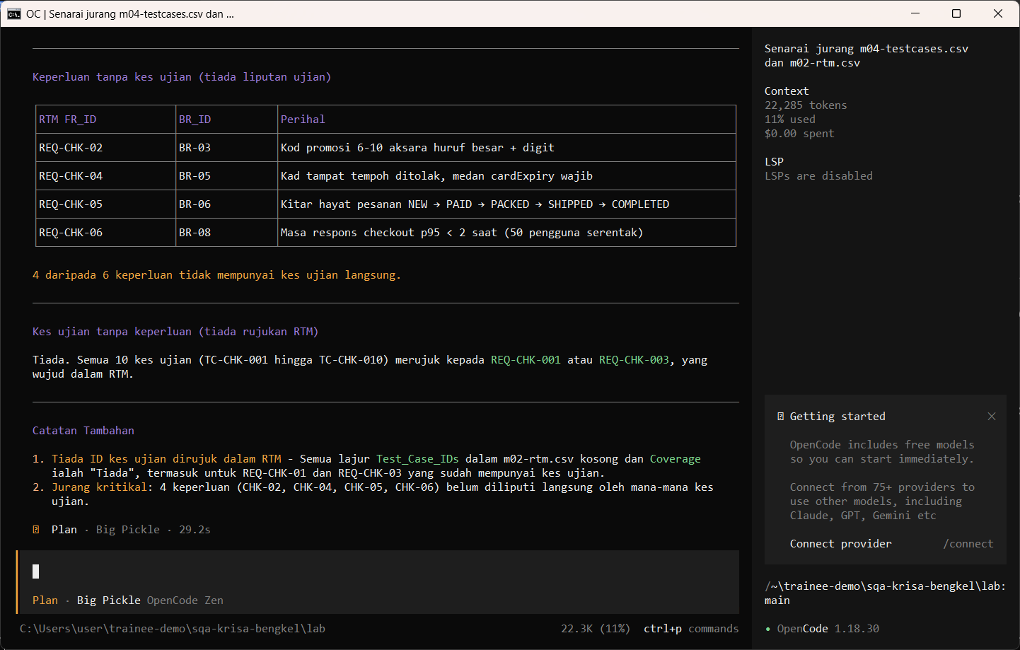
W04 · STEP 4 OF 4 · LANGKAH 4
Ask the Plan agent to compare test cases with the RTM. It correctly lists 4 uncovered requirements, but claims REQ-CHK-001 exists in the RTM when the RTM uses REQ-CHK-01. The AI does not check its own IDs: you must.
Minta ejen Plan membandingkan kes ujian dengan RTM. Ia betul menyenaraikan 4 keperluan tanpa liputan, tetapi mendakwa REQ-CHK-001 wujud dalam RTM sedangkan RTM menggunakan REQ-CHK-01. AI tidak menyemak ID sendiri: anda yang mesti menyemak.
TYPE IN OPENCODE (PLAN)
Bandingkan outputs/m04-testcases.csv dengan outputs/m02-rtm.csv. Senaraikan keperluan tanpa kes ujian dan kes ujian tanpa keperluan. Jangan tulis fail.
Real screenshot, 13 Sep 2026
Notes:
Step 4: Ask the Plan agent to compare test cases with the RTM. It correctly lists 4 uncovered requirements, but claims REQ-CHK-001 exists in the RTM when the RTM uses REQ-CHK-01. The AI does not check its own IDs: you must.
Command or prompt:
Bandingkan outputs/m04-testcases.csv dengan outputs/m02-rtm.csv. Senaraikan keperluan tanpa kes ujian dan kes ujian tanpa keperluan. Jangan tulis fail.
Screenshot: workshop-ai/W04-reka-bentuk-ujian/screenshots/04-coverage-gaps.png

Slide 7
Human check before you accept the output / Semakan manusia
Boundary values 10 and RM200.00 are present
Nilai sempadan 10 dan RM200.00 ada
Every case names its technique and REQ-CHK ID
Setiap kes menamakan teknik dan ID REQ-CHK
Expected results come from the SRS, not from what the app does
Hasil dijangka datang daripada SRS, bukan daripada tingkah laku aplikasi
The AI draft becomes evidence only after this check. Record who checked it and when (Module 7 audit trail).

Slide 8
If something goes wrong / Jika ada masalah
opencode is not recognised
Close and reopen PowerShell so PATH refreshes. Still failing: powershell -ExecutionPolicy Bypass -File .\setup\install-opencode.ps1 -Portable
Scripts are disabled on this system
Set-ExecutionPolicy -Scope CurrentUser RemoteSigned, or run opencode.cmd instead of opencode
The model is slow or stops
Wait up to 2 minutes. Press Esc to interrupt, then send the prompt again. Try another free model with /models
Permission required dialog
Read the preview. Choose Allow once for files in outputs/. Reject anything outside the lab folder
File or command not found
Check the status bar path ends with \lab. Commands and @files are relative to the lab folder
Answer uses Indonesian words or dashes
Reply: Ikut AGENTS.md peraturan 1 dan 14, tulis semula dalam Bahasa Melayu Malaysia
Network or proxy error
$env:HTTPS_PROXY = "http://proxy:port" and $env:NO_PROXY = "localhost,127.0.0.1" before starting opencode
Port 3000 already in use
$env:PORT = 3001 before npm start, and use http://localhost:3001

Slide 9
Links / Pautan
Web guide with copyable prompts
Module hub (slides, references, templates)
Example outputs from the real run
Lab README and command list
AGENTS.md rules used by the assistant
opencode documentation
opencode TUI commands and keys
OpenCode Zen free models and data policy
Bab 5, 5.7 Pengujian Sistem, peringkat ujian (p.33)
Bab 6, 6.6 Pelan Induk Pengujian F5.1 (p.4)
Bab 6, Jadual 6.2 Peringkat UAT, PAT, FAT (p.5)

