Slide 1
W05 · M05 · 15 MINIT / MINUTES · Hari 2, 10:10 hingga 10:25
Hands-On SQA-AI Assistant Workshop
AI-generated UI and API tests that find a real bug
Ujian UI dan API dijana AI yang menemui pepijat sebenar
Ask the AI for a Playwright test for the quantity boundary, save and run it against ShopFast, read the failure, then generate API tests from the OpenAPI contract.
opencode 1.18 · model Big Pickle (OpenCode Zen, free, no API key) · synthetic ShopFast data only
Bengkel SQA KRISAv2 dan PPrISA 2.0 · 14 hingga 15 September 2026 · Makmal Komputer Aras 11, Menara MyIPO
Web guide (copy prompts)
Module hub
Example outputs (GitHub)
Notes:
W05: 15 minutes. Real screenshots captured on 13 Sep 2026 from a fresh clone of the course repository on Windows 11 with opencode 1.18.30 and the free Big Pickle model. AI answers vary between runs; the steps and checks do not.

Slide 2
Before you start / Sebelum mula
YOU WILL / ANDA AKAN
CHECK FIRST / SEMAK DAHULU
1. Run /gen-ui-test for TC-CHK-004 (quantity 10)
2. Save the code block as tests\ui\m05-senario.spec.js
3. Run it with npx playwright test and read the result
4. Run /gen-api-tests for the same requirements
- PowerShell is in C:\Users\<you>\sqa-krisa-bengkel\lab
- opencode starts and shows Big Pickle, OpenCode Zen (W00)
- In shopfast\: npm install and npx playwright install chromium are done
Data rules / Peraturan data
- Synthetic ShopFast data only. Never paste real agency documents or personal data.
- Free models run outside Malaysia and may learn from prompts.
- AI output is a draft. A person checks and signs off.
1. Jalankan /gen-ui-test untuk TC-CHK-004 (kuantiti 10)
2. Simpan blok kod sebagai tests\ui\m05-senario.spec.js
3. Jalankan dengan npx playwright test dan baca hasilnya
4. Jalankan /gen-api-tests untuk keperluan yang sama
OUTPUT
outputs/m05-ui-test.md, shopfast/tests/ui/m05-senario.spec.js, outputs/m05-api-tests.md

Slide 3
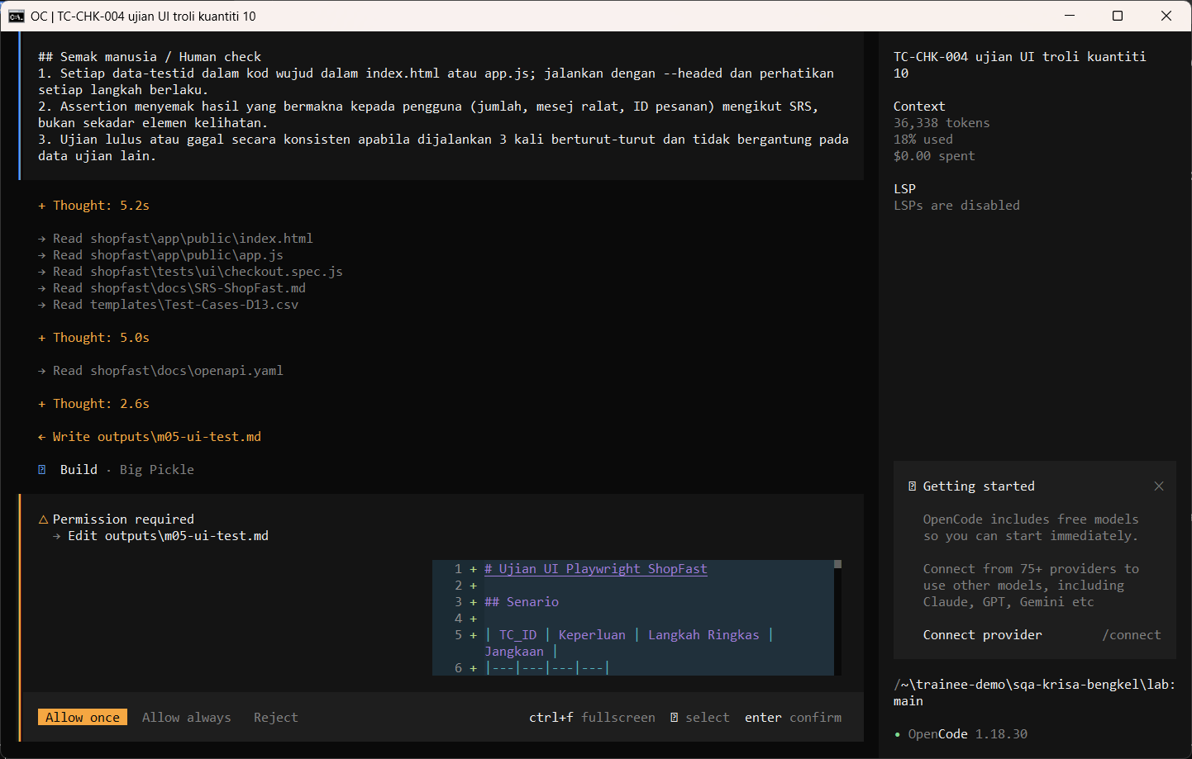
W05 · STEP 1 OF 5 · LANGKAH 1
Run /gen-ui-test for the quantity 10 boundary case. The AI reads the documents first and may pause at Preparing write. When the Permission required dialog appears, read the preview and choose Allow once.
Jalankan /gen-ui-test untuk kes sempadan kuantiti 10. AI membaca dokumen dahulu dan mungkin berhenti seketika pada Preparing write. Apabila dialog Permission required muncul, baca pratonton dan pilih Allow once.
TYPE IN OPENCODE (BUILD)
/gen-ui-test TC-CHK-004 tambah P002 kuantiti 10 ke troli dan semak troli menerima kuantiti 10 (REQ-CHK-01)
Real screenshot, 13 Sep 2026
Notes:
Step 1: Run /gen-ui-test for the quantity 10 boundary case. The AI reads the documents first and may pause at Preparing write. When the Permission required dialog appears, read the preview and choose Allow once.
Command or prompt:
/gen-ui-test TC-CHK-004 tambah P002 kuantiti 10 ke troli dan semak troli menerima kuantiti 10 (REQ-CHK-01)
Screenshot: workshop-ai/W05-automasi-ujian/screenshots/01-gen-ui-test-permission.png

Slide 4
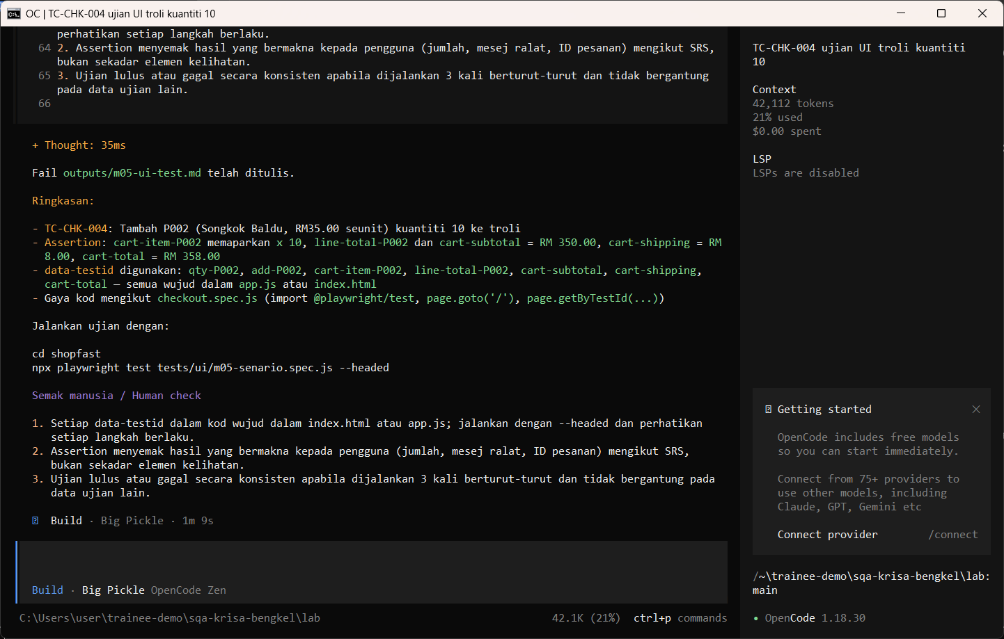
W05 · STEP 2 OF 5 · LANGKAH 2
Allow once. The test and instructions are saved in outputs/m05-ui-test.md.
Allow once. Ujian dan arahan disimpan dalam outputs/m05-ui-test.md.
TYPE IN OPENCODE
Allow once (Enter)
Real screenshot, 13 Sep 2026
Notes:
Step 2: Allow once. The test and instructions are saved in outputs/m05-ui-test.md.
Command or prompt:
Allow once (Enter)
Screenshot: workshop-ai/W05-automasi-ujian/screenshots/02-gen-ui-test-saved.png

Slide 5
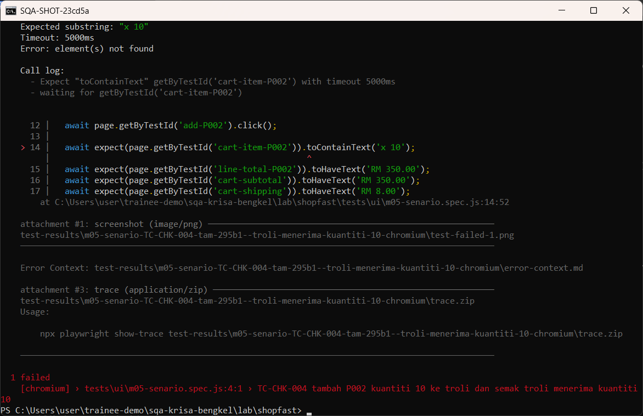
W05 · STEP 3 OF 5 · LANGKAH 3
Save the code block as a spec file and run it. A failure here is a real finding to reproduce and report in Module 6.
Simpan blok kod sebagai fail spec dan jalankan. Kegagalan di sini ialah penemuan sebenar untuk dihasilkan semula dan dilaporkan dalam Modul 6.
TYPE IN POWERSHELL
$md = Get-Content outputs\m05-ui-test.md -Raw
[regex]::Match($md, '(?s)```(?:js|javascript)\s*(.*?)```').Groups[1].Value | Set-Content -Encoding utf8 shopfast\tests\ui\m05-senario.spec.js
cd shopfast
npx playwright test tests/ui/m05-senario.spec.js --reporter=list
Real screenshot, 13 Sep 2026
Notes:
Step 3: Save the code block as a spec file and run it. A failure here is a real finding to reproduce and report in Module 6.
Command or prompt:
$md = Get-Content outputs\m05-ui-test.md -Raw
[regex]::Match($md, '(?s)```(?:js|javascript)\s*(.*?)```').Groups[1].Value | Set-Content -Encoding utf8 shopfast\tests\ui\m05-senario.spec.js
cd shopfast
npx playwright test tests/ui/m05-senario.spec.js --reporter=list
Screenshot: workshop-ai/W05-automasi-ujian/screenshots/03-save-and-run-test.png

Slide 6
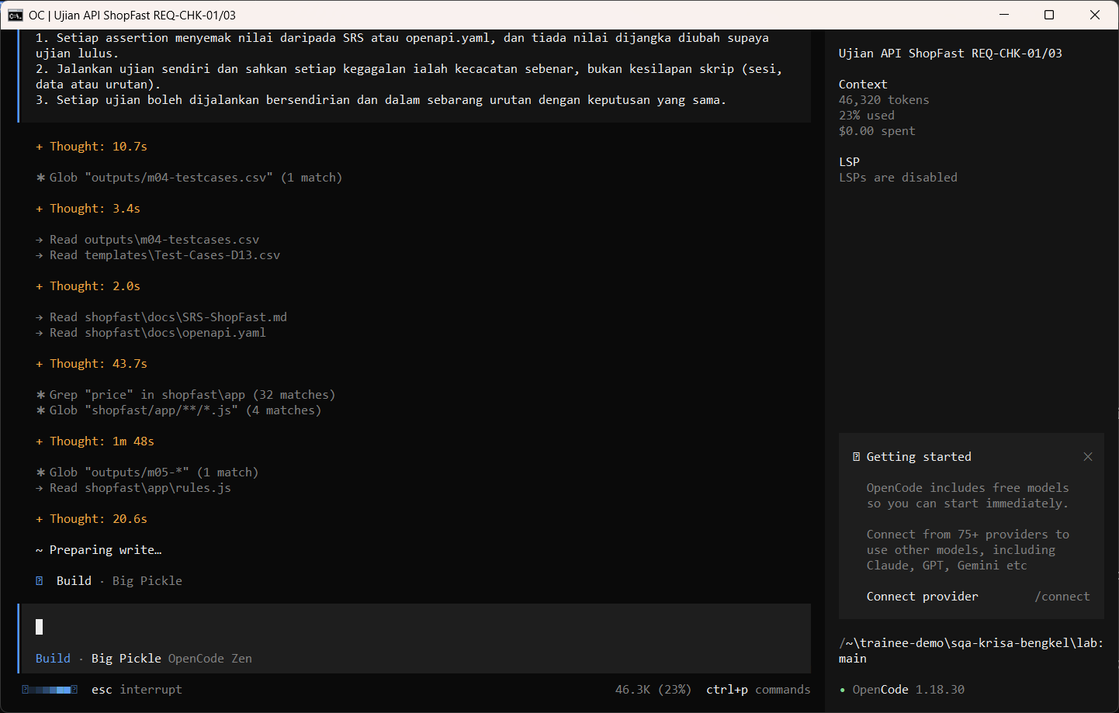
W05 · STEP 4 OF 5 · LANGKAH 4
Back in opencode, run /gen-api-tests from the OpenAPI contract. The AI reads the documents first and may pause at Preparing write. When the Permission required dialog appears, read the preview and choose Allow once.
Kembali ke opencode, jalankan /gen-api-tests daripada kontrak OpenAPI. AI membaca dokumen dahulu dan mungkin berhenti seketika pada Preparing write. Apabila dialog Permission required muncul, baca pratonton dan pilih Allow once.
TYPE IN OPENCODE (BUILD)
/gen-api-tests REQ-CHK-01 REQ-CHK-03
Real screenshot, 13 Sep 2026
Notes:
Step 4: Back in opencode, run /gen-api-tests from the OpenAPI contract. The AI reads the documents first and may pause at Preparing write. When the Permission required dialog appears, read the preview and choose Allow once.
Command or prompt:
/gen-api-tests REQ-CHK-01 REQ-CHK-03
Screenshot: workshop-ai/W05-automasi-ujian/screenshots/04-gen-api-tests-permission.png

Slide 7
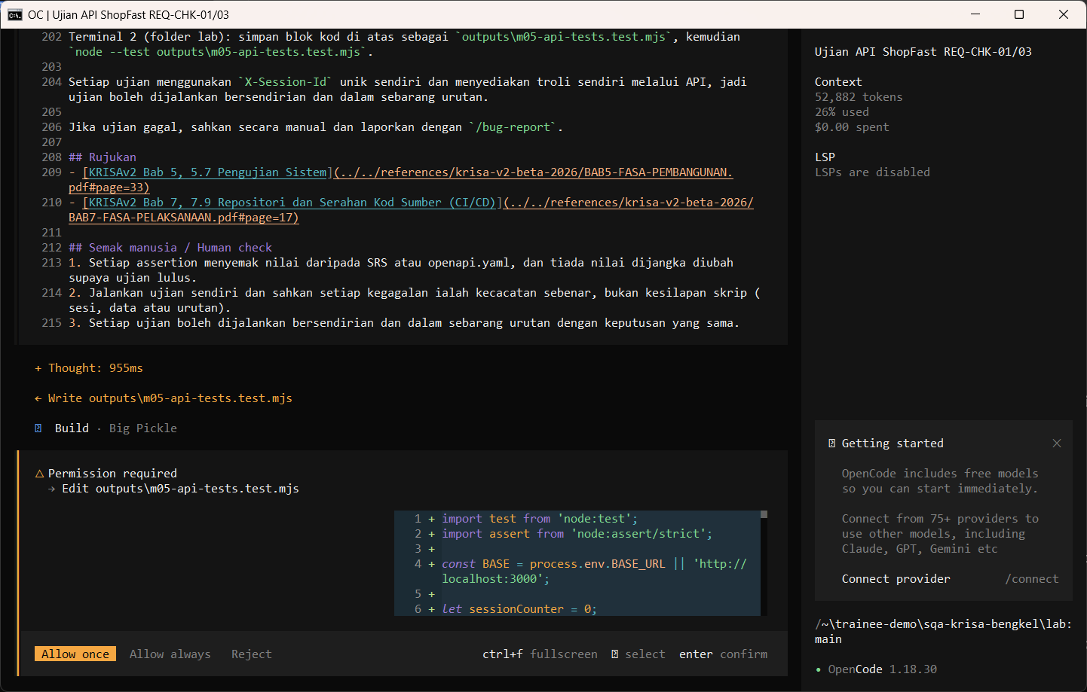
W05 · STEP 5 OF 5 · LANGKAH 5
Allow once. Review the generated API tests before using them.
Allow once. Semak ujian API yang dijana sebelum digunakan.
TYPE IN OPENCODE
Allow once (Enter)
Real screenshot, 13 Sep 2026
Notes:
Step 5: Allow once. Review the generated API tests before using them.
Command or prompt:
Allow once (Enter)
Screenshot: workshop-ai/W05-automasi-ujian/screenshots/05-gen-api-tests-saved.png

Slide 8
Human check before you accept the output / Semakan manusia
The test selects elements by data-testid that really exist
Ujian memilih elemen melalui data-testid yang benar-benar wujud
A failing test is a finding: reproduce it by hand before logging a bug
Ujian yang gagal ialah penemuan: hasilkan semula secara manual sebelum log pepijat
Generated tests are reviewed like code before they are committed
Ujian yang dijana disemak seperti kod sebelum di-commit
The AI draft becomes evidence only after this check. Record who checked it and when (Module 7 audit trail).

Slide 9
If something goes wrong / Jika ada masalah
opencode is not recognised
Close and reopen PowerShell so PATH refreshes. Still failing: powershell -ExecutionPolicy Bypass -File .\setup\install-opencode.ps1 -Portable
Scripts are disabled on this system
Set-ExecutionPolicy -Scope CurrentUser RemoteSigned, or run opencode.cmd instead of opencode
The model is slow or stops
Wait up to 2 minutes. Press Esc to interrupt, then send the prompt again. Try another free model with /models
Permission required dialog
Read the preview. Choose Allow once for files in outputs/. Reject anything outside the lab folder
File or command not found
Check the status bar path ends with \lab. Commands and @files are relative to the lab folder
Answer uses Indonesian words or dashes
Reply: Ikut AGENTS.md peraturan 1 dan 14, tulis semula dalam Bahasa Melayu Malaysia
Network or proxy error
$env:HTTPS_PROXY = "http://proxy:port" and $env:NO_PROXY = "localhost,127.0.0.1" before starting opencode
Port 3000 already in use
$env:PORT = 3001 before npm start, and use http://localhost:3001

Slide 10
Links / Pautan
Web guide with copyable prompts
Module hub (slides, references, templates)
Example outputs from the real run
Lab README and command list
AGENTS.md rules used by the assistant
opencode documentation
opencode TUI commands and keys
OpenCode Zen free models and data policy
Bab 5, 5.7 Pengujian Sistem F4.3 (p.33)
Bab 5, Langkah 5 Laporan Ujian Sistem (Jadual 5.6) (p.39)
Bab 5, 5.6.7 Amalan terbaik (Git, piawaian kod) (p.28)

