Slide 1
W06 · M06 · 25 MINIT / MINUTES · Hari 2, 12:00 hingga 12:25
Hands-On SQA-AI Assistant Workshop
AI bug reports and quality metrics
Laporan pepijat dan metrik kualiti dibantu AI
Turn the failure you reproduced into a complete bug report with KRISAv2 severity, compute metrics from your test run, and prepare a triage summary.
opencode 1.18 · model Big Pickle (OpenCode Zen, free, no API key) · synthetic ShopFast data only
Bengkel SQA KRISAv2 dan PPrISA 2.0 · 14 hingga 15 September 2026 · Makmal Komputer Aras 11, Menara MyIPO
Web guide (copy prompts)
Module hub
Example outputs (GitHub)
Notes:
W06: 25 minutes. Real screenshots captured on 13 Sep 2026 from a fresh clone of the course repository on Windows 11 with opencode 1.18.30 and the free Big Pickle model. AI answers vary between runs; the steps and checks do not.

Slide 2
Before you start / Sebelum mula
YOU WILL / ANDA AKAN
CHECK FIRST / SEMAK DAHULU
1. Run /bug-report with steps, expected and actual result
2. Check severity against KRISAv2 Bab 6 Jadual 6.3
3. Run /metrics with your run numbers
4. Ask for a three-line triage summary
- PowerShell is in C:\Users\<you>\sqa-krisa-bengkel\lab
- opencode starts and shows Big Pickle, OpenCode Zen (W00)
- Outputs from earlier workshops exist in outputs\ (or copy them from example-output)
Data rules / Peraturan data
- Synthetic ShopFast data only. Never paste real agency documents or personal data.
- Free models run outside Malaysia and may learn from prompts.
- AI output is a draft. A person checks and signs off.
1. Jalankan /bug-report dengan langkah, hasil dijangka dan hasil sebenar
2. Semak severity dengan KRISAv2 Bab 6 Jadual 6.3
3. Jalankan /metrics dengan angka larian anda
4. Minta ringkasan triage tiga baris
OUTPUT
outputs/m06-bug-report-BUG-CHK-001.md, outputs/m06-metrics.csv

Slide 3
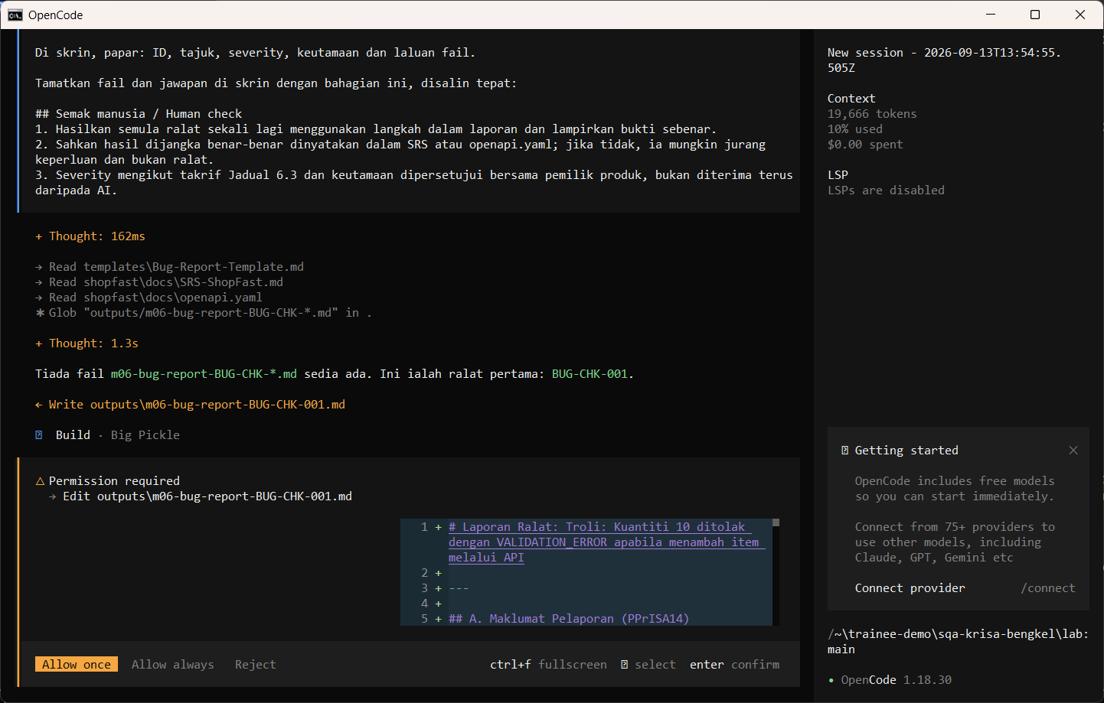
W06 · STEP 1 OF 5 · LANGKAH 1
Run /bug-report with your reproduction evidence. The AI reads the documents first and may pause at Preparing write. When the Permission required dialog appears, read the preview and choose Allow once.
Jalankan /bug-report dengan bukti penghasilan semula anda. AI membaca dokumen dahulu dan mungkin berhenti seketika pada Preparing write. Apabila dialog Permission required muncul, baca pratonton dan pilih Allow once.
TYPE IN OPENCODE (BUILD)
/bug-report Langkah: tambah P002 kuantiti 10 melalui POST /api/cart/items. Dijangka: 201 dan kuantiti 10 diterima (REQ-CHK-01). Sebenar: 400 VALIDATION_ERROR. Bukti: ujian tests/ui/m05-senario.spec.js gagal, binaan 1.0.0.
Real screenshot, 13 Sep 2026
Notes:
Step 1: Run /bug-report with your reproduction evidence. The AI reads the documents first and may pause at Preparing write. When the Permission required dialog appears, read the preview and choose Allow once.
Command or prompt:
/bug-report Langkah: tambah P002 kuantiti 10 melalui POST /api/cart/items. Dijangka: 201 dan kuantiti 10 diterima (REQ-CHK-01). Sebenar: 400 VALIDATION_ERROR. Bukti: ujian tests/ui/m05-senario.spec.js gagal, binaan 1.0.0.
Screenshot: workshop-ai/W06-pepijat-metrik/screenshots/01-bug-report-permission.png

Slide 4
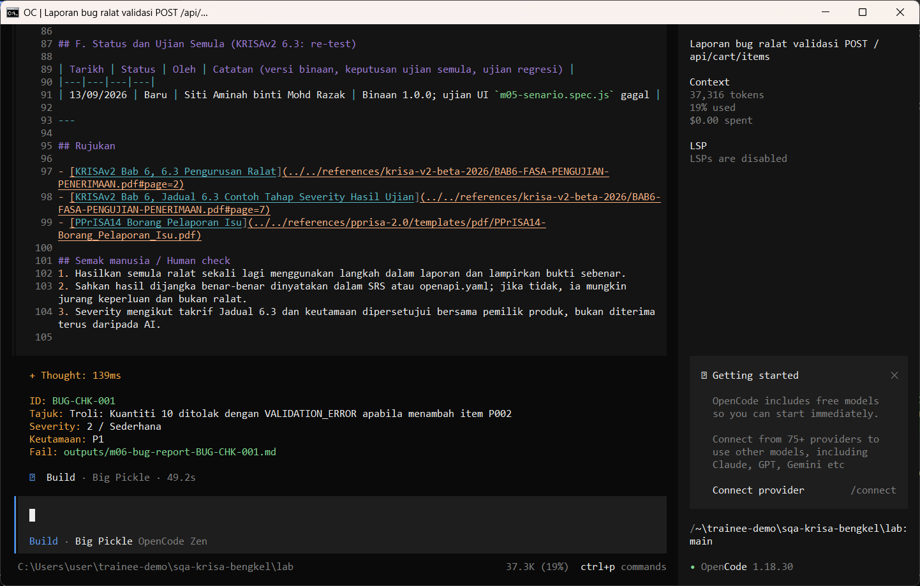
W06 · STEP 2 OF 5 · LANGKAH 2
Allow once. Check the severity against KRISAv2 Jadual 6.3.
Allow once. Semak severity dengan KRISAv2 Jadual 6.3.
TYPE IN OPENCODE
Allow once (Enter)
Real screenshot, 13 Sep 2026
Notes:
Step 2: Allow once. Check the severity against KRISAv2 Jadual 6.3.
Command or prompt:
Allow once (Enter)
Screenshot: workshop-ai/W06-pepijat-metrik/screenshots/02-bug-report-saved.png

Slide 5
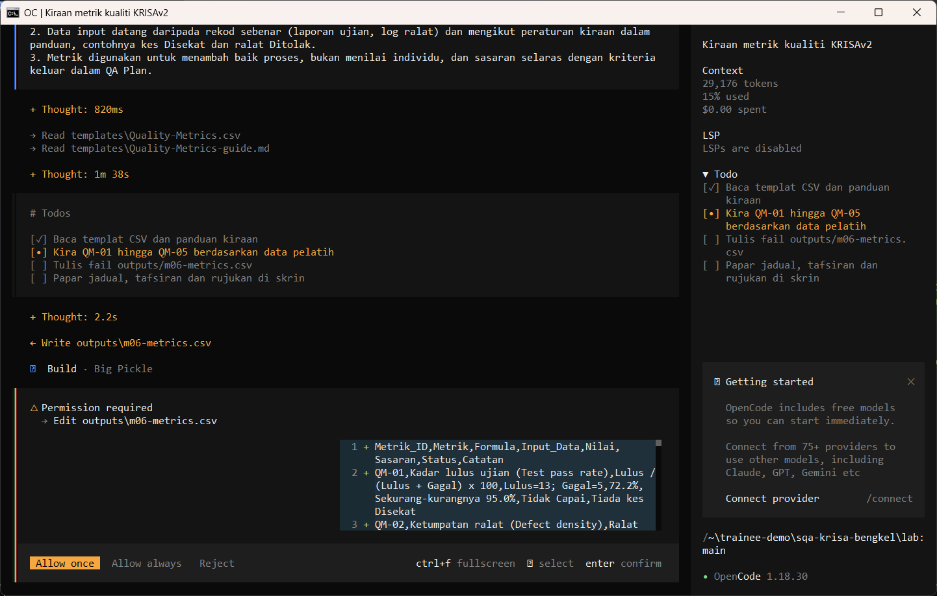
W06 · STEP 3 OF 5 · LANGKAH 3
Run /metrics with your test run numbers. The AI reads the documents first and may pause at Preparing write. When the Permission required dialog appears, read the preview and choose Allow once.
Jalankan /metrics dengan angka larian ujian anda. AI membaca dokumen dahulu dan mungkin berhenti seketika pada Preparing write. Apabila dialog Permission required muncul, baca pratonton dan pilih Allow once.
TYPE IN OPENCODE (BUILD)
/metrics kes dirancang 20, dilaksana 18, lulus 13, gagal 5, pepijat ditemui 5, pepijat bocor ke produksi 1, saiz kod 1.2 KLOC
Real screenshot, 13 Sep 2026
Notes:
Step 3: Run /metrics with your test run numbers. The AI reads the documents first and may pause at Preparing write. When the Permission required dialog appears, read the preview and choose Allow once.
Command or prompt:
/metrics kes dirancang 20, dilaksana 18, lulus 13, gagal 5, pepijat ditemui 5, pepijat bocor ke produksi 1, saiz kod 1.2 KLOC
Screenshot: workshop-ai/W06-pepijat-metrik/screenshots/03-metrics-permission.png

Slide 6
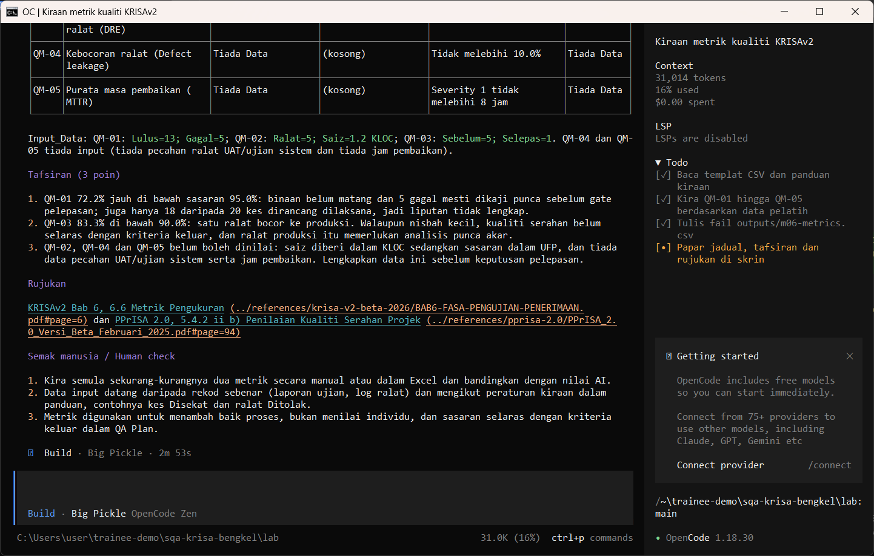
W06 · STEP 4 OF 5 · LANGKAH 4
Allow once. The metrics CSV shows each formula.
Allow once. CSV metrik memaparkan setiap formula.
TYPE IN OPENCODE
Allow once (Enter)
Real screenshot, 13 Sep 2026
Notes:
Step 4: Allow once. The metrics CSV shows each formula.
Command or prompt:
Allow once (Enter)
Screenshot: workshop-ai/W06-pepijat-metrik/screenshots/04-metrics-saved.png

Slide 7
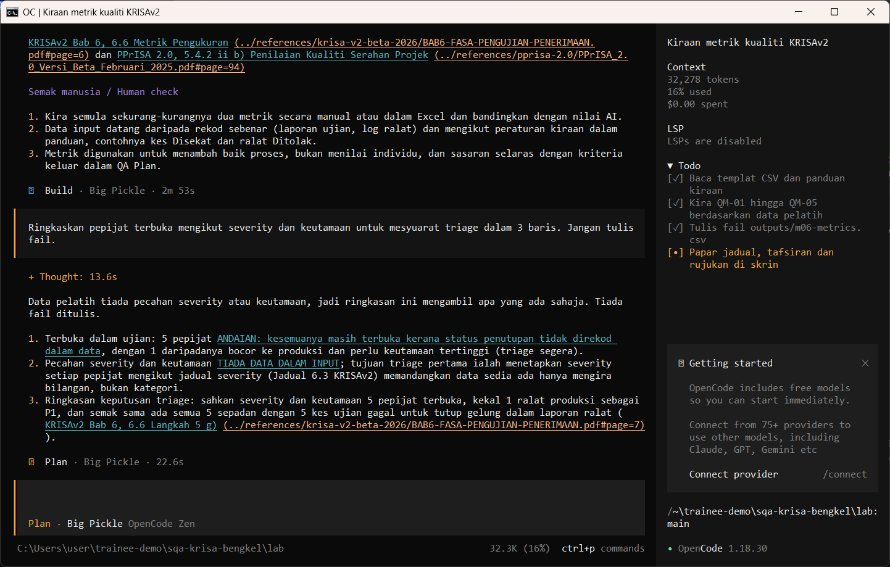
W06 · STEP 5 OF 5 · LANGKAH 5
Switch to Plan and ask for a three-line triage summary.
Tukar ke Plan dan minta ringkasan triage tiga baris.
TYPE IN OPENCODE (PLAN)
Ringkaskan pepijat terbuka mengikut severity dan keutamaan untuk mesyuarat triage dalam 3 baris. Jangan tulis fail.
Real screenshot, 13 Sep 2026
Notes:
Step 5: Switch to Plan and ask for a three-line triage summary.
Command or prompt:
Ringkaskan pepijat terbuka mengikut severity dan keutamaan untuk mesyuarat triage dalam 3 baris. Jangan tulis fail.
Screenshot: workshop-ai/W06-pepijat-metrik/screenshots/05-triage-summary.png

Slide 8
Human check before you accept the output / Semakan manusia
Steps can be reproduced by someone else
Langkah boleh dihasilkan semula oleh orang lain
Severity follows KRISAv2 Jadual 6.3; priority is a business decision
Severity mengikut KRISAv2 Jadual 6.3; keutamaan ialah keputusan bisnes
Metric formulas are shown so the numbers can be rechecked
Formula metrik dipaparkan supaya angka boleh disemak semula
The AI draft becomes evidence only after this check. Record who checked it and when (Module 7 audit trail).

Slide 9
If something goes wrong / Jika ada masalah
opencode is not recognised
Close and reopen PowerShell so PATH refreshes. Still failing: powershell -ExecutionPolicy Bypass -File .\setup\install-opencode.ps1 -Portable
Scripts are disabled on this system
Set-ExecutionPolicy -Scope CurrentUser RemoteSigned, or run opencode.cmd instead of opencode
The model is slow or stops
Wait up to 2 minutes. Press Esc to interrupt, then send the prompt again. Try another free model with /models
Permission required dialog
Read the preview. Choose Allow once for files in outputs/. Reject anything outside the lab folder
File or command not found
Check the status bar path ends with \lab. Commands and @files are relative to the lab folder
Answer uses Indonesian words or dashes
Reply: Ikut AGENTS.md peraturan 1 dan 14, tulis semula dalam Bahasa Melayu Malaysia
Network or proxy error
$env:HTTPS_PROXY = "http://proxy:port" and $env:NO_PROXY = "localhost,127.0.0.1" before starting opencode
Port 3000 already in use
$env:PORT = 3001 before npm start, and use http://localhost:3001

Slide 10
Links / Pautan
Web guide with copyable prompts
Module hub (slides, references, templates)
Example outputs from the real run
Lab README and command list
AGENTS.md rules used by the assistant
opencode documentation
opencode TUI commands and keys
OpenCode Zen free models and data policy
Bab 6, 6.3 Pengurusan Ralat (Rajah 6.2) (p.2)
Bab 6, Jadual 6.3 Tahap Severity (p.7)
Bab 6, 6.8 Defect Triage dan kriteria keluar UAT (p.21)

