Slide 1
W07 · M07 · 20 MINIT / MINUTES · Hari 2, 14:35 hingga 14:55
Hands-On SQA-AI Assistant Workshop
AI audit, CAPA and Test Summary Report
Audit, CAPA dan Laporan Ringkasan Ujian dibantu AI
Audit your outputs folder against the ISO/CMMI-lite checklist, raise CAPA for non-conformities and draft the D14/D16 Test Summary with a release recommendation.
opencode 1.18 · model Big Pickle (OpenCode Zen, free, no API key) · synthetic ShopFast data only
Bengkel SQA KRISAv2 dan PPrISA 2.0 · 14 hingga 15 September 2026 · Makmal Komputer Aras 11, Menara MyIPO
Web guide (copy prompts)
Module hub
Example outputs (GitHub)
Notes:
W07: 20 minutes. Real screenshots captured on 13 Sep 2026 from a fresh clone of the course repository on Windows 11 with opencode 1.18.30 and the free Big Pickle model. AI answers vary between runs; the steps and checks do not.

Slide 2
Before you start / Sebelum mula
YOU WILL / ANDA AKAN
CHECK FIRST / SEMAK DAHULU
1. Run /audit on the RTM and test cases (Plan agent)
2. Switch to Build and save the audit to outputs/
3. Run /capa on the saved audit, then /test-summary
4. Decide GO, NO-GO or CONDITIONAL as a team
- PowerShell is in C:\Users\<you>\sqa-krisa-bengkel\lab
- opencode starts and shows Big Pickle, OpenCode Zen (W00)
- Outputs from earlier workshops exist in outputs\ (or copy them from example-output)
Data rules / Peraturan data
- Synthetic ShopFast data only. Never paste real agency documents or personal data.
- Free models run outside Malaysia and may learn from prompts.
- AI output is a draft. A person checks and signs off.
1. Jalankan /audit pada RTM dan kes ujian (ejen Plan)
2. Tukar ke Build dan simpan audit ke outputs/
3. Jalankan /capa pada audit yang disimpan, kemudian /test-summary
4. Putuskan GO, NO-GO atau CONDITIONAL sebagai pasukan
OUTPUT
outputs/m07-audit.md, outputs/m07-capa.md, outputs/m07-test-summary.md

Slide 3
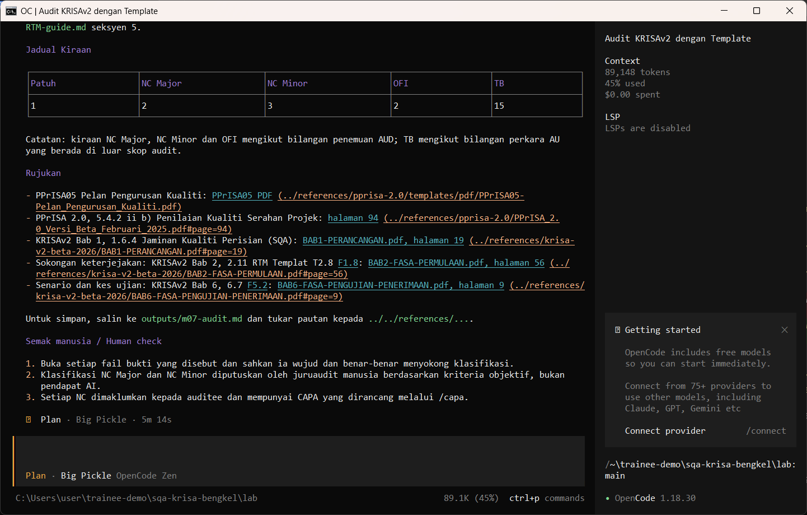
W07 · STEP 1 OF 7 · LANGKAH 1
Run /audit in Plan mode on the RTM and test cases. It prints conformities, non-conformities (NC Major and Minor) and evidence.
Jalankan /audit dalam mod Plan pada RTM dan kes ujian. Ia memaparkan pematuhan, ketidakpatuhan (NC Major dan Minor) dan bukti.
TYPE IN OPENCODE (PLAN)
/audit outputs/m02-rtm.csv dan outputs/m04-testcases.csv
Real screenshot, 13 Sep 2026
Notes:
Step 1: Run /audit in Plan mode on the RTM and test cases. It prints conformities, non-conformities (NC Major and Minor) and evidence.
Command or prompt:
/audit outputs/m02-rtm.csv dan outputs/m04-testcases.csv
Screenshot: workshop-ai/W07-audit-dokumentasi/screenshots/01-audit.png

Slide 4
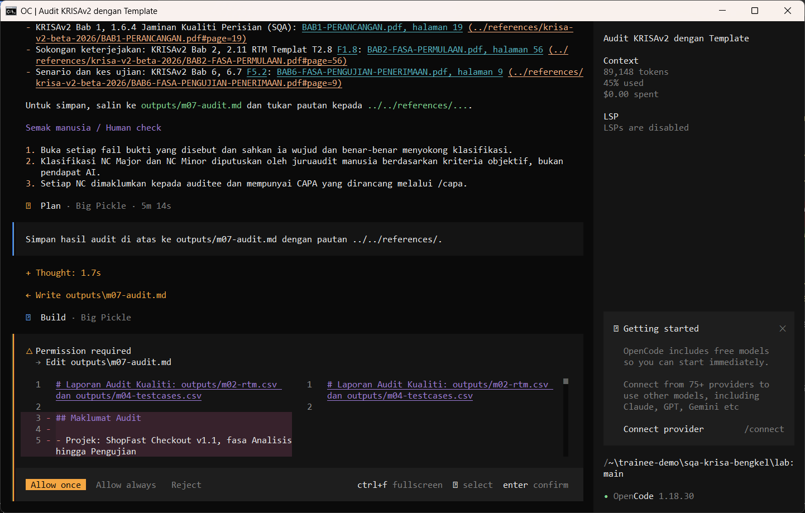
W07 · STEP 2 OF 7 · LANGKAH 2
Press Tab to switch to Build and ask the assistant to save the audit. The AI reads the documents first and may pause at Preparing write. When the Permission required dialog appears, read the preview and choose Allow once.
Tekan Tab untuk tukar ke Build dan minta pembantu menyimpan audit. AI membaca dokumen dahulu dan mungkin berhenti seketika pada Preparing write. Apabila dialog Permission required muncul, baca pratonton dan pilih Allow once.
TYPE IN OPENCODE (BUILD)
Simpan hasil audit di atas ke outputs/m07-audit.md dengan pautan ../../references/.
Real screenshot, 13 Sep 2026
Notes:
Step 2: Press Tab to switch to Build and ask the assistant to save the audit. The AI reads the documents first and may pause at Preparing write. When the Permission required dialog appears, read the preview and choose Allow once.
Command or prompt:
Simpan hasil audit di atas ke outputs/m07-audit.md dengan pautan ../../references/.
Screenshot: workshop-ai/W07-audit-dokumentasi/screenshots/02-save-audit-permission.png

Slide 5
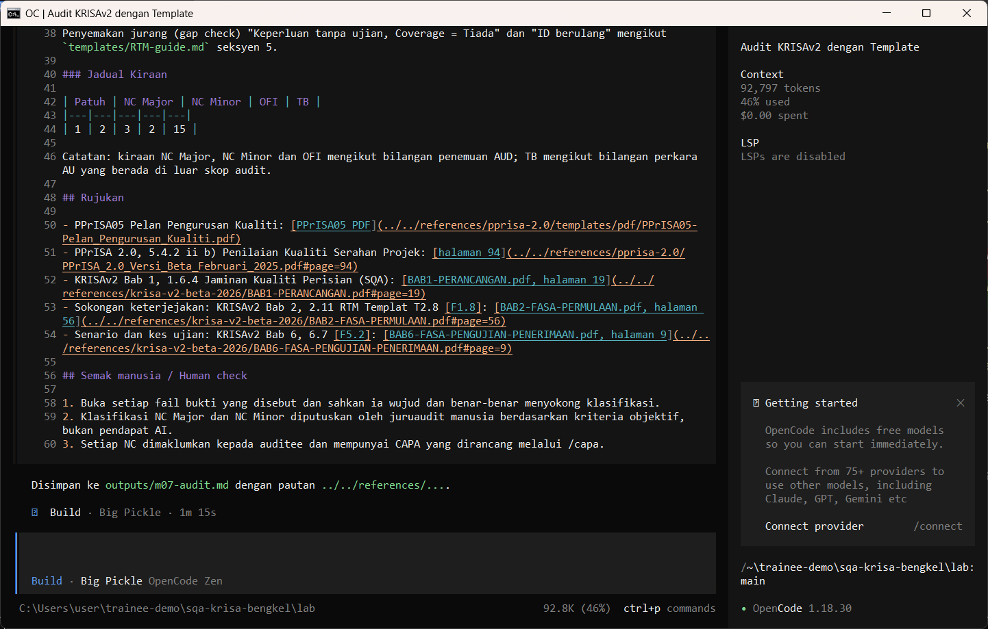
W07 · STEP 3 OF 7 · LANGKAH 3
Allow once. The audit is saved as evidence in outputs/m07-audit.md.
Allow once. Audit disimpan sebagai bukti dalam outputs/m07-audit.md.
TYPE IN OPENCODE
Allow once (Enter)
Real screenshot, 13 Sep 2026
Notes:
Step 3: Allow once. The audit is saved as evidence in outputs/m07-audit.md.
Command or prompt:
Allow once (Enter)
Screenshot: workshop-ai/W07-audit-dokumentasi/screenshots/03-audit-saved.png

Slide 6
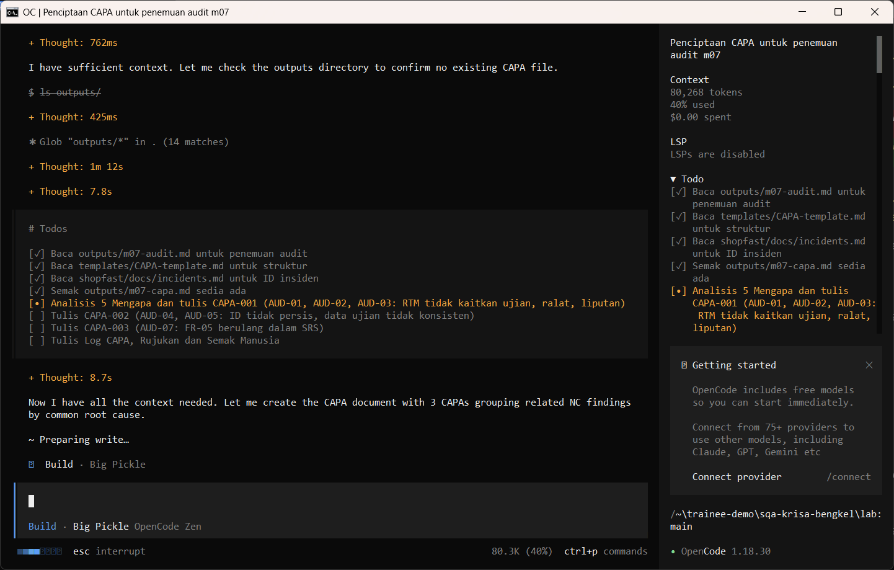
W07 · STEP 4 OF 7 · LANGKAH 4
Run /capa on the saved audit file. The AI reads the documents first and may pause at Preparing write. When the Permission required dialog appears, read the preview and choose Allow once.
Jalankan /capa pada fail audit yang disimpan. AI membaca dokumen dahulu dan mungkin berhenti seketika pada Preparing write. Apabila dialog Permission required muncul, baca pratonton dan pilih Allow once.
TYPE IN OPENCODE (BUILD)
/capa semua NC dalam outputs/m07-audit.md
Real screenshot, 13 Sep 2026
Notes:
Step 4: Run /capa on the saved audit file. The AI reads the documents first and may pause at Preparing write. When the Permission required dialog appears, read the preview and choose Allow once.
Command or prompt:
/capa semua NC dalam outputs/m07-audit.md
Screenshot: workshop-ai/W07-audit-dokumentasi/screenshots/04-capa-permission.png

Slide 7
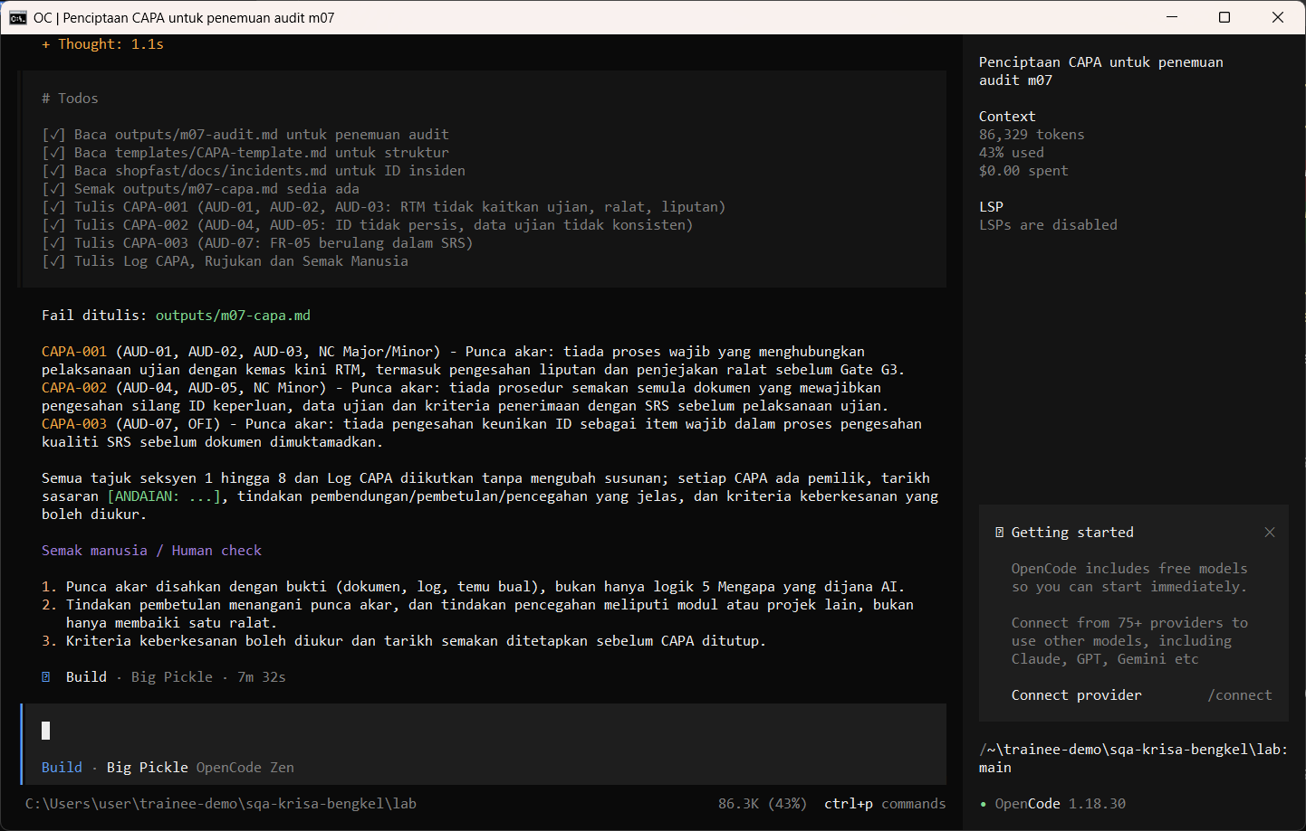
W07 · STEP 5 OF 7 · LANGKAH 5
Allow once. Each NC gets root cause (5 Whys), correction, prevention, owner and date.
Allow once. Setiap NC mendapat punca akar (5 Mengapa), pembetulan, pencegahan, pemilik dan tarikh.
TYPE IN OPENCODE
Allow once (Enter)
Real screenshot, 13 Sep 2026
Notes:
Step 5: Allow once. Each NC gets root cause (5 Whys), correction, prevention, owner and date.
Command or prompt:
Allow once (Enter)
Screenshot: workshop-ai/W07-audit-dokumentasi/screenshots/05-capa-saved.png

Slide 8
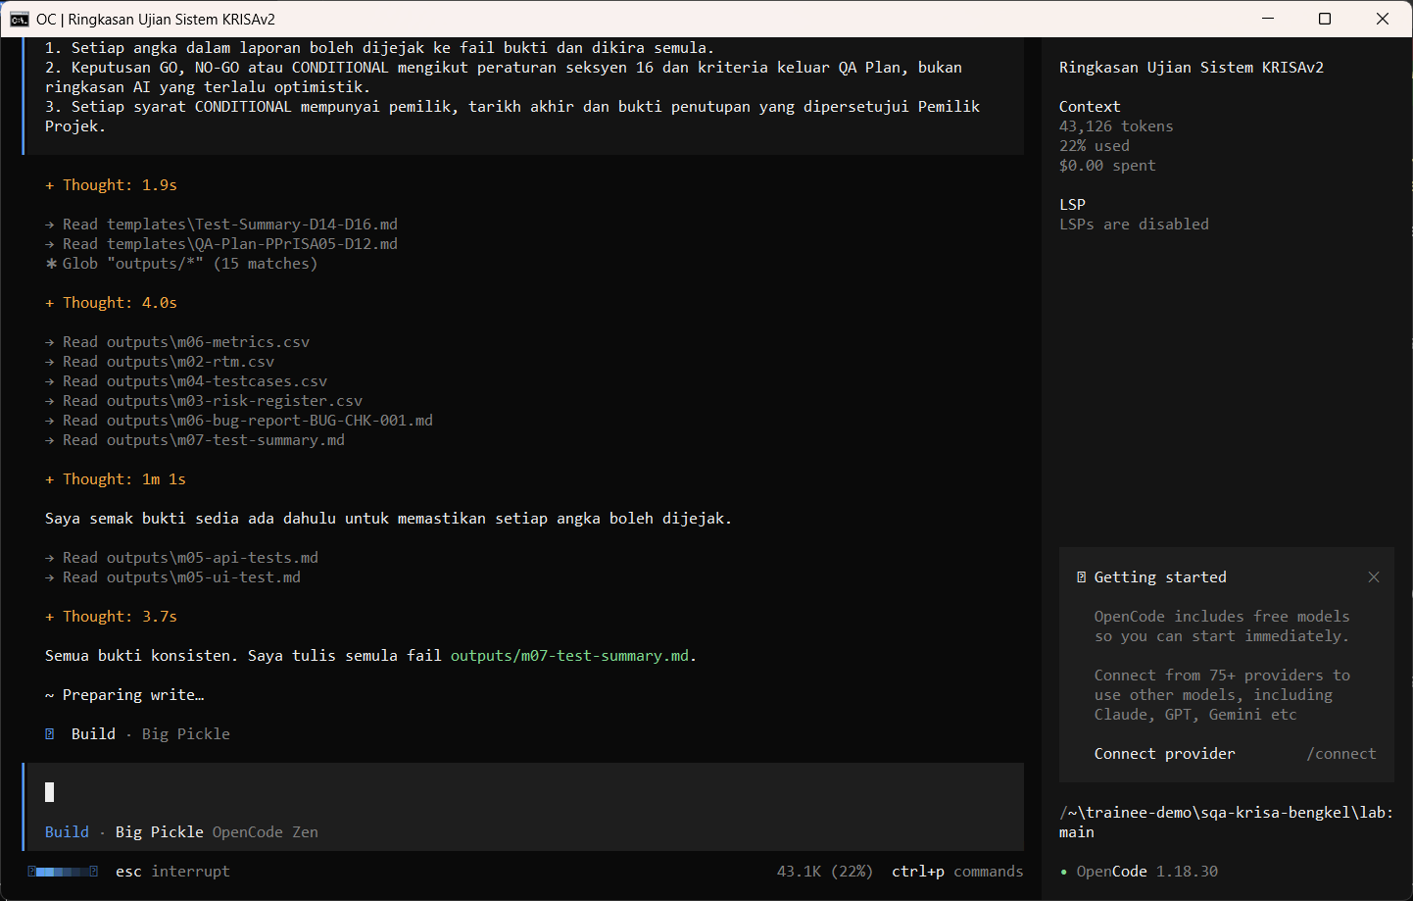
W07 · STEP 6 OF 7 · LANGKAH 6
Run /test-summary with the test period and build. The AI reads the documents first and may pause at Preparing write. When the Permission required dialog appears, read the preview and choose Allow once.
Jalankan /test-summary dengan tempoh ujian dan binaan. AI membaca dokumen dahulu dan mungkin berhenti seketika pada Preparing write. Apabila dialog Permission required muncul, baca pratonton dan pilih Allow once.
TYPE IN OPENCODE (BUILD)
/test-summary Ujian sistem 14 hingga 15 September 2026, binaan 1.0.0, penguji 4 orang
Real screenshot, 13 Sep 2026
Notes:
Step 6: Run /test-summary with the test period and build. The AI reads the documents first and may pause at Preparing write. When the Permission required dialog appears, read the preview and choose Allow once.
Command or prompt:
/test-summary Ujian sistem 14 hingga 15 September 2026, binaan 1.0.0, penguji 4 orang
Screenshot: workshop-ai/W07-audit-dokumentasi/screenshots/06-test-summary-permission.png

Slide 9
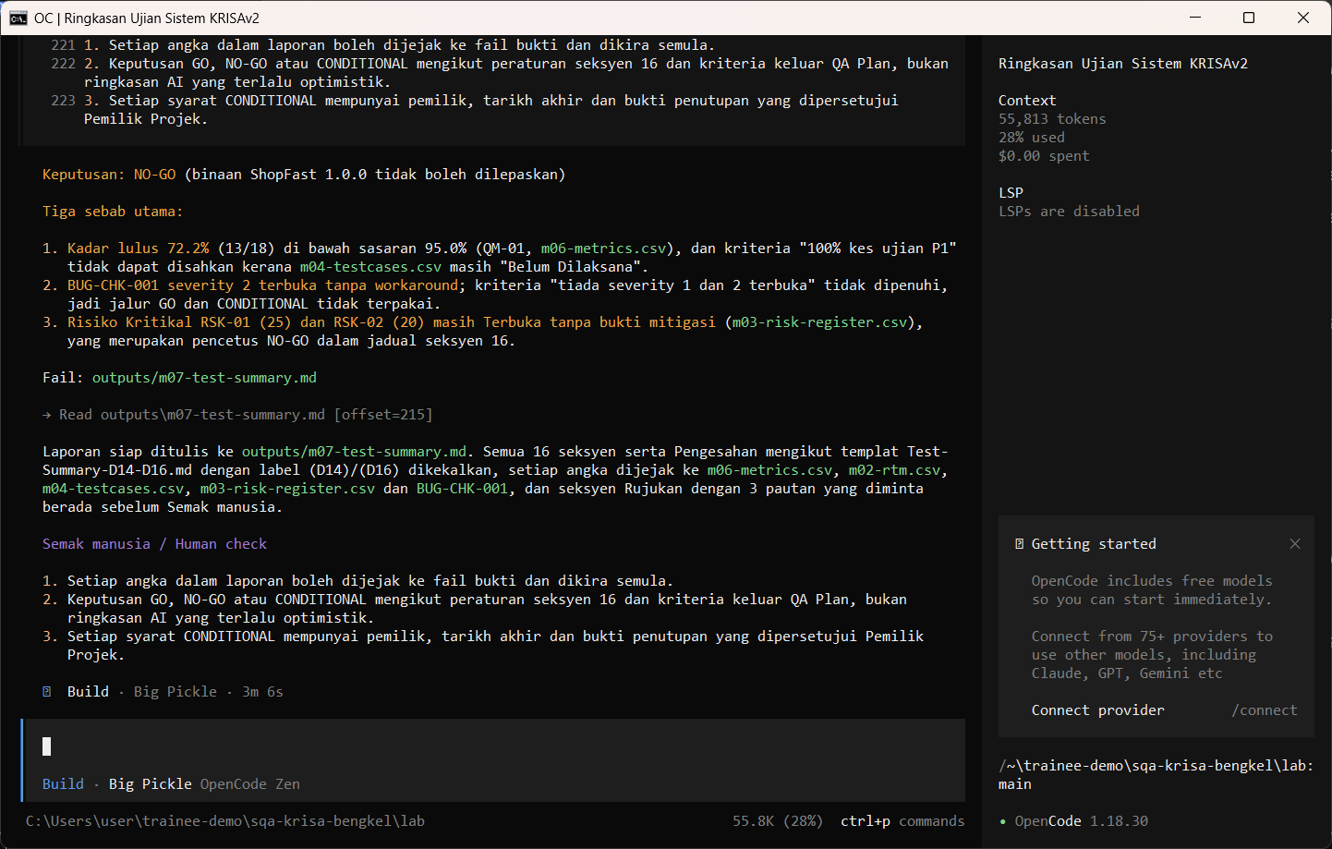
W07 · STEP 7 OF 7 · LANGKAH 7
Allow once. Read the recommendation, then decide as a team.
Allow once. Baca cadangan, kemudian putuskan sebagai pasukan.
TYPE IN OPENCODE
Allow once (Enter)
Real screenshot, 13 Sep 2026
Notes:
Step 7: Allow once. Read the recommendation, then decide as a team.
Command or prompt:
Allow once (Enter)
Screenshot: workshop-ai/W07-audit-dokumentasi/screenshots/07-test-summary-saved.png

Slide 10
Human check before you accept the output / Semakan manusia
Each non-conformity cites evidence (file and line)
Setiap ketidakpatuhan memetik bukti (fail dan baris)
Exit criteria use KRISAv2 Bab 6 6.8 numbers (95% pass, severity 1 and 2 closed)
Kriteria keluar menggunakan angka KRISAv2 Bab 6 6.8 (95% lulus, severity 1 dan 2 ditutup)
The release decision is made and signed by a person
Keputusan keluaran dibuat dan ditandatangani oleh manusia
The AI draft becomes evidence only after this check. Record who checked it and when (Module 7 audit trail).

Slide 11
If something goes wrong / Jika ada masalah
opencode is not recognised
Close and reopen PowerShell so PATH refreshes. Still failing: powershell -ExecutionPolicy Bypass -File .\setup\install-opencode.ps1 -Portable
Scripts are disabled on this system
Set-ExecutionPolicy -Scope CurrentUser RemoteSigned, or run opencode.cmd instead of opencode
The model is slow or stops
Wait up to 2 minutes. Press Esc to interrupt, then send the prompt again. Try another free model with /models
Permission required dialog
Read the preview. Choose Allow once for files in outputs/. Reject anything outside the lab folder
File or command not found
Check the status bar path ends with \lab. Commands and @files are relative to the lab folder
Answer uses Indonesian words or dashes
Reply: Ikut AGENTS.md peraturan 1 dan 14, tulis semula dalam Bahasa Melayu Malaysia
Network or proxy error
$env:HTTPS_PROXY = "http://proxy:port" and $env:NO_PROXY = "localhost,127.0.0.1" before starting opencode
Port 3000 already in use
$env:PORT = 3001 before npm start, and use http://localhost:3001

Slide 12
Links / Pautan
Web guide with copyable prompts
Module hub (slides, references, templates)
Example outputs from the real run
Lab README and command list
AGENTS.md rules used by the assistant
opencode documentation
opencode TUI commands and keys
OpenCode Zen free models and data policy
Bab 6, 6.10 Laporan Ujian Penerimaan (UAT dan PAT) (p.26)
Bab 7, 7.6 Ujian Penerimaan Akhir (FAT) (p.7)
Bab 7, Laporan Penamatan Ujian (Jadual 7.5, ISO/IEC/IEEE 29119) (p.9)

