Slide 1
W08 · M08 · 15 MINIT / MINUTES · Hari 2, 16:10 hingga 16:25
Hands-On SQA-AI Assistant Workshop
AI change request, impact analysis and CI review
Permohonan pindaan, analisis impak dan semakan CI dibantu AI
Raise a PPrISA10 change request for a new promo code, let the AI trace the impact through the RTM and test cases, and review the CI quality gate workflow.
opencode 1.18 · model Big Pickle (OpenCode Zen, free, no API key) · synthetic ShopFast data only
Bengkel SQA KRISAv2 dan PPrISA 2.0 · 14 hingga 15 September 2026 · Makmal Komputer Aras 11, Menara MyIPO
Web guide (copy prompts)
Module hub
Example outputs (GitHub)
Notes:
W08: 15 minutes. Real screenshots captured on 13 Sep 2026 from a fresh clone of the course repository on Windows 11 with opencode 1.18.30 and the free Big Pickle model. AI answers vary between runs; the steps and checks do not.

Slide 2
Before you start / Sebelum mula
YOU WILL / ANDA AKAN
CHECK FIRST / SEMAK DAHULU
1. Run /change-request for promo code RAYA26
2. Run /impact-analysis (Plan agent)
3. Ask the Plan agent to review the GitHub Actions workflow
4. Agree the minimal regression set and rollback trigger
- PowerShell is in C:\Users\<you>\sqa-krisa-bengkel\lab
- opencode starts and shows Big Pickle, OpenCode Zen (W00)
- Outputs from earlier workshops exist in outputs\ (or copy them from example-output)
Data rules / Peraturan data
- Synthetic ShopFast data only. Never paste real agency documents or personal data.
- Free models run outside Malaysia and may learn from prompts.
- AI output is a draft. A person checks and signs off.
1. Jalankan /change-request untuk kod promo RAYA26
2. Jalankan /impact-analysis (ejen Plan)
3. Minta ejen Plan menyemak aliran kerja GitHub Actions
4. Setuju set regresi minimum dan pencetus rollback
OUTPUT
outputs/m08-change-request.md, outputs/m08-impact-analysis.md

Slide 3
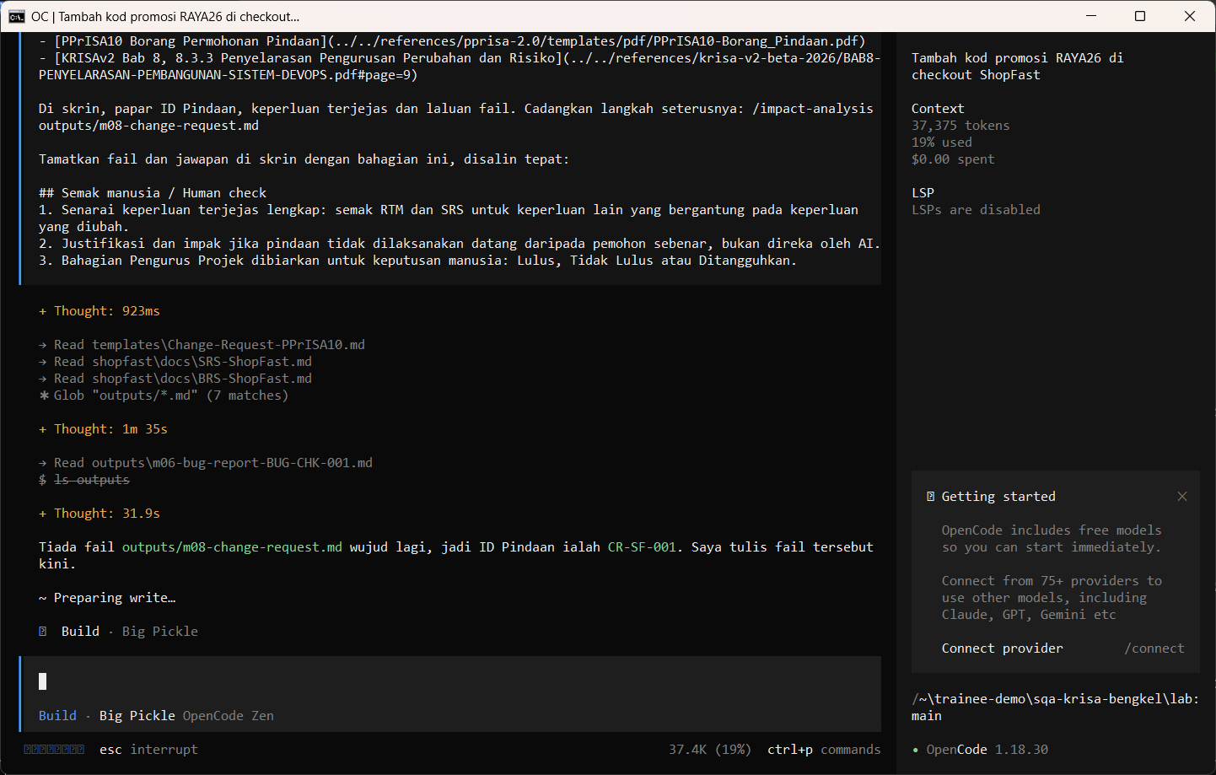
W08 · STEP 1 OF 4 · LANGKAH 1
Run /change-request for promo code RAYA26. The AI reads the documents first and may pause at Preparing write. When the Permission required dialog appears, read the preview and choose Allow once.
Jalankan /change-request untuk kod promo RAYA26. AI membaca dokumen dahulu dan mungkin berhenti seketika pada Preparing write. Apabila dialog Permission required muncul, baca pratonton dan pilih Allow once.
TYPE IN OPENCODE (BUILD)
/change-request Tambah kod promo RAYA26 (diskaun 26 peratus, sah 1 hingga 31 Mac 2027) pada checkout ShopFast
Real screenshot, 13 Sep 2026
Notes:
Step 1: Run /change-request for promo code RAYA26. The AI reads the documents first and may pause at Preparing write. When the Permission required dialog appears, read the preview and choose Allow once.
Command or prompt:
/change-request Tambah kod promo RAYA26 (diskaun 26 peratus, sah 1 hingga 31 Mac 2027) pada checkout ShopFast
Screenshot: workshop-ai/W08-perubahan-pemantauan/screenshots/01-change-request-permission.png

Slide 4
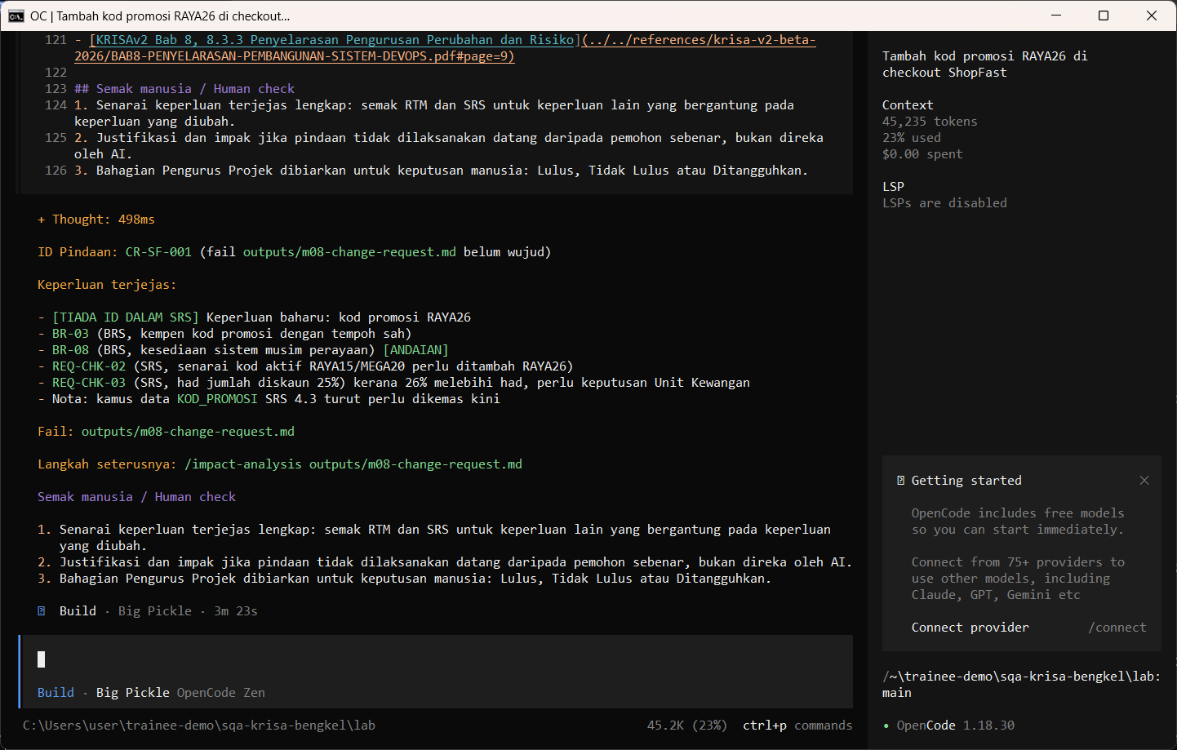
W08 · STEP 2 OF 4 · LANGKAH 2
Allow once. The PPrISA10-style change request is saved.
Allow once. Permohonan pindaan gaya PPrISA10 disimpan.
TYPE IN OPENCODE
Allow once (Enter)
Real screenshot, 13 Sep 2026
Notes:
Step 2: Allow once. The PPrISA10-style change request is saved.
Command or prompt:
Allow once (Enter)
Screenshot: workshop-ai/W08-perubahan-pemantauan/screenshots/02-change-request-saved.png

Slide 5
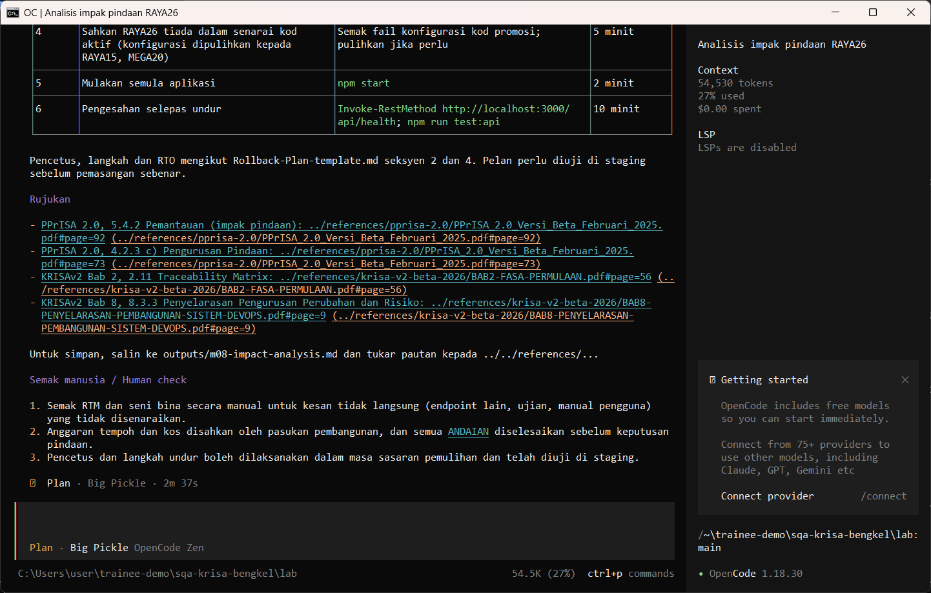
W08 · STEP 3 OF 4 · LANGKAH 3
Run /impact-analysis in Plan mode.
Jalankan /impact-analysis dalam mod Plan.
TYPE IN OPENCODE (PLAN)
/impact-analysis RAYA26
Real screenshot, 13 Sep 2026
Notes:
Step 3: Run /impact-analysis in Plan mode.
Command or prompt:
/impact-analysis RAYA26
Screenshot: workshop-ai/W08-perubahan-pemantauan/screenshots/03-impact-analysis.png

Slide 6
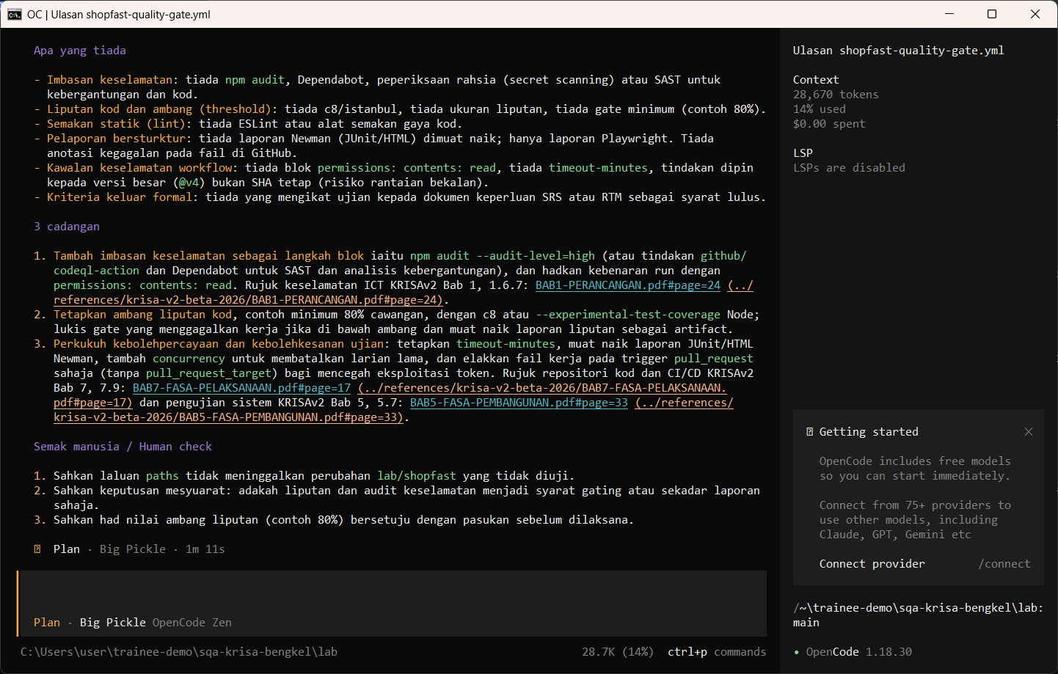
W08 · STEP 4 OF 4 · LANGKAH 4
Ask the Plan agent to review the GitHub Actions quality gate.
Minta ejen Plan menyemak quality gate GitHub Actions.
TYPE IN OPENCODE (PLAN)
Semak ../.github/workflows/shopfast-quality-gate.yml sebagai quality gate. Nyatakan apa yang disemak, apa yang tiada (contoh imbasan keselamatan atau ambang liputan) dan 3 cadangan. Jangan tulis fail.
Real screenshot, 13 Sep 2026
Notes:
Step 4: Ask the Plan agent to review the GitHub Actions quality gate.
Command or prompt:
Semak ../.github/workflows/shopfast-quality-gate.yml sebagai quality gate. Nyatakan apa yang disemak, apa yang tiada (contoh imbasan keselamatan atau ambang liputan) dan 3 cadangan. Jangan tulis fail.
Screenshot: workshop-ai/W08-perubahan-pemantauan/screenshots/04-ci-workflow-review.png

Slide 7
Human check before you accept the output / Semakan manusia
RAYA26 at 26 percent breaks the 25 percent cap in REQ-CHK-03: did the AI notice?
RAYA26 pada 26 peratus melanggar had 25 peratus dalam REQ-CHK-03: adakah AI perasan?
The regression set is minimal and traced to REQ-CHK IDs
Set regresi adalah minimum dan dijejak ke ID REQ-CHK
Rollback has a clear trigger and an owner
Rollback mempunyai pencetus yang jelas dan pemilik
The AI draft becomes evidence only after this check. Record who checked it and when (Module 7 audit trail).

Slide 8
If something goes wrong / Jika ada masalah
opencode is not recognised
Close and reopen PowerShell so PATH refreshes. Still failing: powershell -ExecutionPolicy Bypass -File .\setup\install-opencode.ps1 -Portable
Scripts are disabled on this system
Set-ExecutionPolicy -Scope CurrentUser RemoteSigned, or run opencode.cmd instead of opencode
The model is slow or stops
Wait up to 2 minutes. Press Esc to interrupt, then send the prompt again. Try another free model with /models
Permission required dialog
Read the preview. Choose Allow once for files in outputs/. Reject anything outside the lab folder
File or command not found
Check the status bar path ends with \lab. Commands and @files are relative to the lab folder
Answer uses Indonesian words or dashes
Reply: Ikut AGENTS.md peraturan 1 dan 14, tulis semula dalam Bahasa Melayu Malaysia
Network or proxy error
$env:HTTPS_PROXY = "http://proxy:port" and $env:NO_PROXY = "localhost,127.0.0.1" before starting opencode
Port 3000 already in use
$env:PORT = 3001 before npm start, and use http://localhost:3001

Slide 9
Links / Pautan
Web guide with copyable prompts
Module hub (slides, references, templates)
Example outputs from the real run
Lab README and command list
AGENTS.md rules used by the assistant
opencode documentation
opencode TUI commands and keys
OpenCode Zen free models and data policy
Bab 8, Jadual 8.1 Pemetaan Aktiviti KRISA ke DevOps (p.6)
Bab 8, 8.3.3 Penyelarasan Pengurusan Perubahan dan Risiko (p.9)
Bab 7, 7.9 Repositori dan Serahan Kod Sumber (CI/CD) (p.17)

