Slide 1
W09 · M09 · 10 MINIT / MINUTES · Hari 2, 17:10 hingga 17:20
Hands-On SQA-AI Assistant Workshop
Capstone with an AI pair: prove the quality gate
Kemuncak bersama rakan AI: buktikan quality gate
Let the AI evaluate a quality gate from the evidence you produced over two days, including a live test run, then present the trail and the AI mistakes you caught.
opencode 1.18 · model Big Pickle (OpenCode Zen, free, no API key) · synthetic ShopFast data only
Bengkel SQA KRISAv2 dan PPrISA 2.0 · 14 hingga 15 September 2026 · Makmal Komputer Aras 11, Menara MyIPO
Web guide (copy prompts)
Module hub
Example outputs (GitHub)
Notes:
W09: 10 minutes. Real screenshots captured on 13 Sep 2026 from a fresh clone of the course repository on Windows 11 with opencode 1.18.30 and the free Big Pickle model. AI answers vary between runs; the steps and checks do not.

Slide 2
Before you start / Sebelum mula
YOU WILL / ANDA AKAN
CHECK FIRST / SEMAK DAHULU
1. Run /quality-gate G3 with a live test run
2. Check every criterion has an evidence file
3. Ask the AI to list its own weakest conclusions
4. Commit your outputs as audit evidence
- PowerShell is in C:\Users\<you>\sqa-krisa-bengkel\lab
- opencode starts and shows Big Pickle, OpenCode Zen (W00)
- In shopfast\: npm install and npx playwright install chromium are done
- Outputs from earlier workshops exist in outputs\ (or copy them from example-output)
Data rules / Peraturan data
- Synthetic ShopFast data only. Never paste real agency documents or personal data.
- Free models run outside Malaysia and may learn from prompts.
- AI output is a draft. A person checks and signs off.
1. Jalankan /quality-gate G3 dengan larian ujian langsung
2. Semak setiap kriteria mempunyai fail bukti
3. Minta AI menyenaraikan kesimpulannya yang paling lemah
4. Commit outputs anda sebagai bukti audit
OUTPUT
outputs/m09-quality-gate.md

Slide 3
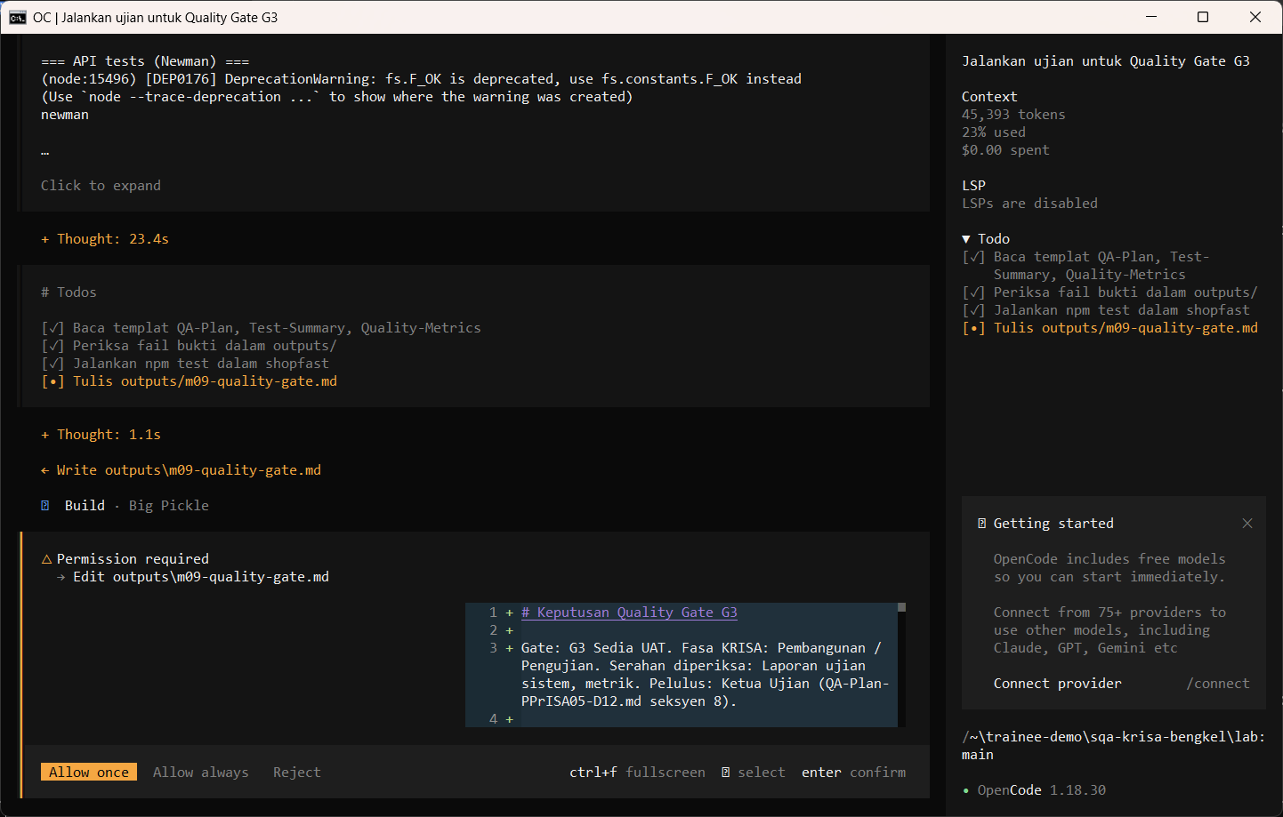
W09 · STEP 1 OF 4 · LANGKAH 1
Run /quality-gate with a live test run. opencode runs npm test (allowed in opencode.json) and asks before writing. The AI reads the documents first and may pause at Preparing write. When the Permission required dialog appears, read the preview and choose Allow once.
Jalankan /quality-gate dengan larian ujian langsung. opencode menjalankan npm test (dibenarkan dalam opencode.json) dan meminta kebenaran sebelum menulis. AI membaca dokumen dahulu dan mungkin berhenti seketika pada Preparing write. Apabila dialog Permission required muncul, baca pratonton dan pilih Allow once.
TYPE IN OPENCODE (BUILD)
/quality-gate G3 jalankan-ujian
Real screenshot, 13 Sep 2026
Notes:
Step 1: Run /quality-gate with a live test run. opencode runs npm test (allowed in opencode.json) and asks before writing. The AI reads the documents first and may pause at Preparing write. When the Permission required dialog appears, read the preview and choose Allow once.
Command or prompt:
/quality-gate G3 jalankan-ujian
Screenshot: workshop-ai/W09-kemuncak/screenshots/01-quality-gate-permission.png

Slide 4
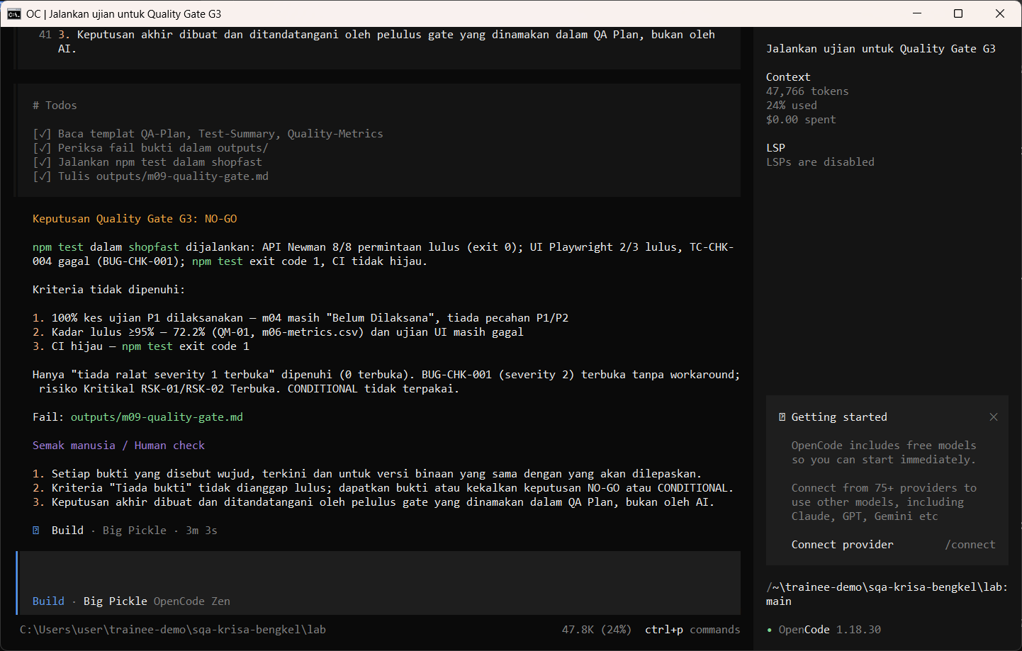
W09 · STEP 2 OF 4 · LANGKAH 2
Allow once. Read the decision and the evidence per criterion.
Allow once. Baca keputusan dan bukti bagi setiap kriteria.
TYPE IN OPENCODE
Allow once (Enter)
Real screenshot, 13 Sep 2026
Notes:
Step 2: Allow once. Read the decision and the evidence per criterion.
Command or prompt:
Allow once (Enter)
Screenshot: workshop-ai/W09-kemuncak/screenshots/02-quality-gate-saved.png

Slide 5
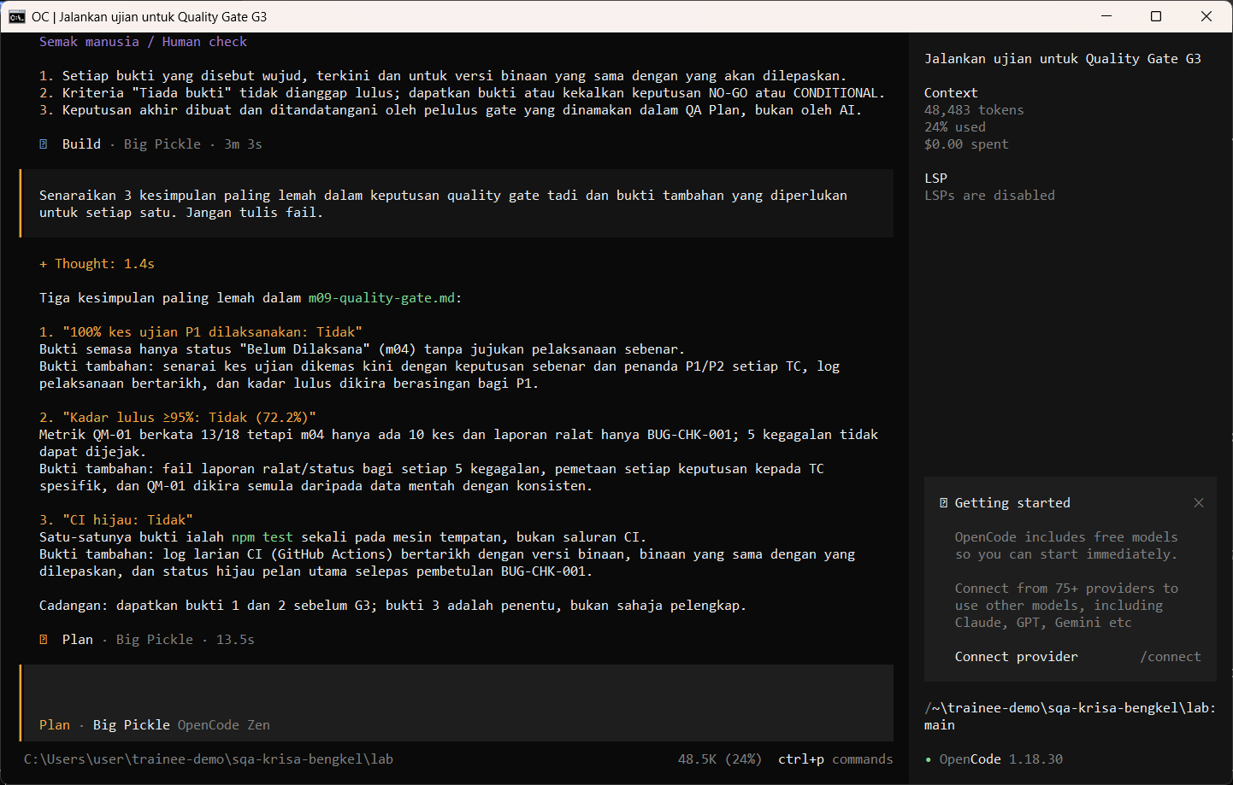
W09 · STEP 3 OF 4 · LANGKAH 3
Switch to Plan and ask the AI to criticise its own conclusions.
Tukar ke Plan dan minta AI mengkritik kesimpulannya sendiri.
TYPE IN OPENCODE (PLAN)
Senaraikan 3 kesimpulan paling lemah dalam keputusan quality gate tadi dan bukti tambahan yang diperlukan untuk setiap satu. Jangan tulis fail.
Real screenshot, 13 Sep 2026
Notes:
Step 3: Switch to Plan and ask the AI to criticise its own conclusions.
Command or prompt:
Senaraikan 3 kesimpulan paling lemah dalam keputusan quality gate tadi dan bukti tambahan yang diperlukan untuk setiap satu. Jangan tulis fail.
Screenshot: workshop-ai/W09-kemuncak/screenshots/03-weakest-conclusions.png

Slide 6
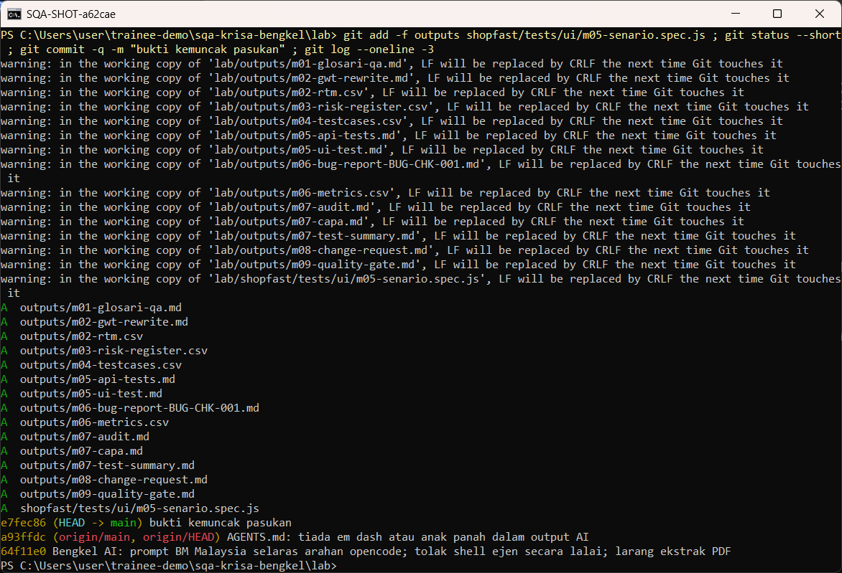
W09 · STEP 4 OF 4 · LANGKAH 4
Stage your outputs as audit evidence and commit. Use -f because lab/outputs is ignored by .gitignore, so trainee work never reaches the public repository by accident.
Sediakan outputs anda sebagai bukti audit dan commit. Guna -f kerana lab/outputs diabaikan oleh .gitignore supaya kerja pelatih tidak termasuk ke repositori awam secara tidak sengaja.
TYPE IN POWERSHELL
git add -f outputs shopfast/tests/ui/m05-senario.spec.js
git status --short
git commit -m "bukti kemuncak pasukan"
git log --oneline -3
Real screenshot, 13 Sep 2026
Notes:
Step 4: Stage your outputs as audit evidence and commit. Use -f because lab/outputs is ignored by .gitignore, so trainee work never reaches the public repository by accident.
Command or prompt:
git add -f outputs shopfast/tests/ui/m05-senario.spec.js
git status --short
git commit -m "bukti kemuncak pasukan"
git log --oneline -3
Screenshot: workshop-ai/W09-kemuncak/screenshots/04-commit-evidence.png

Slide 7
Human check before you accept the output / Semakan manusia
Every criterion links to an evidence file and a real value
Setiap kriteria dipautkan ke fail bukti dan nilai sebenar
No GO while any criterion is unmet or without evidence
Tiada GO selagi ada kriteria tidak dipenuhi atau tanpa bukti
At least one AI mistake was found and corrected by the team
Sekurang-kurangnya satu kesilapan AI ditemui dan dibetulkan oleh pasukan
The AI draft becomes evidence only after this check. Record who checked it and when (Module 7 audit trail).

Slide 8
If something goes wrong / Jika ada masalah
opencode is not recognised
Close and reopen PowerShell so PATH refreshes. Still failing: powershell -ExecutionPolicy Bypass -File .\setup\install-opencode.ps1 -Portable
Scripts are disabled on this system
Set-ExecutionPolicy -Scope CurrentUser RemoteSigned, or run opencode.cmd instead of opencode
The model is slow or stops
Wait up to 2 minutes. Press Esc to interrupt, then send the prompt again. Try another free model with /models
Permission required dialog
Read the preview. Choose Allow once for files in outputs/. Reject anything outside the lab folder
File or command not found
Check the status bar path ends with \lab. Commands and @files are relative to the lab folder
Answer uses Indonesian words or dashes
Reply: Ikut AGENTS.md peraturan 1 dan 14, tulis semula dalam Bahasa Melayu Malaysia
Network or proxy error
$env:HTTPS_PROXY = "http://proxy:port" and $env:NO_PROXY = "localhost,127.0.0.1" before starting opencode
Port 3000 already in use
$env:PORT = 3001 before npm start, and use http://localhost:3001

Slide 9
Links / Pautan
Web guide with copyable prompts
Module hub (slides, references, templates)
Example outputs from the real run
Lab README and command list
AGENTS.md rules used by the assistant
opencode documentation
opencode TUI commands and keys
OpenCode Zen free models and data policy
Bab 8, Serahan mengikut fasa (penyelarasan DevOps) (p.8)
Bab 1, 1.6 Faktor Kejayaan (p.14)
PPrISA 2.0, Rajah 2.4 Pelan Tindakan (templat mengikut fasa) (p.21)

